Slide 2

Friends
How are you and your friends similar?
What makes a good friend?

Slide 3
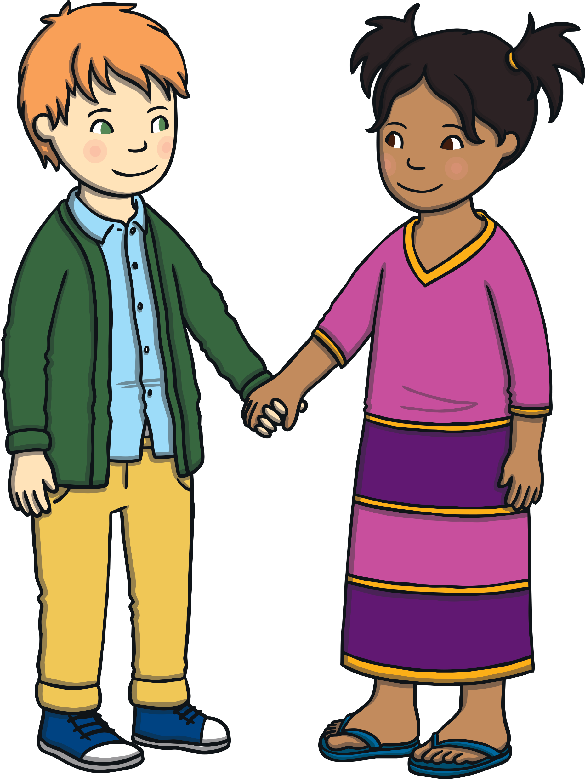
Friends…
Play with us.
Share with us.
Choose to be our partners.
Compliment us.
Make us laugh.
Listen to us.

Slide 4
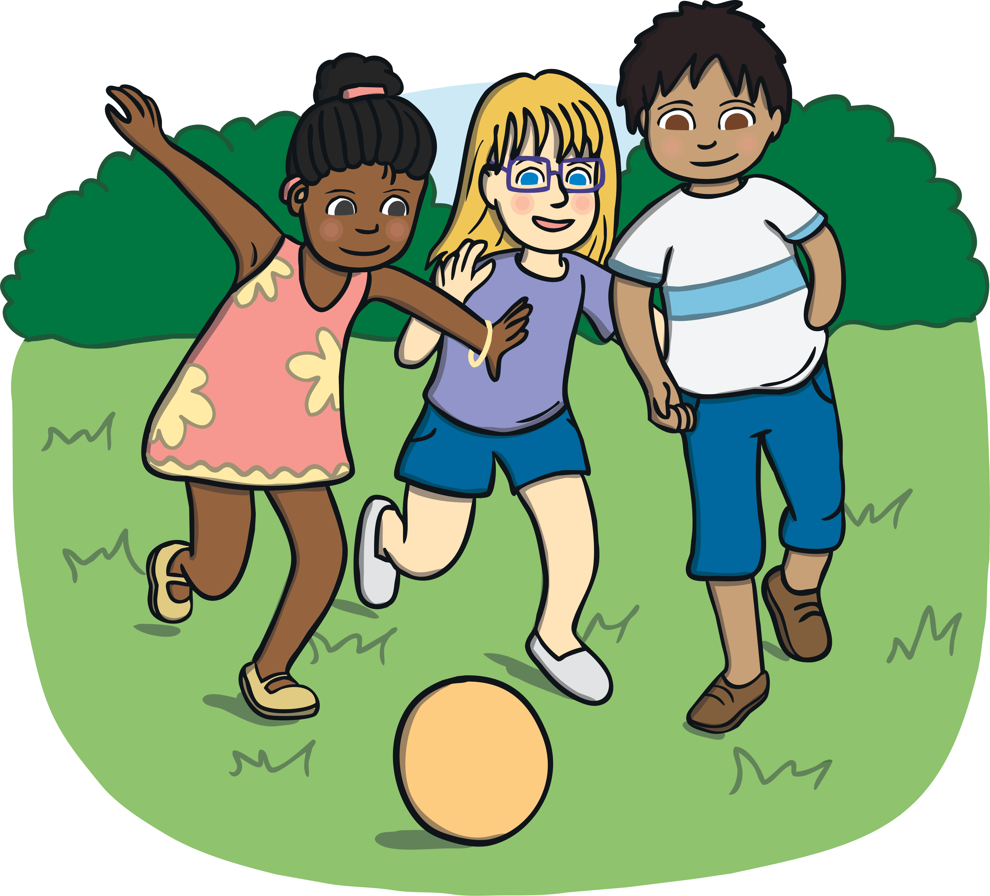
Friends
What do you like to do with your friends?

Slide 5
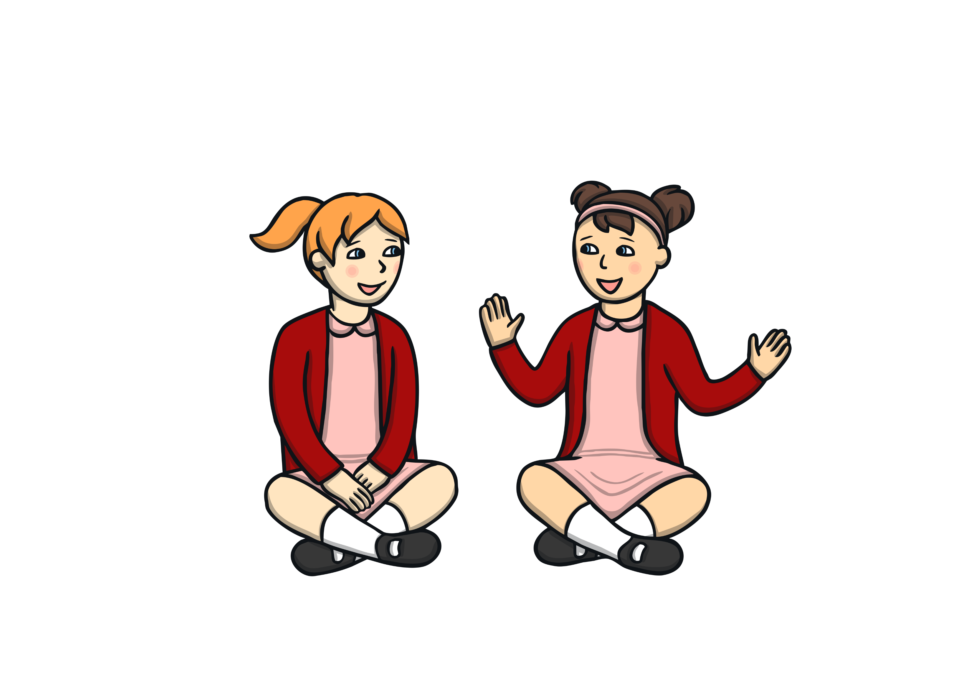
How to be a good listener for your friend
Ask positive and encouraging questions.
Nod and look interested.
Look at the speaker.
Be still.

Slide 6

Friends
How do you feel when your friend compliments you?
How do you feel when you give someone a compliment?

Slide 7
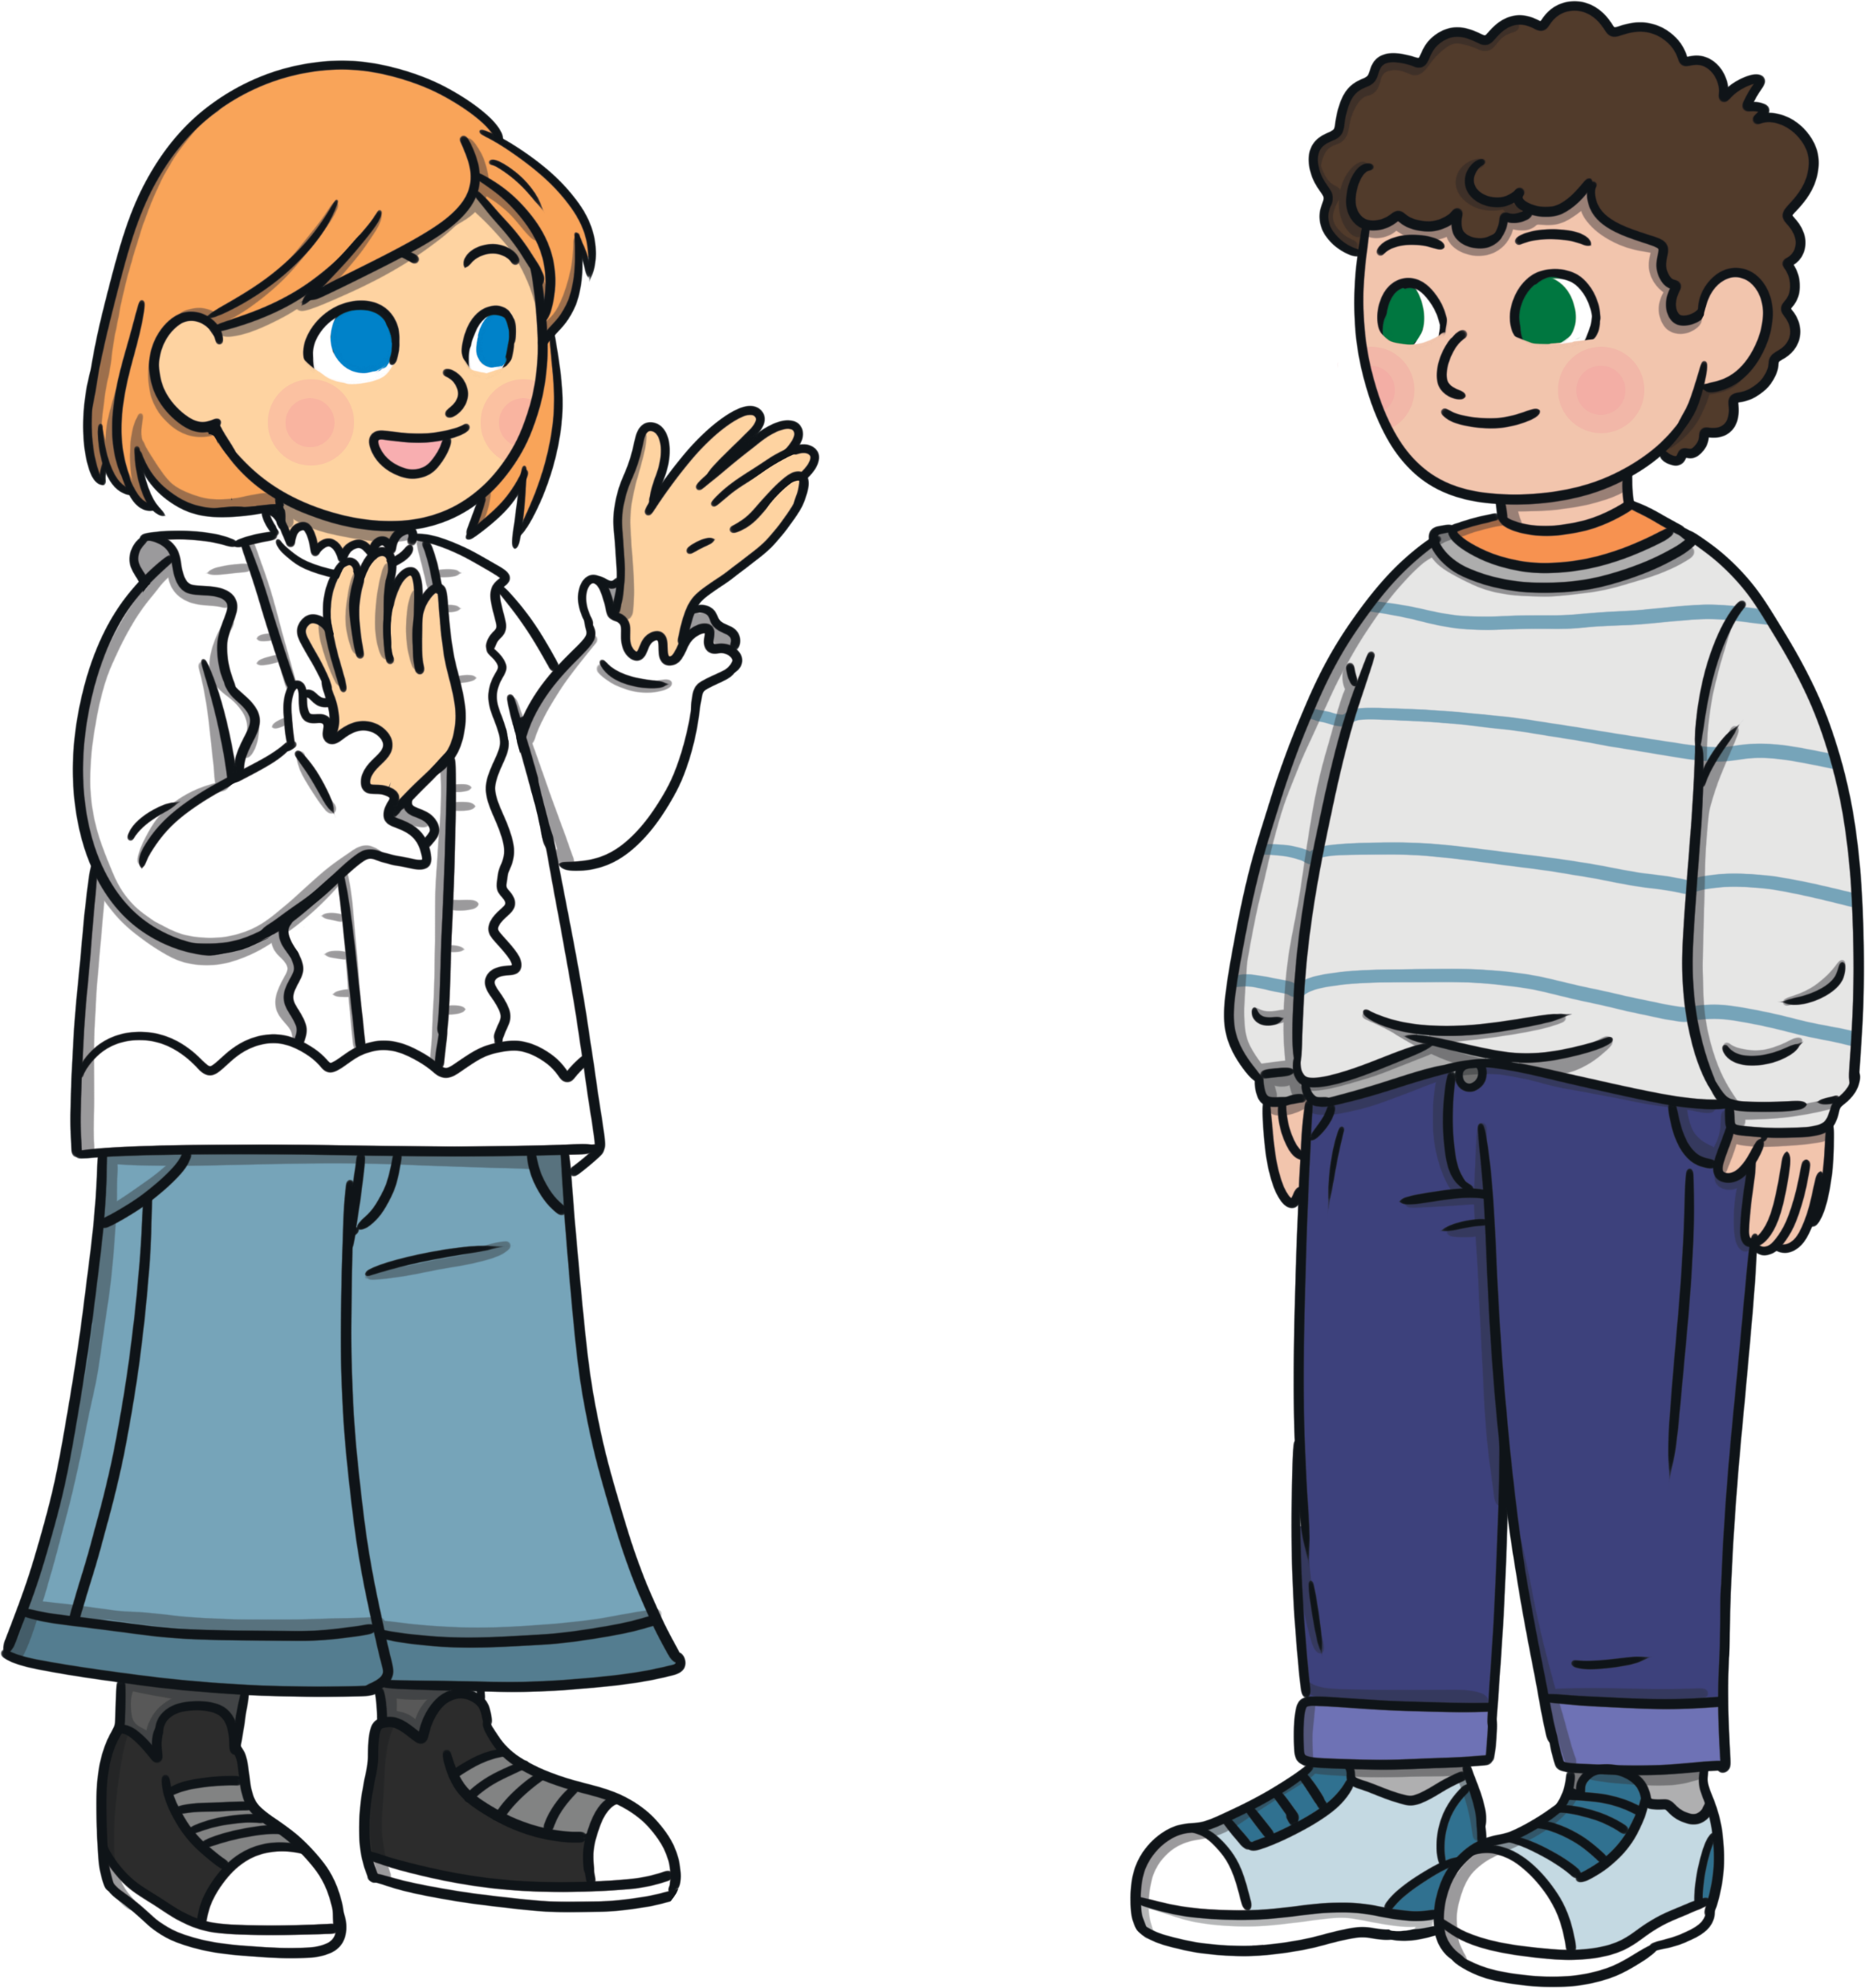
Compliments
Pay your friend a compliment if they
are feeling down. It could even
cheer them up!
Always say ‘thank you’ when someone
pays you a compliment.
Make sure what you say is
nice and genuine.

Slide 8

Friends
Do you think that all friends last forever?
Can everyone be a friend?
Can we be friends with someone all the time?
Could you be friends with someone after you have fallen out?

Slide 9

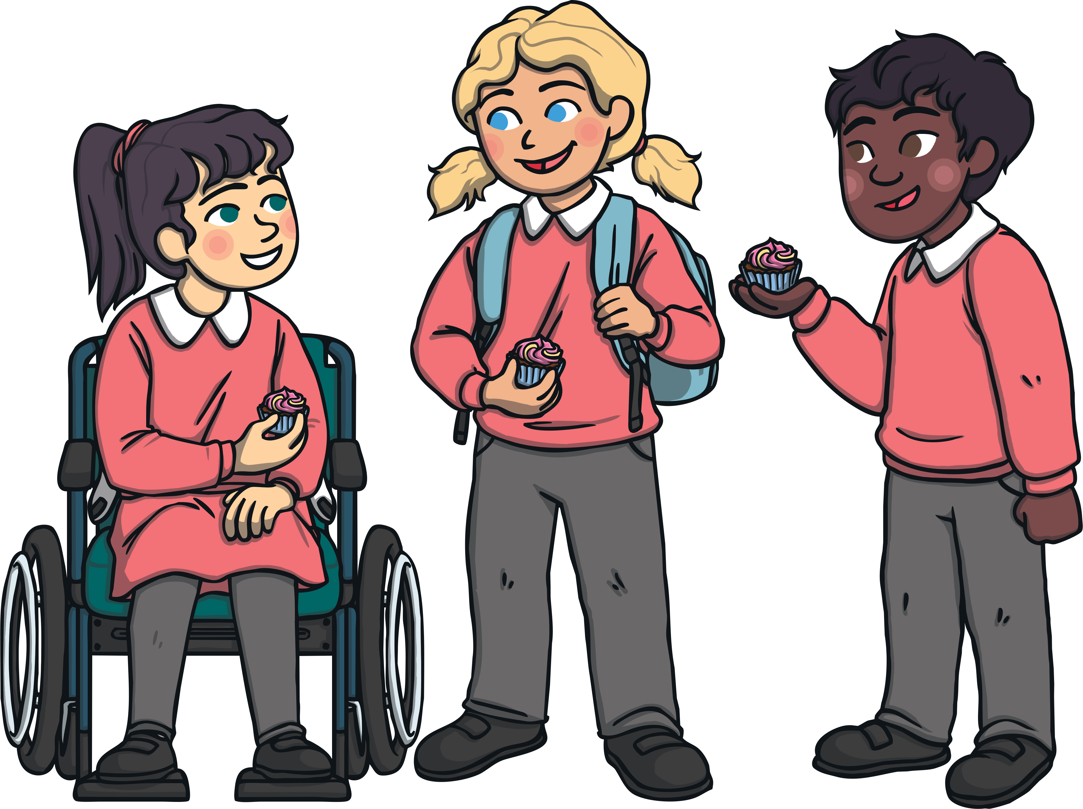
Friends
Try and remember how to be a good one!

