Slide 2
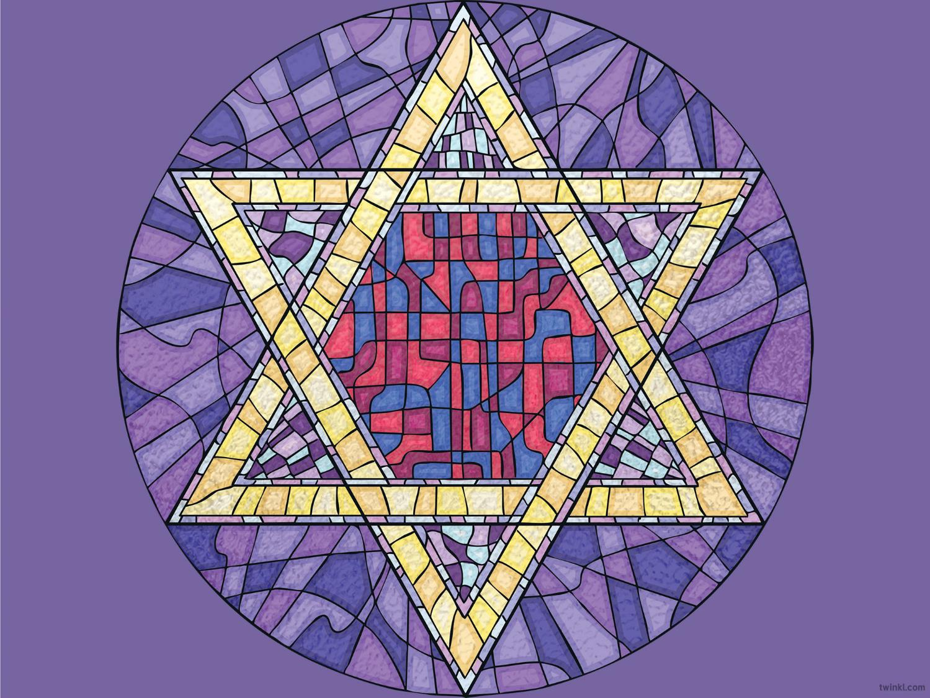
Aim
To learn about Judaism
Success Criteria
I can describe the parts of a synagogue.
I can talk about some Jewish festivals.
I know what happens during a Bar Mitzvah.

Slide 3
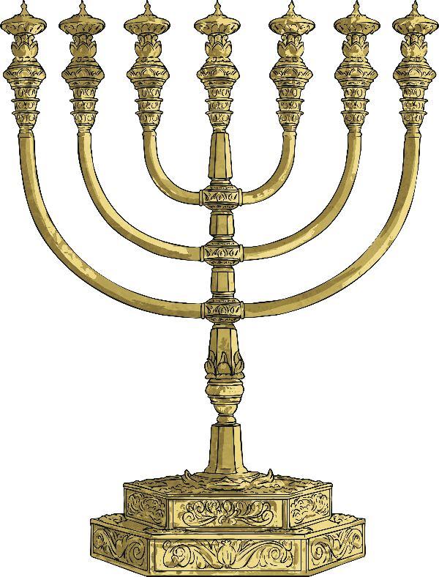
What Is Judaism
Judaism is one of the world’s six major religions. The others
are Christianity, Islam, Buddhism, Hinduism and Sikhism.
Across the world, there are about 15,000,000 followers of Judaism, who are known as ‘Jews’. About half of them live in the USA and another quarter live in Israel.

Slide 4
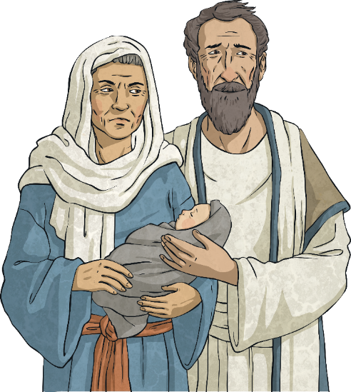
What Is Judaism
Judaism was founded by
Abraham over 4,000 years ago.
Jews believe in one God, like Christians and Muslims do.
Judaism teaches that all life is special and belongs to God. Jews believe that God is the Creator of all life.

Slide 5
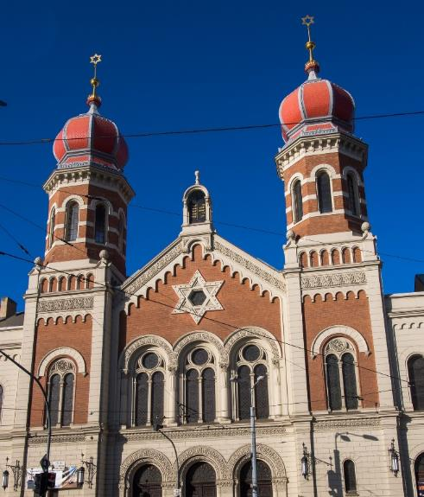
Where Do Jews Go to Worship?
A synagogue is a sacred building where Jewish people go to worship.
Did You Know…?
The word synagogue means ‘meeting place’ in Greek.

Slide 6
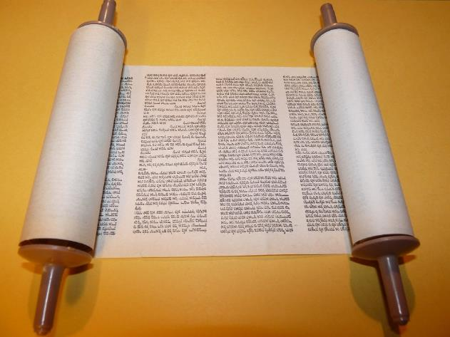
What Is the Torah?
The Torah is the holy book for Jews.
It is considered so special that nobody is allowed to touch it so
a special pointer, called a yad, is used when reading it.
The Torah is kept in a special cupboard called an ‘Ark’.

Slide 7
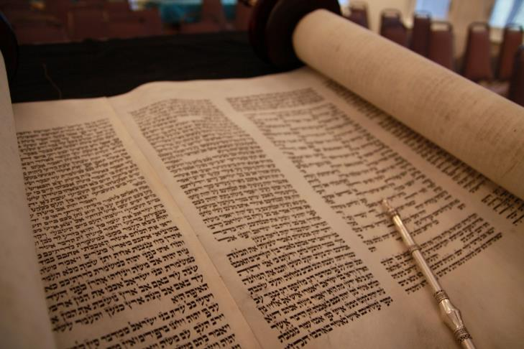
What Is the Torah?
The Torah is written in a language called Hebrew.
This language is read from right to left.
Many Jewish people believe it is the language of God.

Slide 8

What Can You See in a Synagogue?
The menorah candle is the oldest symbol of the Jewish people.
It is a seven-lamp lampstand made out of pure gold and it stands in front of the Ark.
Moses created the first Menorah according to God’s instructions, while out in the wilderness.

Slide 9
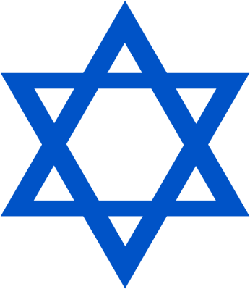
What Can You See in a Synagogue?
The Star, or Shield, of David is the symbol of Judaism. It is named after King David of ancient Israel.
This shape can often been seen in windows in synagogues.

Slide 10
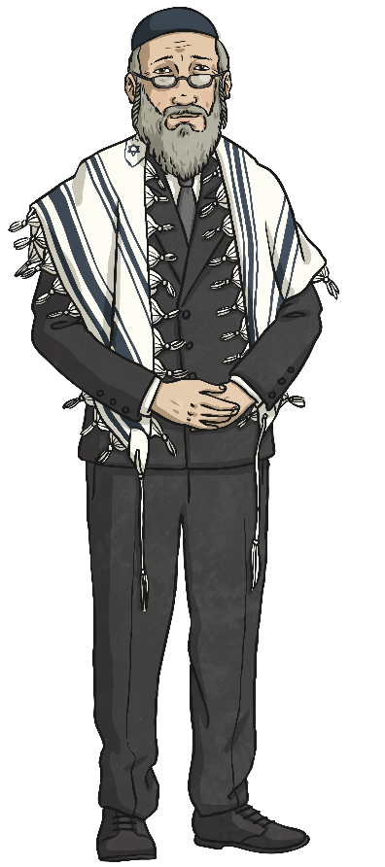
Who Leads the Synagogue Service?
Rabbi
A Rabbi is a Jewish spiritual leader who will often lead services at the synagogue on the holy day (Shabbat) and during festivals.
Did You Know…?
Rabbi means ‘teacher’
in Hebrew.

Slide 11
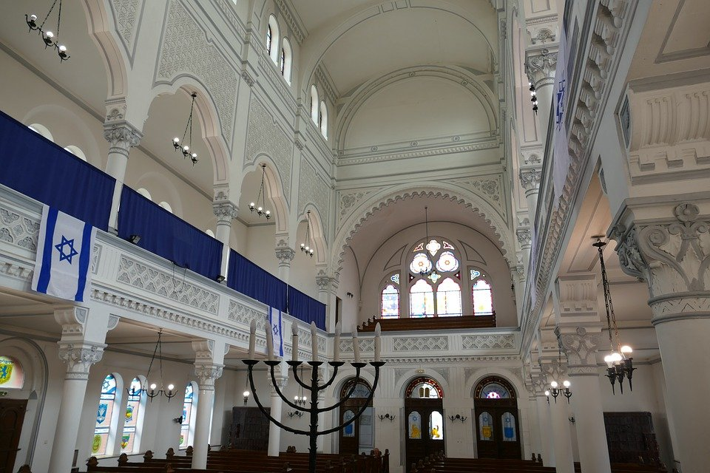
Can You Find Some Jewish Symbols in This Synagogue?
Star of David
menorah

Slide 12
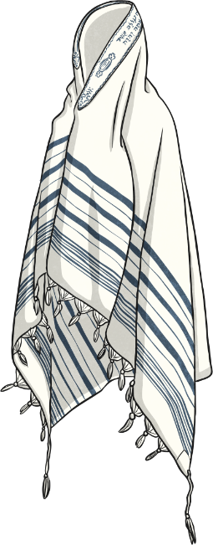
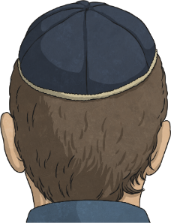
What Do Jewish People Often Wear?
Tallit
Some Jews will put on a shawl, called a tallit, to pray. The fringes are a reminder of the commandments of the Torah.
Kippah
When in the synagogue, men cover their heads. The kippah reminds Jews of their faith.

Slide 13
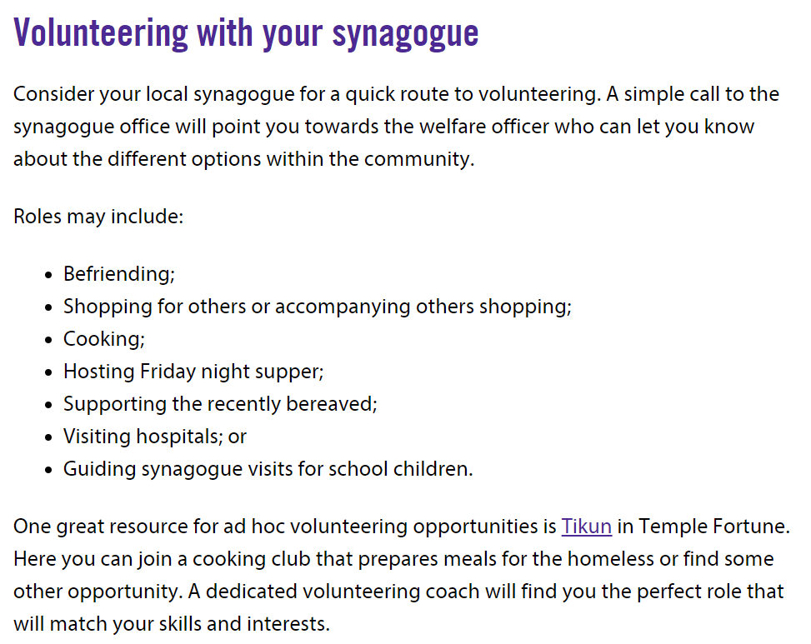
Jewish people help others.

Slide 14
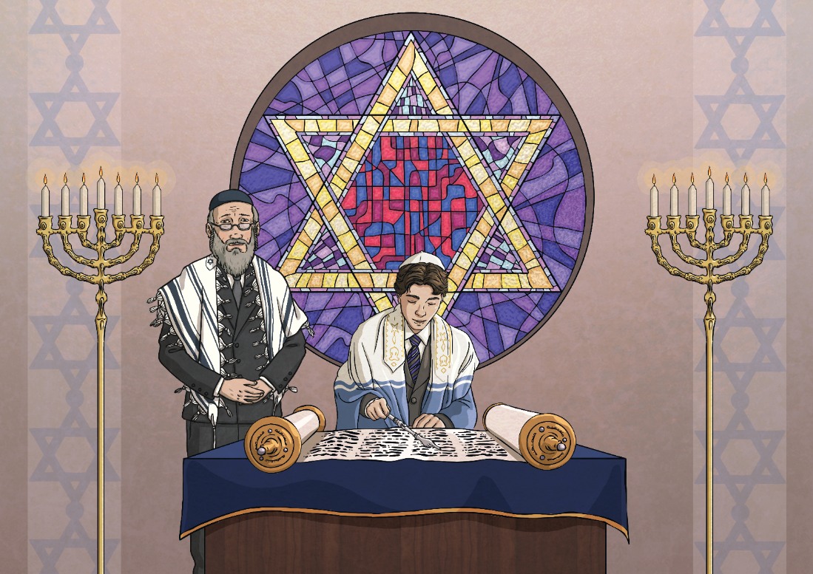
What Is the Jewish Coming of Age Ceremony Called?
Jewish boys and girls celebrate becoming adults at about the age of 12 or 13. At this age, Jews believe that children can tell the difference between right or wrong.
Boys have a Bar Mitzvah and girls have a Bat Mitzvah. The names mean ‘son’ or ‘daughter’ of the commandment.

Slide 15
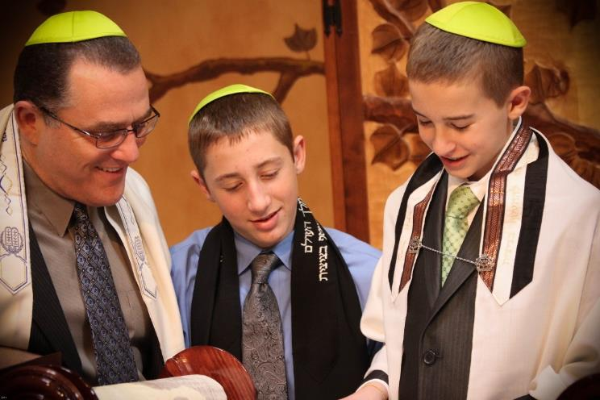
What Happens During a Bar Mitzvah?
For a boy’s Bar Mitzvah, he is called up to read from the Torah for the very first time. He reads a special part from the Torah and, as he reads it, he sings it in a way that has taken a long time to learn.
Later, the boy may give a speech, relating to his Jewish life and future. At this point it is traditional to thank his parents.
After the ceremony, many families gather for a party to celebrate.
IMG_7537 by Michele Pace is licensed under CC BY 2.0

Slide 16
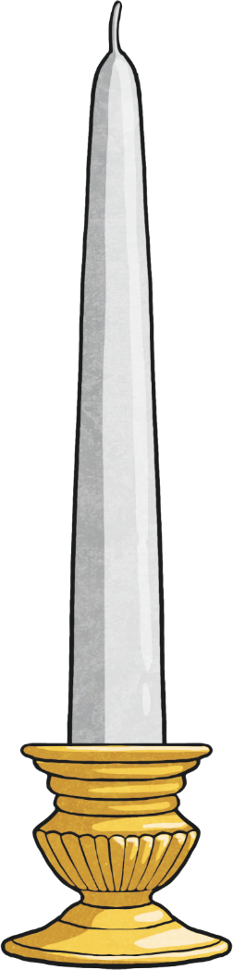
What Are Some Jewish Holidays?
Shabbat (Sabbath)
From Friday sunset until Saturday nightfall, Jewish people take a special day of rest, known as the Shabbat.
Jews remember that God created the world and on the seventh day he rested. Jews believe God's day of rest was a Saturday. On this day, Jews visit the synagogue as part of their celebration.
Sabbath candles are lit at sunset on Friday and placed into candlesticks. Then, families drink wine from a special goblet
called the Kiddush Cup and eat challah (a soft, plaited bread).
Shabbat is a time without television, phones, shopping, cleaning or cooking.
Did You Know…?
You can say ‘Shabbat Shalom’ to wish someone a happy Shabbat.

Slide 17
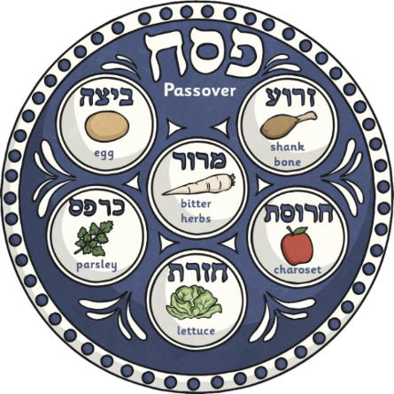
What Are Some Jewish Holidays?
Passover (Pesach in Hebrew)
This festival lasts for seven or eight days each spring.
Matzah (unleavened bread) is eaten throughout the festival. Challah bread is not allowed. At the beginning, a special Seder meal is held in each family’s home. There are six parts on the Seder plate:
Did You Know…?
Easter happens around the same time as Pesach.
The ancient Greek word for Easter is ‘Pascha’
which comes from the word ‘Pesach’.

Slide 18
What Are Some Jewish Holidays?
Rosh Hashanah – Jewish New Year
This festival celebrates the creation of the world. It is also known as the Day of Judgment. Special services are held in the synagogue and a musical instrument called a Shofar is blown to remind Jews of God’s power.
Yom Kippur – The Day of Atonement
This day is the most sacred day in the entire Jewish year. Jews must fast for 25 hours and spend the day praying, asking God for forgiveness.
Sukkot
This is a festival about giving thanks for the autumn harvest.
Hanukkah
This holiday lasts for eight days and is known as the Festival of Light.

