Slide 1
Term 4 Week 1
Recognise roman numerals to 5.
Use place value to show tenths.
Show tenths as fractions and decimals.
Notes:
Objectives for the week

Slide 2
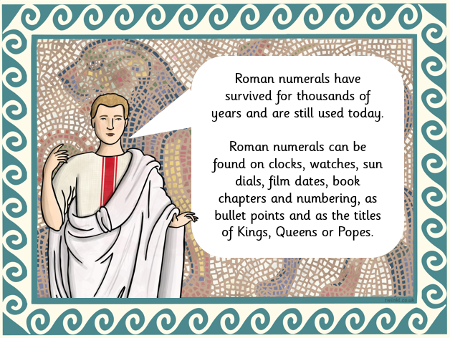
Roman Numerals
Notes:
Outline of what they are

Slide 3
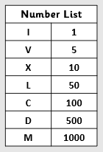
Roman numerals
‪
Here are the symbols used for Roman Numerals.
All numbers are made up of these.
1 = I
2 = II (1+1)
3 = III (1+1+1)
4 = IV (5-1)
5 = V
Using this guide, see if you can complete the colour by numbers Roman attached.
Notes:
How Roman Numerals work.
Picture attached in files

Slide 4
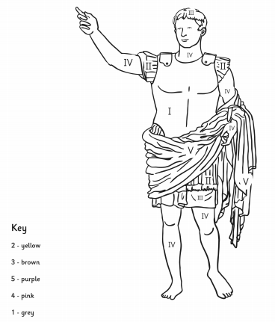
Notes:
Colour by numbers

Slide 5
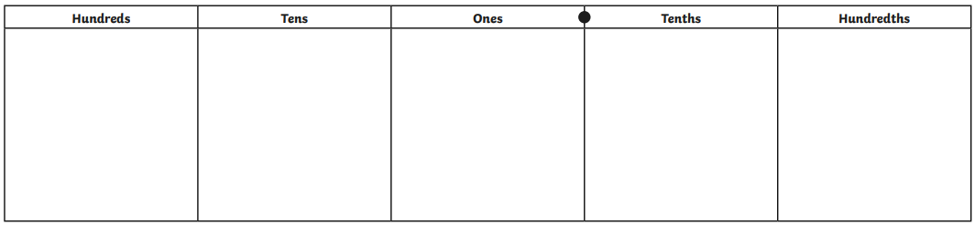
Tenths
‪This is a place value grid.
It helps us to see the value of the digits in a number.
The first column after the decimal point is called ‘tenths’.
Notes:
Place value grid

Slide 6

‪’Tenths’ means it has been split into 10 equal parts. This can be a decimal which would look like this 0.1
Or it can be a fraction which would look like this
1
10
Notes:
Tenths as fraction and decimals

Slide 7

‪4 tenths
Decimal = 0.4
Fraction =
4
10
Notes:
Tenths as fraction and decimals

Slide 8
4 wholes and 6 tenths would look like this as a decimal.
.
4
6
Notes:
Put the data into the chart

Slide 9
Tenths
‪Here is a video to help you if you are still not quite sure ☺
Tenths - Maths - Catch Up Lessons - Home Learning with BBC Bitesize - BBC Bitesize
Notes:
Link for Bitesize Tenths - Year 4 - P5 - Maths - Catch Up Lessons - Home Learning with BBC Bitesize - BBC Bitesize

Slide 10
Tenths
‪Now try matching a colouring in fractions on the sheets.
Can you also write the decimal next to it?
Notes:
Worksheets

Slide 11
What are you more confident in today?
Notes:
Whole class – gather ideas to check understanding of tasks set

Slide 12
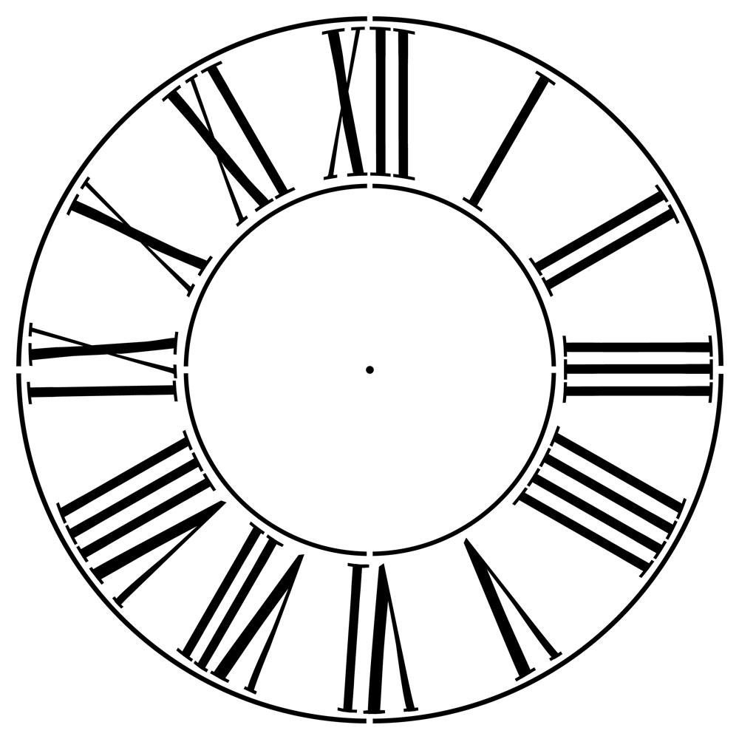
Roman numerals
‪
Here are the Roman Numerals used on an analogue clock.
Using this as a guide, see if you can complete the colour by numbers Roman attached.
Notes:
Lesson 2
Starter
How Roman Numerals work.
Picture attached in files

Slide 13
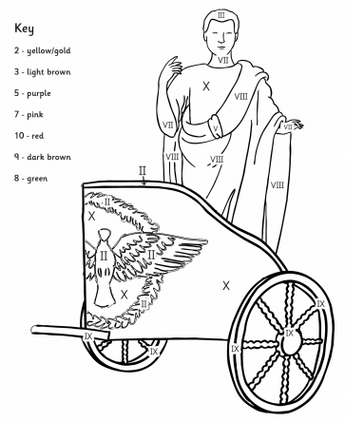
Notes:
Colour by numbers

Slide 14

Tenths – Fractions and Decimals
‪0.5 is equivalent to a
1
2
Notes:
Discuss five parts being shaded and five parts unshaded. Two equal groups of 5, one group shaded equal to one half

Slide 15
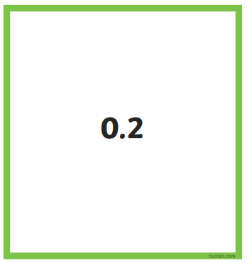
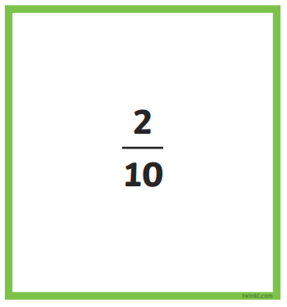

Tenths – Fractions and Decimals
‪Can you match up the decimals and fractions on the cards?
Once you have done that, can you colour one of the ‘wholes’ to match the decimal and fraction also?
Notes:
Worksheets

Slide 16
Money
‪Decimals can be seen in amounts of money.
There are 100 pennies in a pound. We write £1 as £1.00
The second column is called hundredths.
43p would be £0.43 – it is 43 parts of a whole £1
Notes:
Money

Slide 17
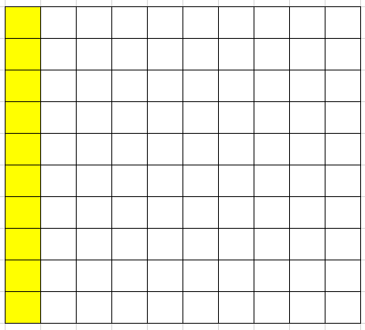
10 hundredths is equal to 1 tenth
10
1
100
10
0.10
0.1
Notes:
10 equal groups of 10. 1 group shaded is 1/10
Remind the zero at the end of 10 hundredths would not normally be written so is the same as 0.1

Slide 18
Your task today is to complete the ‘Hundredths’ worksheet.
You will need to read the fraction and decimal in the first section and then shade the given fraction/decimal in the second section.
Notes:
Worksheet

Slide 19
What are you more confident in today?
Notes:
Whole class – gather ideas to check understanding of tasks set

Slide 20
Notes:
Place value grids

