Slide 2

Think
about where you should cross.

Slide 3
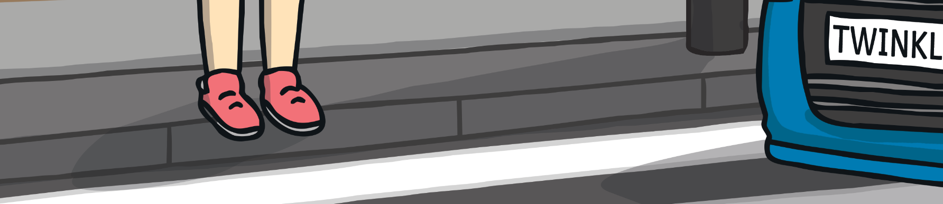
Stop
at the side of the road.

Slide 4




Use your
eyes and ears
to see any approaching vehicles.

Slide 5


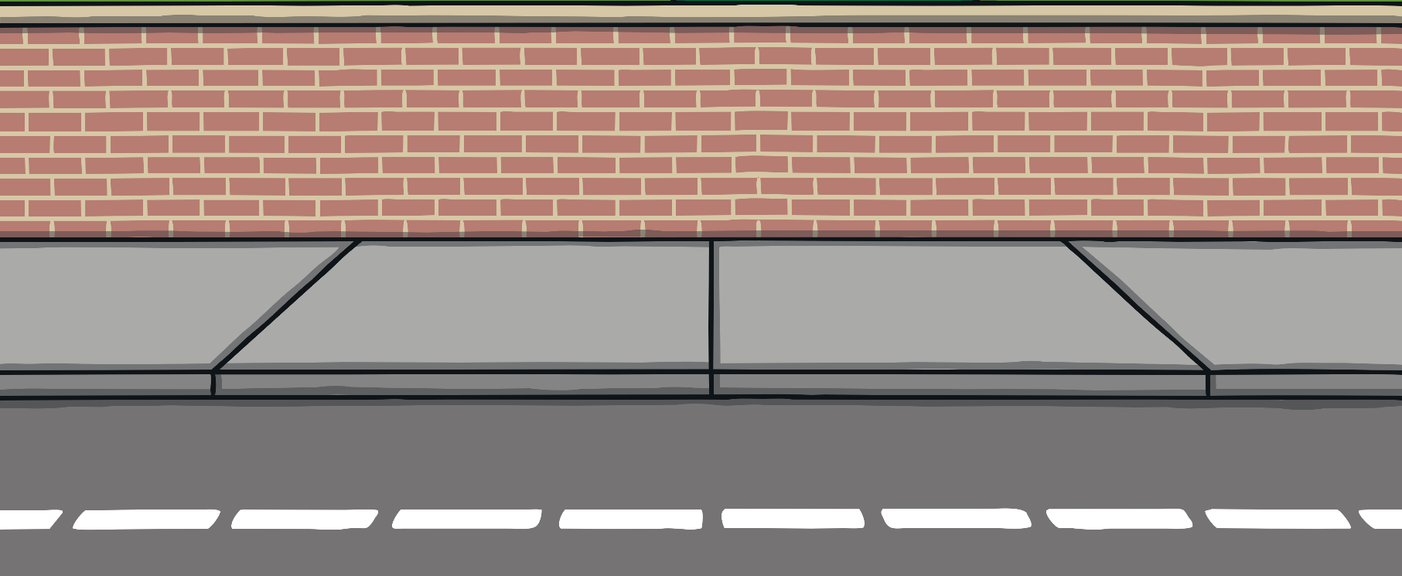
Wait
Until any vehicles have passed

Slide 6
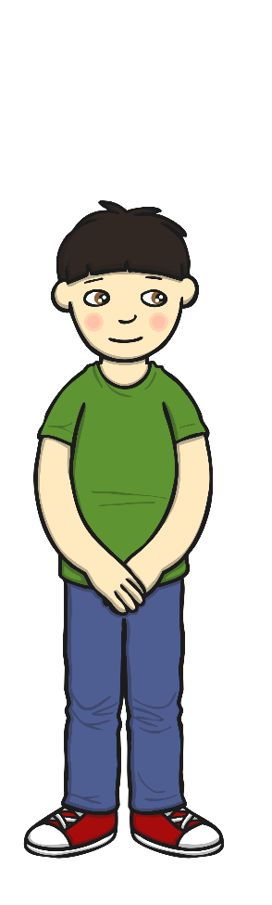
Look and listen
again to make sure all is clear.

Slide 7
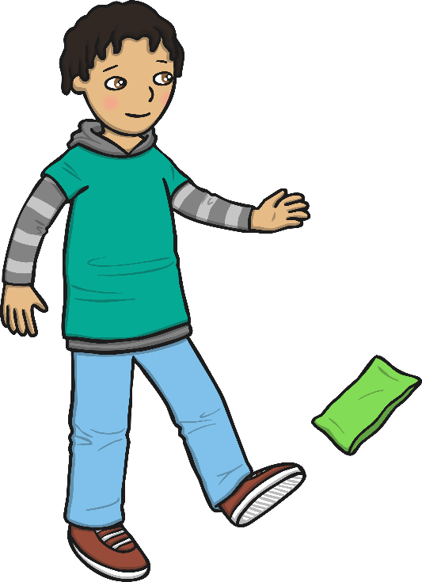
Cross
The road, keep looking and listening.

Slide 8

Only cross the road when the
Lollipop Person
says so

Slide 9
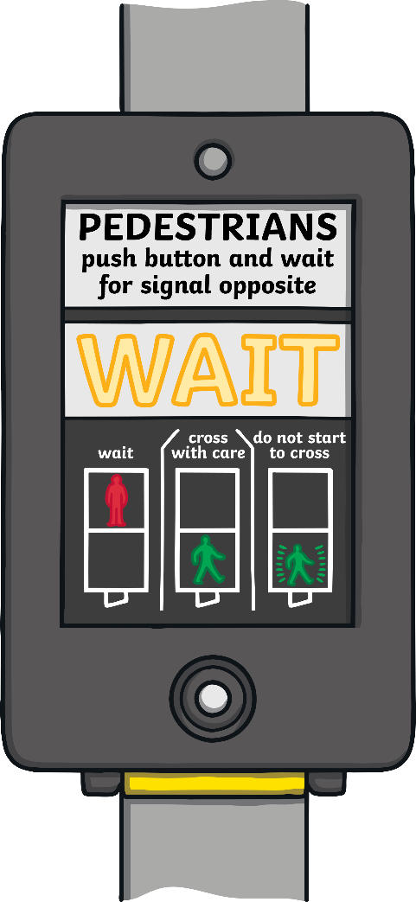

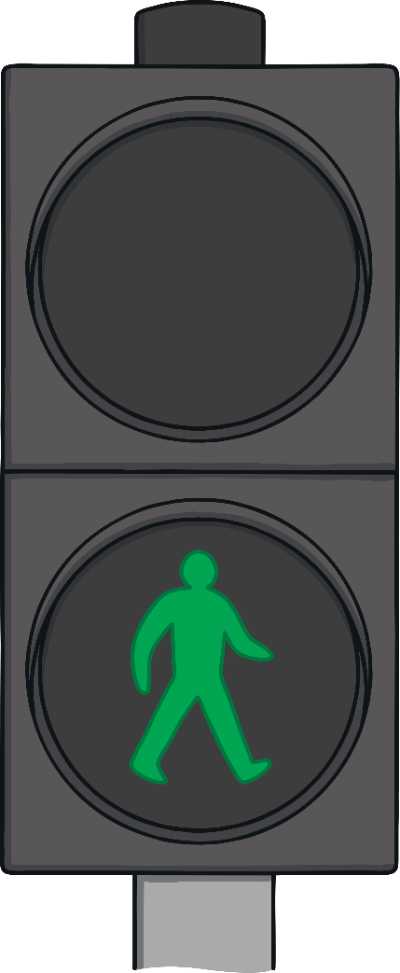
Pelican Crossings
press the button and wait.

Slide 10
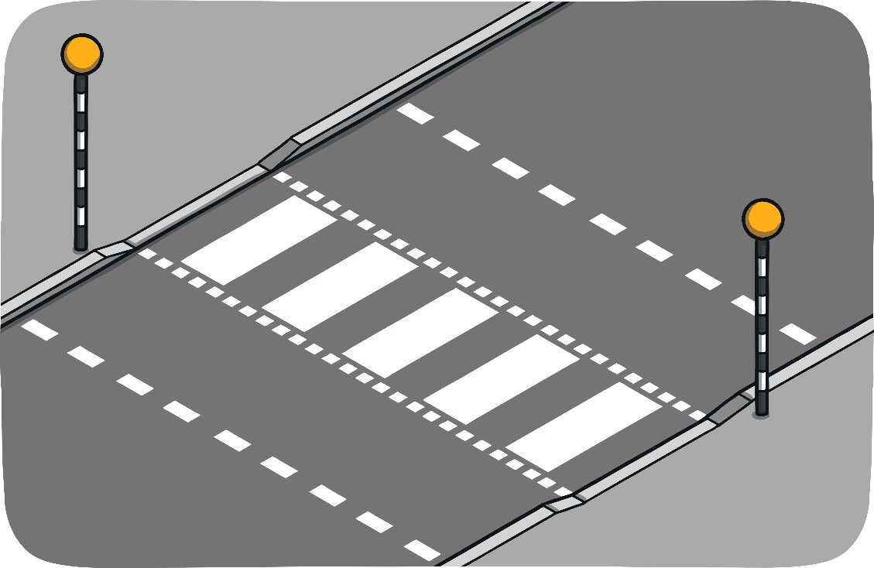
Zebra Crossings
Wait before you cross.
Look and listen all the time.
Only cross when all the traffic has stopped or when there is no traffic at all.

