Slide 1
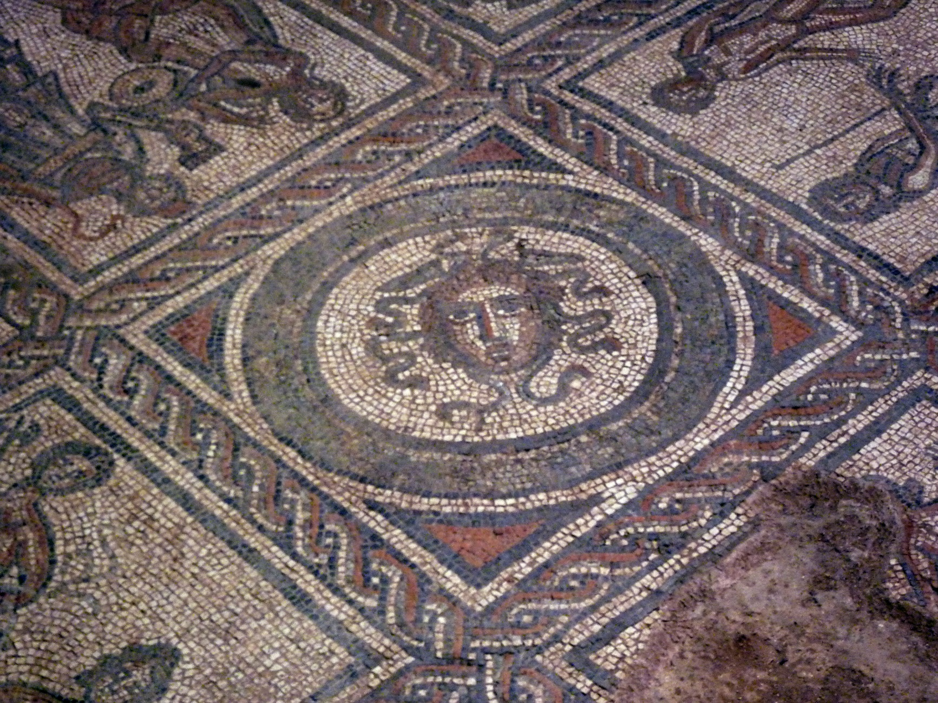

Photo courtesy of LindaH(@flickr.com) - granted under creative commons licence - attribution

Slide 2
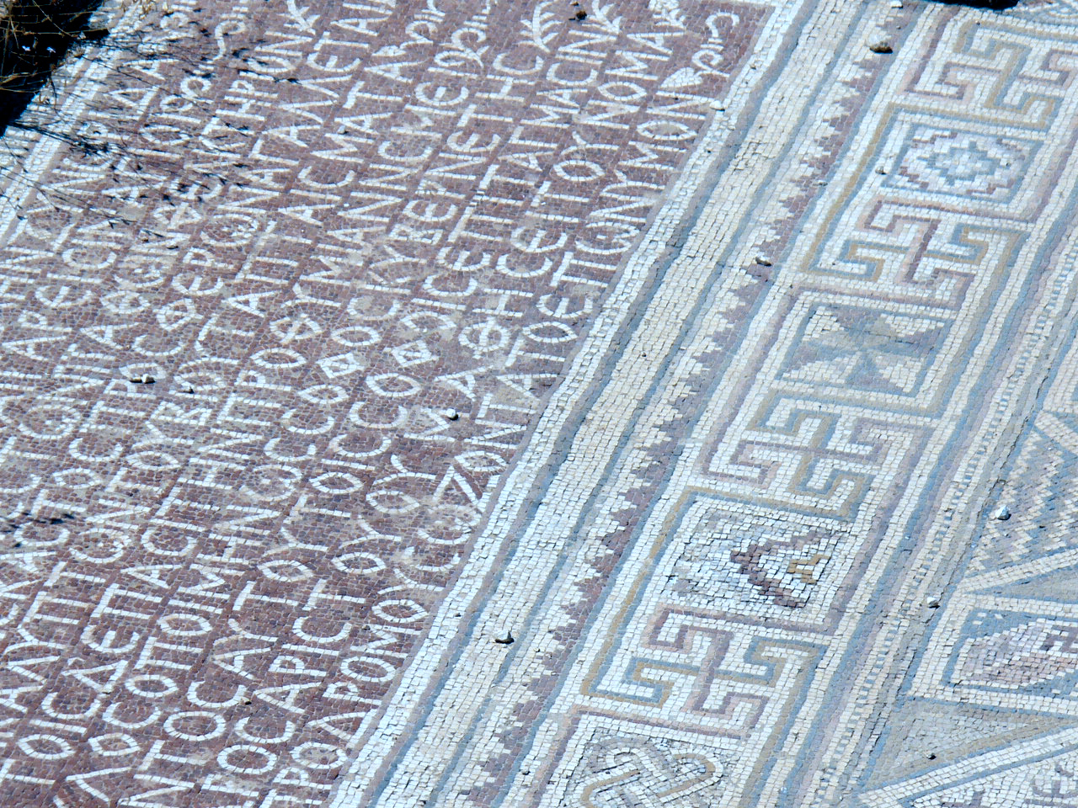
Photo courtesy of isawnyu(@flickr.com) - granted under creative commons licence - attribution

Slide 3
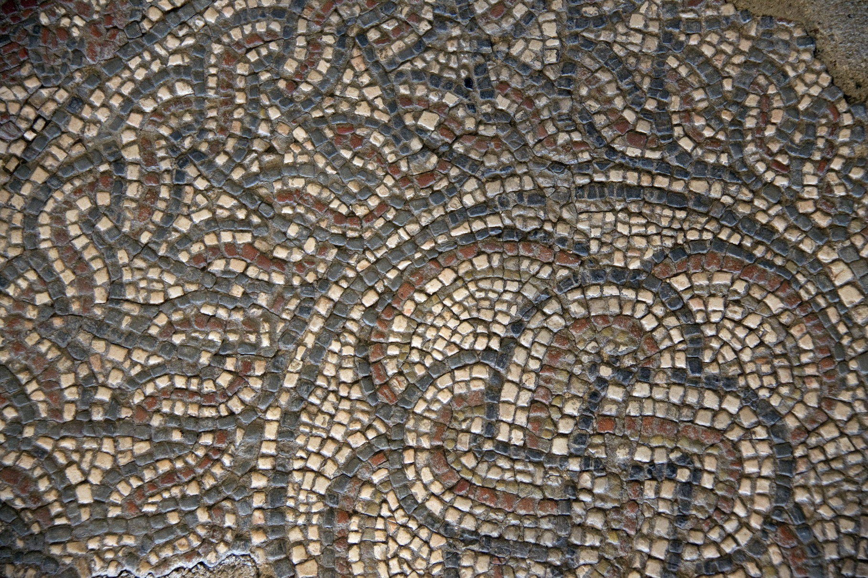
Photo courtesy of ahisgett(@flickr.com) - granted under creative commons licence - attribution

Slide 4
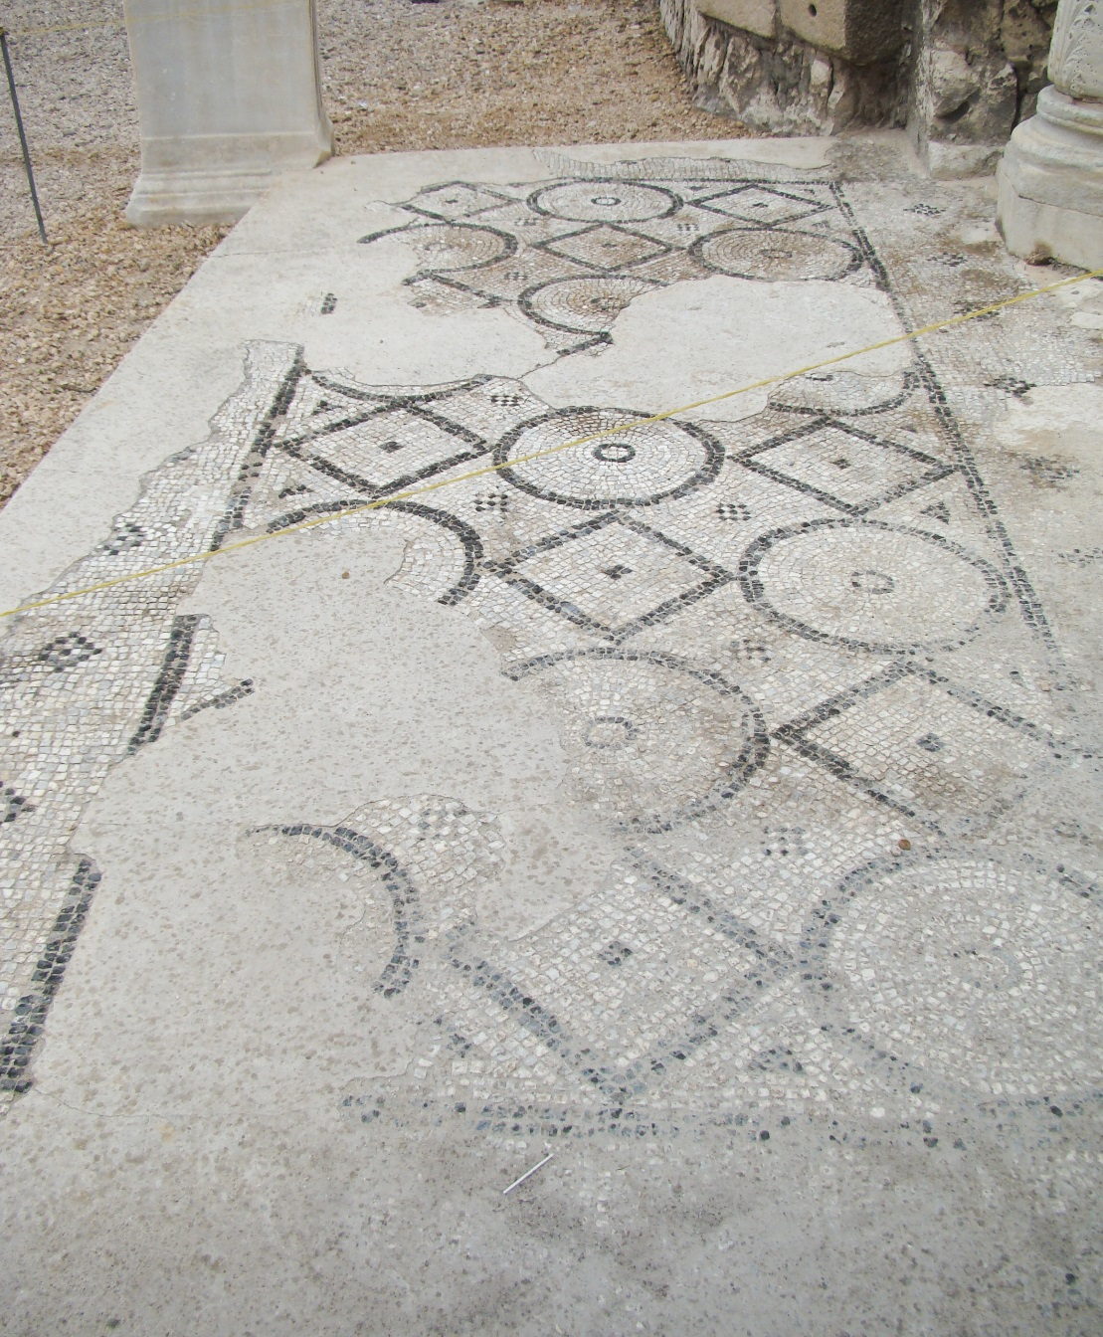
Photo courtesy of isawnyu(@flickr.com) - granted under creative commons licence - attribution

Slide 5
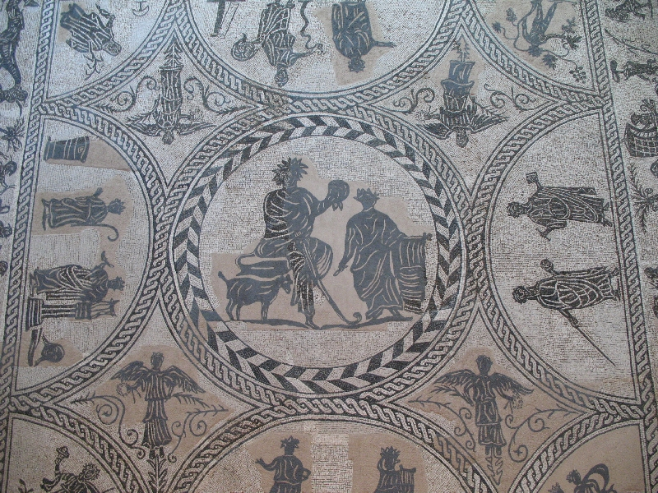
Photo courtesy of amata_es(@flickr.com) - granted under creative commons licence - attribution

Slide 6
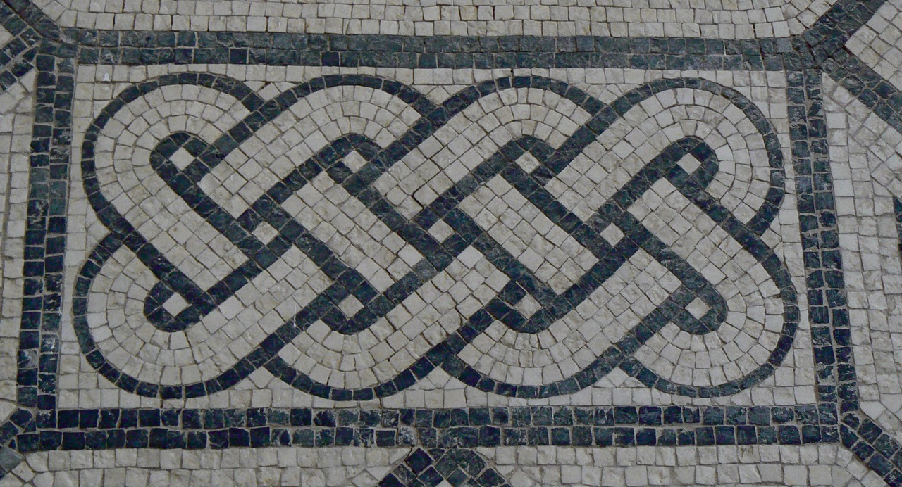
Photo courtesy of Roberto_venturini(@flickr.com) - granted under creative commons licence - attribution

Slide 7
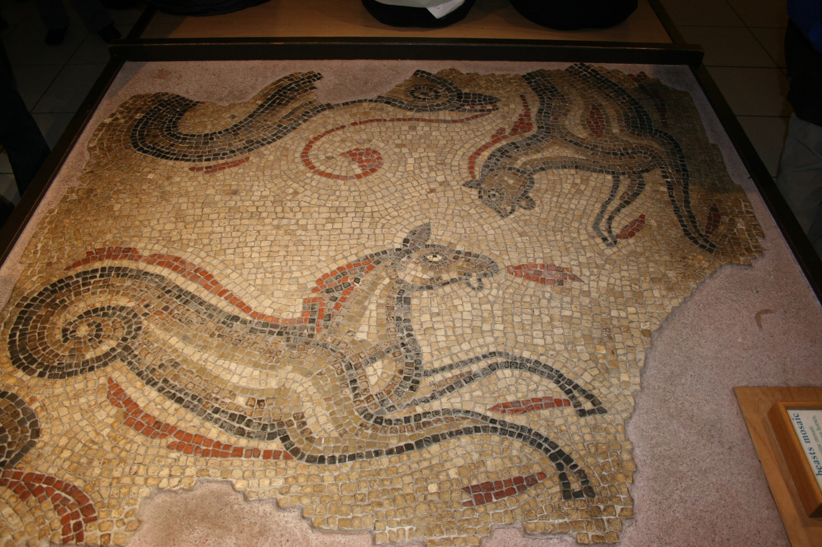
Photo courtesy of Canadacow(@flickr.com) - granted under creative commons licence - attribution

Slide 8
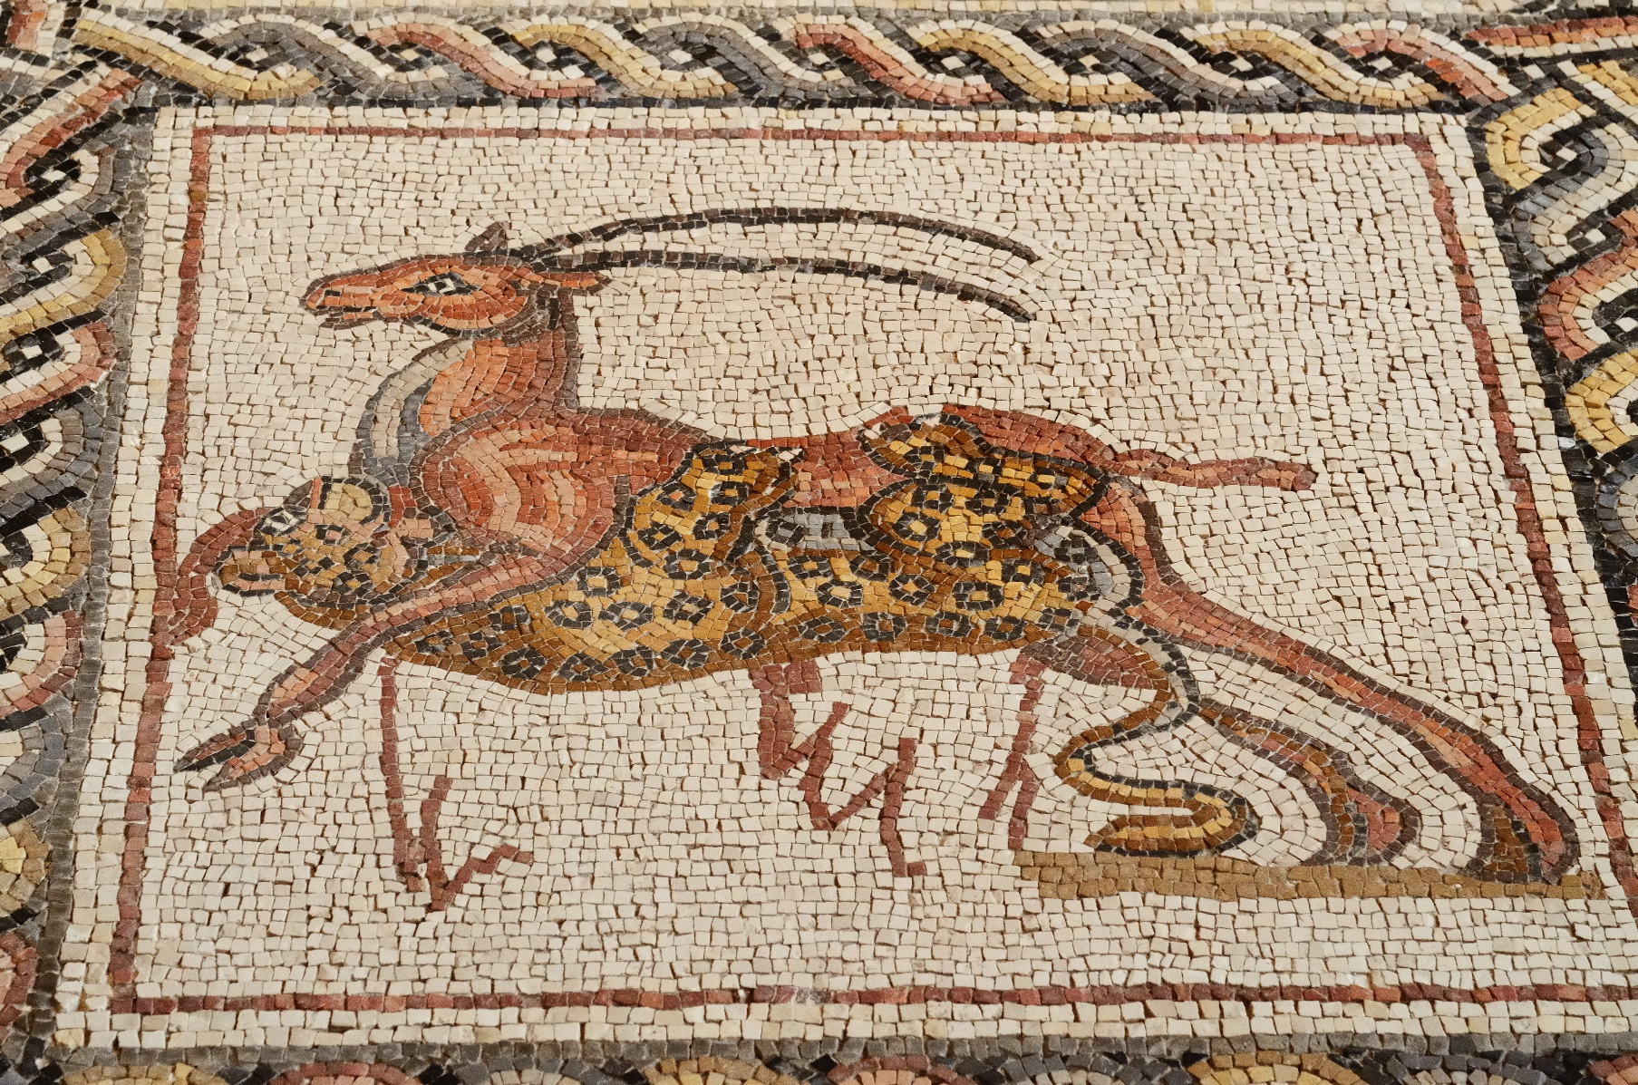
Photo courtesy of ralph and jenny(@flickr.com) - granted under creative commons licence - attribution

Slide 9
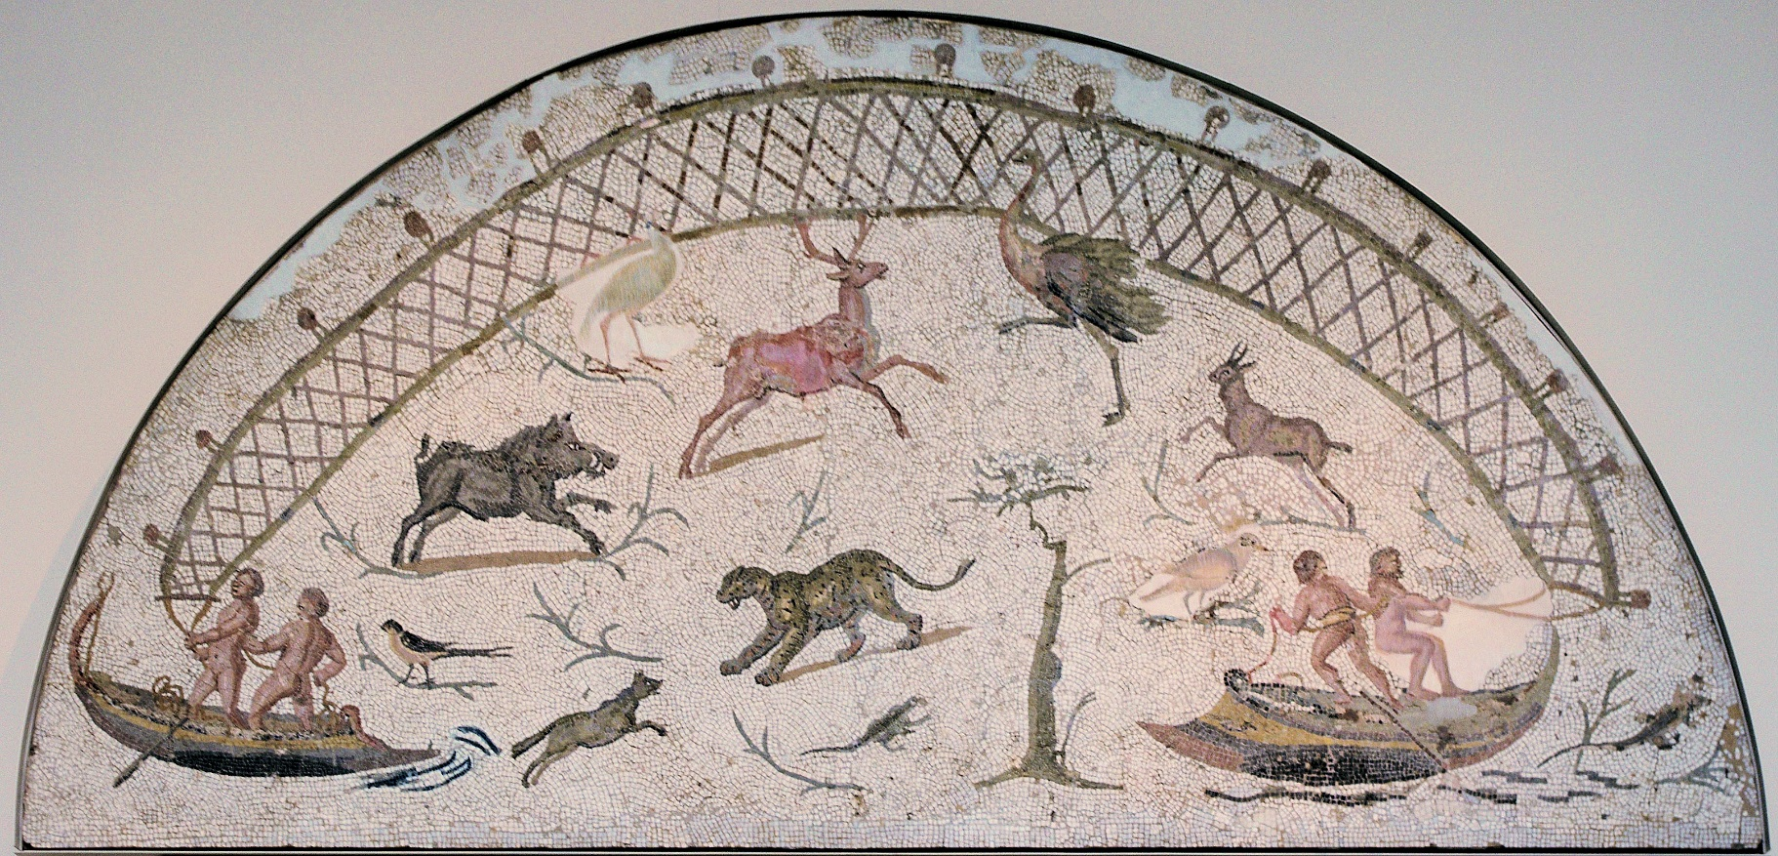
Photo courtesy of Ken and Nyetta(@flickr.com) - granted under creative commons licence - attribution

Slide 10
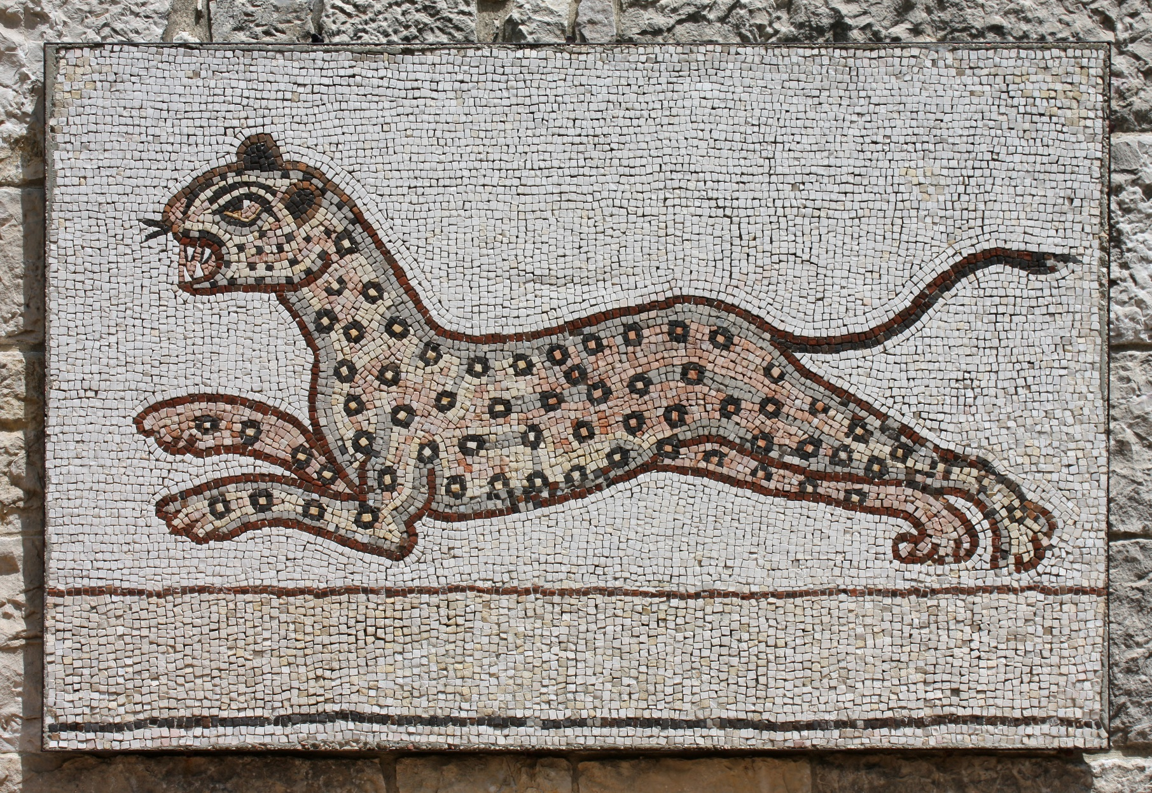
Photo courtesy of Eusebius@Commons(@flickr.com) - granted under creative commons licence - attribution

Slide 11
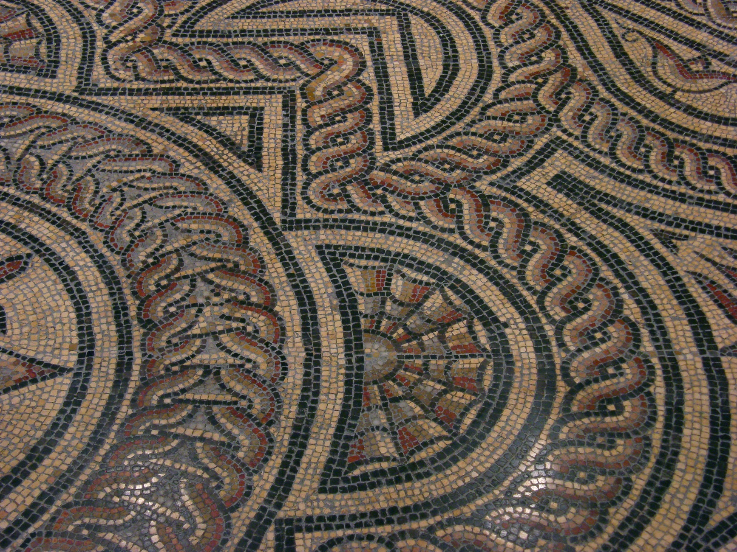
Photo courtesy of OliBac(@flickr.com) - granted under creative commons licence - attribution

Slide 12

THE END

