Slide 1

Tectonic Plates
Information PowerPoint

Slide 2
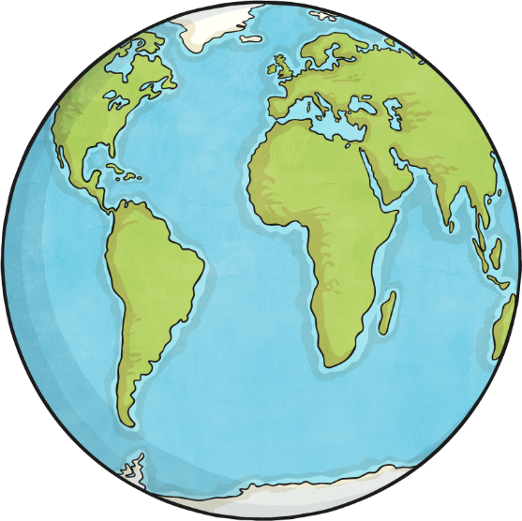
Aim
I can understand how the continents of the world have changed over time.
Success Criteria
To know that the Earth’s surface is made up of tectonic plates.
To know that tectonic plates move over millions of years.
To describe how the position of landmasses has changed over time.

Slide 3
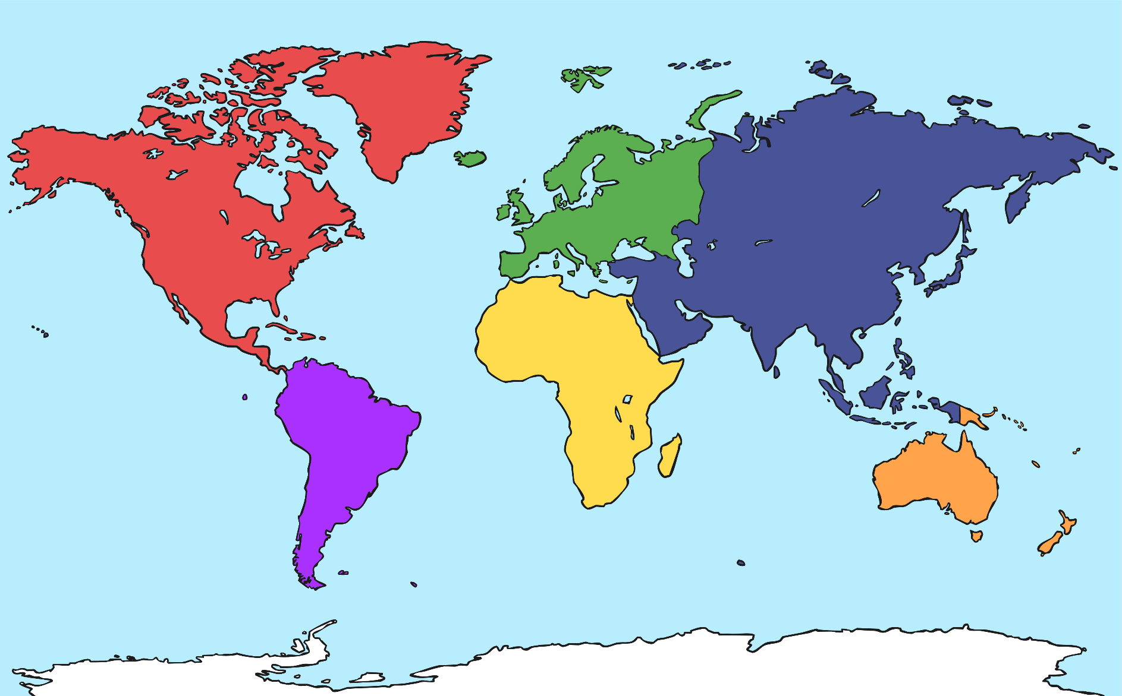
The Continents
Can you remember the names of the continents?

Slide 4
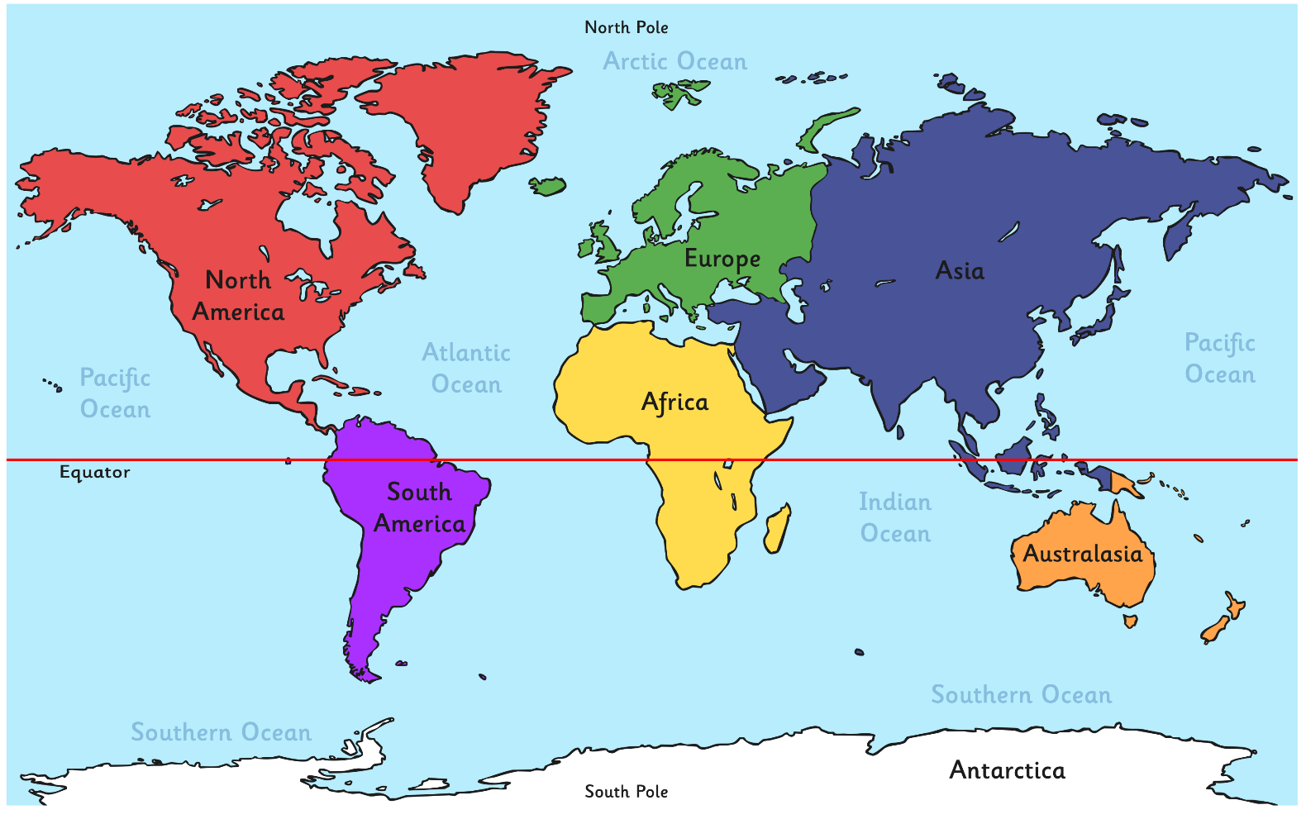
The Continents
Can you remember the names of the continents?

Slide 5
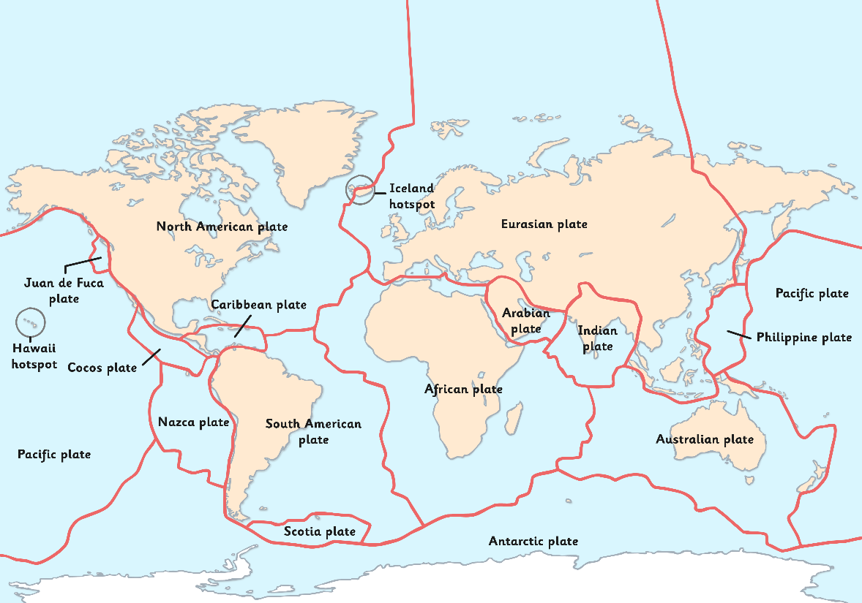
Tectonic Plates
The Earth’s surface is called the crust.
It is made up of different rocky sections called tectonic plates.
This map shows where the plates are.
Tectonic plates can move about on the softer mantle underneath them.

Slide 6
Tectonic Plates
If we could slide South America towards Africa, do you think the two landmasses would fit together like a jigsaw puzzle?

Slide 7
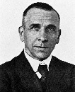
Continental Drift
In 1910, a German scientist called Alfred Wegener, was the first to study the idea that the continents might have once been a single landmass.
However, it wasn’t until 20 years after Wegener died, that geologists realised he was right.
The continents and ocean floors really do “float” on moving rock plates, and have been drifting for millions of years.
Image: Public Domain

Slide 8
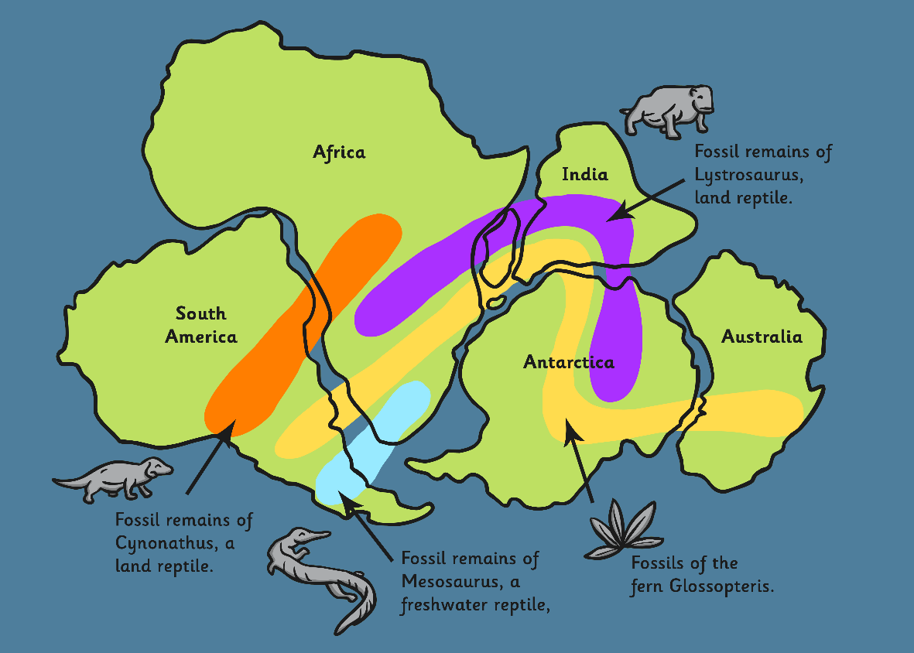
Continental Drift
Alfred Wegener came up with some very convincing evidence to support his idea.
He looked at where different fossils were found and was able to piece the continents back together into one landmass.

Slide 9
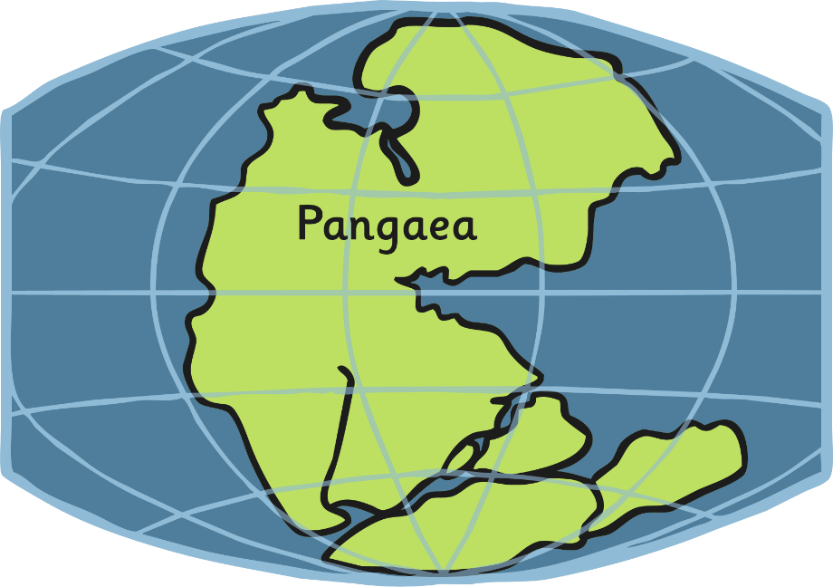
How the Continents Formed
Permian Period
250 million years ago
250 million years ago, all the land on Earth was one large landmass.
Wegener named this landmass Pangaea.

Slide 10
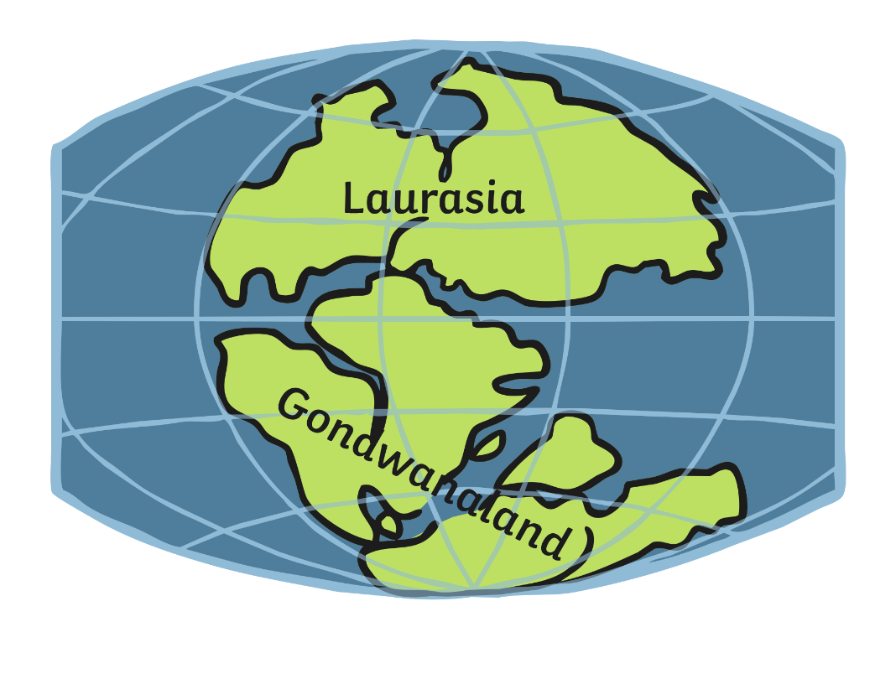
How the Continents Formed
Triassic Period
200 million years ago
The moving tectonic plates started to split Pangaea apart.
200 million years ago, the land was split into two landmasses – Laurasia and Gondwanaland.

Slide 11
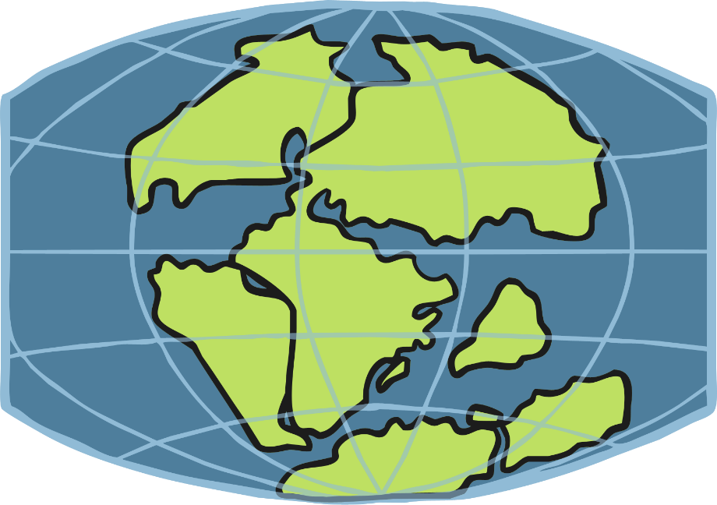
How the Continents Formed
Jurassic Period
145 million years ago
145 million years ago, the continents we know today were starting to become visible.

Slide 12
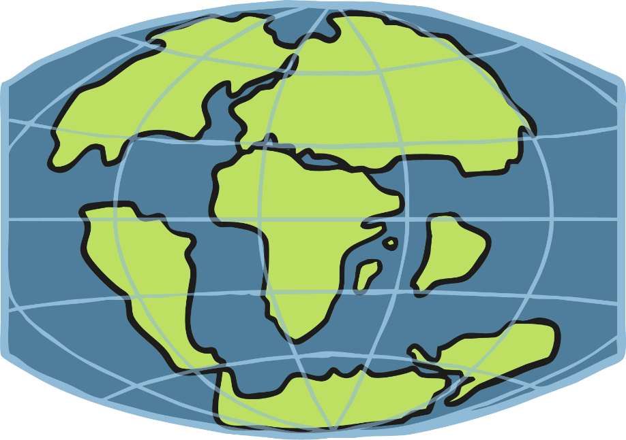
How the Continents Formed
Cretaceous Period
65 million years ago
Which landmasses can you spot on this map of Earth, 65 million years ago?

Slide 13
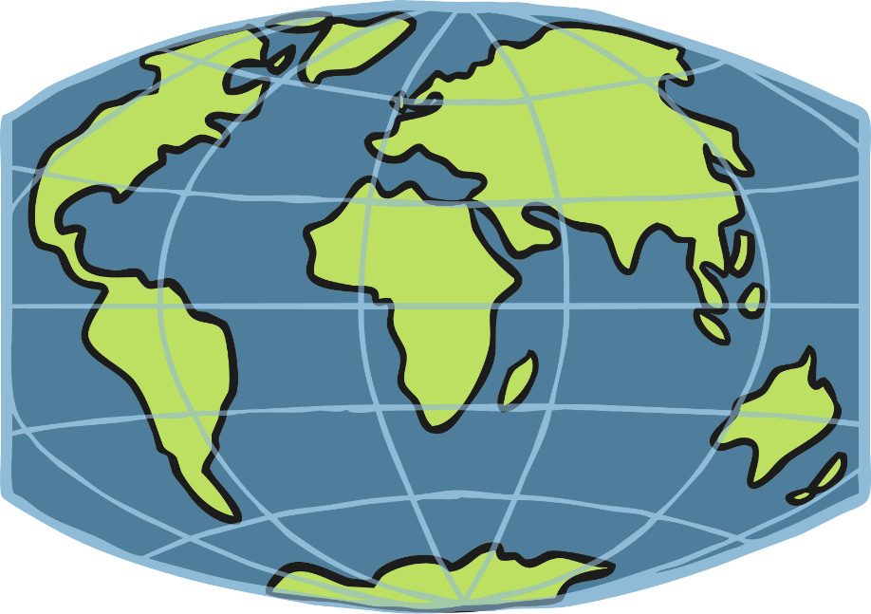
How the Continents Formed
Present Day
Over 250 million years, the movement of the plates has created the land masses we recognise today.

Slide 14

Are the Plates Still Moving?
The plates move about 1 to 10 cm every year.
Plates can move towards each other, away from each other or rub alongside each other.
Watch this video, which shows a part of Iceland where the North American and Eurasian plates are moving apart.

Slide 15

50 Million Years From Now…
South America is moving towards North America.
North America is moving away from Europe.
Australasia is moving towards Asia.
Can you imagine what the world will look like in 50 million years time?

