Slide 2


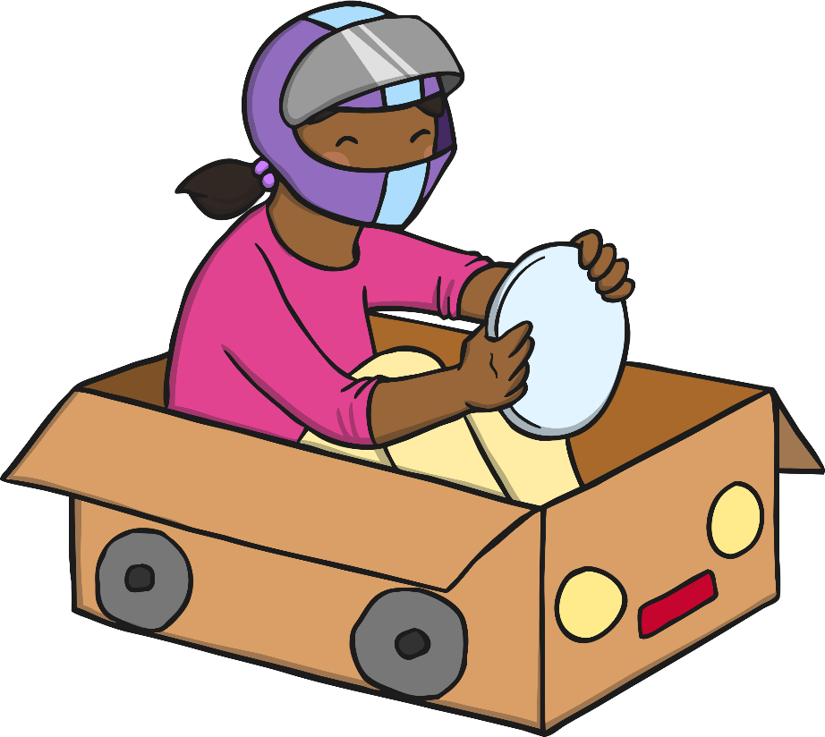
1, 2, 3, 4, 5, take my super-car to drive.
6, 7, 8, 9, 10, turns into a bike again.

Slide 3
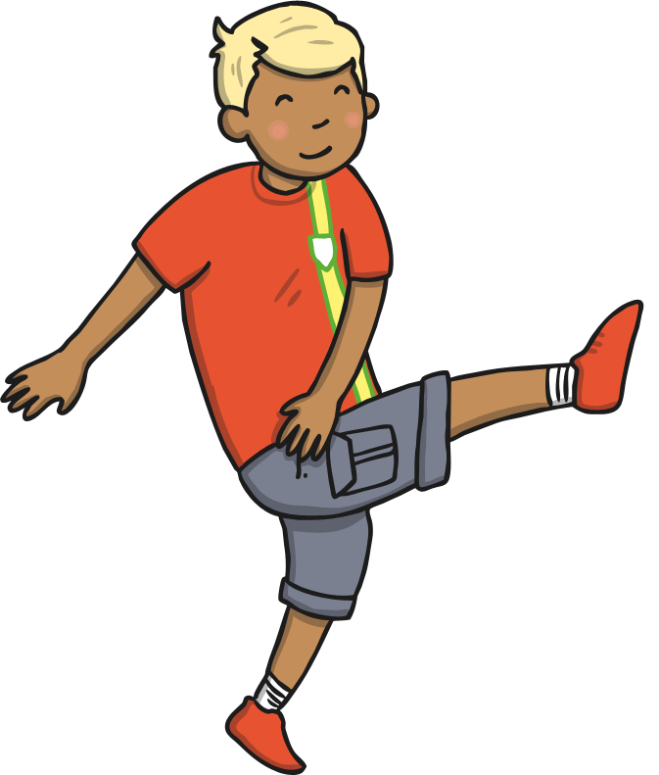

10, 9, 8, 7, 6, practising my hero kicks.
5, 4, 3, 2 and 1, super-speedy super-run.

Slide 4

1, 2, 3, 4, 5, into water I can dive.
6, 7, 8, 9, 10, super-suit is dry again.

Slide 5

10, 9, 8, 7, 6, come and see my super tricks.
5, 4, 3, 2 and 1, being super’s so much fun.

