Slide 2
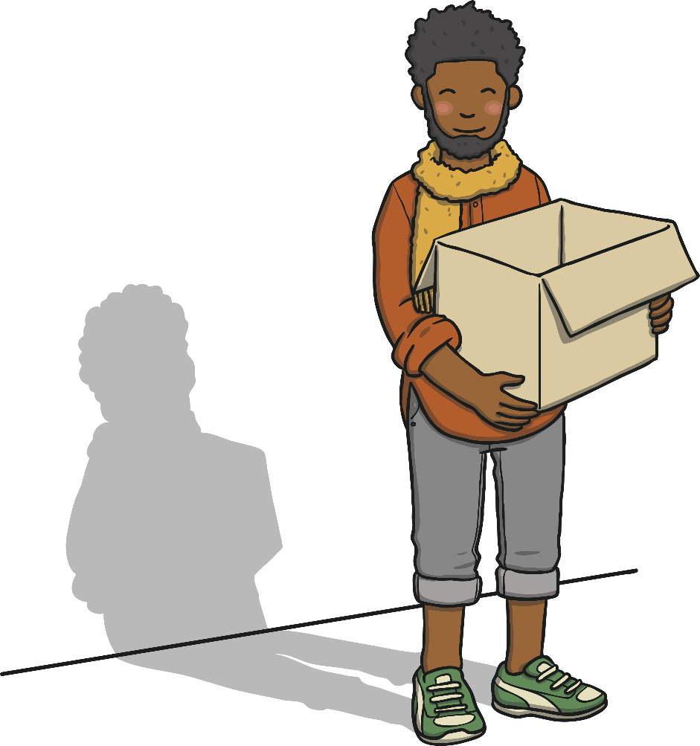
A Riddle to Get You Thinking…
I follow you around in the light but I’ll say goodbye to you at the night.
What am I?
That’s right, I’m your shadow
When there is a light source you will nearly always have a shadow somewhere close by.
A shadow is made when an object blocks light.
The object must not be seen through or the light will pass through and you will end up with no shadow.

Slide 3
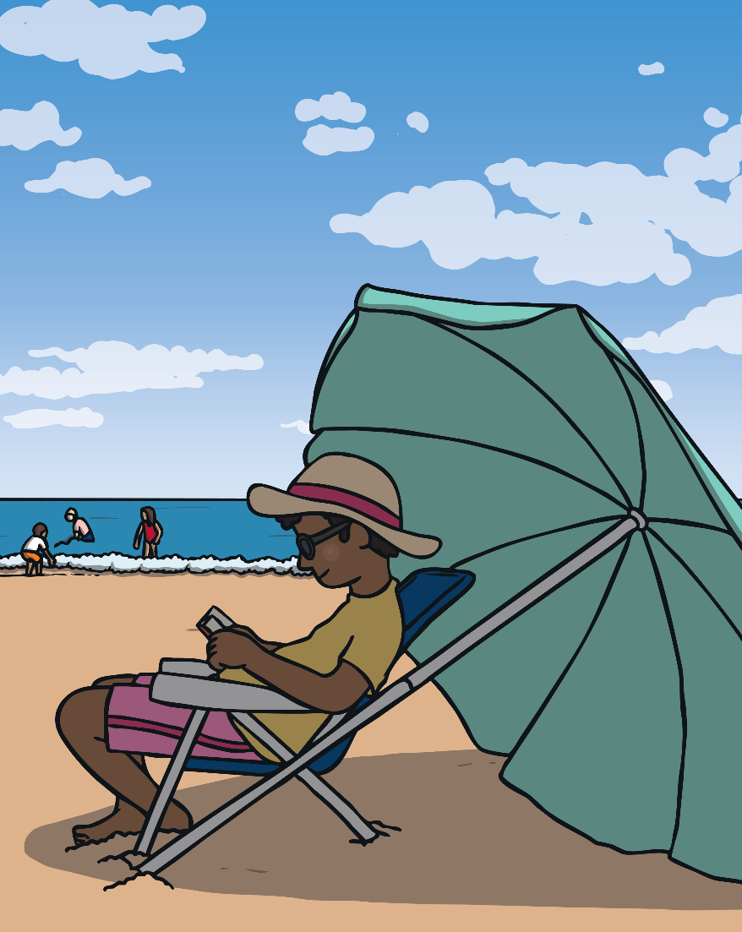
Shifting Shadows
Take a look around and see what objects you can see that form shadows. You will notice that swings, trees, cars, tables and almost everything else has a shadow!
We are going to look a little closer at shadows and see if we can find out some other interesting things that happen when you have a light source and a shadow.
Let’s find out more…

Slide 4

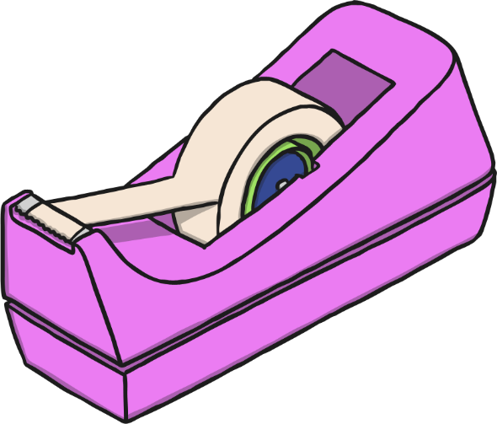

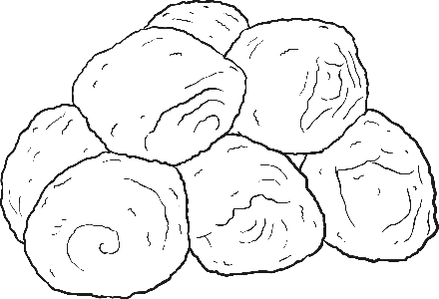
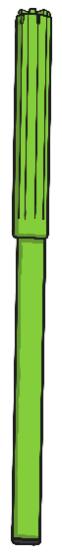

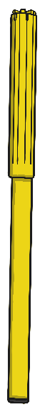



What You Need
A pencil
A piece thick card
Felt-tips
Cotton wool – for hair
Glue
Scissors
Lolly pop stick
Strong sticky tape
A torch (or other light source such as a projector)

Slide 5




What to Do
Draw a character – it could be a person, an animal or an object - onto a piece of thick cardboard.
1
Cut out your character.
2
Place the lollipop stick on the back of your character.
3
Stick it in place with the sticky tape.
4
Hold your puppet up next to a wall, preferably a white wall.
5

Slide 6



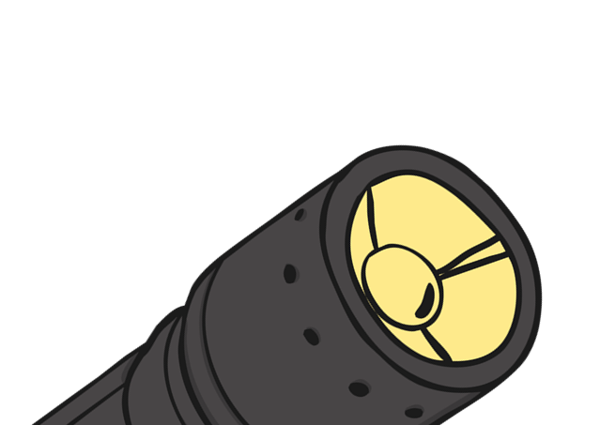
Shine the torch or whatever light source you are using onto your puppet. A large shadow of your puppet will appear on the wall.
6
Now, move your character towards the light.
What do you notice?
7
Move your character further from the light.
What do you notice?
8
Move the light source to one side whilst you hold the character still.
What do you notice?
9

Slide 7
Here’s What’s Happening…
When you move the character towards
the light your shadow gets bigger.
This is because you are blocking out more of the light coming from the light source so the space with no light – the shadow - gets bigger.
When you move your character further away from the light source your shadow gets smaller.
This is because there is more light coming from the light source making the shadow from the character get smaller.
When you move the light source to one side and then another the shadow should move in the opposite direction. This is because light travels in straight lines towards the object so the shadow will always be behind the lines of light from the light source.

