Slide 2
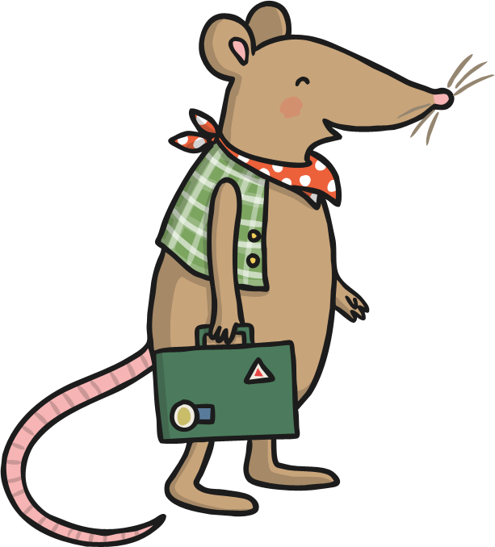

Once upon a time, a town mouse took a trip to the countryside and met a country mouse.

Slide 3
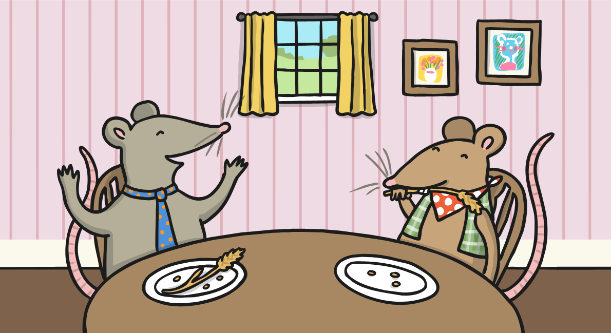
The country mouse invited the town mouse to his home for dinner.
They sat down to eat, but the town mouse was shocked by the country food. He had never eaten anything so plain and boring!

Slide 4
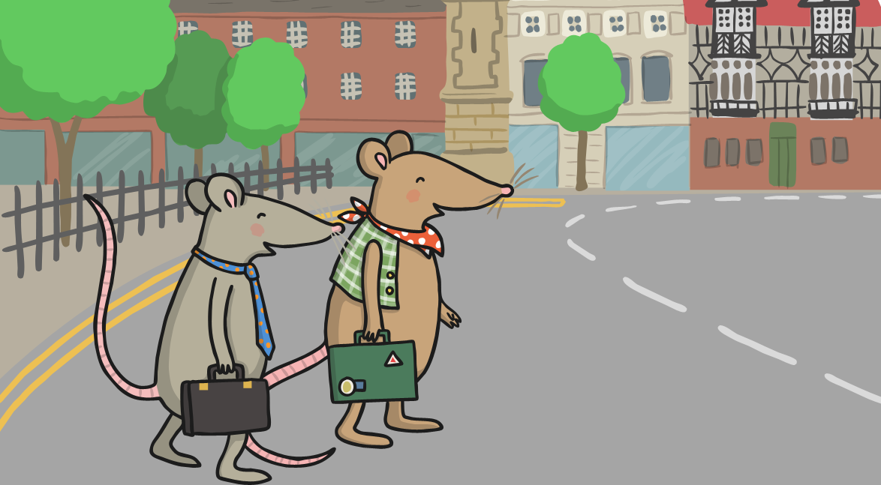
The town mouse invited the country mouse to sample the food that he was used to. The country mouse agreed and they were soon on their way to the town.

Slide 5

They arrived at the town mouse’s home, and headed straight to the cupboard. Inside were jars of jams and chutneys, bags of sugar, rice and pasta and much more! The country mouse was amazed.

Slide 6
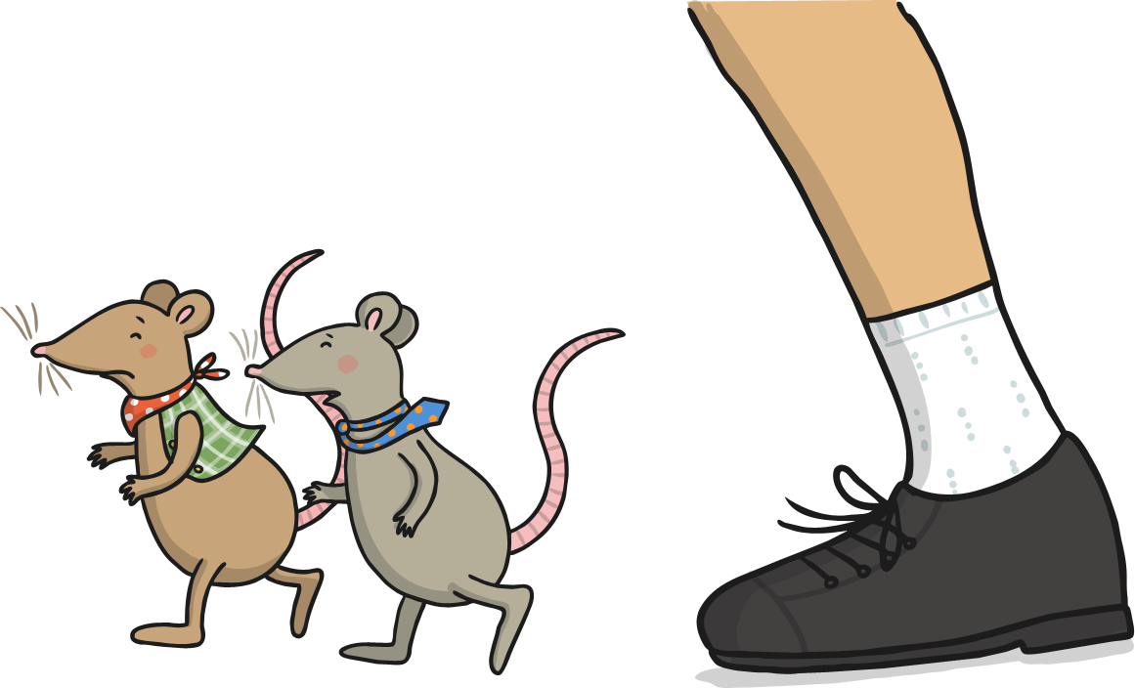
All of a sudden, the kitchen door swung open and the cook walked in.
They jumped out of the cupboard and ran across to the mouse hole.
The country mouse was terrified!

Slide 7

When the coast was clear, the mice ventured back out to find more food.
This time they went to the pantry where they found a jar of delicious, juicy prunes. The country mouse had never tasted anything like it!

Slide 8
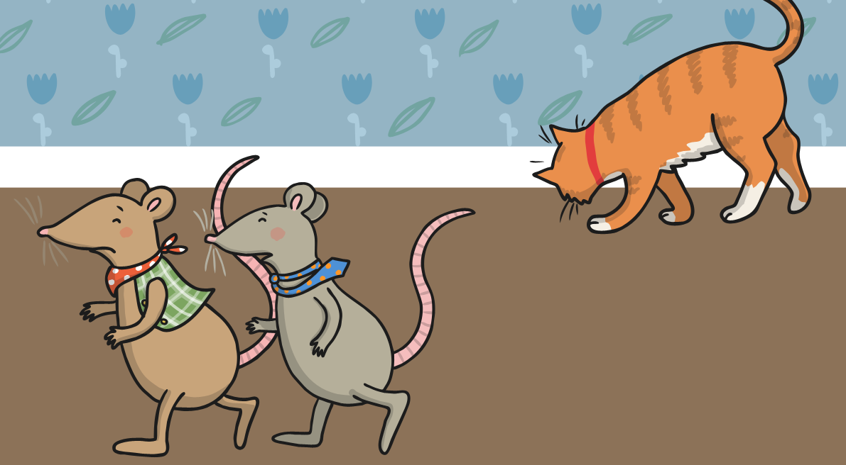
The country mouse was happily munching through the prunes when the town mouse whispered “Quiet!” A cat had crept into the kitchen and was looking for prey. They tiptoed silently back to the hole.

Slide 9
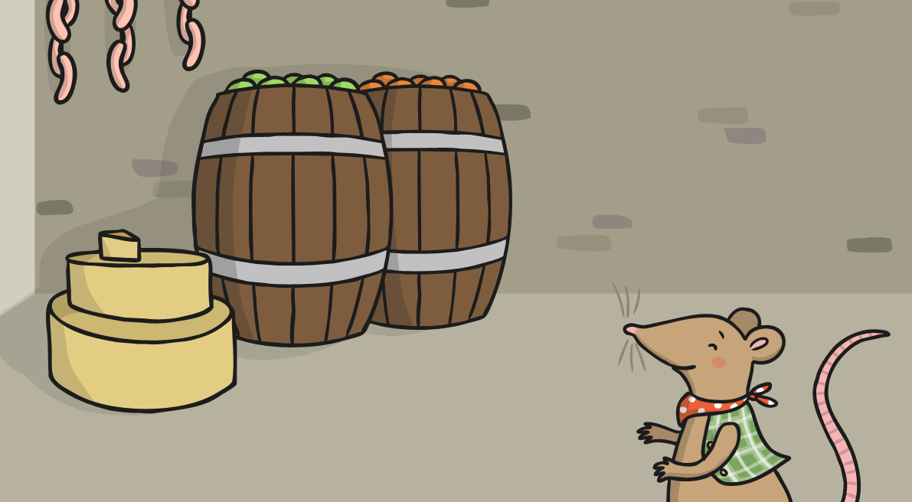
After the cat had left, they decided to explore the cellar. They went down the steps, and the country mouse was astonished by the huge amount of food. There were wheels of cheese, meat, barrels of fruit and more.

Slide 10
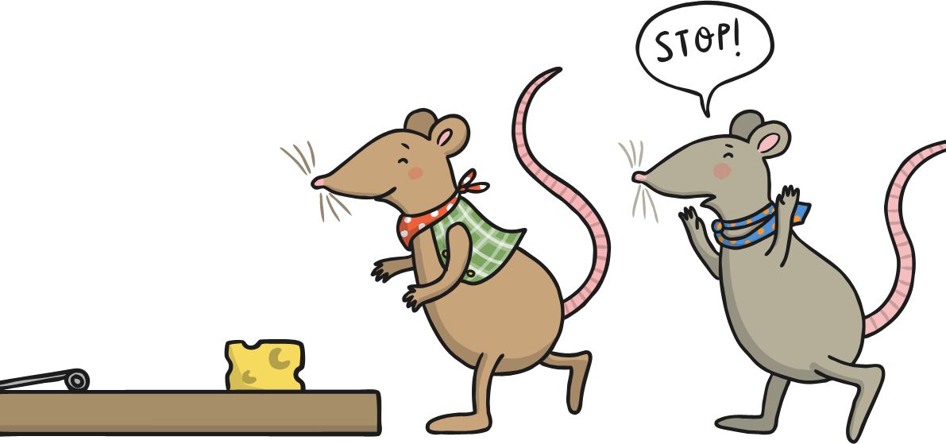
The country mouse spotted a particularly tasty looking piece of cheese in the corner. He ran over and was about to tuck in when the town mouse shouted, “STOP! It’s a trap!”

Slide 11
And with that, the country mouse grabbed his things and went on his way. “Thanks for everything, but I must go now,” he said to the town mouse, “I can’t cope with all these shocks. I would much sooner eat my boring food in peace, than eat delicious food whilst surrounded by danger!”

