Slide 2





Mixing colours red and blue,
Red and blue, red and blue.
Mixing colours red and blue,
Purple is made.
+
=

Slide 3
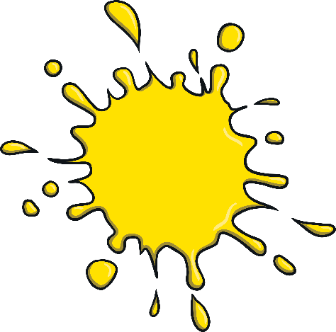
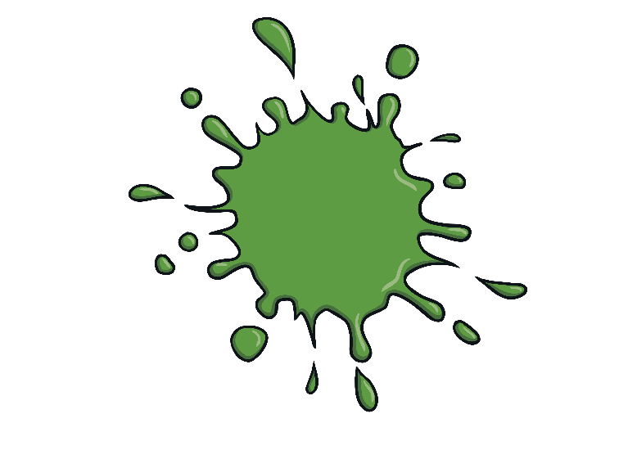
Mixing blue with yellow now,
Yellow now, yellow now.
Mixing blue with yellow now,
Green is there, wow!
+
=

Slide 4

Mixing yellow now with red,
Now with red, now with red.
Mixing yellow now with red,
Orange, orange, orange.
+
=

