Slide 1
Term 3 Week 6
Recognise different angles
Carry out the four operations to solve simple word problems.
Read and interpret data on bar charts.
Read and interpret data on pictograms.
Notes:
Objectives for the week

Slide 2
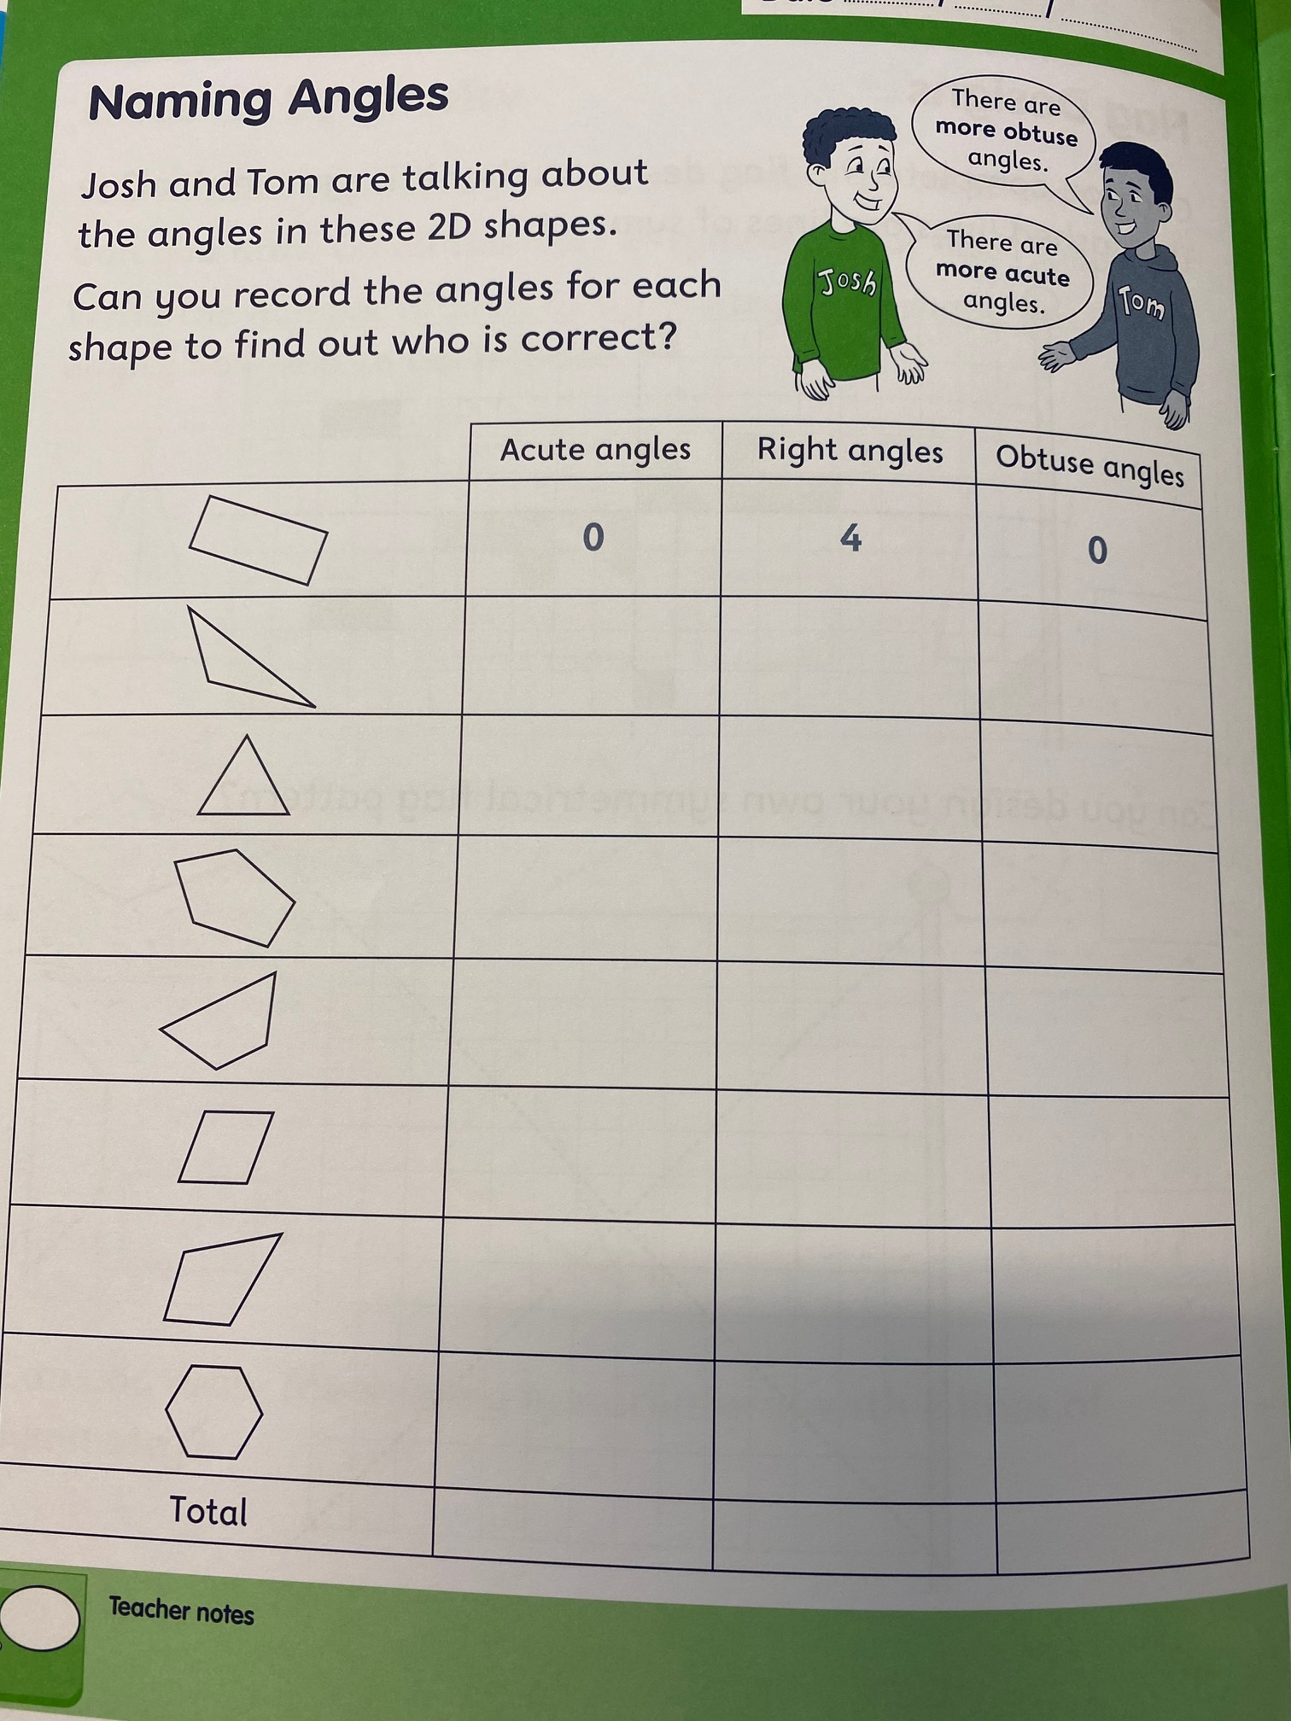
Angles recap
Acute angles are less than 90˚
Right angles are exactly 90˚
Obtuse angles are more than 90˚
Notes:
Lesson 1 – Starter
Worksheet to complete

Slide 3
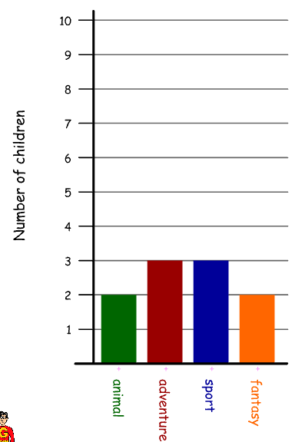
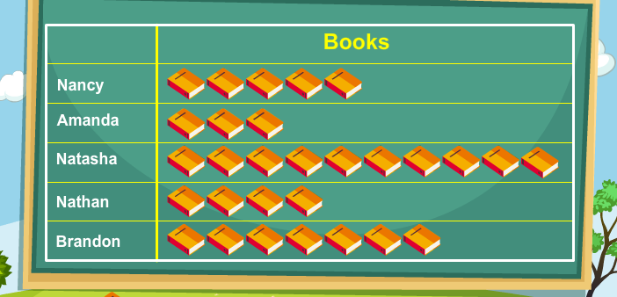
Statistics
‪There are different types of charts and tables we can use to record information including bar charts and pictograms.
Notes:
Types of charts we can read information from

Slide 4
Bar Charts
‪
Y axis goes from the bottom up
Bar charts can be horizontal or vertical bars and they have information on the axis.
The Y axis usually has the numbers and the X axis has the category.
X axis goes across the bottom
Notes:
Types of charts we can read information from

Slide 5
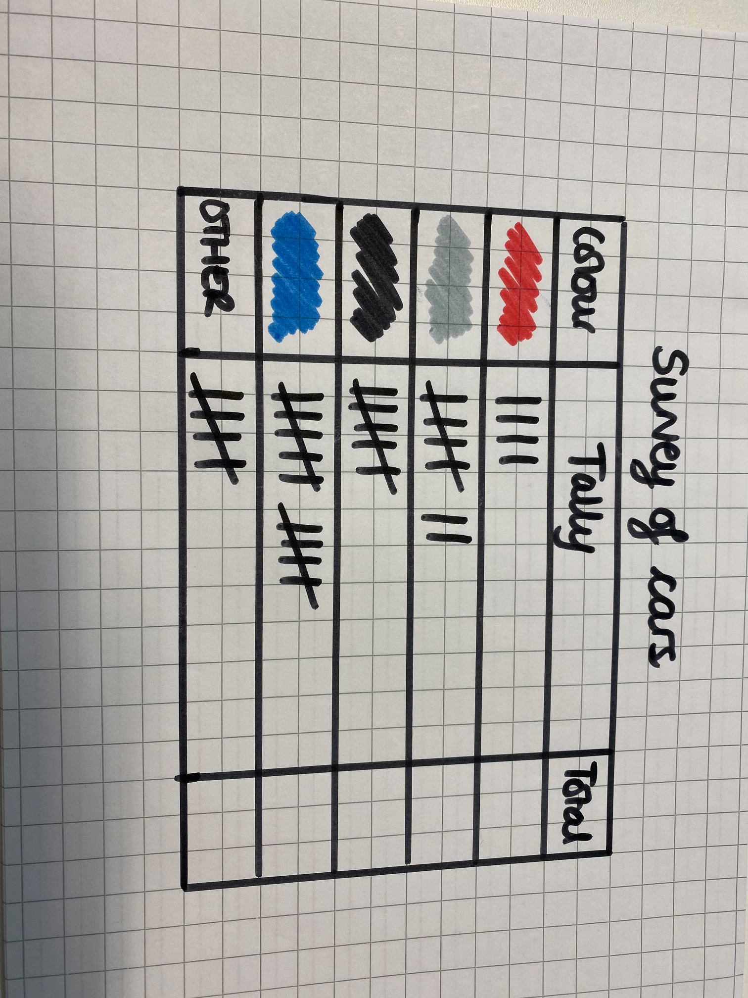
Statistics
‪The information on the charts and tables is called data.
The data could be fixed; like a timetable, or it may be collected; like a survey.
Can you complete a survey of the cars passing your house or in a local car park to collect some data?
Notes:
Collect data in local area to use in a bar graph. Use a table to collect the data. Tally can be used or symbols.

Slide 6
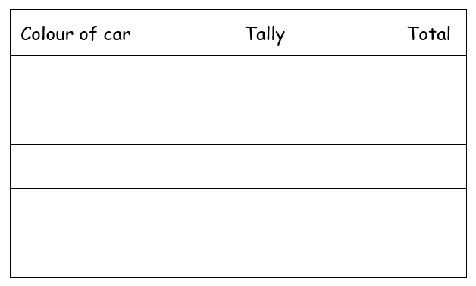
Notes:
Can be printed as a template if drawing a table is tricky. The survey is the skill being learnt – not drawing a table!

Slide 7
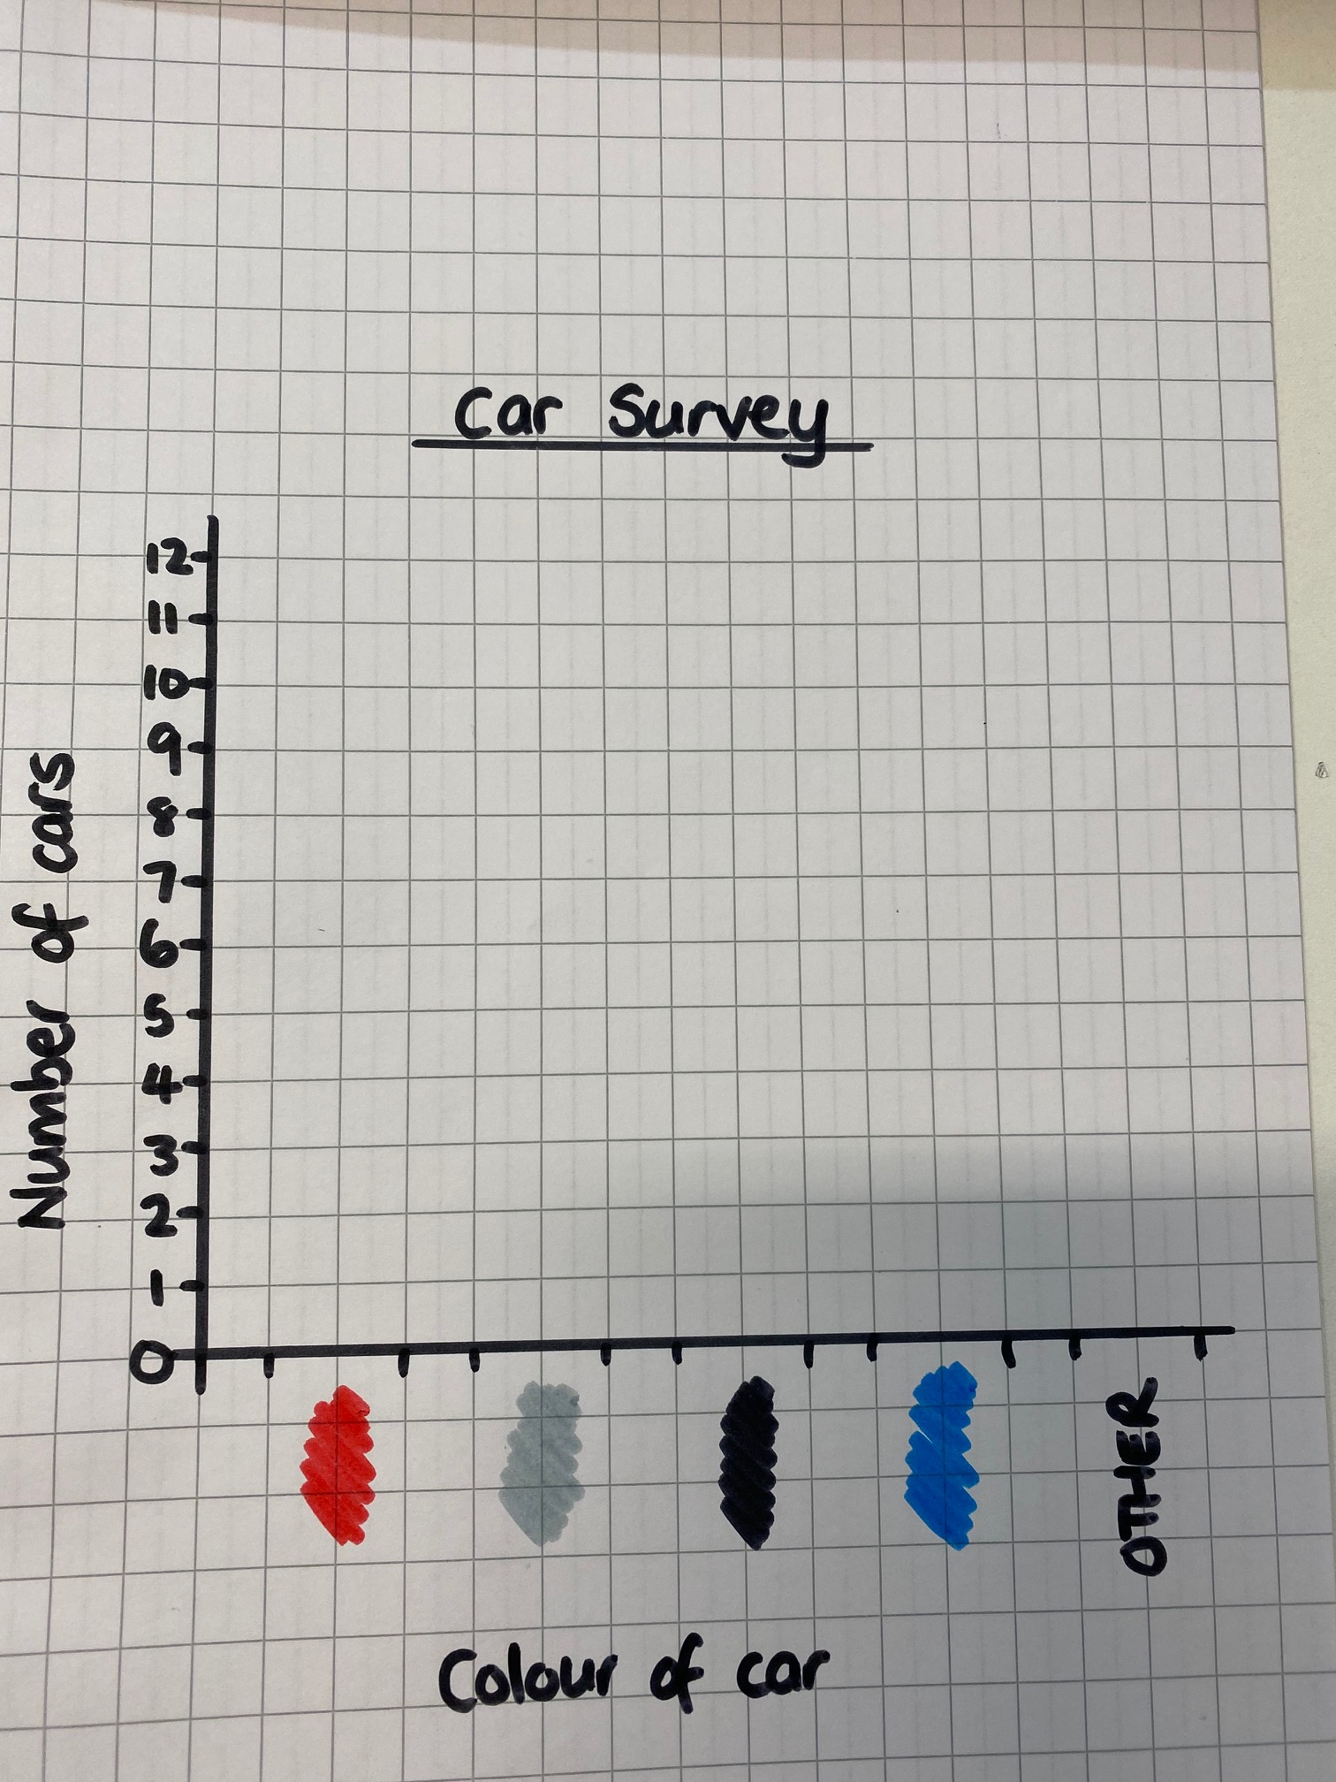
‪
Now you need to put the data into a chart.
Let’s start with a bar chart.
You will need to draw the x axis for the colour of cars and the y axis for the number.
Notes:
Draw an axis and label
Don’t forget it needs a title

Slide 8
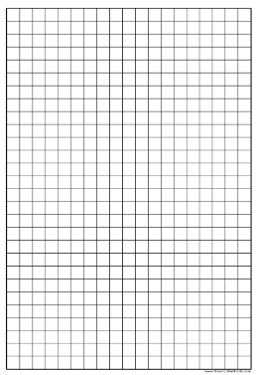
Notes:
Can be printed for squared paper

Slide 9
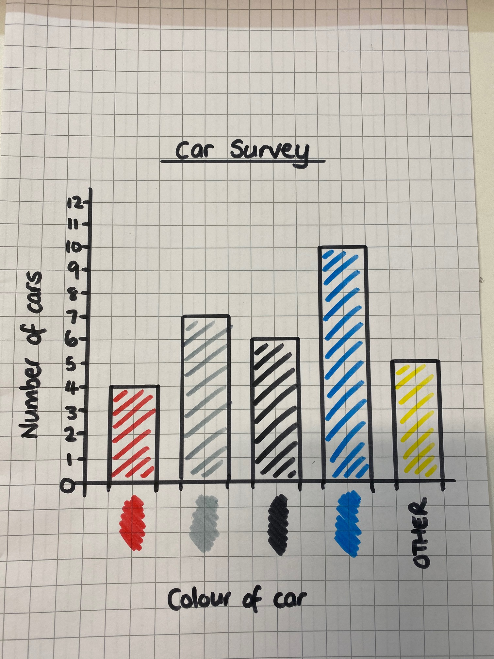
‪
Next, you need to fill in the data you collected on your survey.
Notes:
Put the data into the chart

Slide 10
Statistics
‪As well as constructing the charts you also need to be able to read them and answer questions.
Have a go at this link to play the bar chart games.
‪Bar Charts Topmarks
Notes:
Bar chart games. Choose a category and answer the questions

Slide 11
What are you more confident in today?
Notes:
Whole class – gather ideas to check understanding of tasks set

Slide 12
Word problems ☺
Can you try three of the word problems from the selection given?
Check what operation you need to do (add, take away, multiply or divide) and write the calculation you are going to use.
There are 24 apples in the box. 6 have gone bad. How many are left to eat?
The calculation will be:
24 – 6 =
Notes:
Lesson 2
Starter – questions on sheet

Slide 13
Statistics
‪
Pictograms have pictures to represent a number.
Pictograms need to have a key so you know how much each picture is worth.
On this graph each book is worth 2.
Notes:
Types of charts we can read information from

Slide 14
Statistics
‪Using the same data you collected previously, you can make a pictogram.

Slide 15
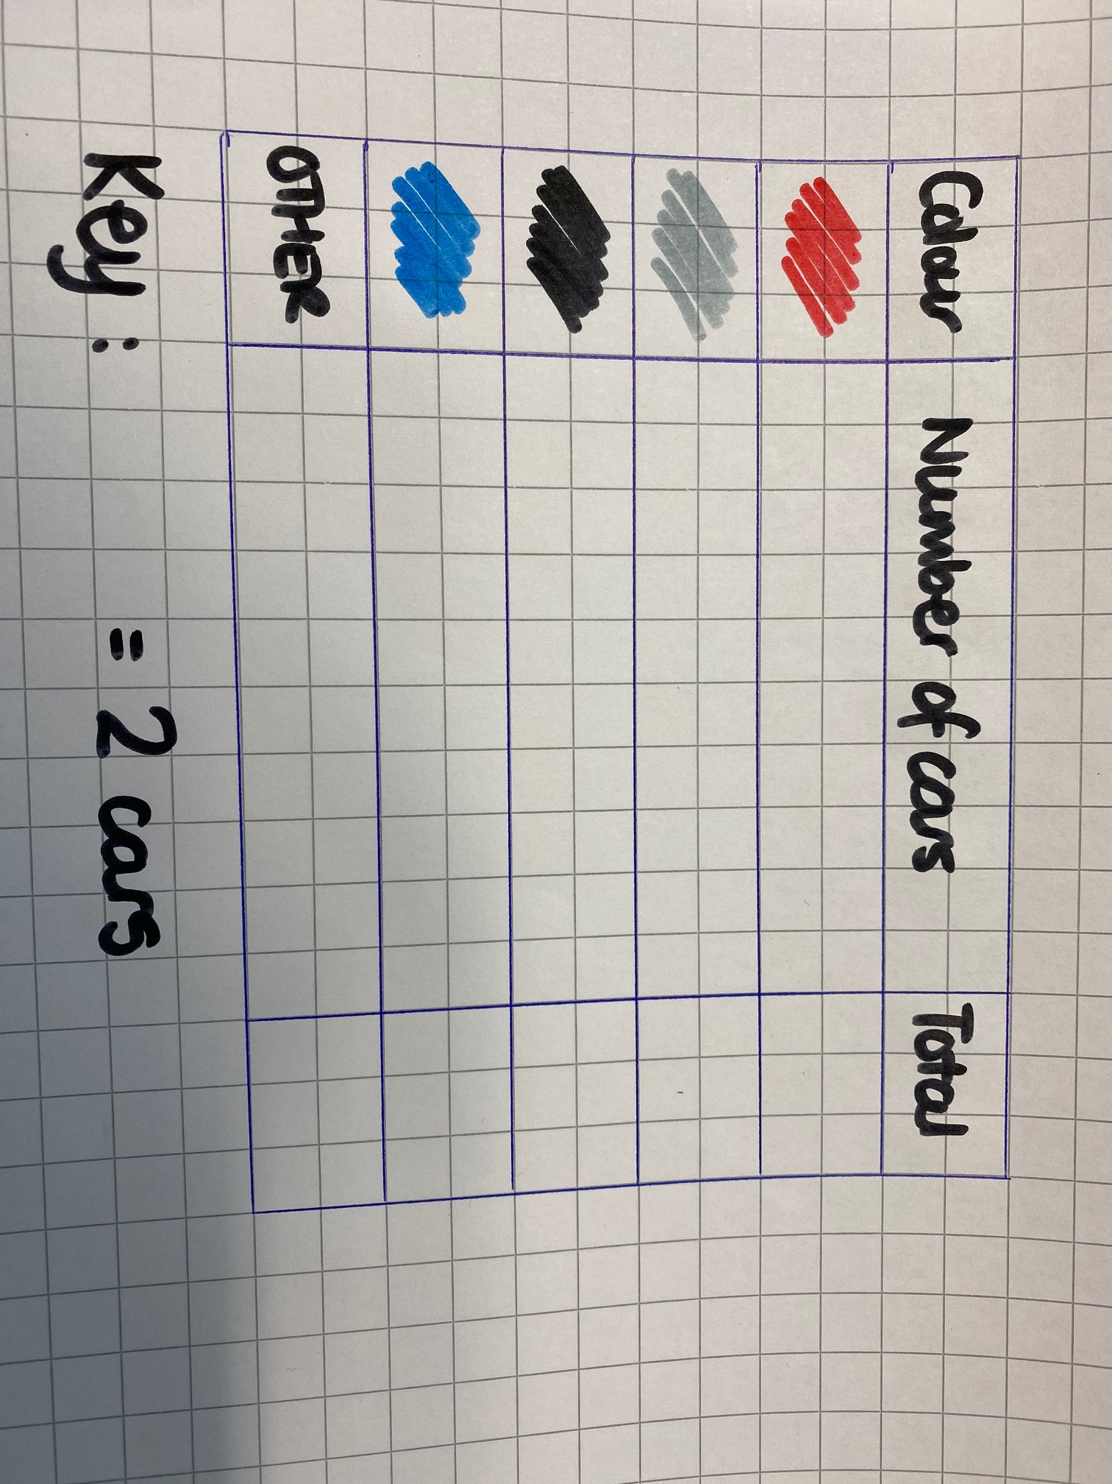
‪
You need to draw the table using 3 columns;
Colour, Number of cars and Total
Notes:
Don’t forget to include the key

Slide 16


‪
Next you need to put in the number using pictures. The key can either be for 1 or 2.
This one is for 2, so for 1 car I have to use half ( ½ ) a car.
Notes:
Don’t forget to include the key

Slide 17
‪
On this pictogram the key is
= 1 car
Notes:
Don’t forget to include the key

Slide 18
‪
Can you fill in the totals?
Notes:
Worksheet

Slide 19
Statistics
‪Now you can try reading these pictograms.
Remember to check the key!
‪Pictograph Games (softschools.com)
Notes:
Pictograms games to play

Slide 20
What are you more confident in today?
Notes:
Whole class – gather ideas to check understanding of tasks set

