Slide 1


RE
People of Faith
Year One
RE | Year 4 | People of Faith | Dalai Lama | Lesson 2

Slide 2
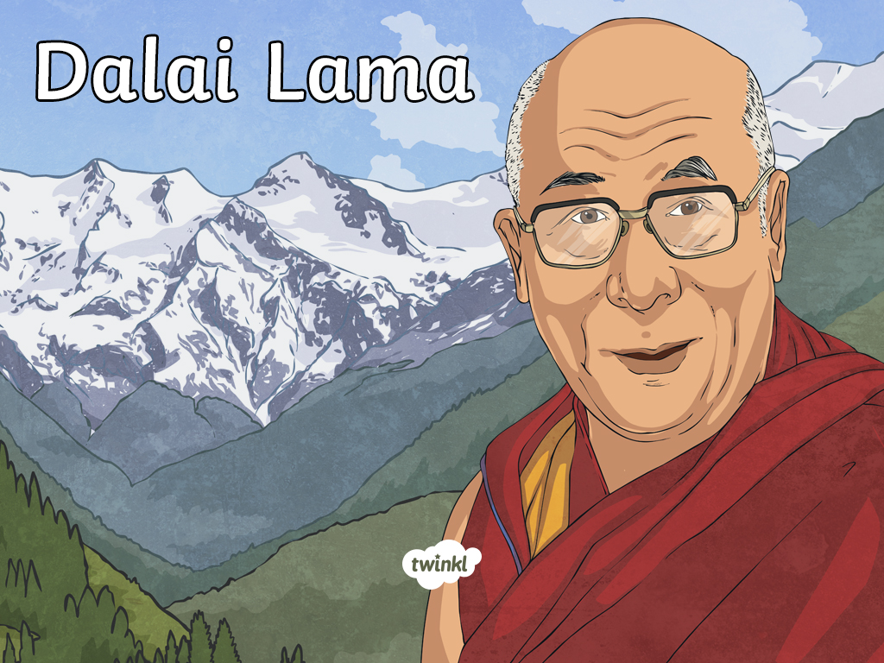

Slide 3
Aim
I can identify the Dalai Lama’s beliefs.
Success Criteria
I can identify key aspects of the Dalai Lama’s life.
I can explain the meaning of the Dalai Lama’s beliefs.

Slide 4
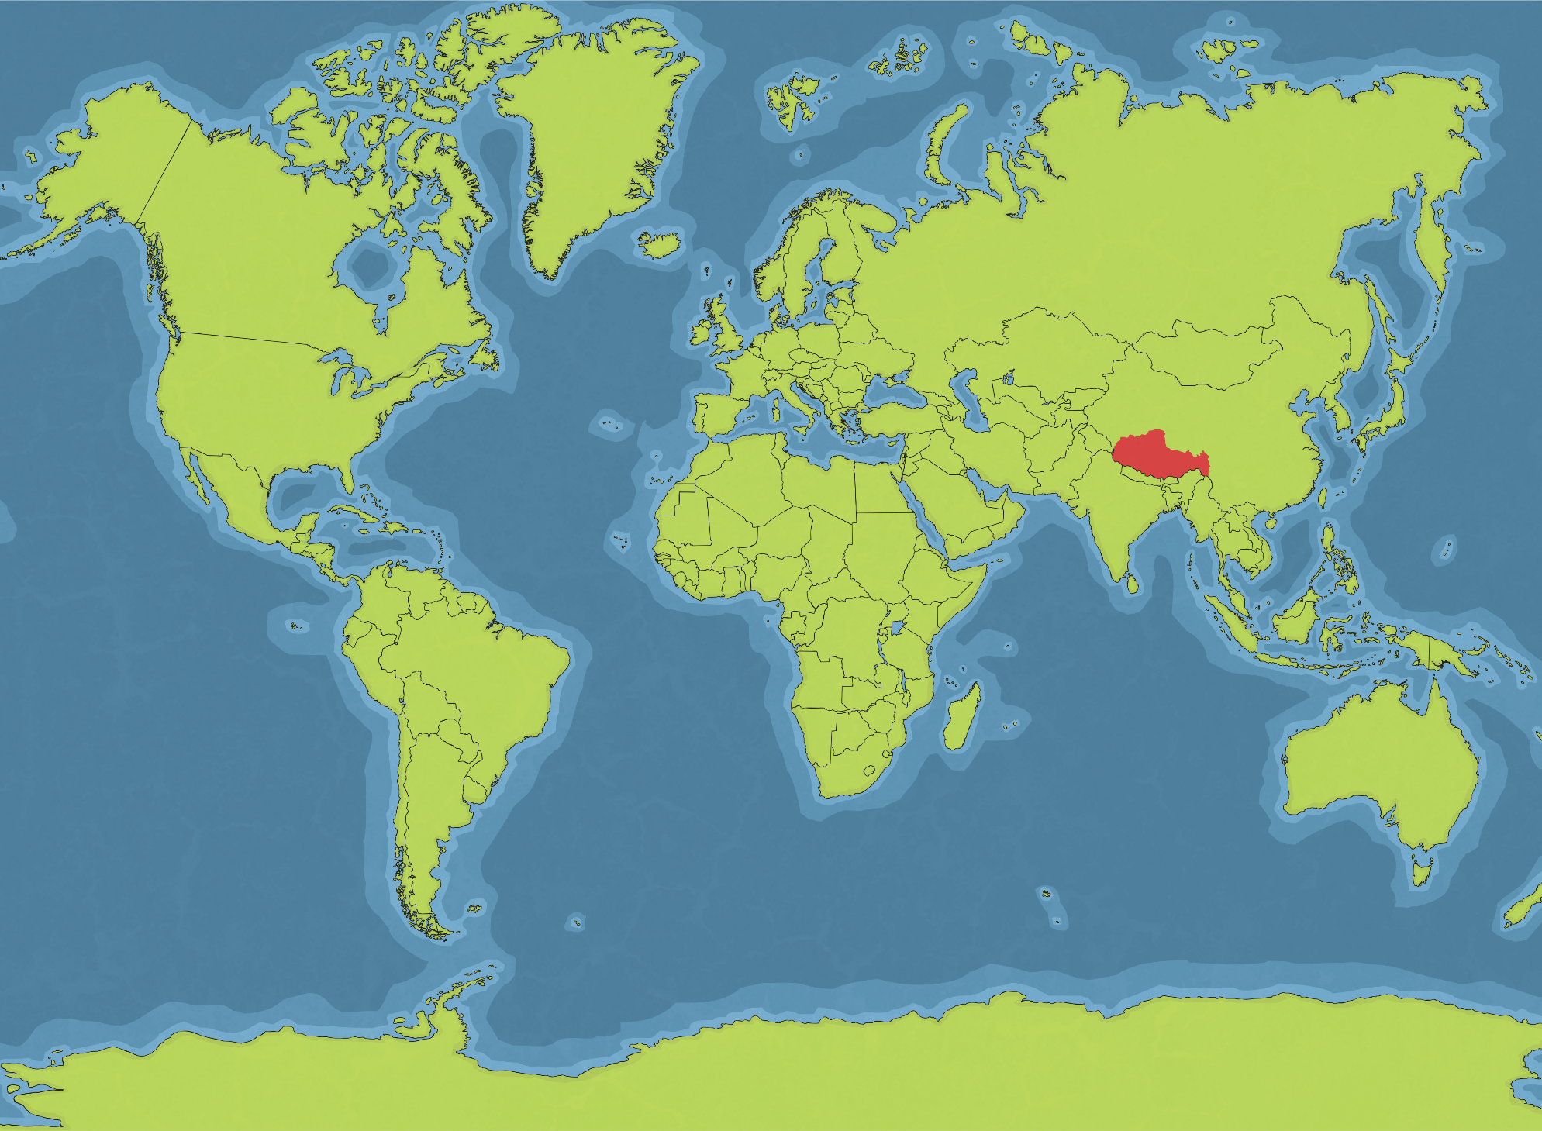
Tibet
Dalai Lama
Dalai Lama means “Ocean of Wisdom”. He is the head monk of Tibetan Buddhism and in the past was in charge of ruling the country of Tibet.
Buddhists believe that the Dalai Lama is the reincarnation of the previous one, who is reborn to continue his work.

Slide 5
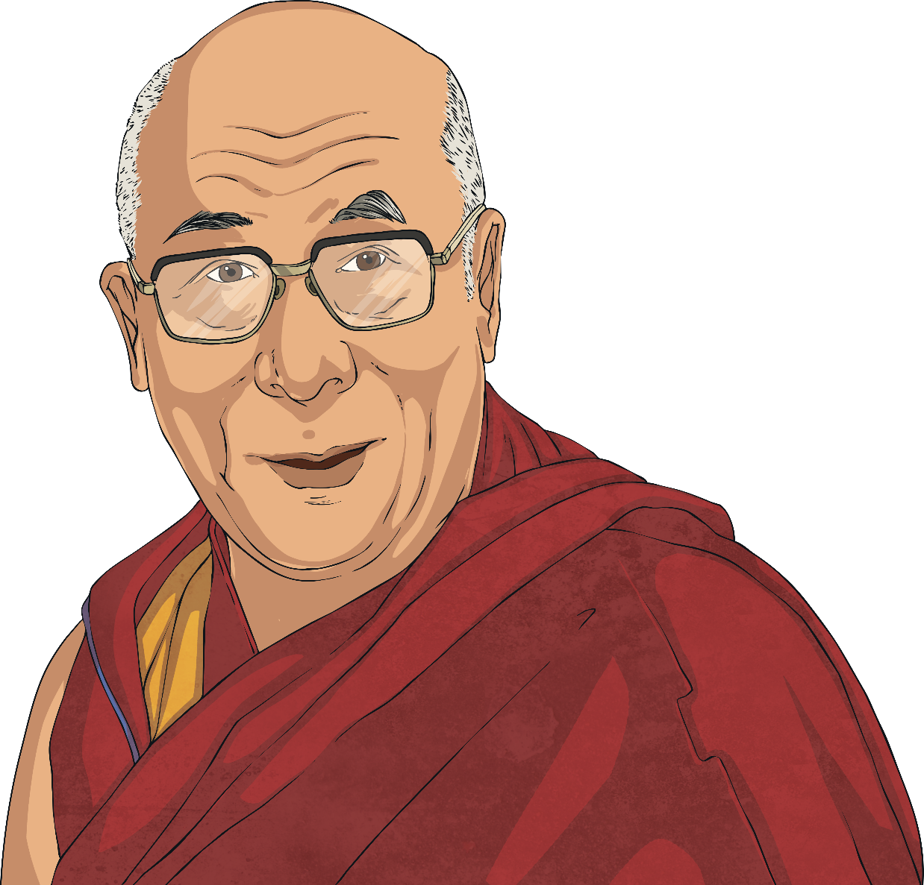
Dalai Lama
The current Dalai Lama is the 14th and was born in 1935.
He was three years old when he was found and five when he enrolled at the local monastery.
Tibet was considered to be part of China by some and the Chinese government decided to bring it under their control.

Slide 6
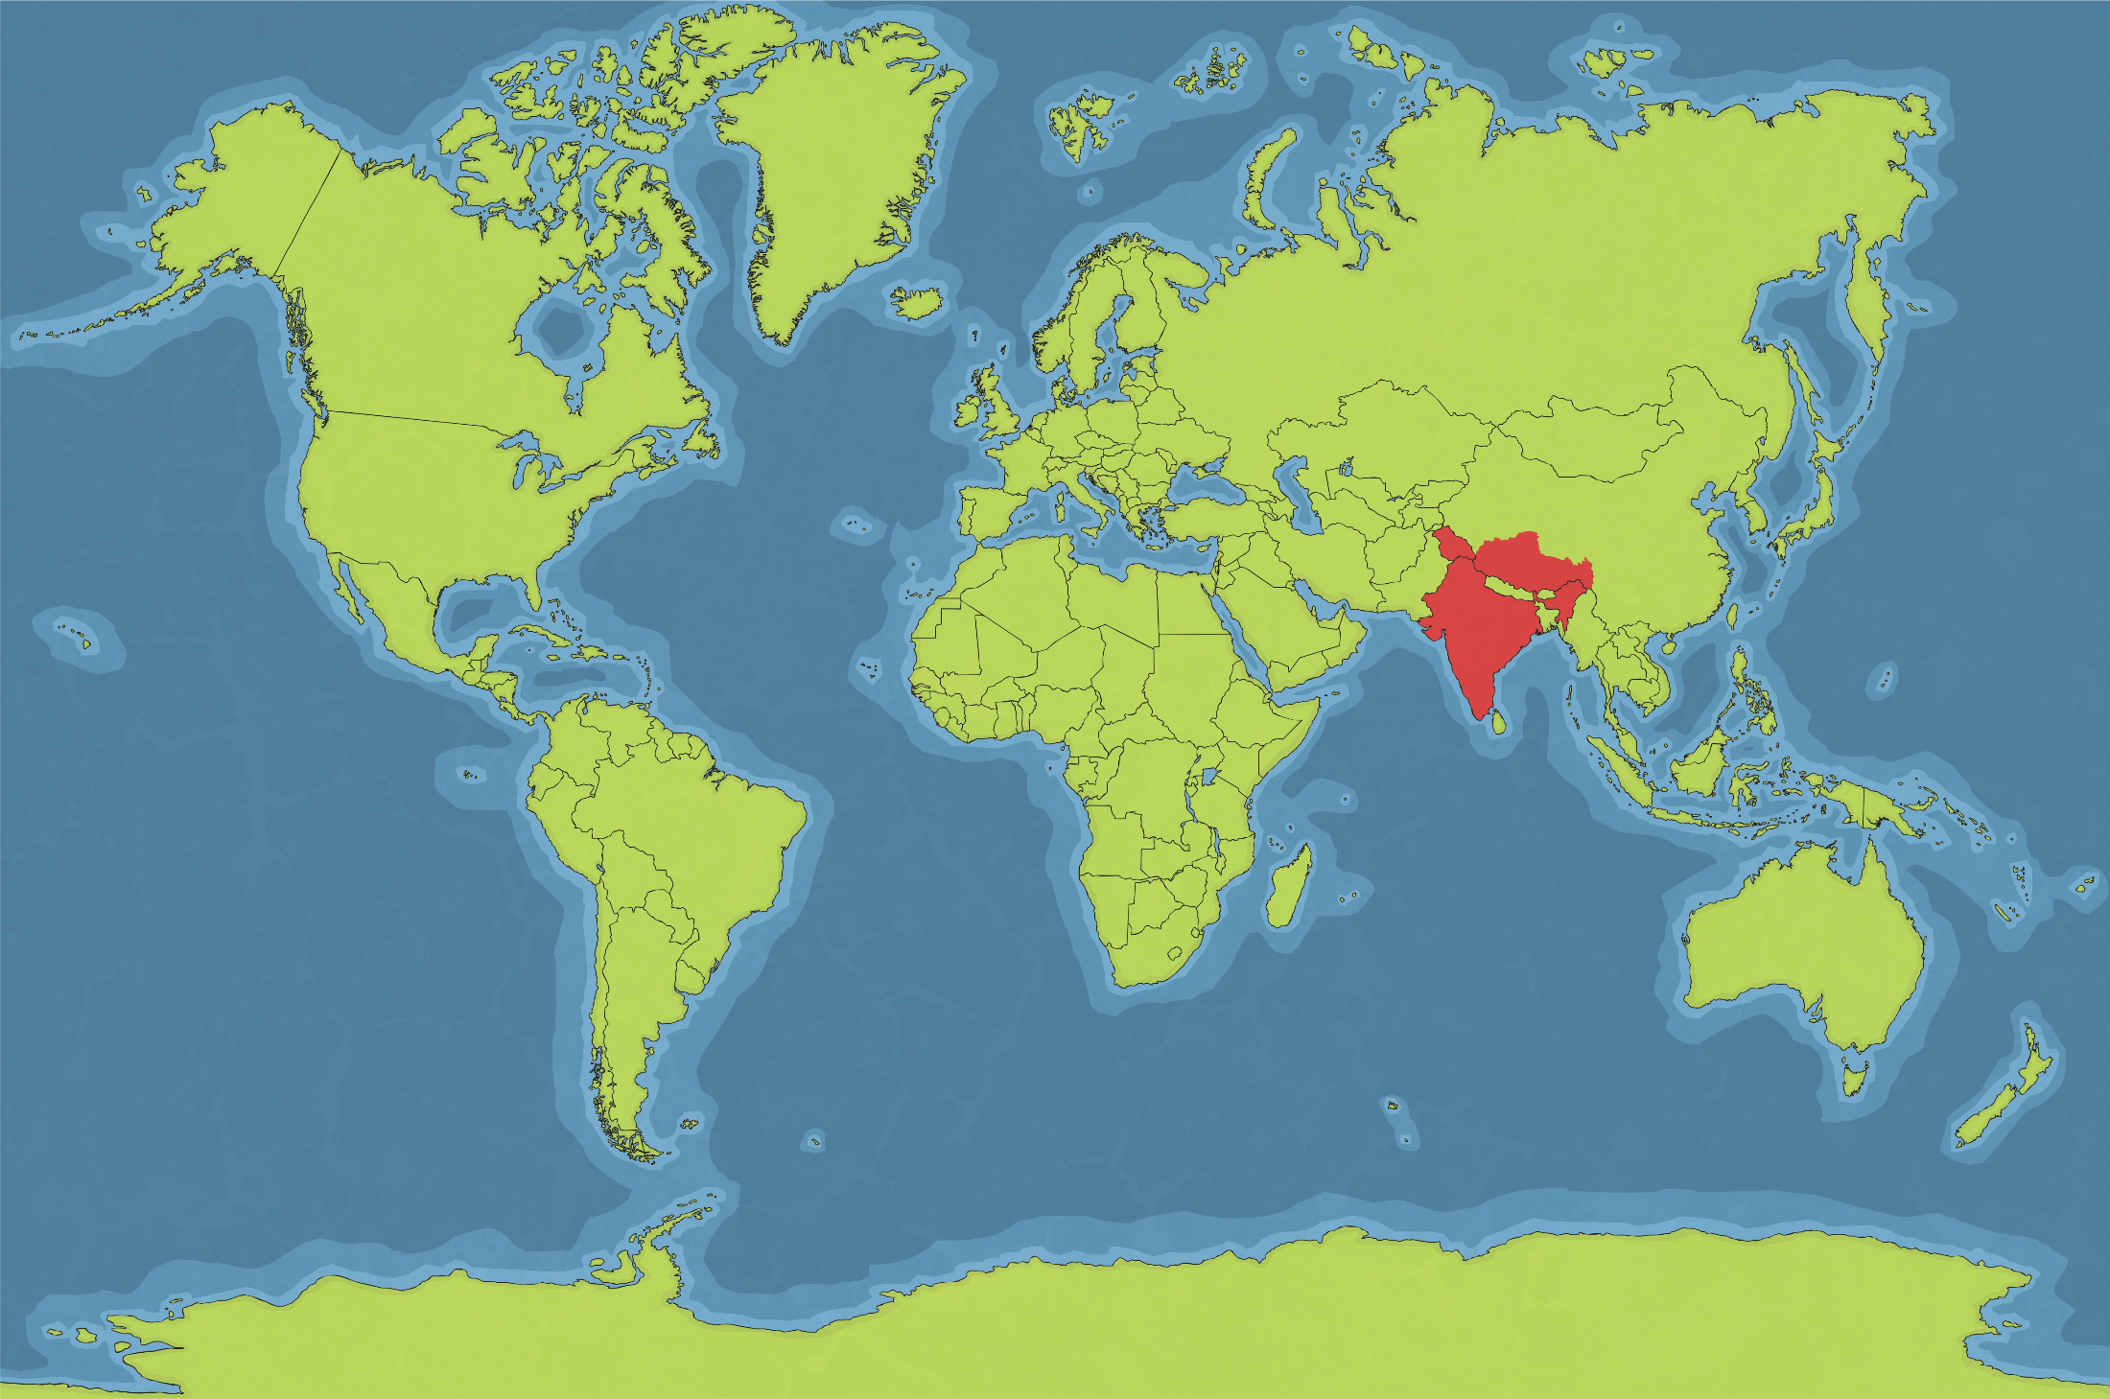

Dalai Lama
When the army arrived, thousands of people protested and were killed.
The Dalai Lama feared for his life, so he had to leave Tibet and move to India.
The Dalai Lama continues to work to free the Tibetan people, so they can rule themselves.
He continues to spread the Buddhist message around the world and even has a Twitter account!
India
@DalaiLama
Dalai Lama

Slide 7


Dalai Lama Quiz
Click the green number to go to the next question.
1
8
2
7
3
6
4
5

Slide 8
Dalai Lama Quiz
Incorrect, try again.
1
8
2
7
3
6
4
5

Slide 9
Dalai Lama Quiz
1
Where was the Dalai Lama born?
India
China
Tibet
UK

Slide 10
Dalai Lama Quiz
Well done! Click number 2 for the next question.
1
8
2
7
3
6
4
5

Slide 11
Dalai Lama Quiz
Incorrect, try again.
1
8
2
7
3
6
4
5

Slide 12
Dalai Lama Quiz
2
How many Dalai Lamas have there been?
14
21
18
8

Slide 13
Dalai Lama Quiz
Well done! Click number 3 for the next question.
1
8
2
7
3
6
4
5

Slide 14
Dalai Lama Quiz
Incorrect, try again.
1
8
2
7
3
6
4
5

Slide 15
Dalai Lama Quiz
3
Who took control of Tibet?
India
China
Tibet
Nepal

Slide 16
Dalai Lama Quiz
Well done! Click number 4 for the next question.
1
8
2
7
3
6
4
5

Slide 17
Dalai Lama Quiz
Incorrect, try again.
1
8
2
7
3
6
4
5

Slide 18
Dalai Lama Quiz
4
How old was the Dalai Lama when he was found?
5
1
2
3

Slide 19
Dalai Lama Quiz
Well done! Click number 5 for the next question.
1
8
2
7
3
6
4
5

Slide 20
Dalai Lama Quiz
Incorrect, try again.
1
8
2
7
3
6
4
5

Slide 21
Dalai Lama Quiz
5
Where does he live now?
India
China
Tibet
Nepal

Slide 22
Dalai Lama Quiz
Well done! Click number 6 for the next question.
1
8
2
7
3
6
4
5

Slide 23
Dalai Lama Quiz
Incorrect, try again.
1
8
2
7
3
6
4
5

Slide 24
Dalai Lama Quiz
6
What social media account does he use?
Facebook
Instagram
Pinterest
Twitter

Slide 25
Dalai Lama Quiz
Well done! Click number 7 for the next question.
1
8
2
7
3
6
4
5

Slide 26
Dalai Lama Quiz
Incorrect, try again.
1
8
2
7
3
6
4
5

Slide 27
Dalai Lama Quiz
7
When was the Dalai Lama born?
1925
1935
1945
1955

Slide 28
Dalai Lama Quiz
Well done! Click number 8 for the next question.
1
8
2
7
3
6
4
5

Slide 29
Dalai Lama Quiz
Incorrect, try again.
1
8
2
7
3
6
4
5

Slide 30
Dalai Lama Quiz
8
Where did the Dalai Lama enrol when he was five years old?
the local church
the local monastery
the local temple
the local park

Slide 31
Dalai Lama Quiz
Well done! You completed the quiz.
1
8
2
7
3
6
4
5

Slide 32
Dalai Lama Quiz
Incorrect, try again.
1
8
2
7
3
6
4
5

Slide 33

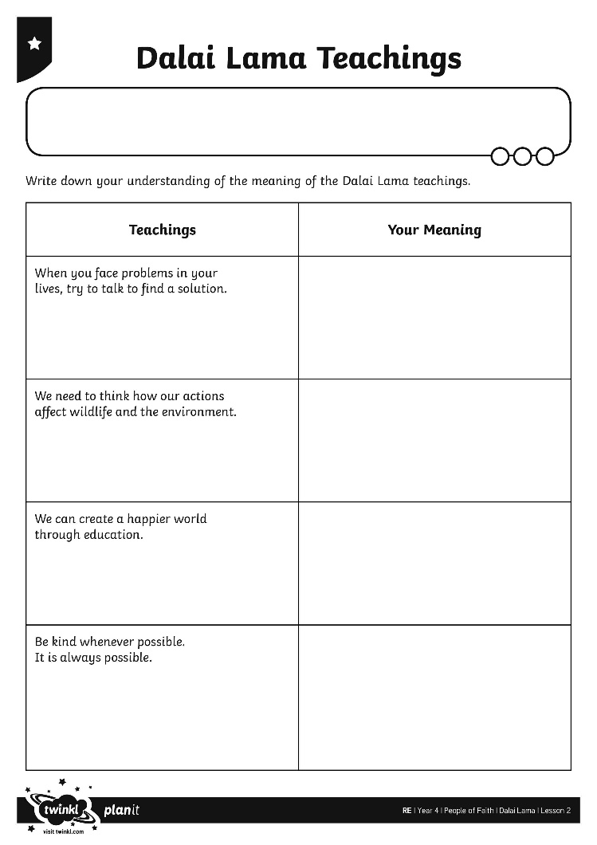
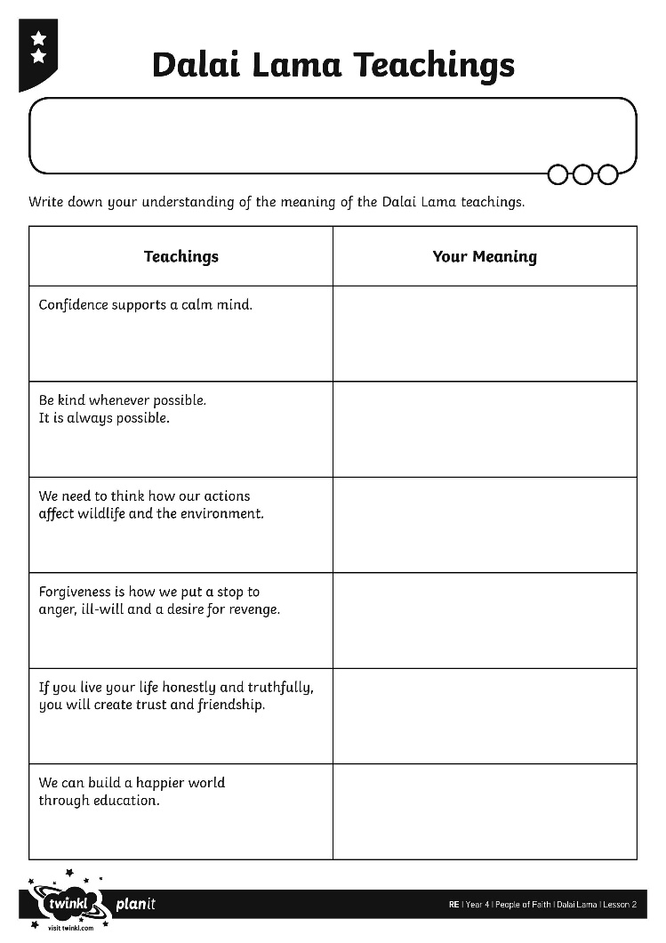
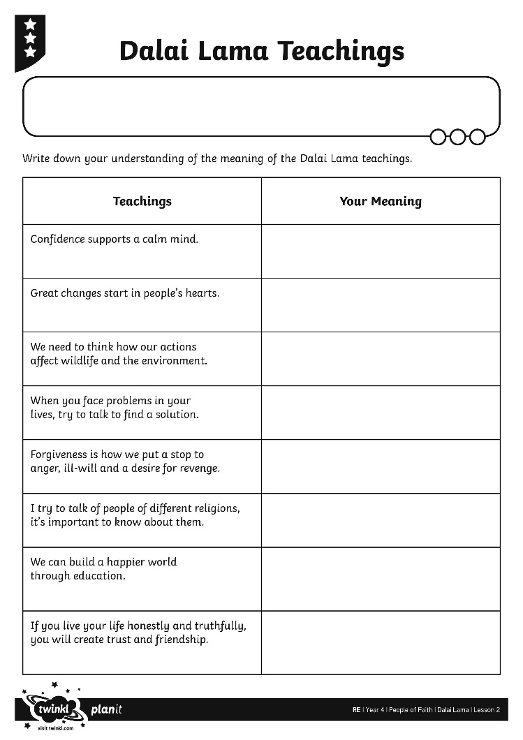
Dalai Lama’s Beliefs

Slide 34
Belief and Action
What does the Dalai Lama believe? | How does this suggest that you should act?

Slide 35
Aim
I can identify the Dalai Lama’s beliefs.
Success Criteria
I can identify key aspects of the Dalai Lama’s life.
I can explain the meaning of the Dalai Lama’s beliefs.

