Slide 1


Slide 2
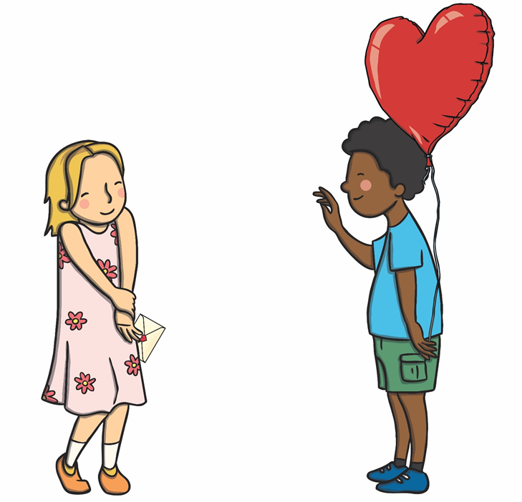
Valentine’s Day is celebrated on the 14th of February. It is a special day when people show their love to another person. People often give presents and cards on this day.

Slide 3

People may give each other chocolates on Valentine’s Day.

Slide 4

People may give each other flowers on Valentine’s Day. Red roses are a popular choice.

Slide 5



People may send Valentine’s Day cards to each other, with a special message inside.

Slide 6

Cupid is often seen on Valentine’s Day cards. He is a baby angel, with a bow and arrow. He helps people to fall in love.

Slide 7


People may also do special things on Valentine’s Day like going out to the cinema or having a special meal.

Slide 8


These are some symbols of Valentine’s Day:

