Slide 1
Sources of Light?
Are the following pictures all sources of light?
If not, why and where does the light come from?

Slide 2
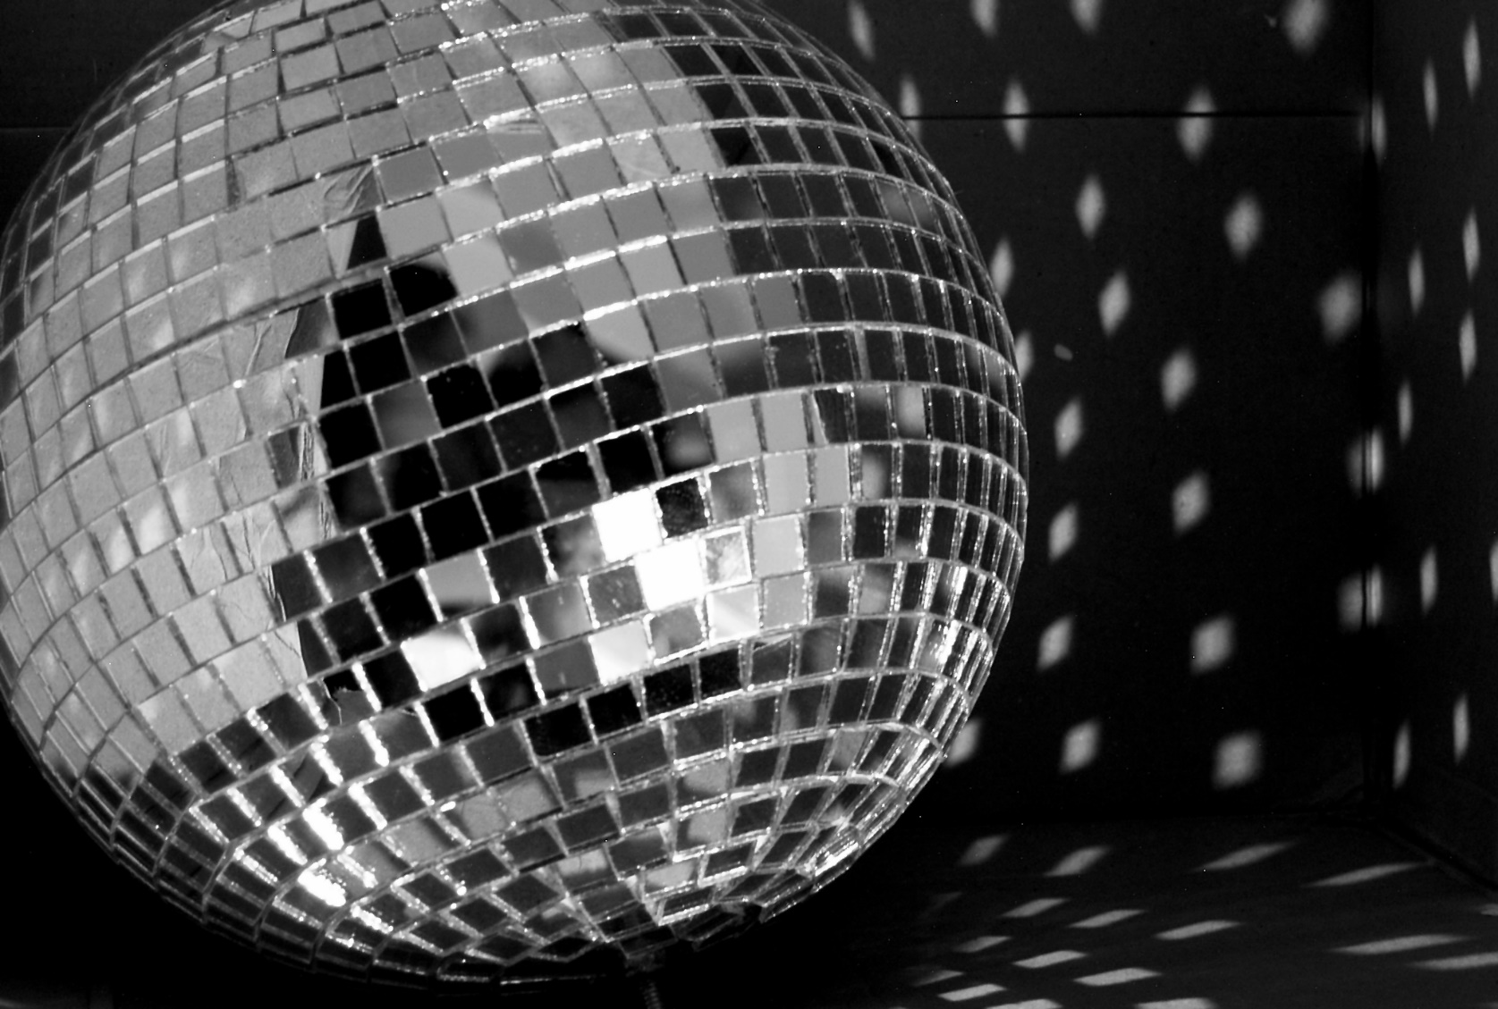
Glitter Ball
Photo courtesy of jonstead.(@flickr.com) - granted under creative commons licence – attribution

Slide 3
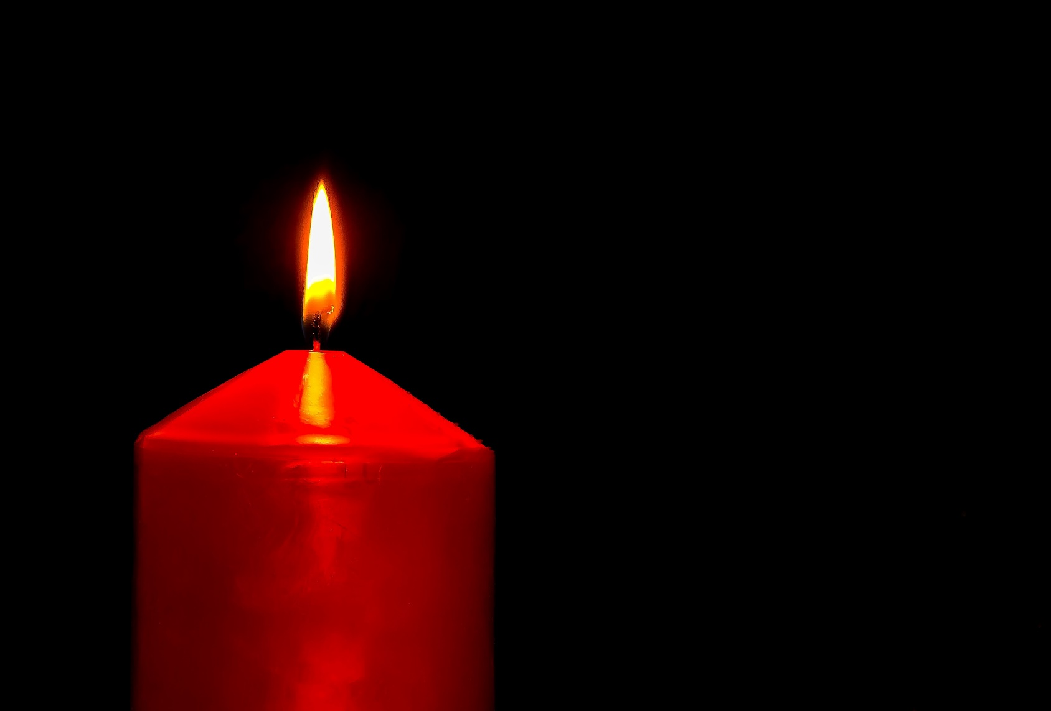
Candle

Slide 4
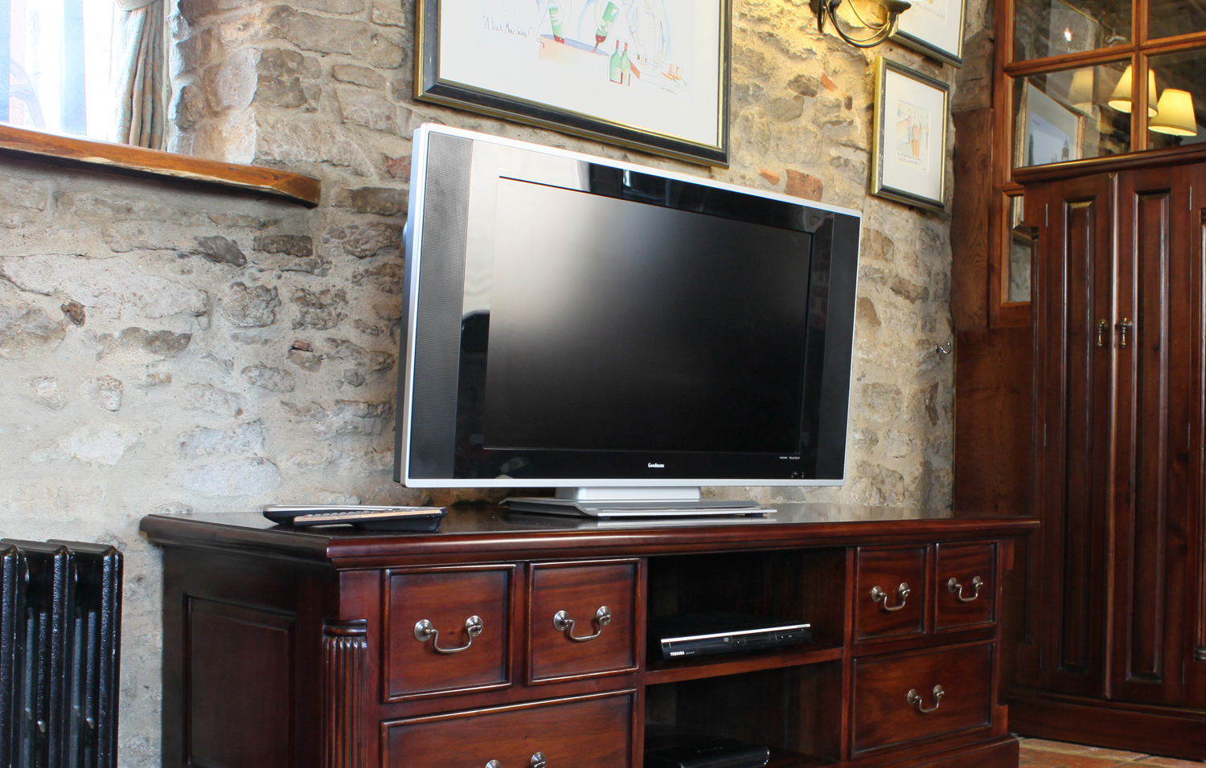
Television
Photo courtesy of Bonsoni.com(@flickr.com) - granted under creative commons licence – attribution

Slide 5
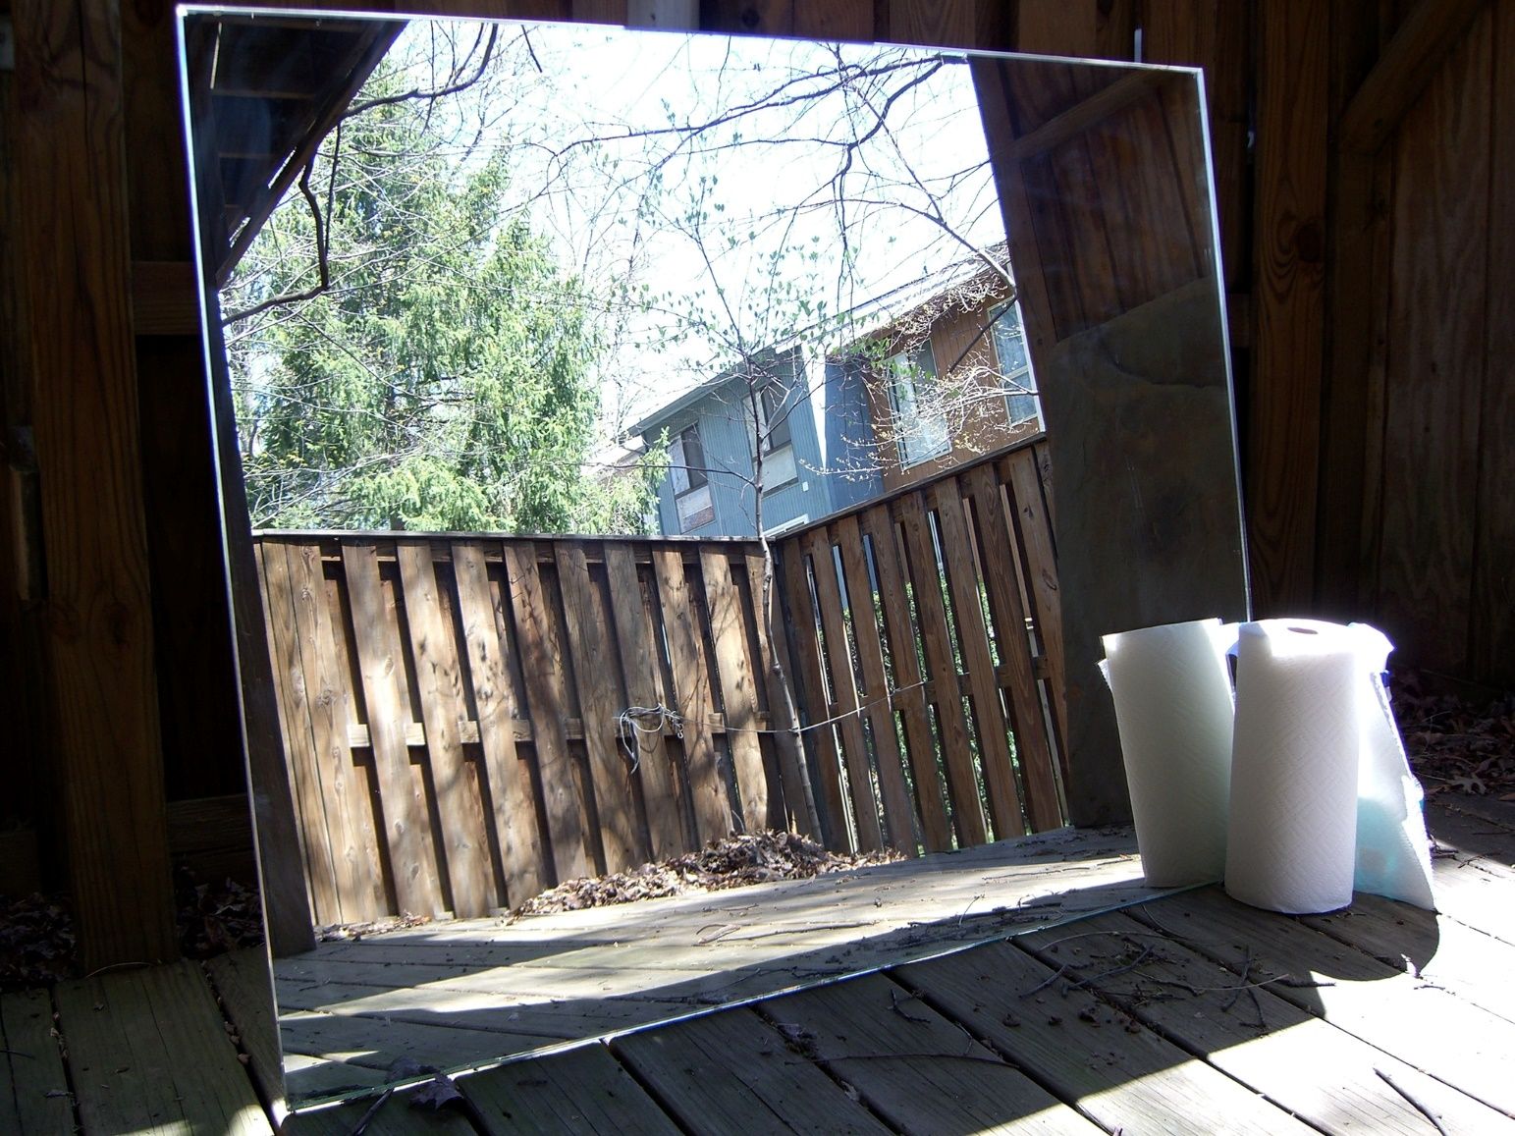
Mirror
Photo courtesy of Andrew Kuchling(@flickr.com) - granted under creative commons licence – attribution

Slide 6
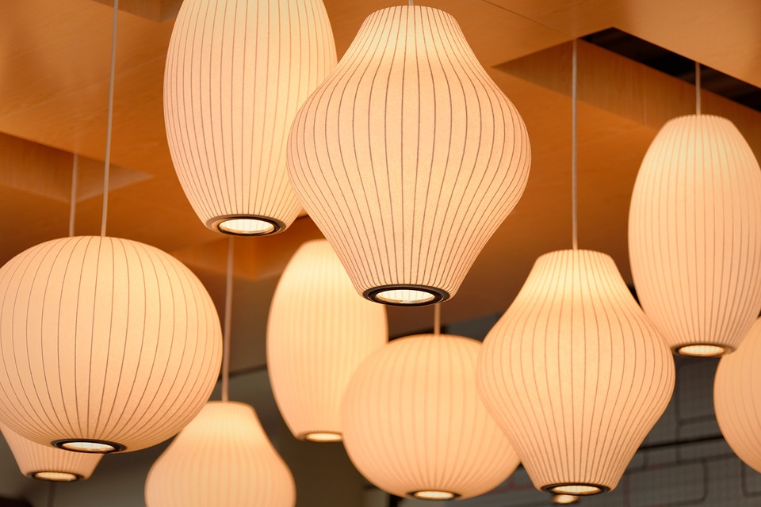
Lamp

Slide 7
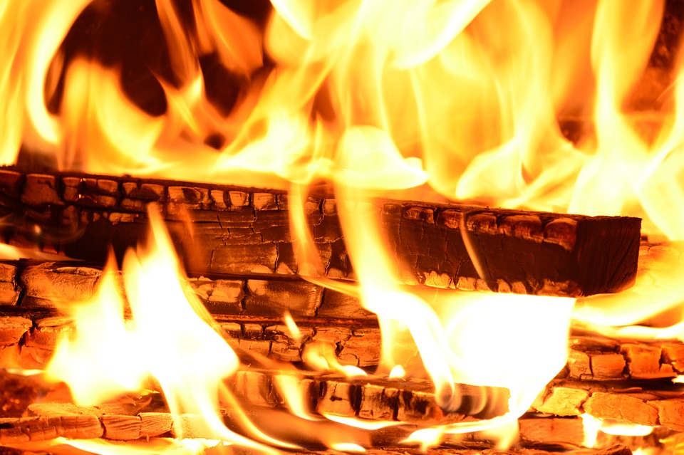
Fire

Slide 8
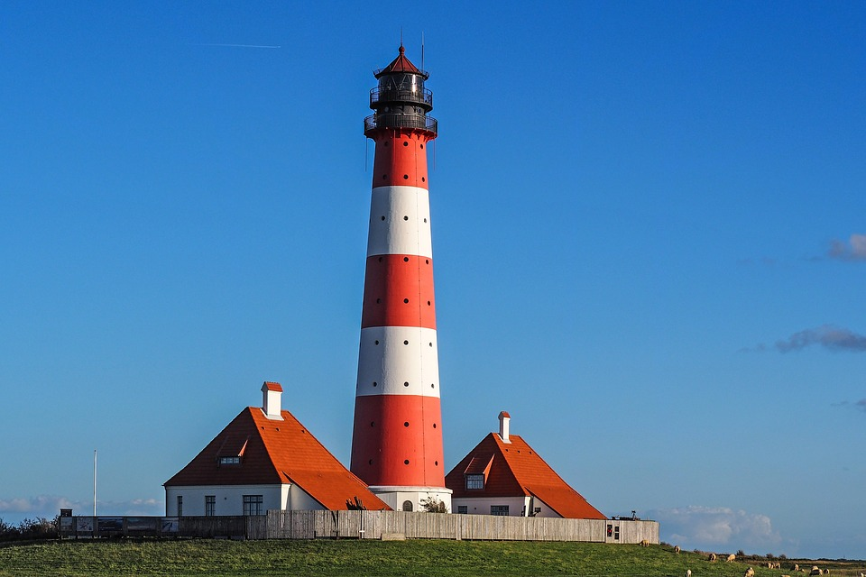
Lighthouse

Slide 9
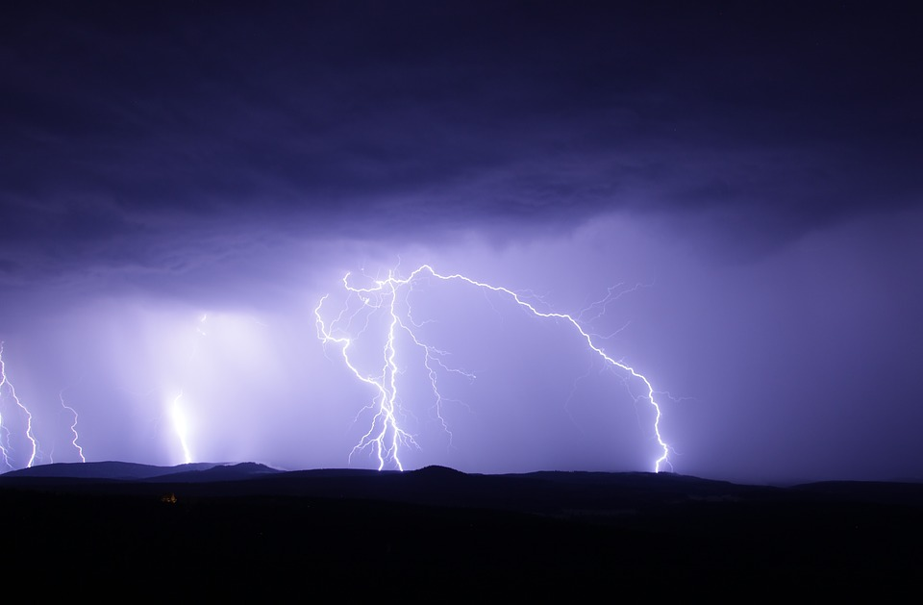
Lightning

Slide 10
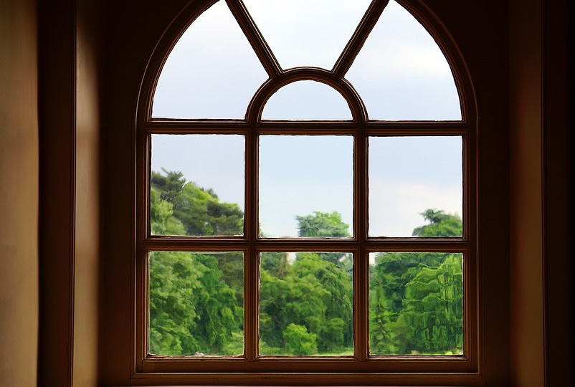
Window

Slide 11
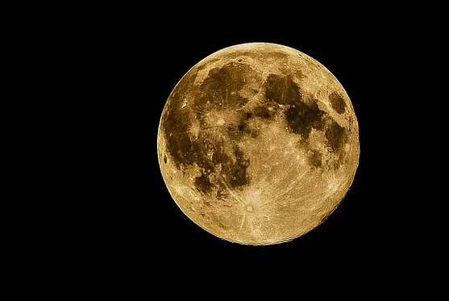
Moon

Slide 12
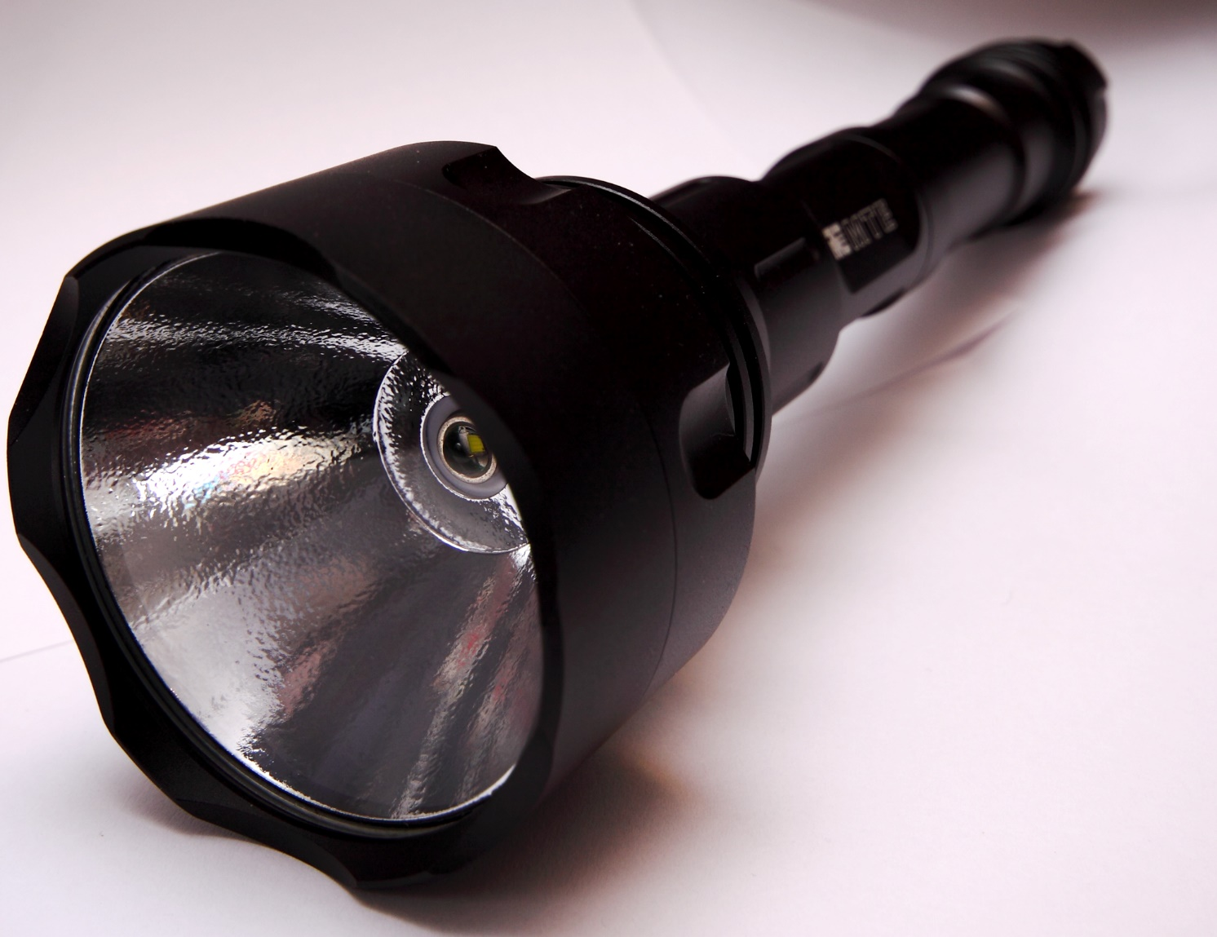
Torch
Photo courtesy of mjtmail (tiggy) (@flickr.com) - granted under creative commons licence – attribution

Slide 13
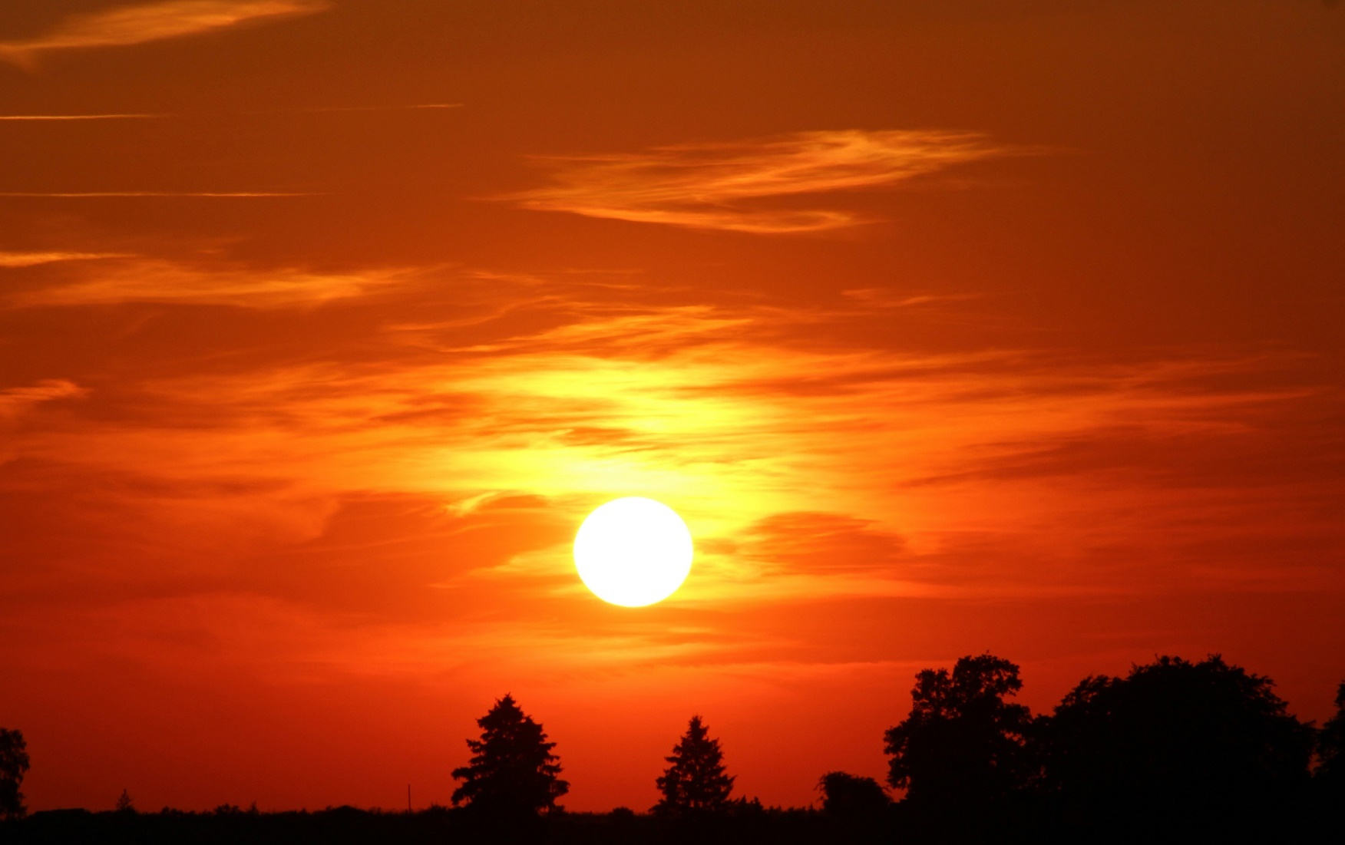
Sun

Slide 14
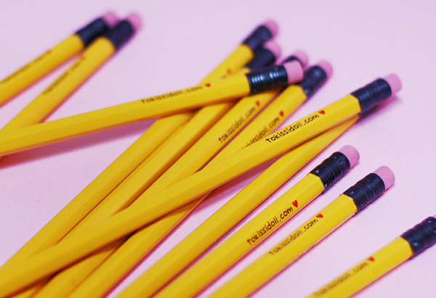
Yellow Pencils

Slide 15
Can you think of any others?

