Slide 2
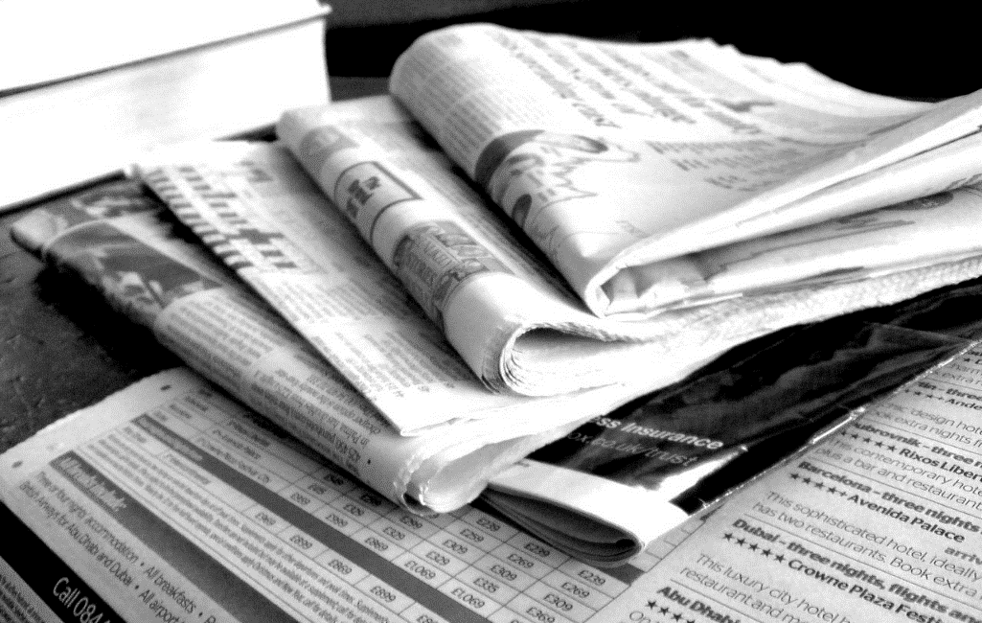
What Is Recycling?
Recycling is when things that are no longer wanted are reused to make something new.
For example, when you finish reading a newspaper and put it in the recycling bin, it is taken away to a factory and turned back into new paper that can be used again.
Photo courtesy of NS Newsflash (@flickr.com) - granted under creative commons licence - attribution

Slide 3
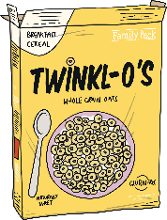
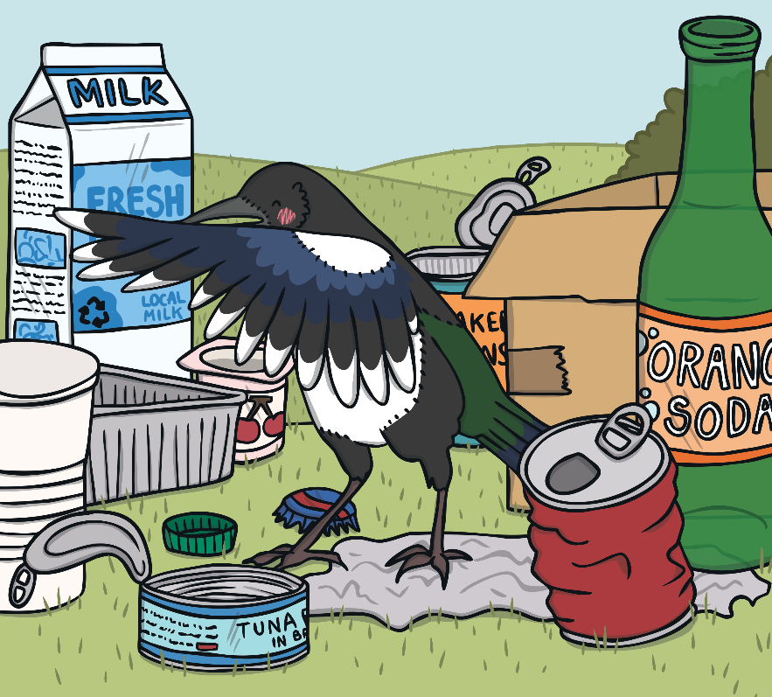

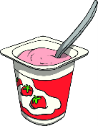
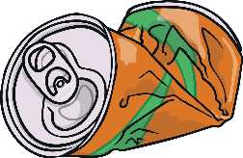
Which Materials Can Be Recycled?
Click on the green circles in the picture to find out which materials can be recycled.
Most paper and cardboard can be recycled.
Most glass can be recycled.
Many types of plastic can be recycled.
Most metals can be recycled.

Slide 4
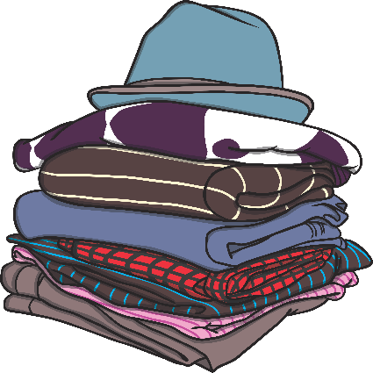
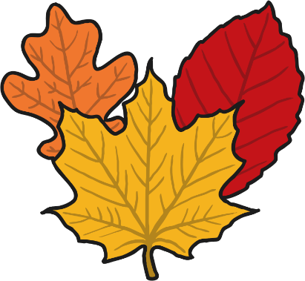
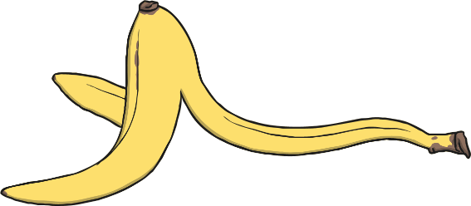
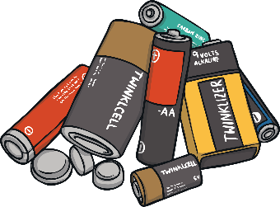
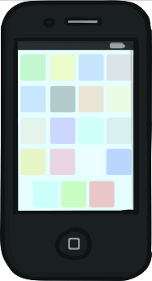
What Other Materials Can Be Recycled?
garden waste
fabrics
food
electronics
batteries

Slide 5
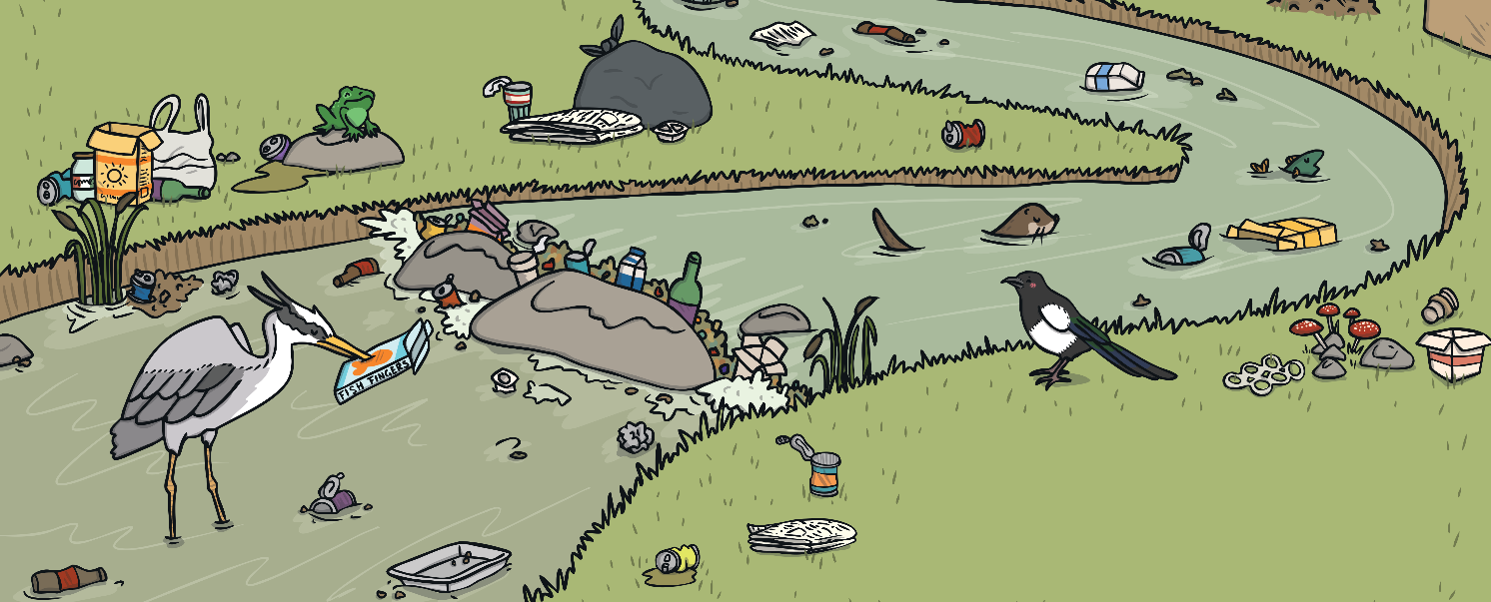
Why Is It Good to Recycle?
Recycling is good because it means that we have less rubbish littering our world.
It also means fewer trees are cut down to make new things.
This helps to protect animals and their homes by making sure less rubbish ends up in places like forests and seas.

Slide 6
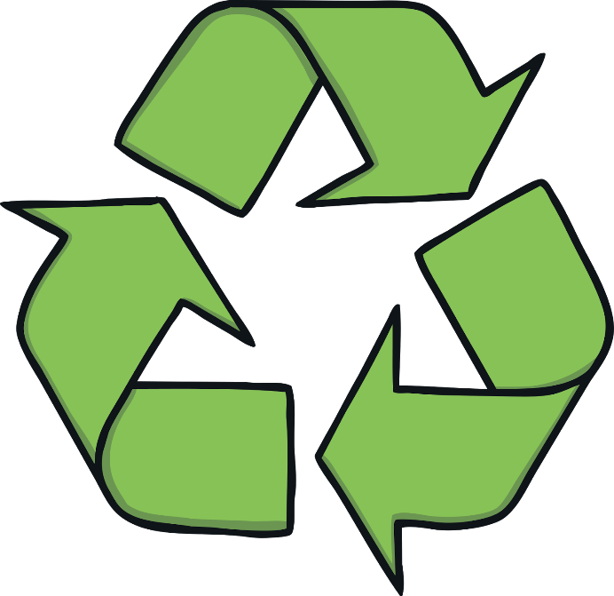
How Do We Recycle?
If you see this symbol on an object, it means that it can be recycled.
There are lots of different symbols on packaging that also mean you can recycle them – have a look at home and see if you can spot them!

Slide 7
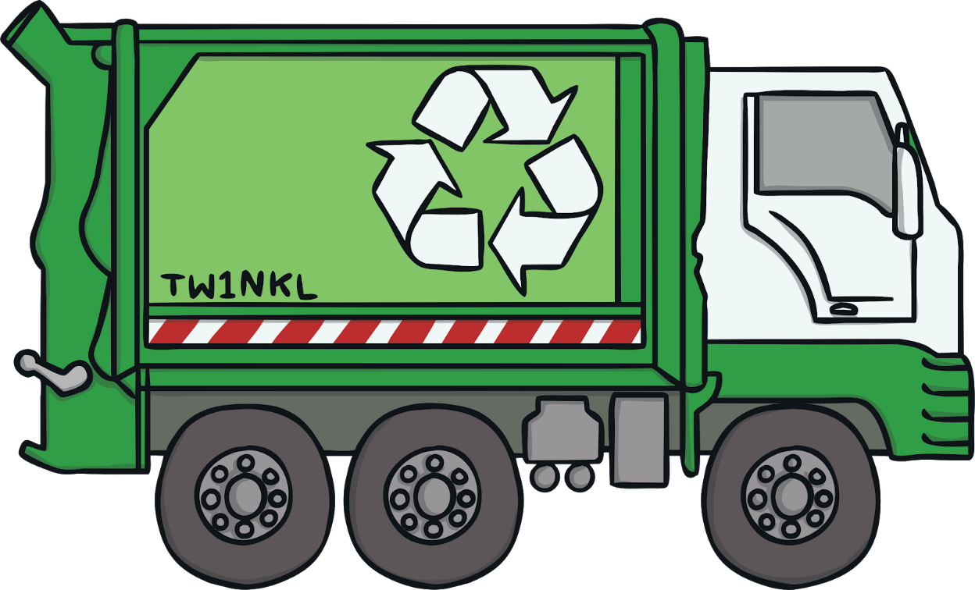
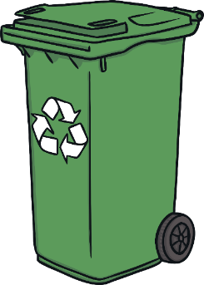
Where Do We Put Our Recycling?
We can recycle our rubbish at home.
We put it in a recycling bin and a truck comes to empty the bin from outside our homes.

Slide 8
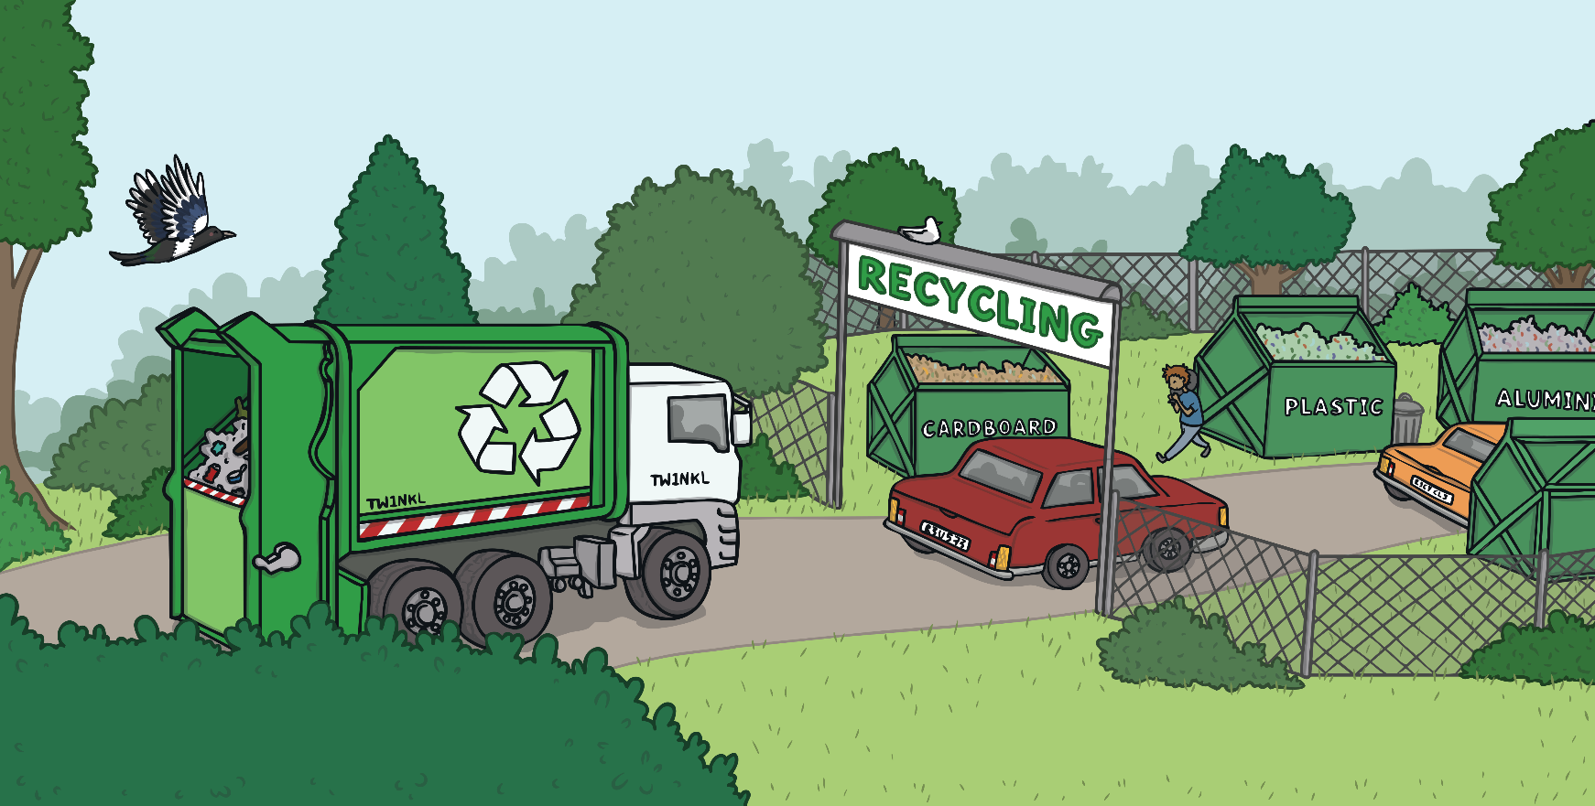
Where Do We Put Our Recycling?
We can also take our rubbish to a recycling centre or to recycling banks. These can be found at places such as supermarkets.

Slide 9
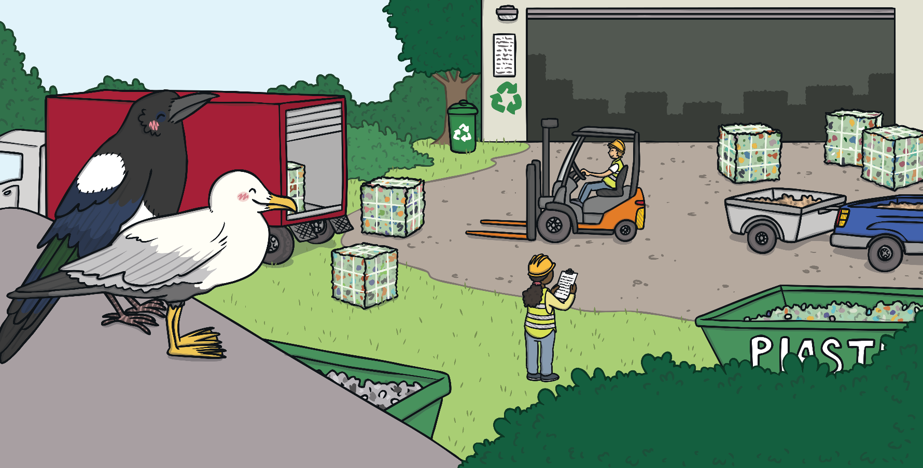
Where Does Our Recycling Go?
The rubbish is sorted at a large place called a recycling facility. It is put into large bundles and taken to factories where it is turned into something new.

Slide 10
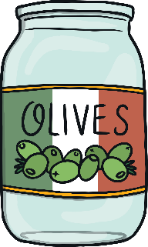
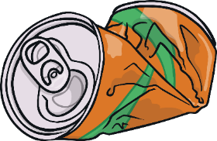
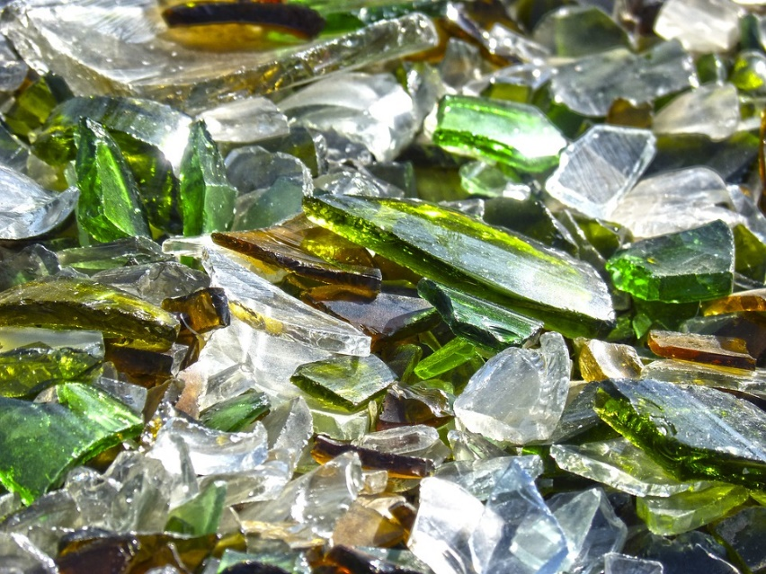
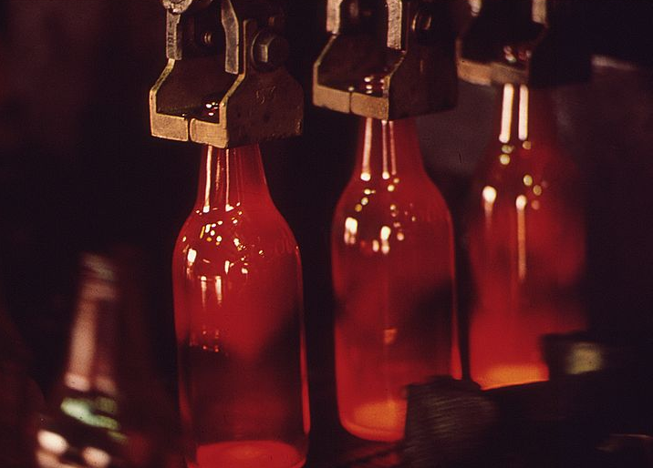
How Is Rubbish Recycled?
Glass and metal are washed and then broken into small pieces. The pieces are then melted and made into new things, such as glass bottles, glass jars, metal cans or even metal parts for cars!

Slide 11
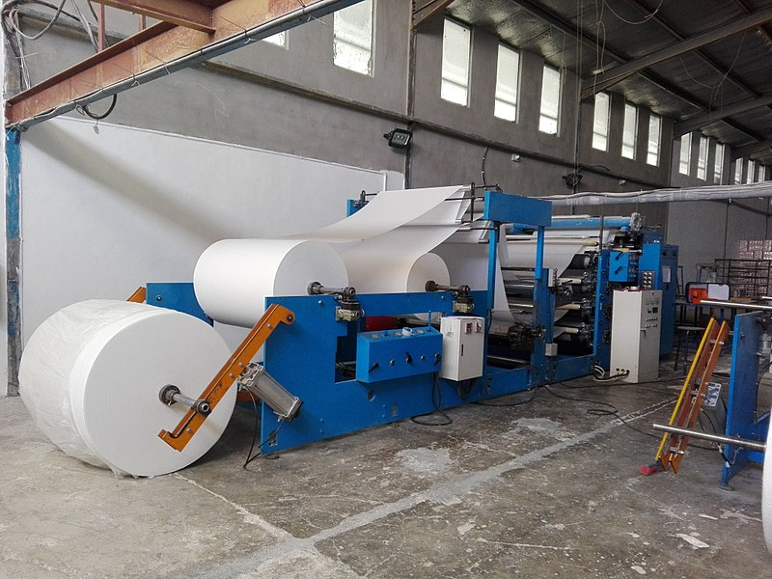
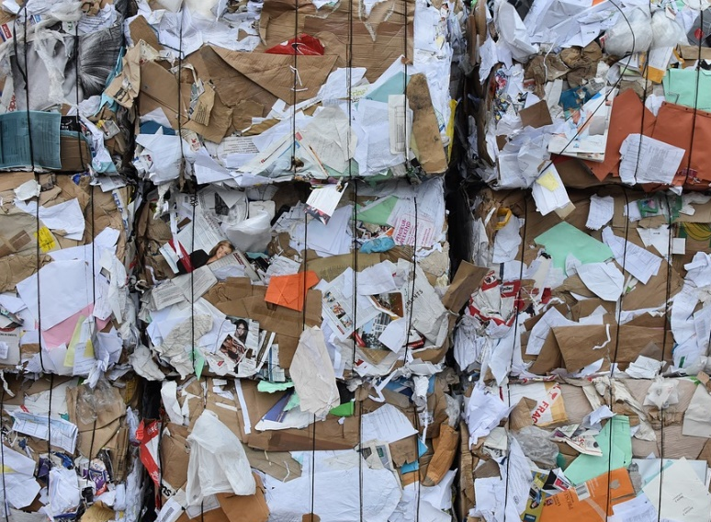
How Is Rubbish Recycled?
Paper is washed in soapy water. It is then mixed and rolled out before being left to dry. It is then turned into different types of new paper and card, such as newspapers.

Slide 12
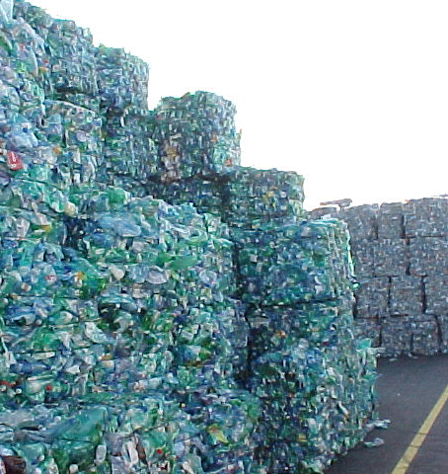
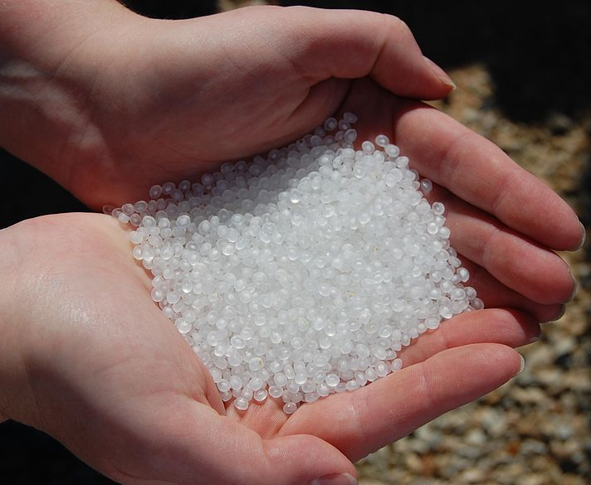
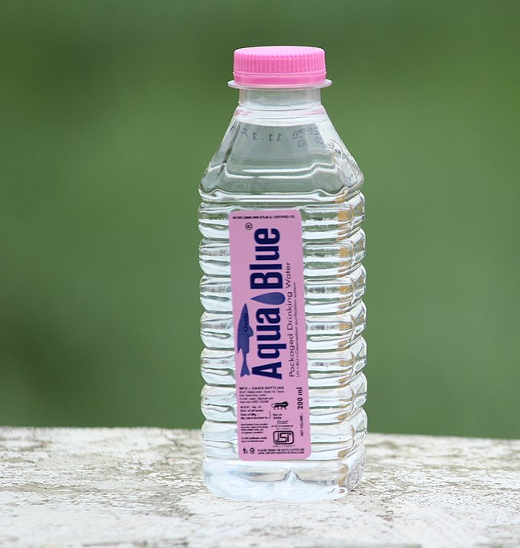
How Is Rubbish Recycled?
Some plastic can be recycled, such as bottles and carrier bags.
They are first crushed into very small pieces. These pieces are melted and turned into new things, such as T-shirts, carpets and new plastic bottles.

Slide 13

How Do You Recycle?
Have a think about these questions.
How do you recycle at home?
How do you recycle at school?
How could we try to recycle even more?

