Slide 2
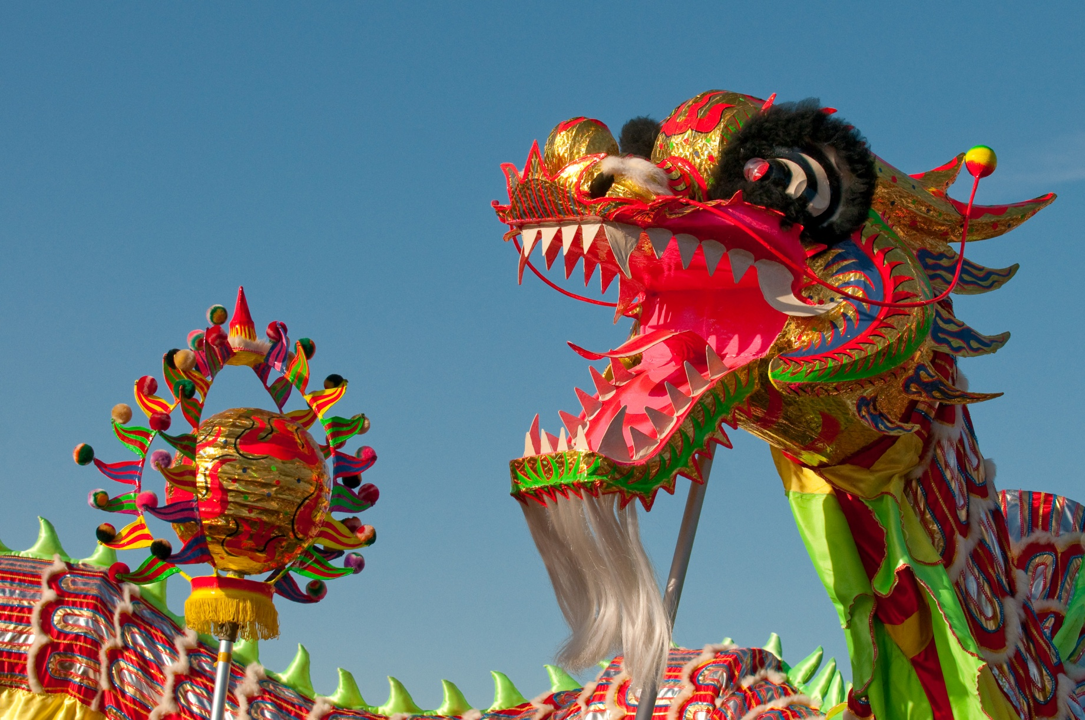
Dragon Dances
Photo courtesy of kennymatic (@flickr.com) - granted under creative commons licence – attribution

Slide 3
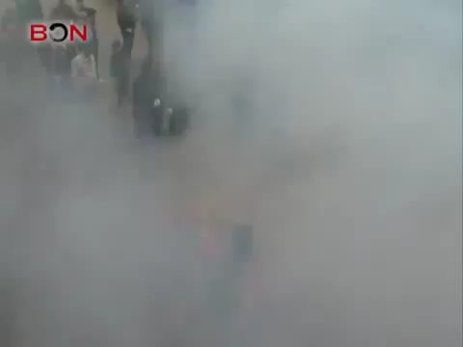
Photo courtesy of AbiHaigh (@Youtube.com) - granted under creative commons licence – attribution

Slide 4
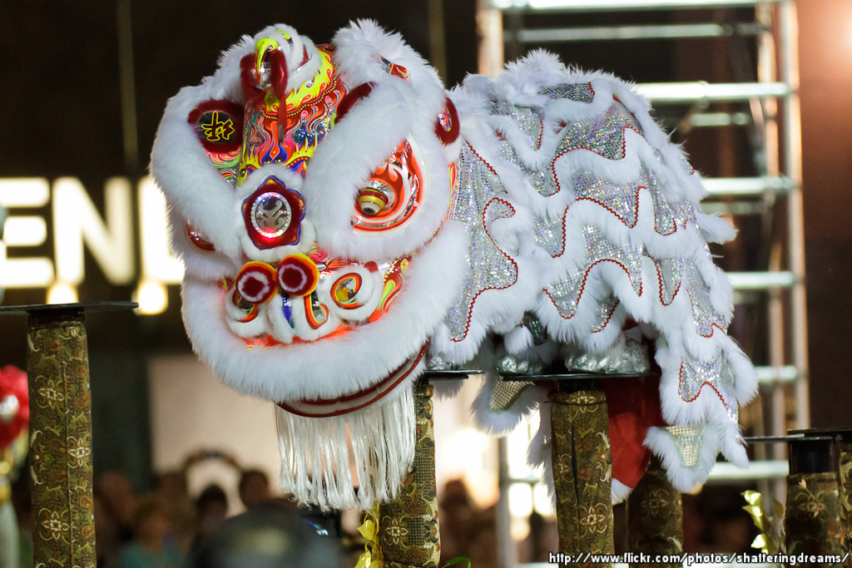
Lion Dances
Photo courtesy of KWSW (@flickr.com) - granted under creative commons licence – attribution

Slide 5
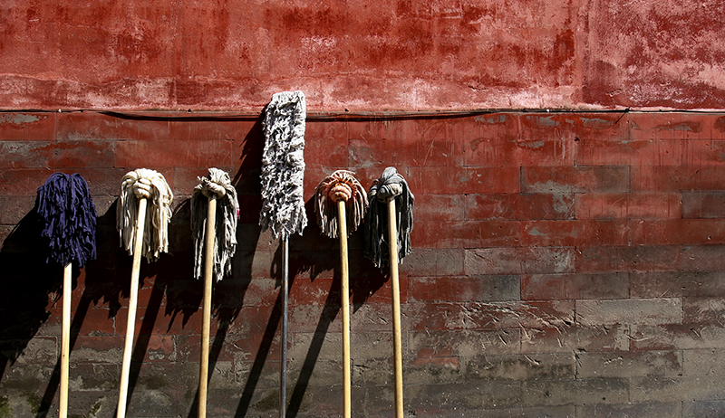
House Cleaning to Sweep Away
Bad Fortune
Photo courtesy of Frederuc Poirot (@flickr.com) - granted under creative commons licence – attribution

Slide 6
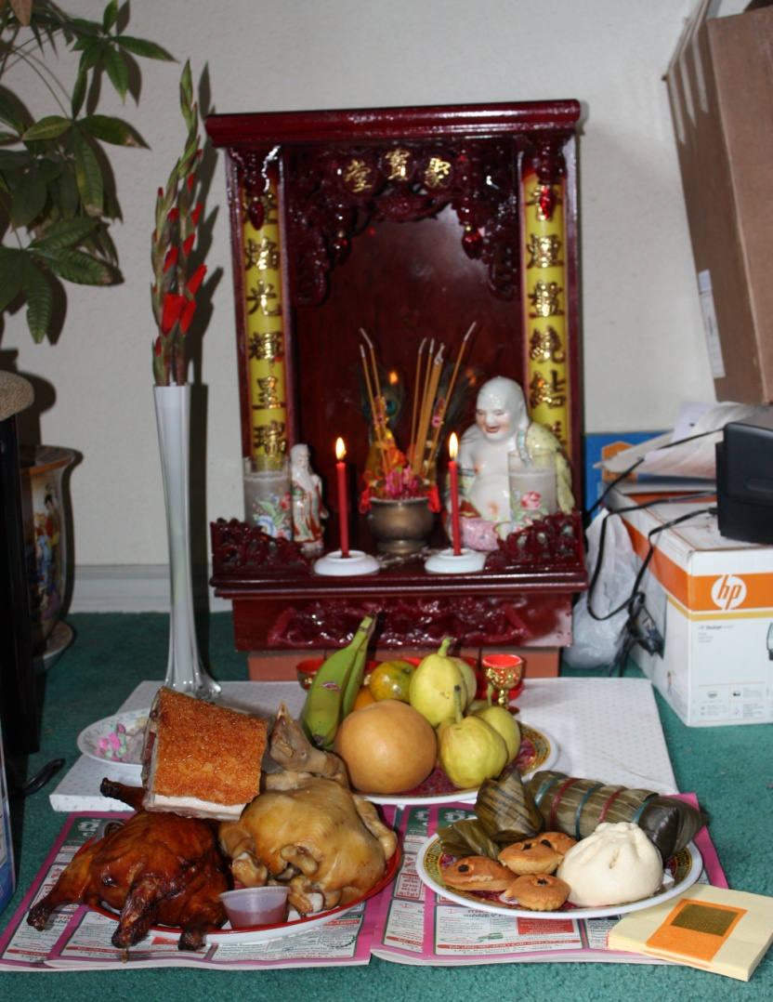
Offerings to the Kitchen God
Photo courtesy of eggiepooh (@flickr.com) - granted under creative commons licence – attribution

Slide 7
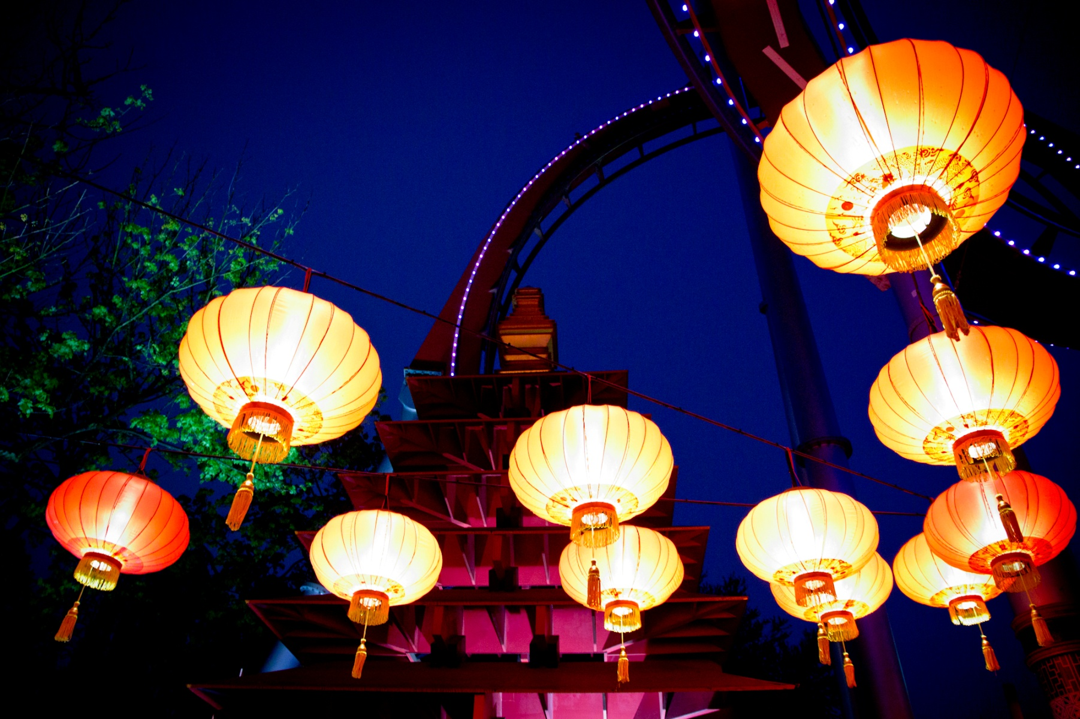
Lanterns Are Lit
Photo courtesy of pellesten (@flickr.com) - granted under creative commons licence – attribution

Slide 8
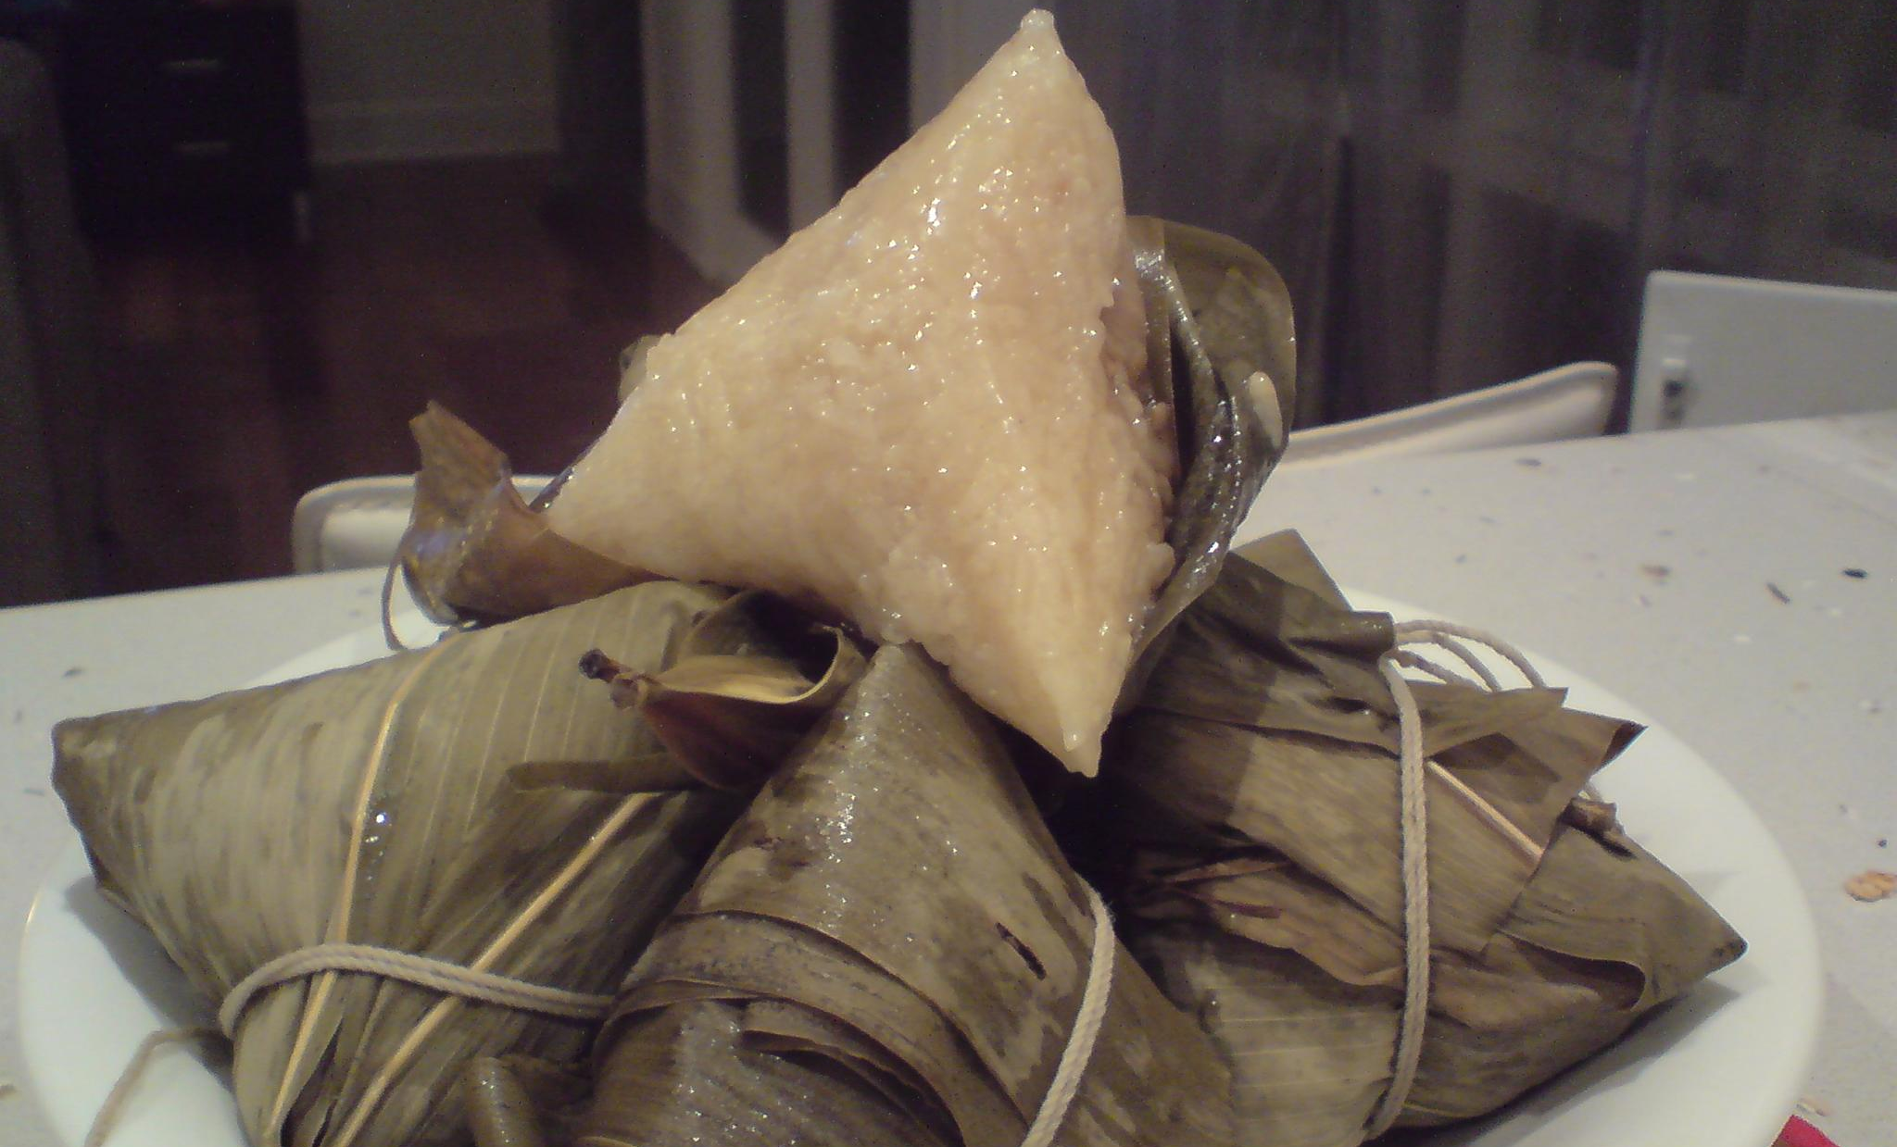
Rice Dumplings Are Eaten
Photo courtesy of avlxyz (@flickr.com) - granted under creative commons licence – attribution

Slide 9
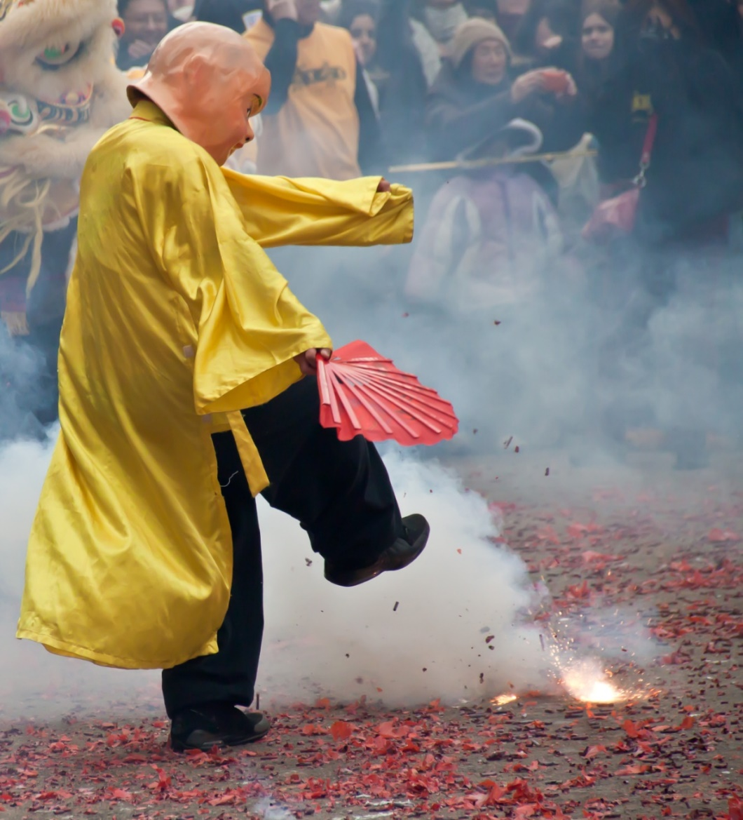
Fire Crackers
Photo courtesy of vpickering (@flickr.com) - granted under creative commons licence – attribution

Slide 10
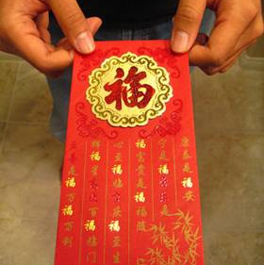
Red Envelopes
Photo courtesy of imtfi (@flickr.com) - granted under creative commons licence – attribution

Slide 11
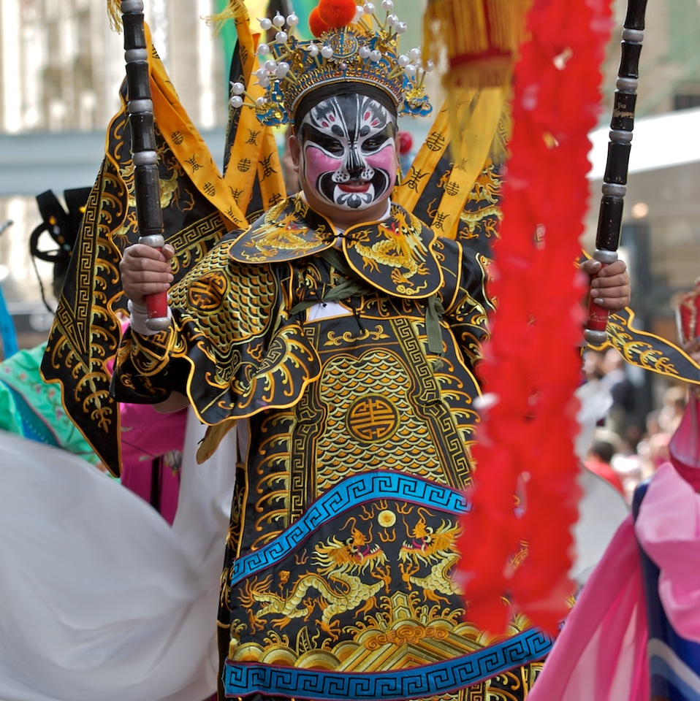
Traditional Dancing
Photo courtesy of yewenyi (@flickr.com) - granted under creative commons licence – attribution

Slide 12
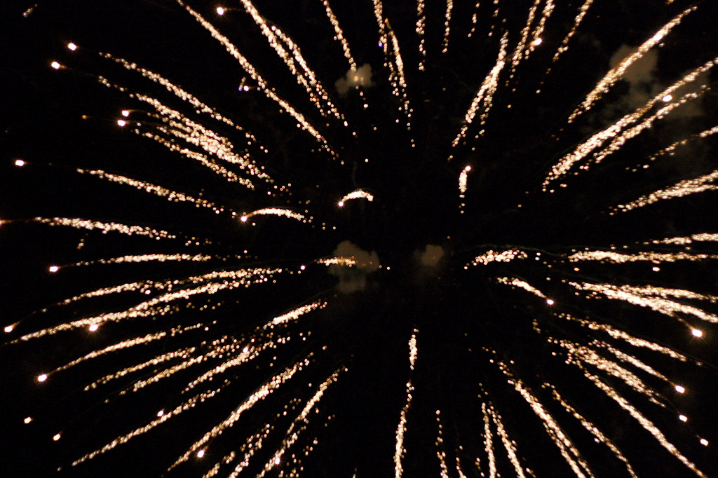
Fireworks
Photo courtesy of stoneflower (@flickr.com) - granted under creative commons licence – attribution

