Slide 1
In China and all over the world people are getting ready to celebrate the
Chinese New Year.
These are some of the things they do.

Slide 2

They clean their houses to sweep away any bad luck.

Slide 3
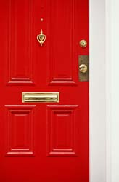
They give their front doors a new coat of paint. Can you guess what colour? Why?

Slide 4
They put lots of decorations up. Some are outside, like this road in London,

Slide 5
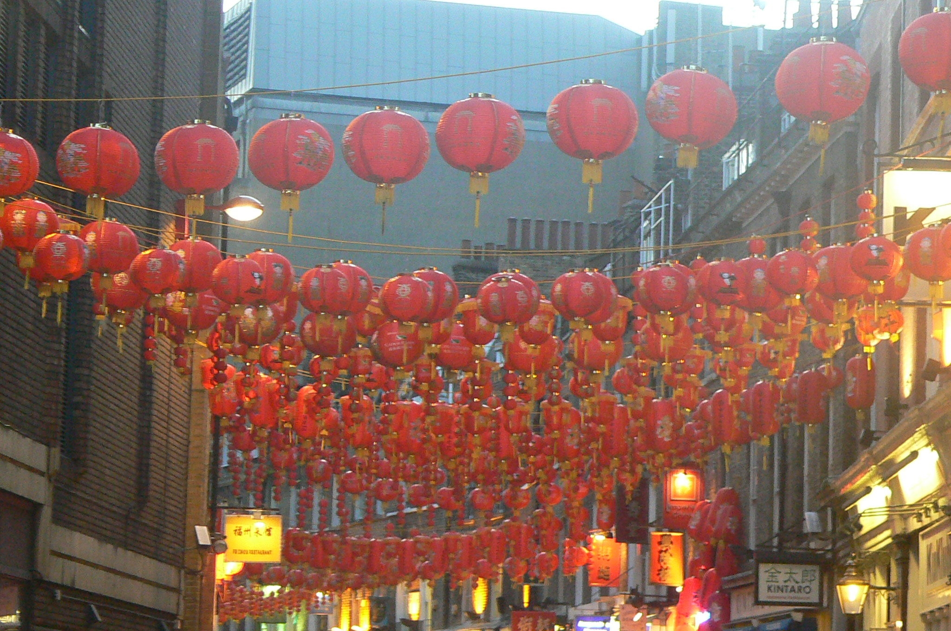

Slide 6
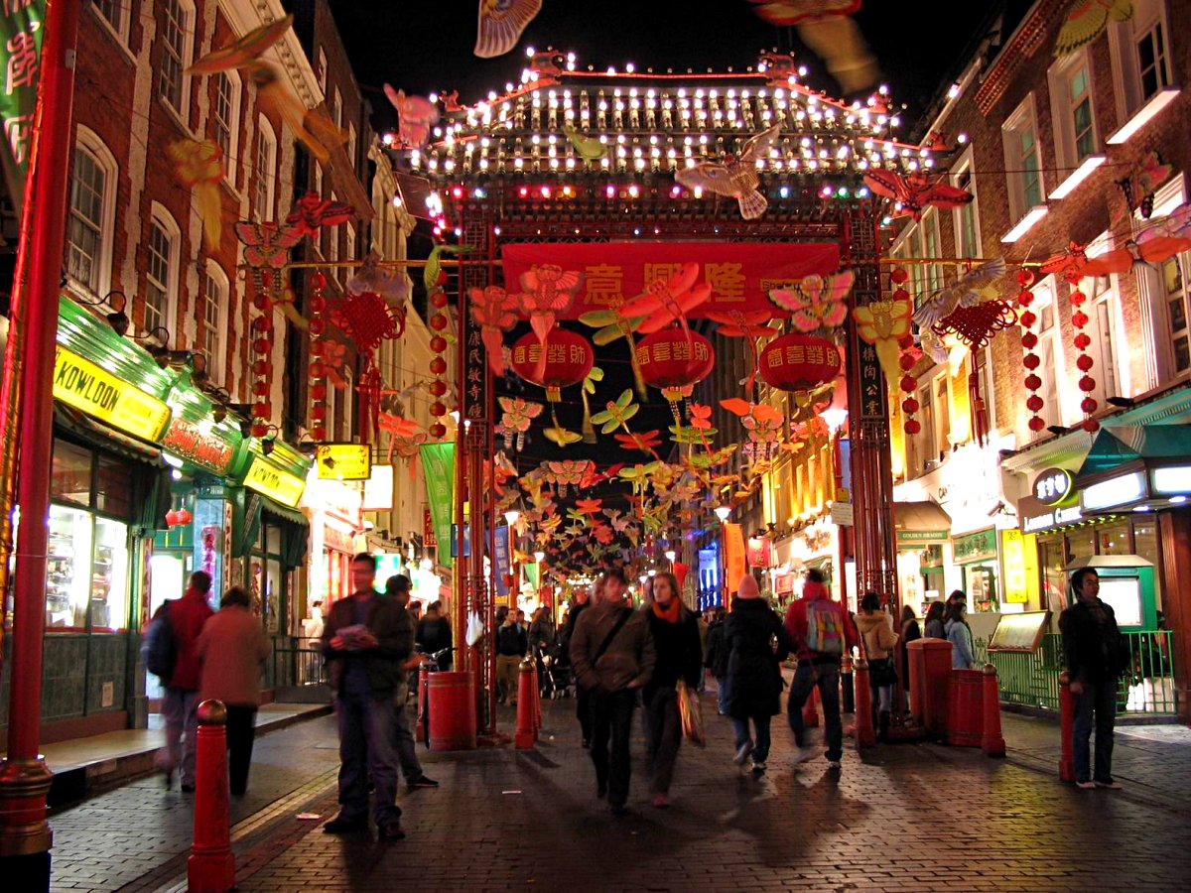

Slide 7
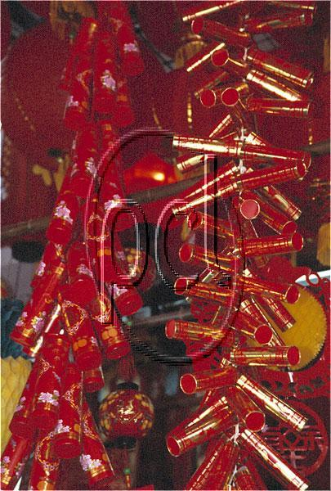
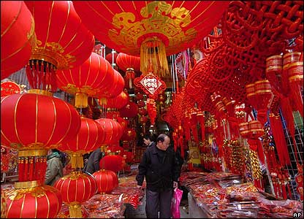
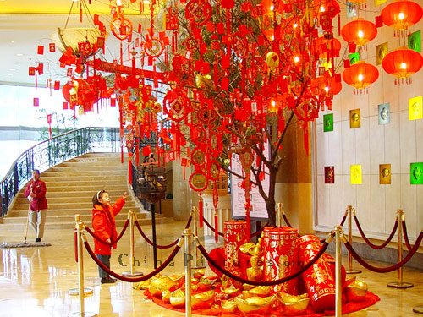
and some are inside, like these.

Slide 8
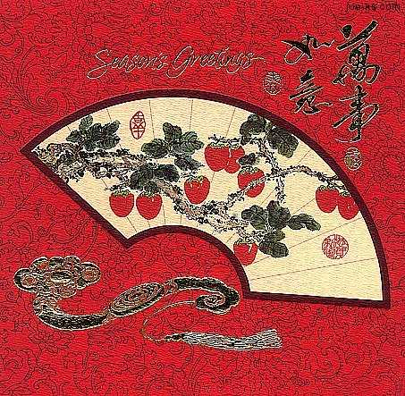
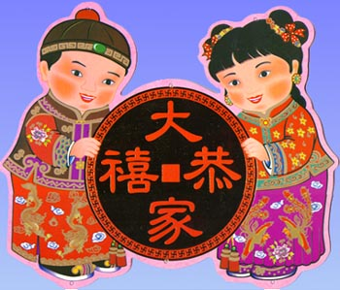
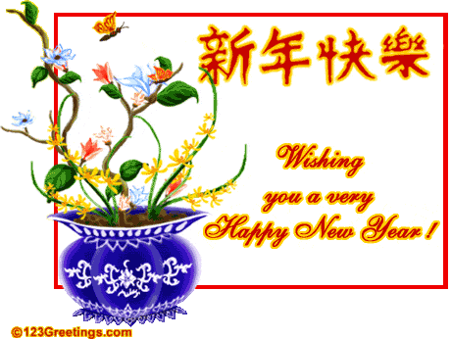
They send New Year cards to their family and friends

Slide 9
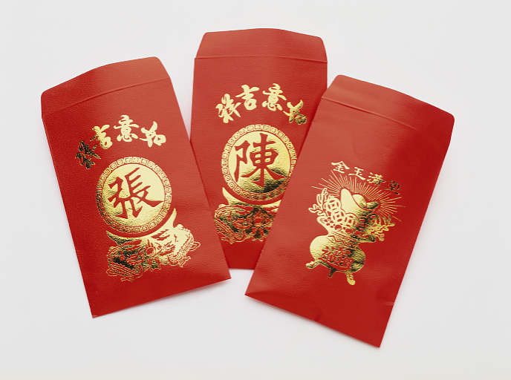
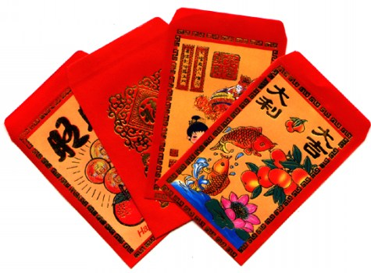
The children get lucky money packets with shiny coins in.

Slide 10
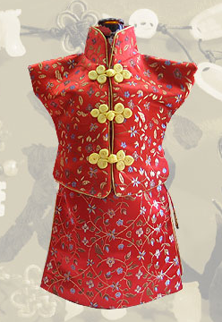
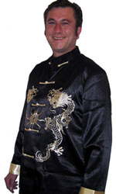
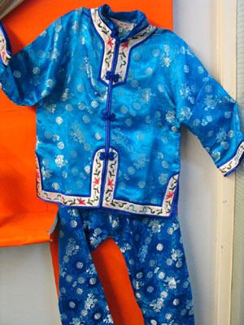
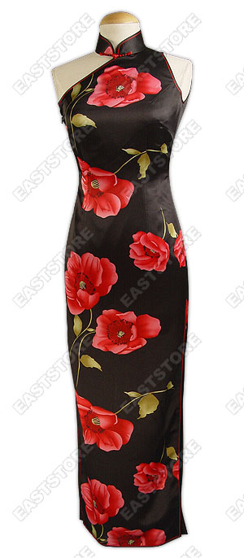
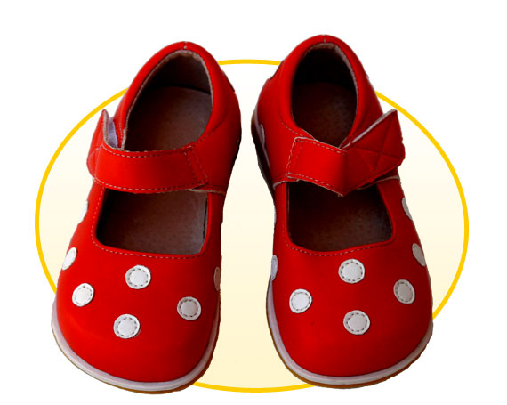
They buy new clothes to wear.

Slide 11
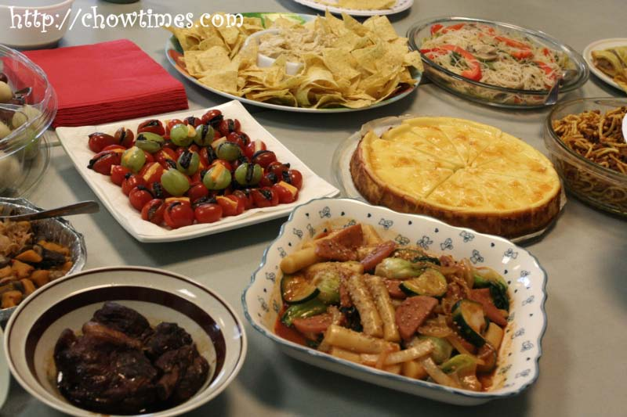
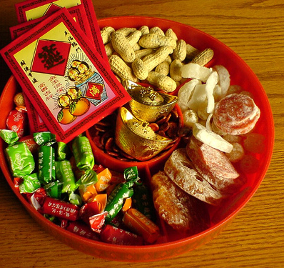
They have special food.

Slide 12
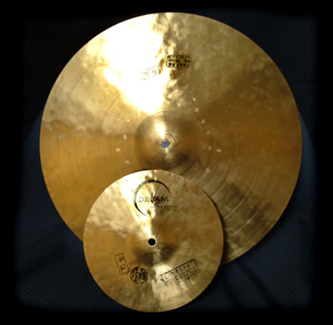
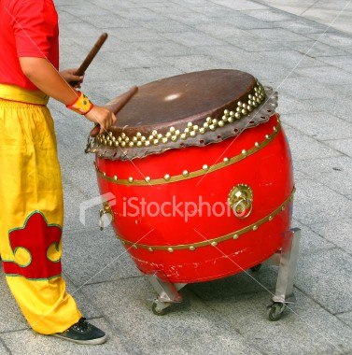
Outside they play really loud music and let off firecrackers (a kind of firework) that make a really loud noise.
Eve Batten 7.2.08

Slide 13
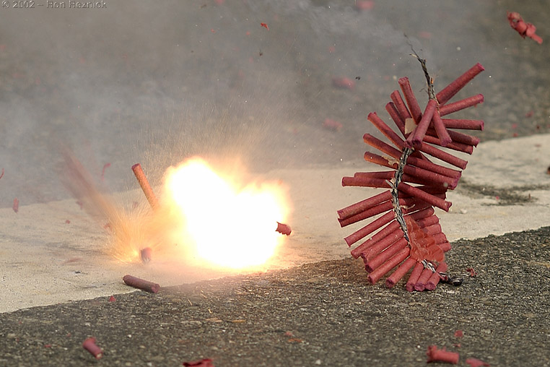

Slide 14
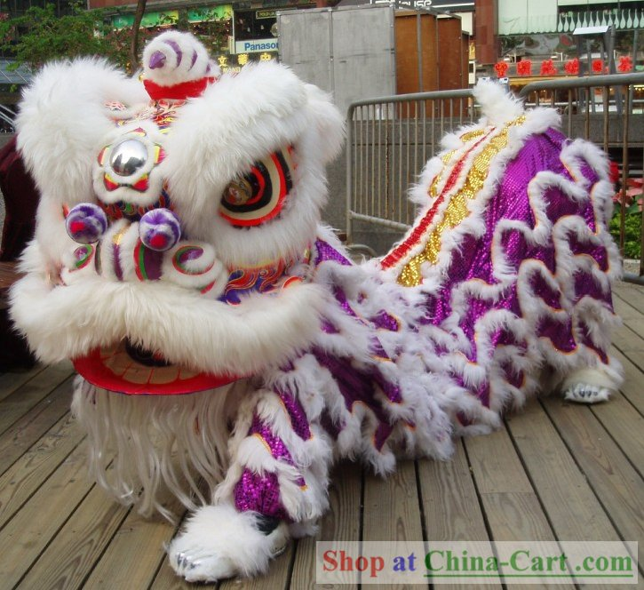
They do a ‘Lion Dance’ using a huge puppet.

Slide 15
They let off beautiful fireworks for everyone to enjoy.
Happy New Year!

Slide 16


