Slide 1


RE
People of Faith
Year One
RE | Year 4 | People of Faith | Rabbi Jonathan Sacks | Lesson 3

Slide 2
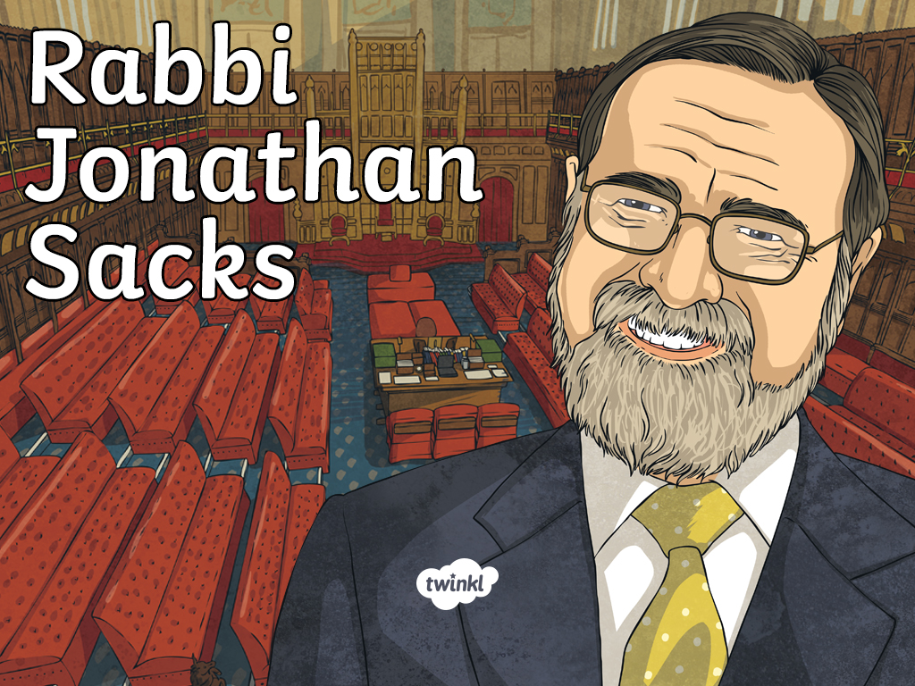

Slide 3
Aim
I can explore Rabbi Jonathan Sacks’ beliefs.
Success Criteria
I can identify the core beliefs of Rabbi Jonathan Sacks.
I can explain how his beliefs are reflected in his life.

Slide 4
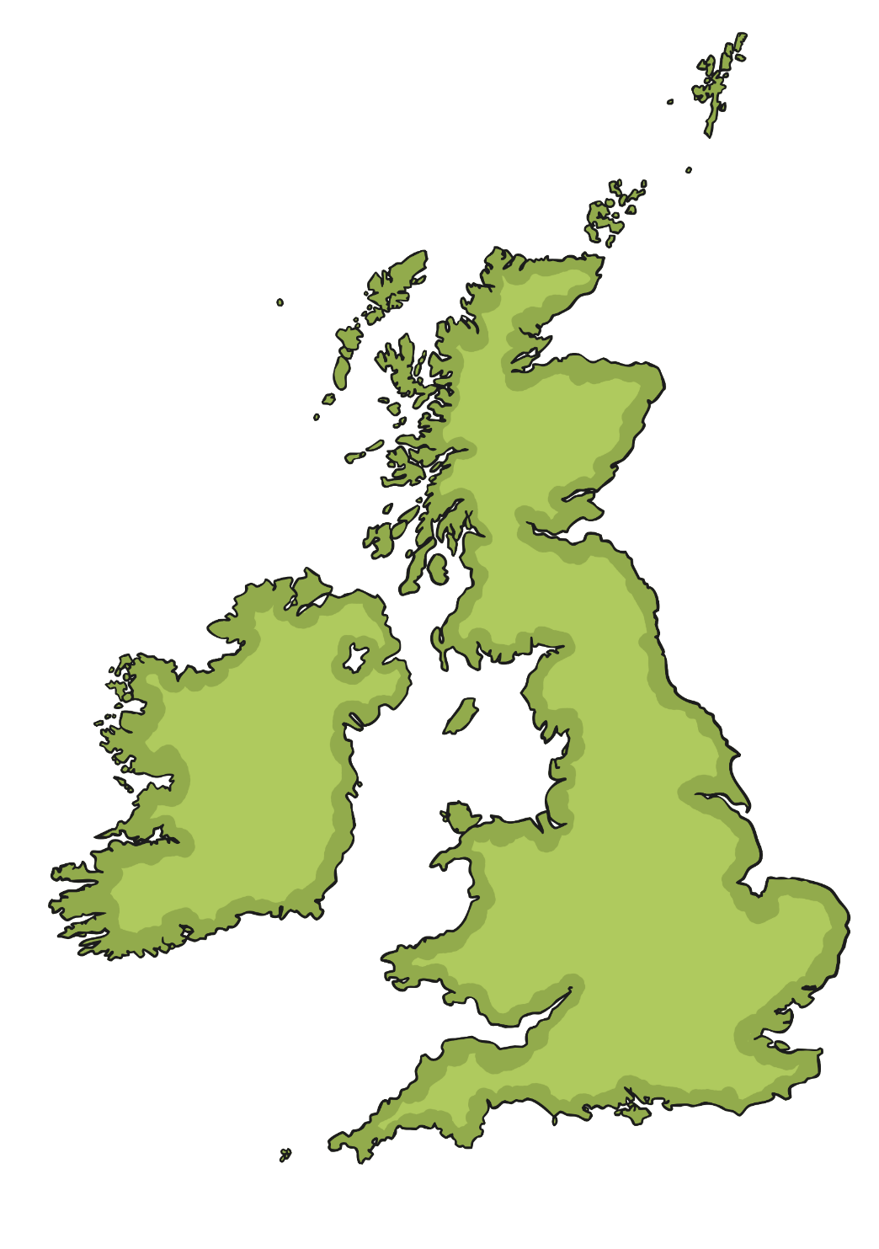
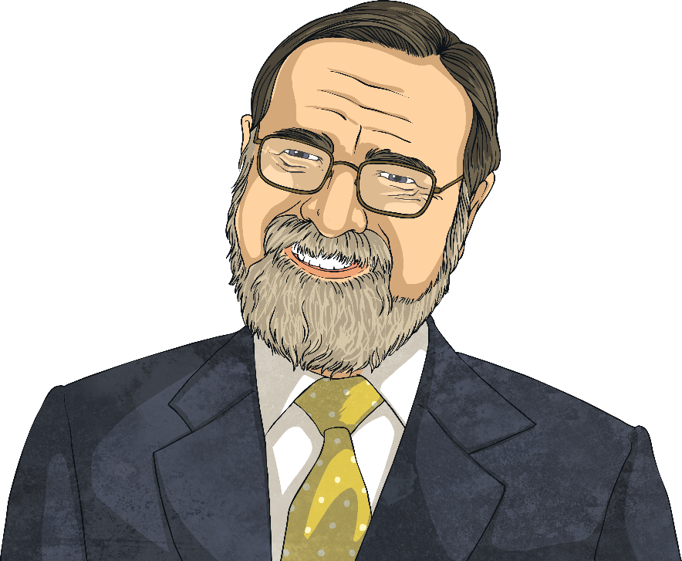
Rabbi Jonathan Sacks
In 1981, he completed his training to become a rabbi (Jewish priest). He was the rabbi at different London Synagogues.
In 1991, he became Chief Rabbi of the United Synagogue, which represents Orthodox Jews.
Jonathan Sacks was born on 8th March, 1948, in London, England.
In 2009, he joined the House of Lords in Parliament.
London

Slide 5

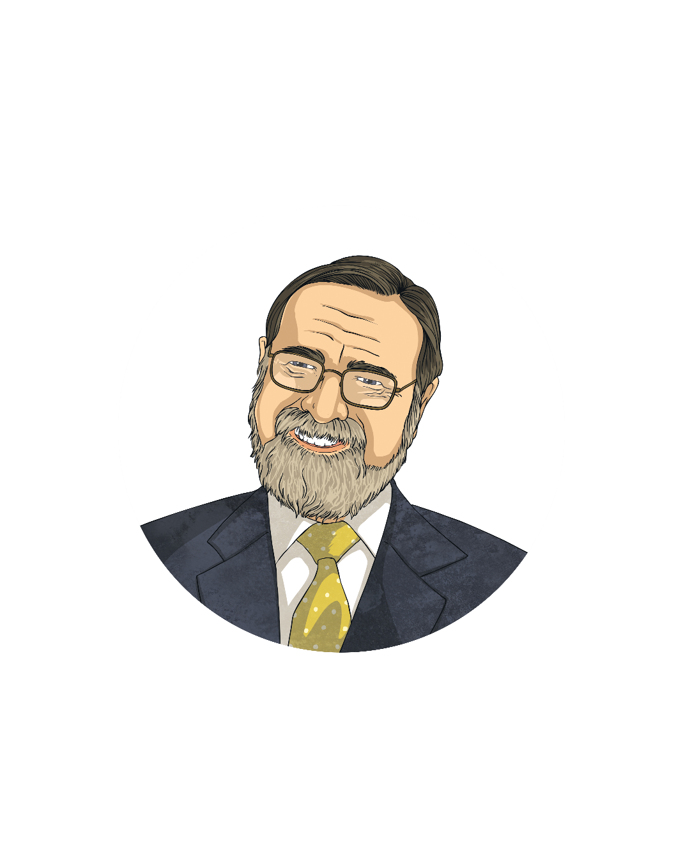
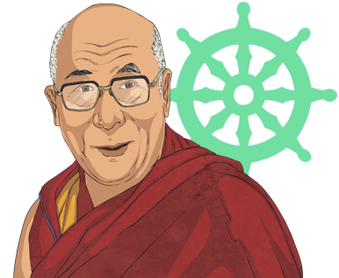
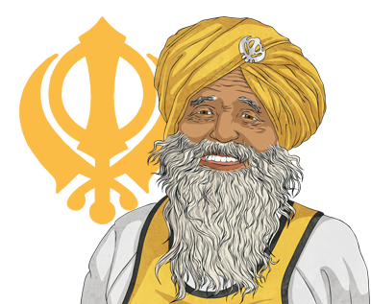
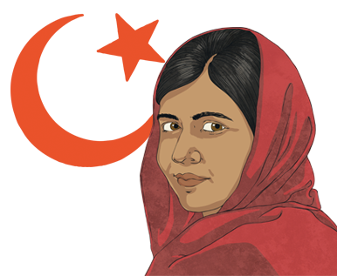
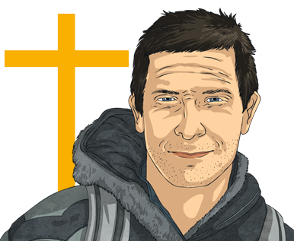
Interfaith Dialogue
Rabbi Sacks is famous for becoming friends with people of different faiths.

Slide 6





Interfaith Dialogue
“We have to learn to speak to those with whom we wish to live.”
?
?
?
?
Who do you see when you go shopping?
Who do you go to school with?
Who do you live with?
Who do you play outside with?

Slide 7
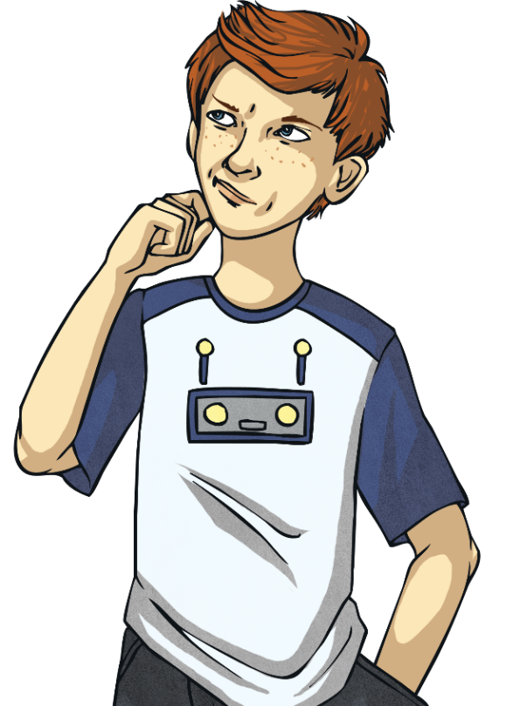
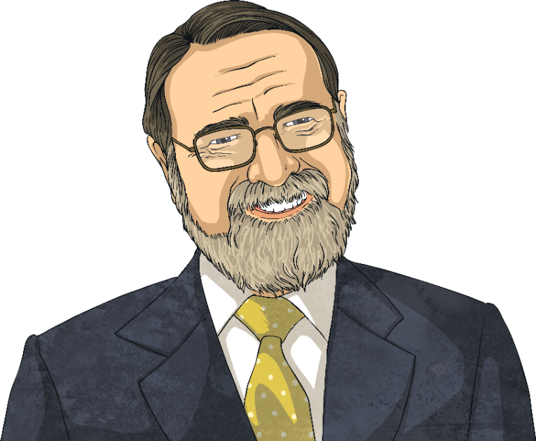
Interfaith Dialogue
“We have to learn to speak to those with whom we wish to live.”
Why does Rabbi Sacks think it’s important to speak to people of different religions?

Slide 8




Respecting Our Differences

Slide 9
Respecting Our Differences
“We have to learn to speak to those with whom we wish to live.”
?
?
?
Why do you think there are lots of people with different beliefs?
How do we show respect to each other? Why is that important?
Do you think everyone in our school believes the same things?

Slide 10
Aim
I can explore Rabbi Jonathan Sacks’ beliefs.
Success Criteria
I can identify the core beliefs of Rabbi Jonathan Sacks.
I can explain how his beliefs are reflected in his life.

Slide 11


