Slide 2
What Is a Food Chain?
A food chain shows how animals depend on other plants and animals for their
food and survival.

Slide 3
What Is a Food Chain?
A food chain can tell you about what animals eat.

Slide 4
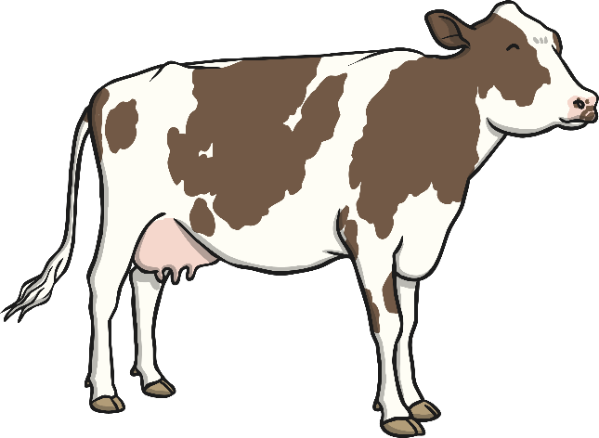
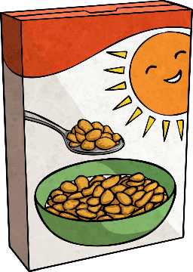

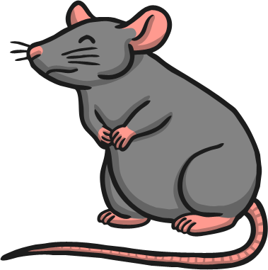
What does a cow eat?
grass
cereal
mice
correct
correct
wrong
wrong
wrong
wrong

Slide 5
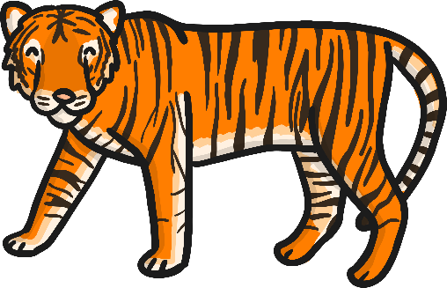
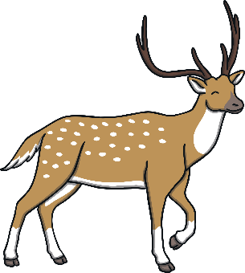
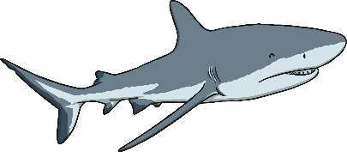
What does a tiger eat?
grass
deer
shark
wrong
correct
wrong
wrong
correct
wrong

Slide 6
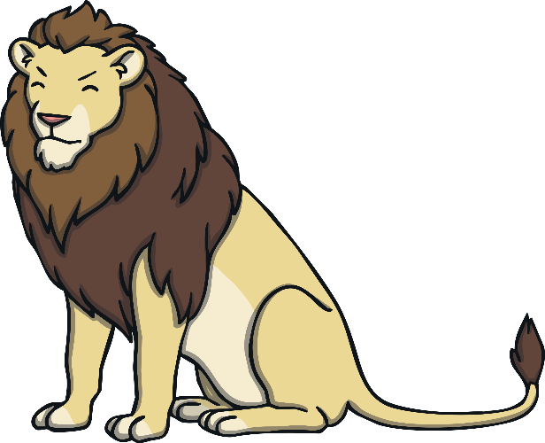
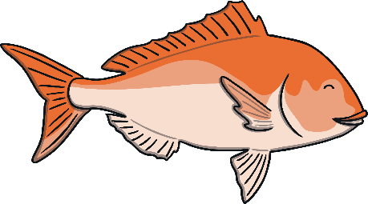
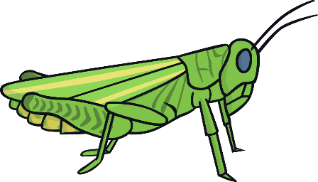
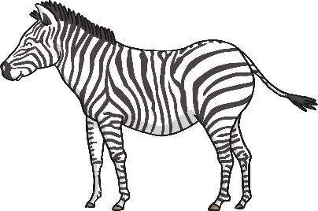
What does a lion eat?
fish
grasshopper
zebra
wrong
wrong
wrong
correct
wrong
correct

Slide 7

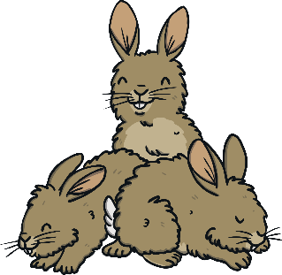


What does a shark eat?
fish
rabbits
grass
correct
correct
wrong
wrong
wrong
correct
wrong

Slide 8
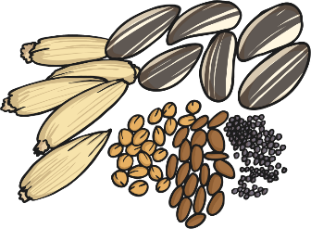
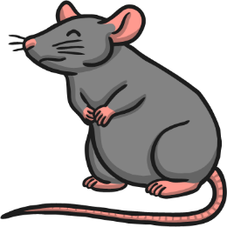
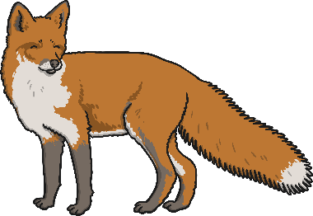
This is a food chain.
seeds
shrew
fox

Slide 9
The arrows show the direction the energy is transferred.
seeds
shrew
fox

Slide 10

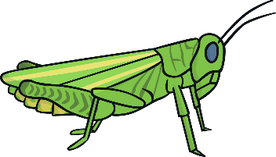
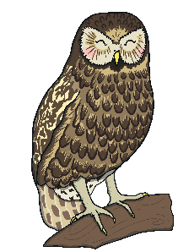
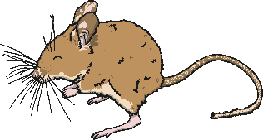

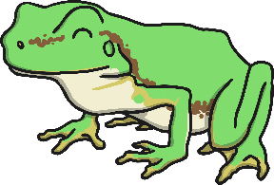
Which animal is missing from
this food chain?
grass
grasshopper
shrew
?
owl
owl
frog
frog

Slide 11
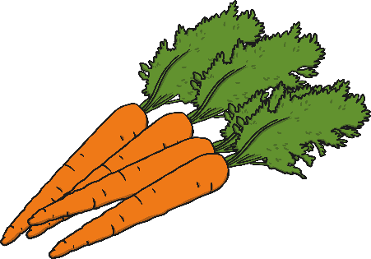

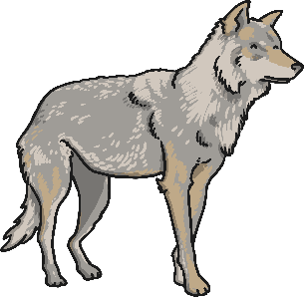
Which animal is missing from
this food chain?
carrots
rabbits
?
fox
rabbits
wolf

Slide 12
What did you find out about
food chains?

