Slide 1
Term 3 Week 5
Understand which months have 30 days and which have 31
To know when there are different amounts of days in a year
To know when an angle is right, acute or obtuse
Label angles on shapes
Notes:
Objectives for the week

Slide 2
Months of the year ☺
Can you order the months of the year?
Use the labels to put the months in the order they happen starting with January.
Challenge: Can you start from September for the school year?
Notes:
Lesson 1
Starter – print out and cut up labels.

Slide 3
Months of the year ☺
Most years have 365 days.
However….
Leap years (which happen every four years) have an extra day so have 366.
Do you know when this day is?
Notes:
February 29th.
All leap years are even numbers as they are every four years. Next one is 2024. The Olympics usually happen on a leap but 2020 didn’t happen. Paris 2024 looks likely to be the next Olympics.

Slide 4
Angles
‪What is an angle? - BBC Bitesize
Notes:
What is an angle?

Slide 5
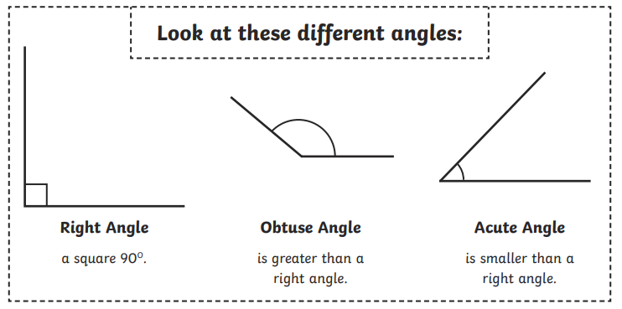

Slide 6
To measure an angle we use a protractor and the unit of measure is degrees (a small circle to the top right of the number e.g. 90˚)
We can see types of angles without using a protractor as they are defined by the shape the size of the angle makes.

Slide 7
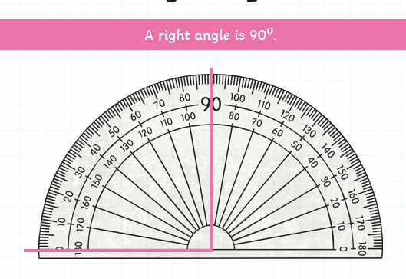
Notes:
One arm of the angle goes to the north and the other arm points to east or west.

Slide 8
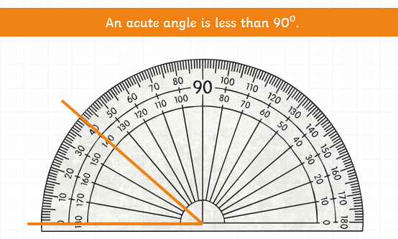
Notes:
Any angle between 1 and 89 degrees

Slide 9
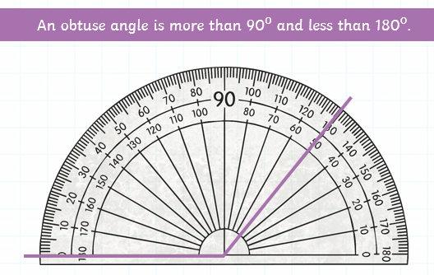
Notes:
Any angle between 91 and 179 degrees

Slide 10
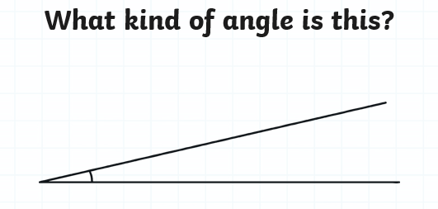
Notes:
Acute – it’s smaller than 90 degrees

Slide 11
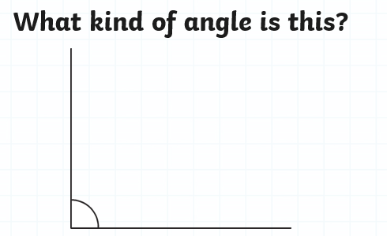
Notes:
Right angle – it’s 90 degrees, it goes straight up to the north and points to east.

Slide 12
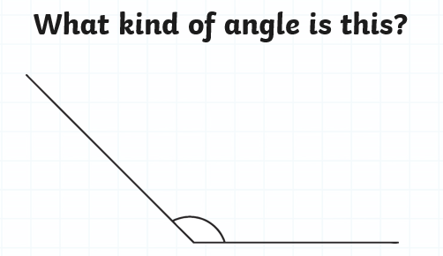
Notes:
Obtuse – it’s more than 90 but less than 180 degrees

Slide 13

Time to find some right angles.
Using the Right Angle Pacman Checker, go around your house or classroom and see how many right angles you can find.
Notes:
Pacman right angle checker

Slide 14
Time to try the questions on the worksheet.
You don’t need to measure, just look at the shape and decide if they are acute, right or obtuse angles.
Notes:
Worksheet

Slide 15
What are you more confident in today?
Notes:
Whole class – gather ideas to check understanding of tasks set

Slide 16
Months of the year ☺
Can you order the months of the year?
Use the labels to sort the months into how many days they have. A group with 30 days, a group with 31 days and the month that is different to both groups.
Notes:
Lesson 2
Starter – use labels from previous lesson

Slide 17
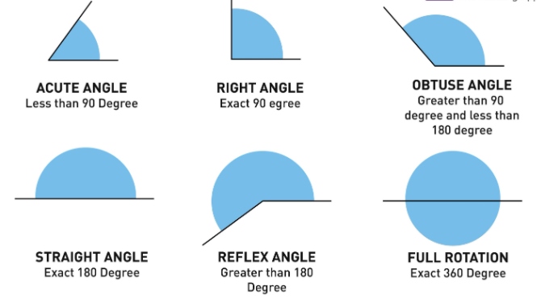
Notes:
Recap the previously taught angles

Slide 18
A straight line is always 180˚.
All the angles in triangles also add up to 180˚. Let’s test this out.
Cut out a triangle – it doesn’t matter what size as long as the sides are straight.
Tear off the corners and put them all together. They will make a straight line.
Notes:
Worksheet

Slide 19

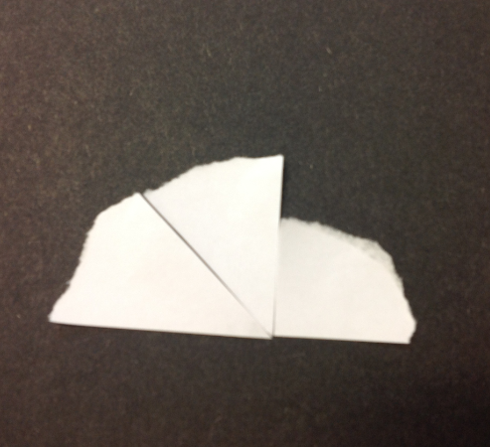
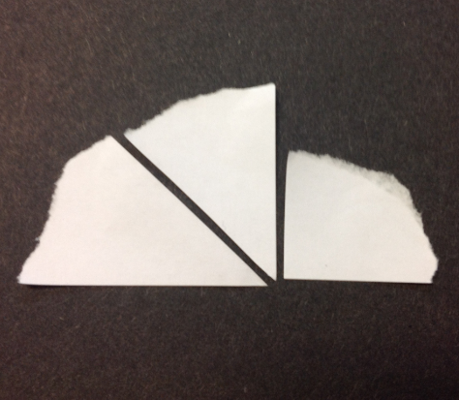
Notes:
Triangle angles

Slide 20
There are lots of different types of triangles.
Click on the triangle to find out more.
Notes:
Worksheet

Slide 21
Time to label some triangles on the worksheets.
Also, have a look around your house or classroom to see what different triangles you can see around you.
Have fun ☺

Slide 22
What are you more confident in today?
Notes:
Whole class – gather ideas to check understanding of tasks set

