Slide 2
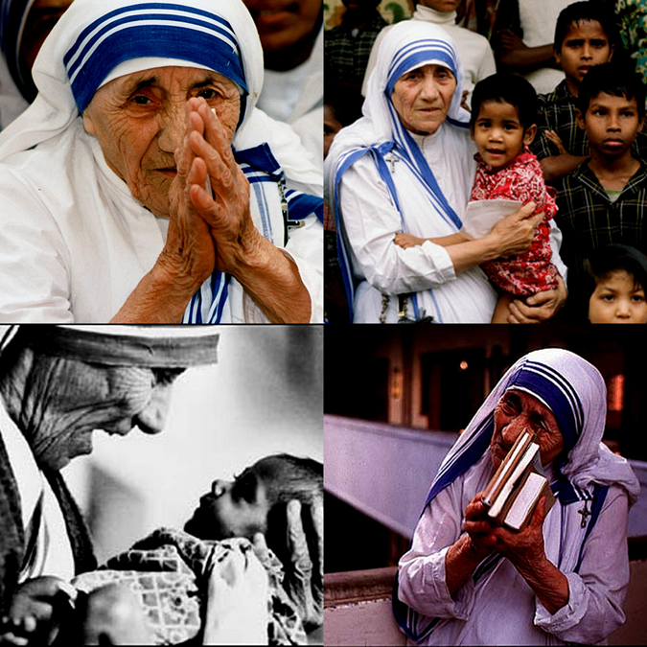
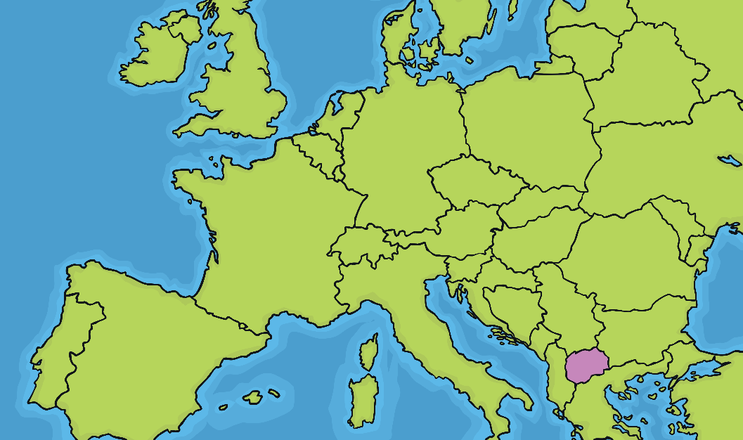
Who Was Mother Teresa?
Mother Teresa was born in North Macedonia on 26th August 1910. When she was born, she was named Agnes Gonxha Bojaxhiu.
Her family were part of the Roman Catholic Church and enjoyed working with the church to help the poor people in their community.
Photo courtesy of (Peta_de_Aztlan@flickr.com) - granted under creative commons licence
North Macedonia

Slide 3
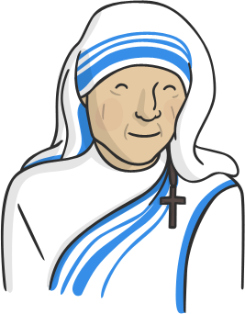
Mother Teresa Became a Nun
Just like her family, Agnes was very religious and she wanted to help people.
So, she decided to become a Nun.

Slide 4
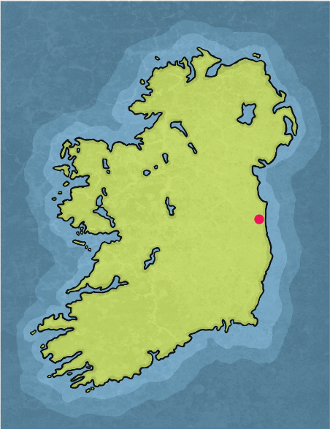
What Is a Nun?
A nun is a person who decides to serve God. Nuns often live together in a place called a convent. They spend their whole life doing the work of God and helping people in their communities.
When Agnes was only 18, she travelled to Ireland to live in a convent and become a nun. When Agnes arrived at the convent, they gave her the name Sister Teresa.
Photo courtesy of (Peta_de_Aztlan@flickr.com) - granted under creative commons licence – attribution

Slide 5

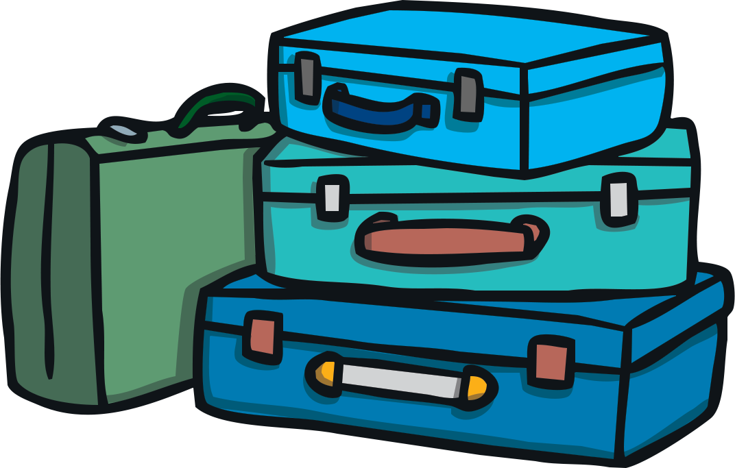
Sister Teresa Travels to India
The convent sent Sister Teresa to India. She was to work there as a missionary.

Slide 6

What Is a Missionary?
A missionary is a person who is sent on a religious mission. They go to a different country from their own and tell everyone about their religion.
Sister Teresa was sent to India to teach everyone about God.

Slide 7

What Did She Do in India?
She had wanted to become a teacher and began working at St. Mary's High School for Girls.
Sister Teresa wanted to be a teacher. She hoped that by helping girls to learn to read and write, she could help stop them being so poor.
There were some very poor people in India. The convent wanted to make sure girls from these poor families were able to go to school.

Slide 8
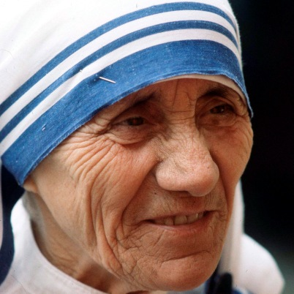
How Did She Become Mother Teresa?
In 1973, Sister Teresa made a promise to God and the church. She promised that she would spend her life trying to help poor people and doing God’s work.
After she made this promise, she was given a new title ‘Mother’. From them on, she was known as Mother Teresa.
Photo courtesy of (india7network@flickr.com) - granted under creative commons licence – attribution

Slide 9
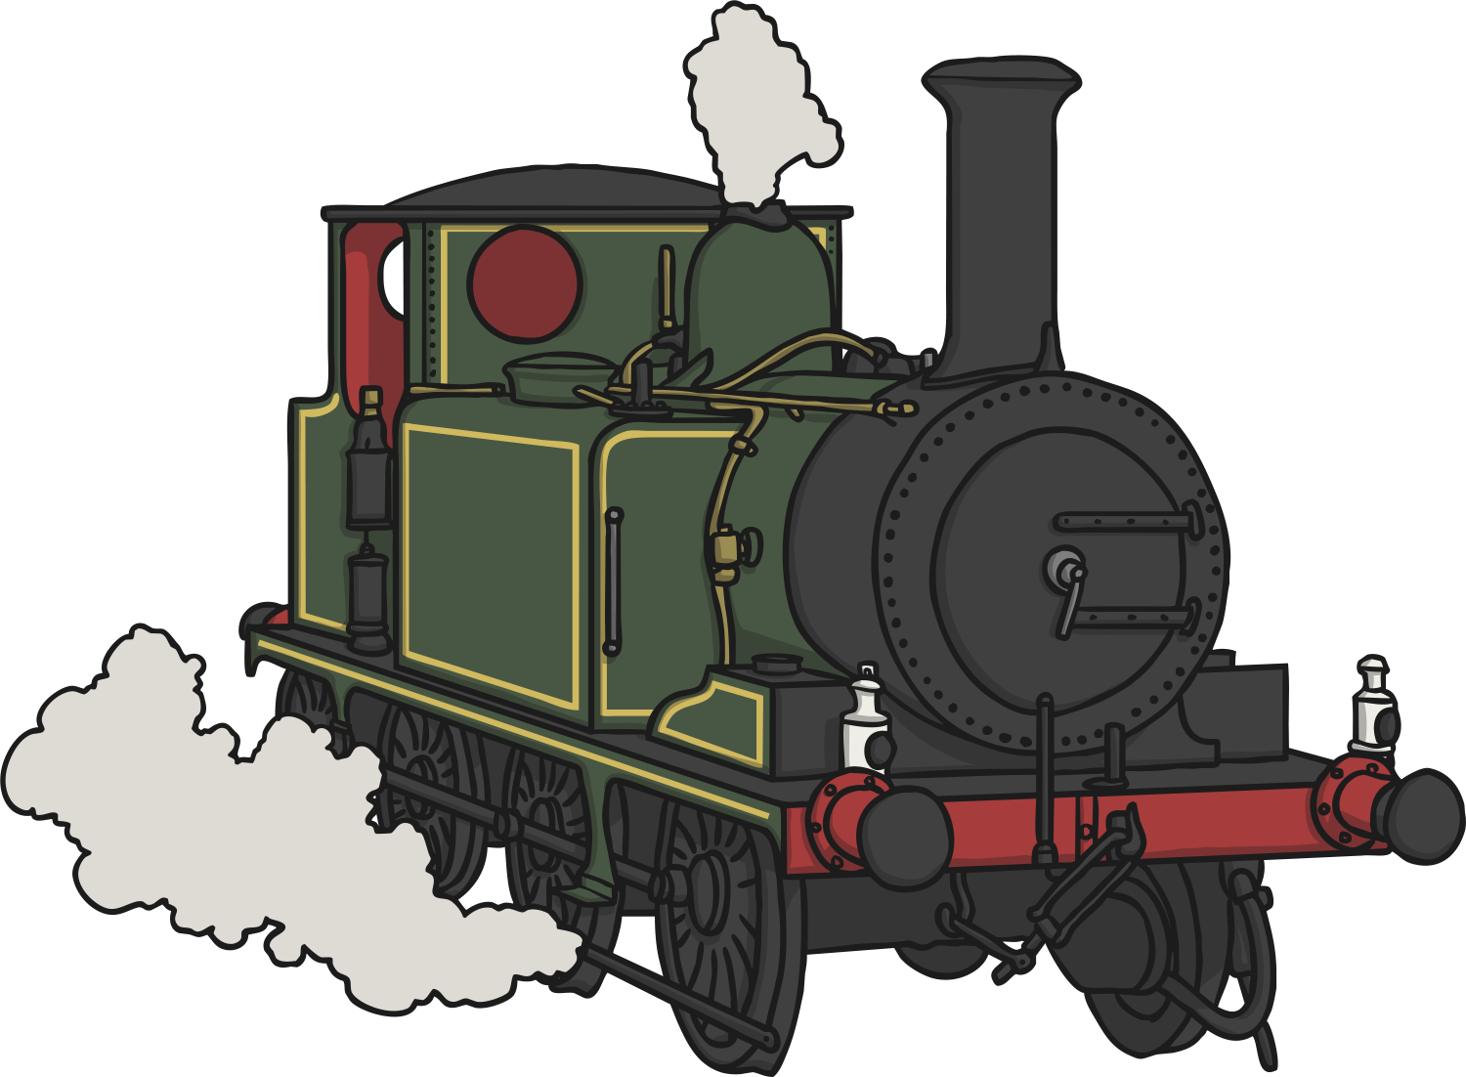
What Changed Her Life?
In September 1946, Mother Teresa was on a train journey when she received a message from God.
She said that God told her to leave the school she worked in and go to work with the poor and sick people who lived in a run-down area called the slums.

Slide 10

Working in the Slums
Mother Teresa learned to do first aid and she went to work in the slums. She helped people who were uncared for and forgotten about.
She went on to open a school for the poor and then an orphanage. The orphanage looked after children who were homeless and had no families.

Slide 11

How Else Did She Help People?
It upset Mother Teresa that people who lived in the slums could not get help when they were ill.
She decided to set up a charity to help give the people medicine and health care. She went on to set up lots of health clinics, a family clinic and a nursing home.

Slide 12
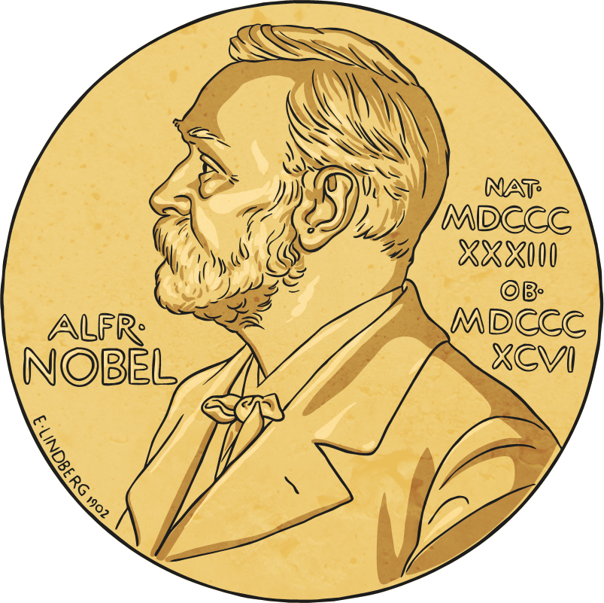
Nobel Peace Prize
In 1979, Mother Teresa was given the Nobel Peace Prize for all her years of helping, caring and hard work.

Slide 13
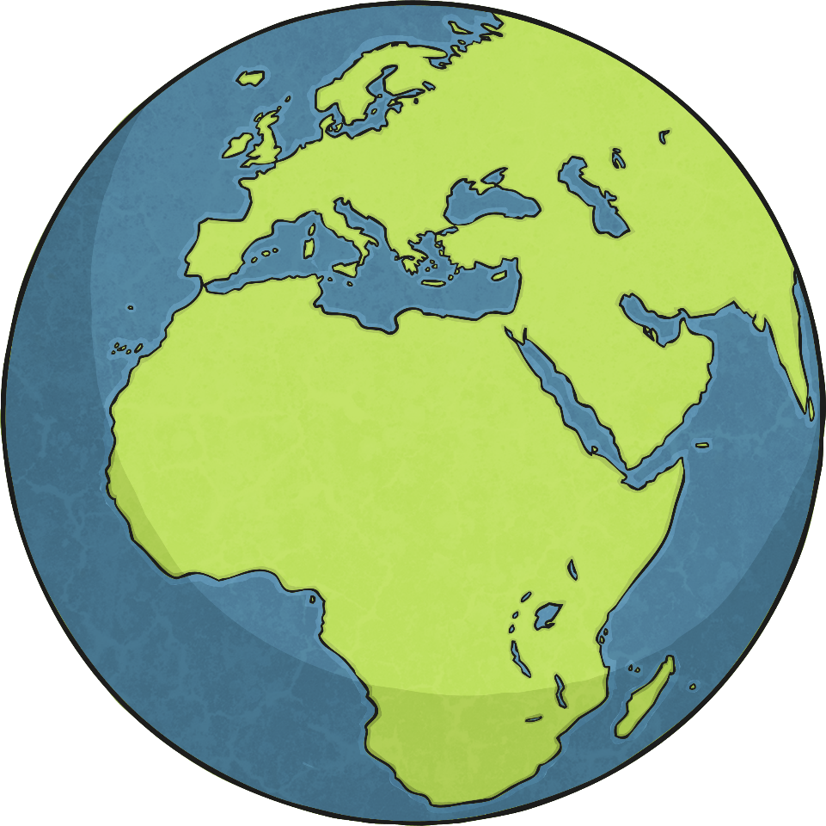
What Happened to Mother Teresa?
In the 1980s, Mother Teresa travelled all around the world teaching other people how to help the poor people in their communities.

Slide 14
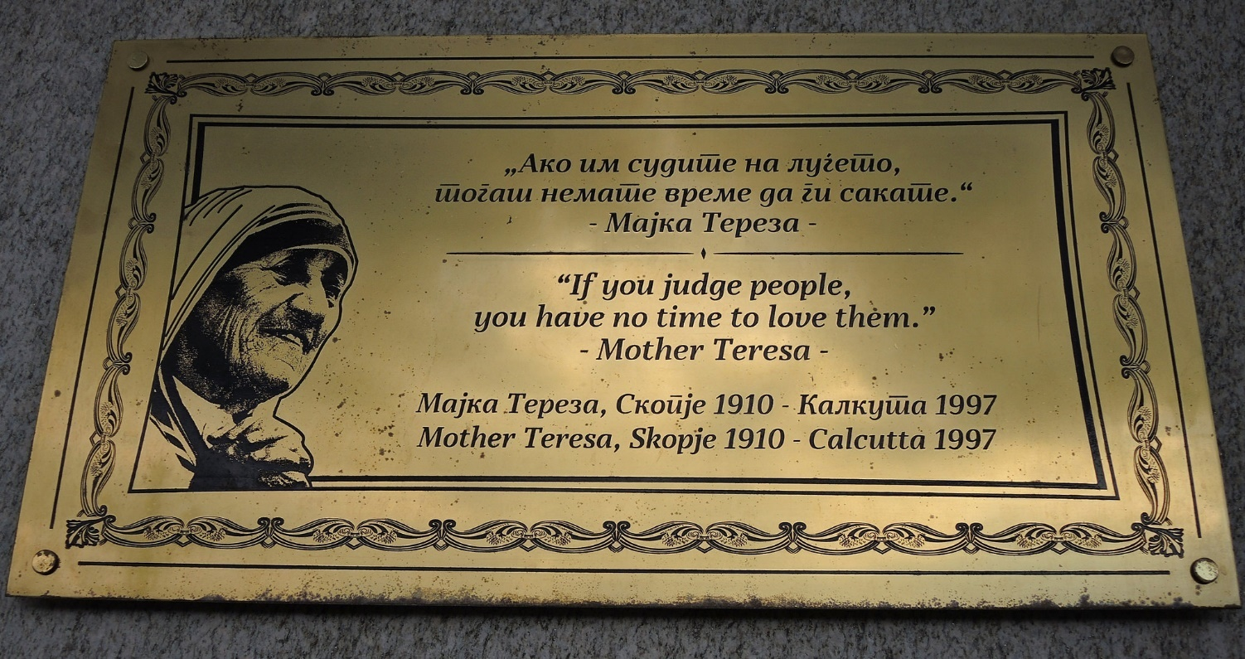
What Happened to Mother Teresa?
On 5th September 1997, Mother Teresa died.
People all around the world were sad to hear about her death.
Photo courtesy of (ustung@flickr.com) - granted under creative commons licence

Slide 15
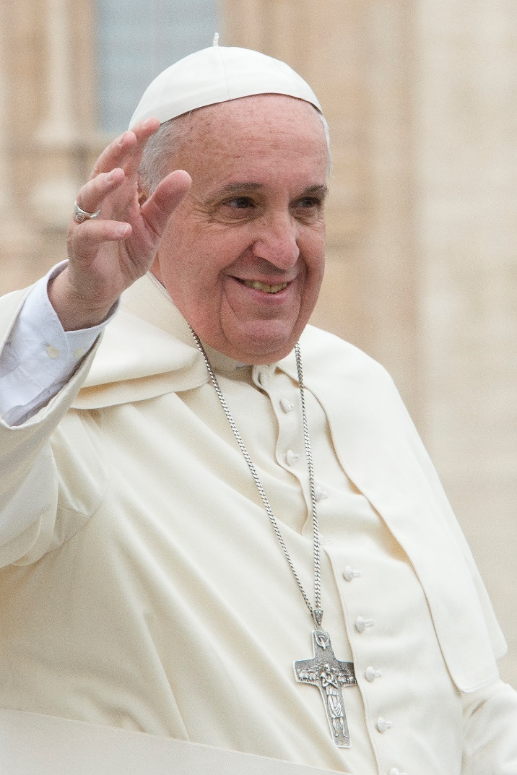
Mother Teresa Became a Saint
In 2016, Pope Francis said that Mother Teresa was to become a saint.
Photo courtesy of (Aleteia Image Partner@flickr.com) - granted under creative commons licence

Slide 16
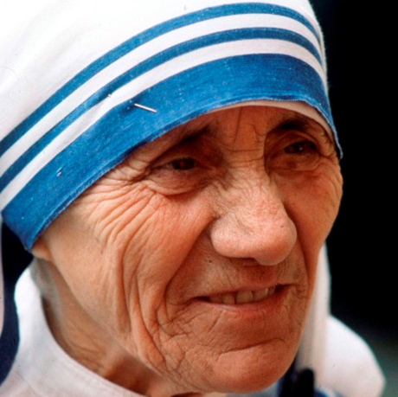
Saint Teresa
What were some of the key moments of her life?
Why do you think people still remember her today?
Photo courtesy of (india7network@flickr.com) - granted under creative commons licence

