Slide 2

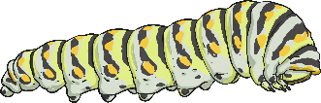
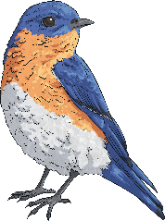
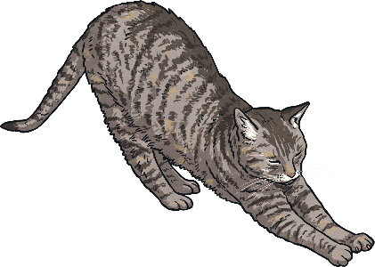
Key Words
producer
consumer
prey
predator

Slide 3
Consumer or Producer?
Producers are plants that make their own food.
Consumers are animals that eat food.
Which are consumers and which are producers?
rabbit
rabbit
mouse
mouse
lion
lion
lettuce
lettuce
sea otter
sea otter

Slide 4
Design your own food chain
All food chains start with a producer.
Arrows are used in a food chain to show who is eaten by who.
eaten by
energy flow
Check
Are the arrows going in the right direction?
Does it have a producer?

Slide 5
What do all food chains start with?
Click to reveal answer
a producer
back
next

Slide 6
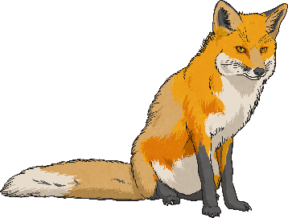
Name a predator and its prey.
Click to reveal answer
bear and fish
fox and rabbit
How many examples did you come up with?
back
next

Slide 7
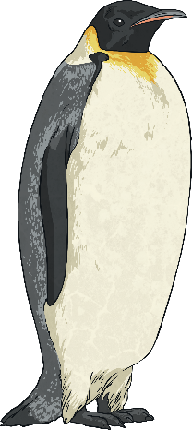
Are penguins the prey of polar bears?
Click to reveal answer
No!
Penguins live in the Antarctic and polar bears live in the Arctic.

Slide 8
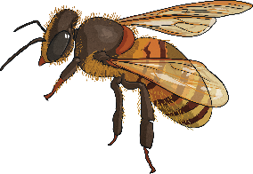
Give an example of a consumer that makes honey.
Click to reveal answer
A bee
back
next

Slide 9
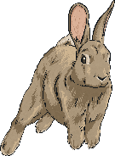

Write down an example of a food chain including a fox.
Click for an example
grass → rabbit → fox → bear
back
next

Slide 10
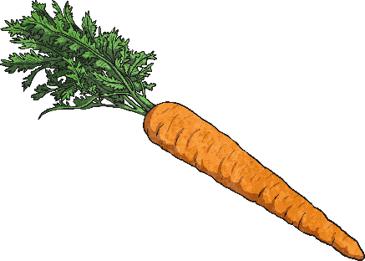
Name a producer eaten by a rabbit.
Click to reveal answer
cabbage
carrot
grass
back
next

Slide 11
What do the arrows in a food chain show?
Click to reveal answer
‘energy flow’ or ‘eaten by’
back
next

Slide 12
Name a consumer.
Click to reveal answer
Any animal!
back
next

Slide 13
Name a producer.
Click to reveal answer
Any plant!
back

