Slide 1






Guidance for Video/Audio in PowerPoints
1. Open the folder and copy all the files.
2. Paste the copied files into a new folder.
3. Open the PowerPoint file, enable editing and enter presentation mode (start the slide show).
Please note the embedded audio may not be compatible with early versions of PowerPoint.
You may wish to delete this slide before beginning the presentation.

Slide 3
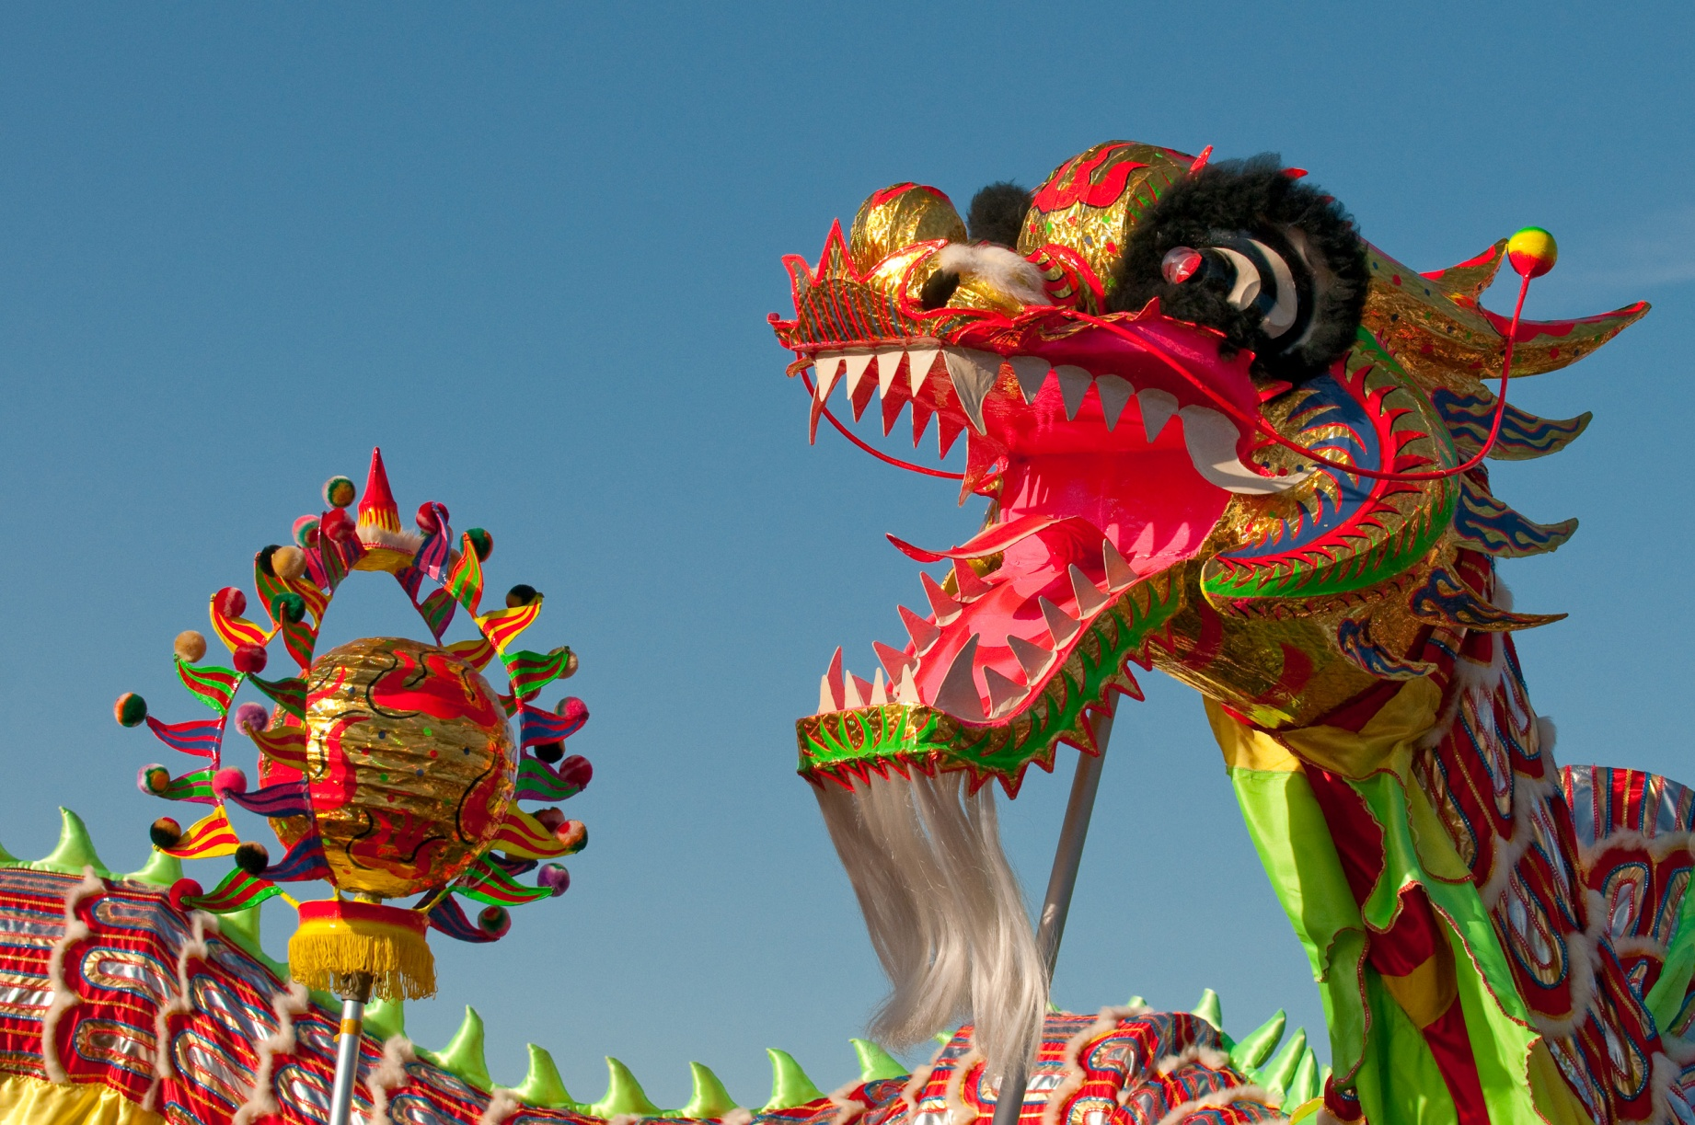
Dragon Dances
Photo courtesy of kennymatic (@flickr.com) - granted under creative commons licence – attribution

Slide 4
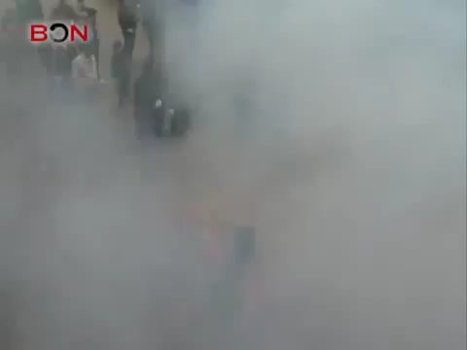
Photo courtesy of AbiHaigh (@Youtube.com) - granted under creative commons licence – attribution
Notes:
Click on the image to play the video.

Slide 5
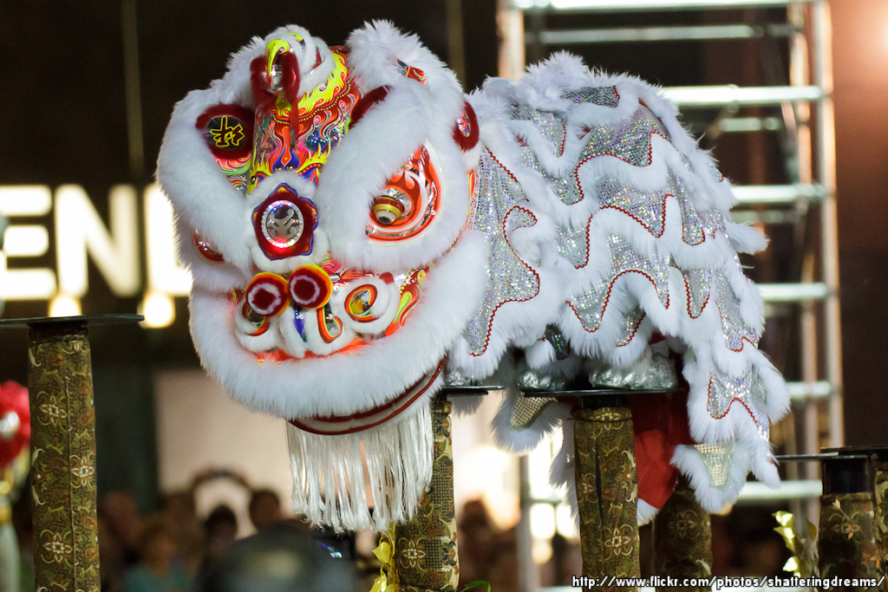
Lion Dances
Photo courtesy of KWSW (@flickr.com) - granted under creative commons licence – attribution

Slide 6
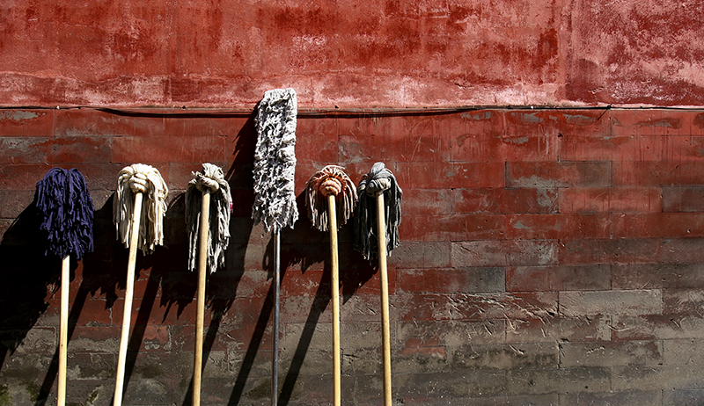
House Cleaning to Sweep Away
Bad Fortune
Photo courtesy of Frederuc Poirot (@flickr.com) - granted under creative commons licence – attribution

Slide 7
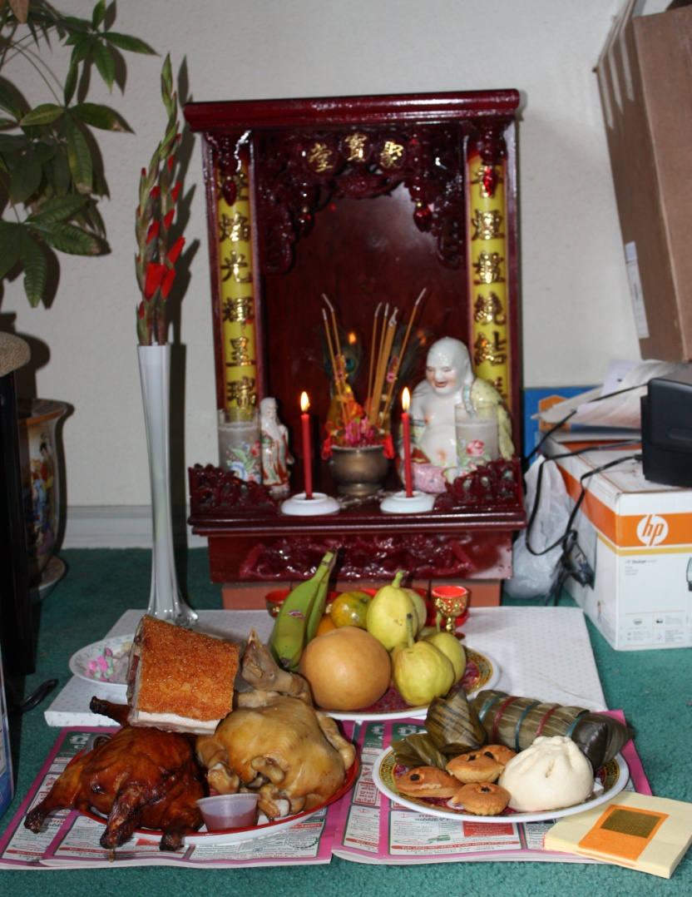
Offerings to the Kitchen God
Photo courtesy of eggiepooh (@flickr.com) - granted under creative commons licence – attribution

Slide 8
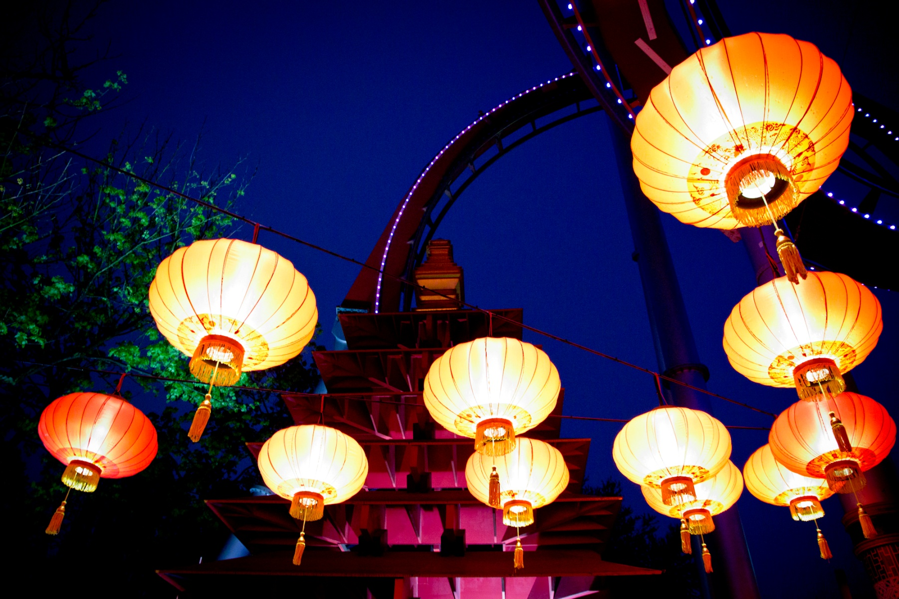
Lanterns Are Lit
Photo courtesy of pellesten (@flickr.com) - granted under creative commons licence – attribution

Slide 9
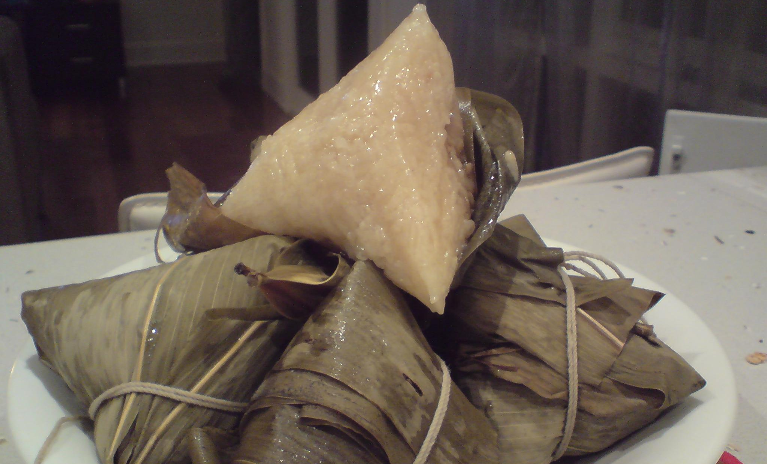
Rice Dumplings Are Eaten
Photo courtesy of avlxyz (@flickr.com) - granted under creative commons licence – attribution

Slide 10
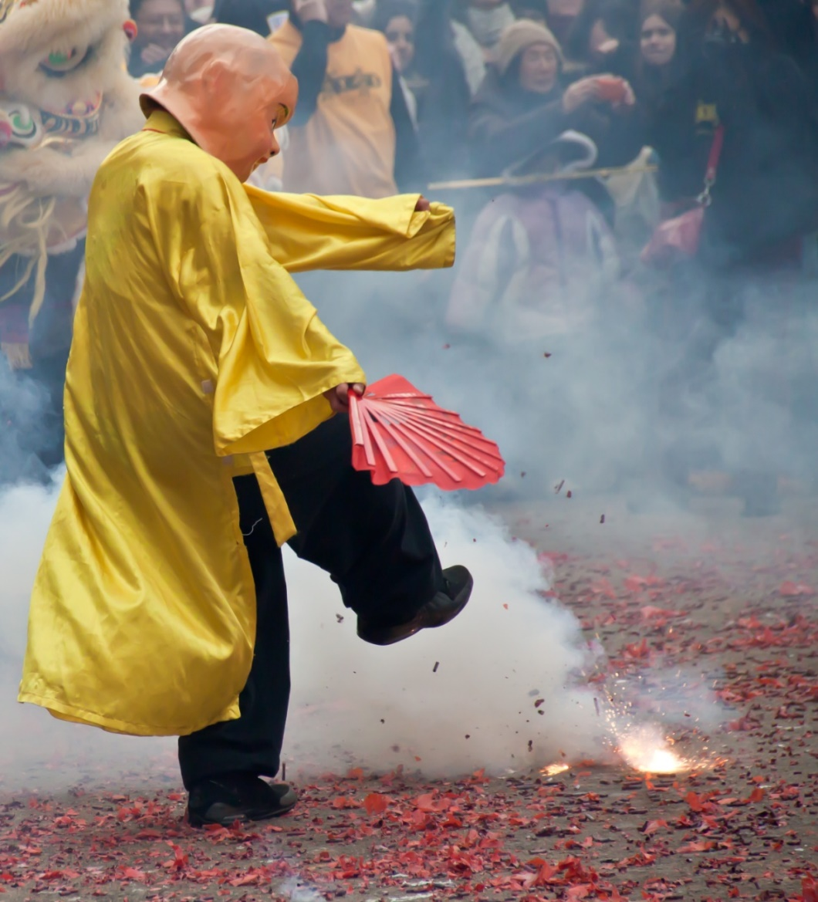
Fire Crackers
Photo courtesy of vpickering (@flickr.com) - granted under creative commons licence – attribution

Slide 11
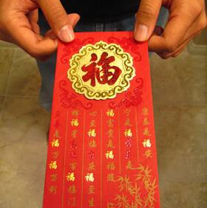
Red Envelopes
Photo courtesy of imtfi (@flickr.com) - granted under creative commons licence – attribution

Slide 12
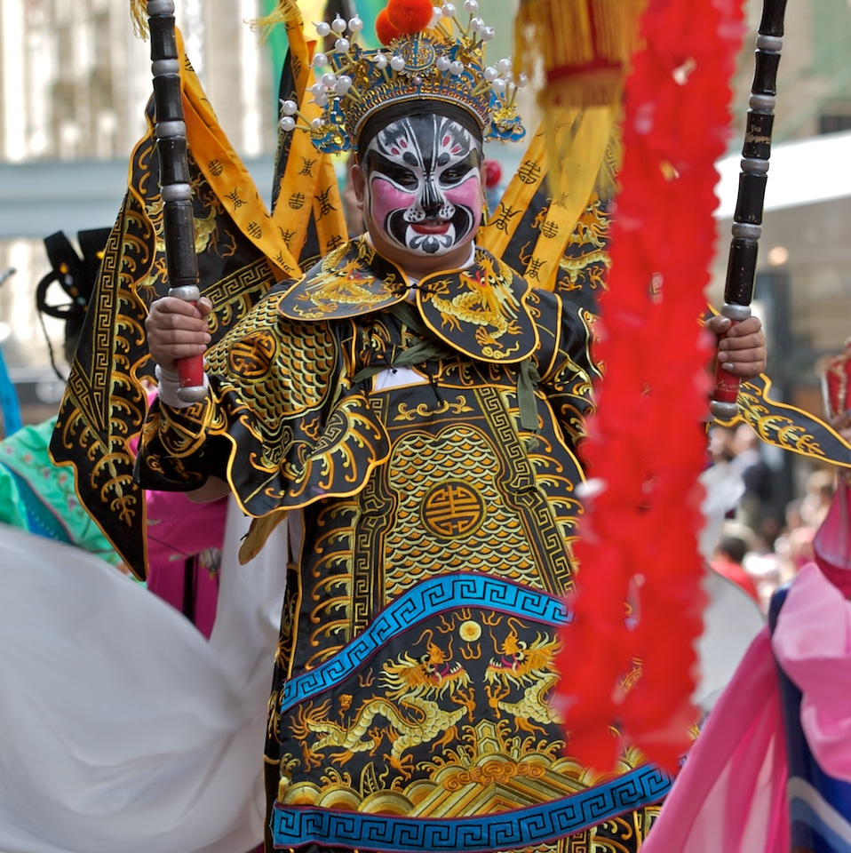
Traditional Dancing
Photo courtesy of yewenyi (@flickr.com) - granted under creative commons licence – attribution

Slide 13
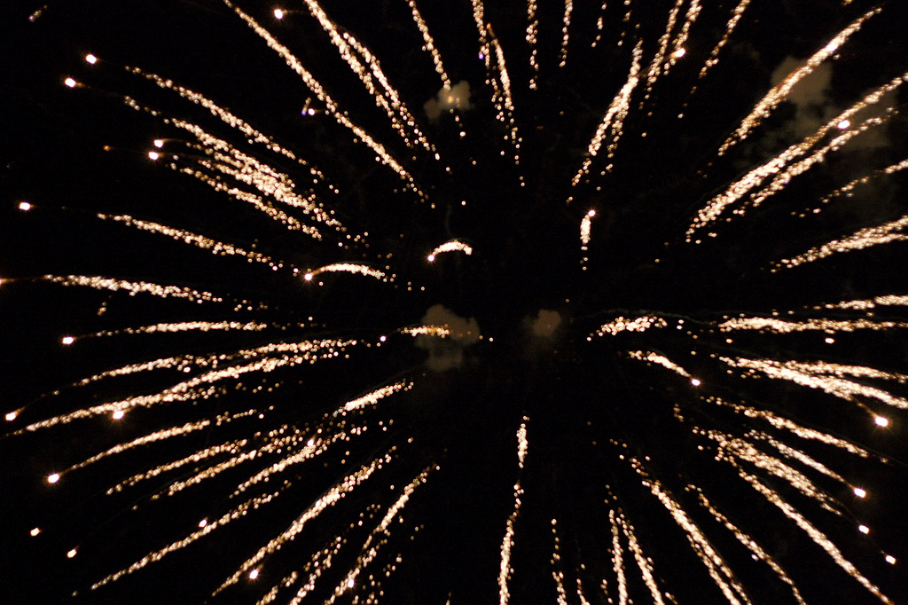
Fireworks
Photo courtesy of stoneflower (@flickr.com) - granted under creative commons licence – attribution

