Slide 1
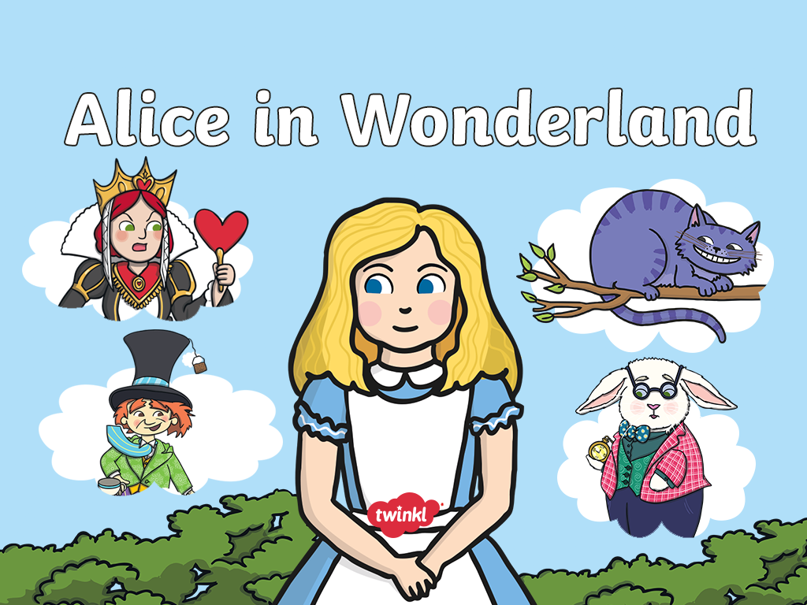

Slide 2

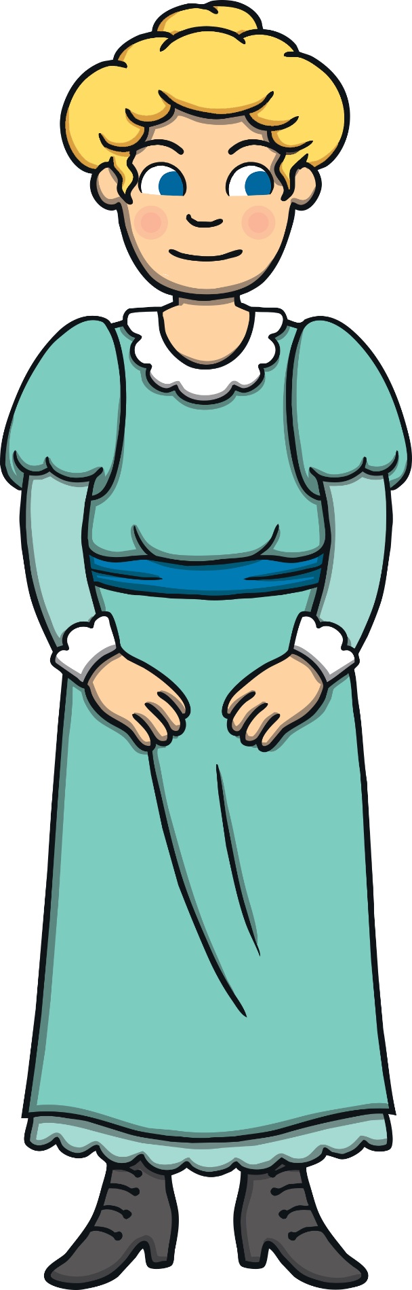

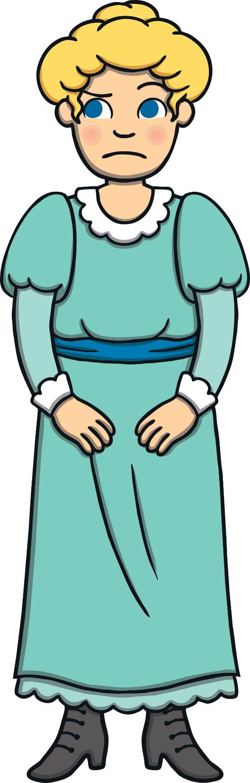
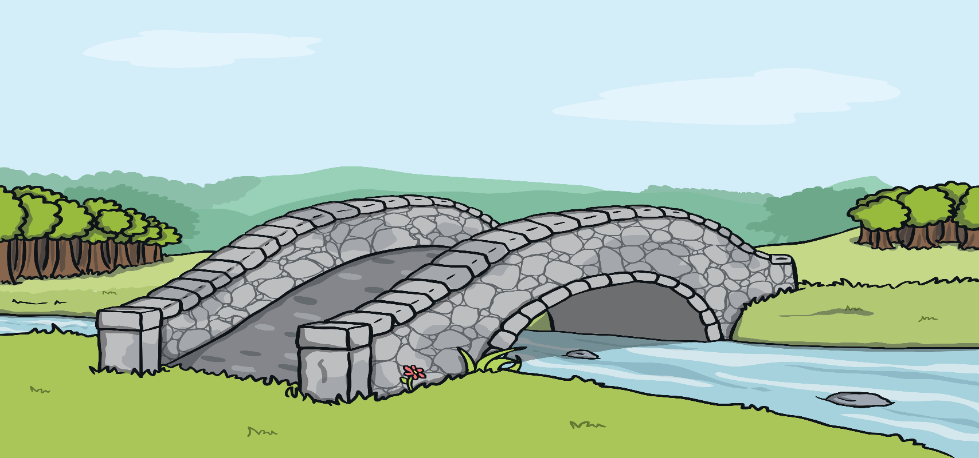
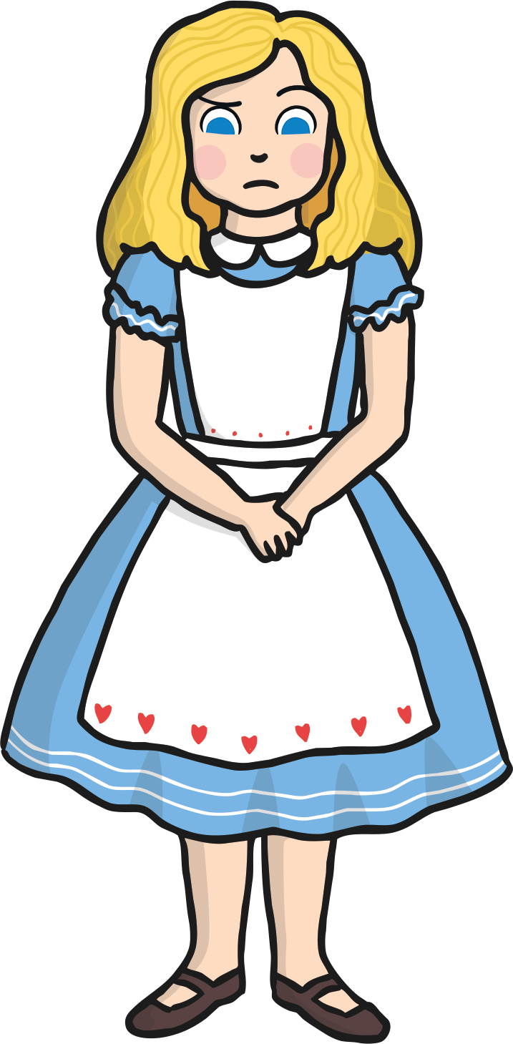


It was a warm day in summer.
Alice was sitting in the sunshine and she was reading a book with her sister.
The book was terribly boring and Alice began to feel sleepy.

Slide 3
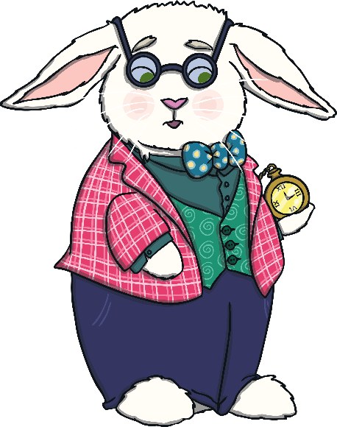

Suddenly, a small, white rabbit raced past.
The rabbit was wearing clothes!
He pulled a watch from his pocket to check the time.
He cried, “Oh dear! Oh no! I'm late! I’m late!”
The rabbit shook his head and then disappeared down a rabbit hole.

Slide 4
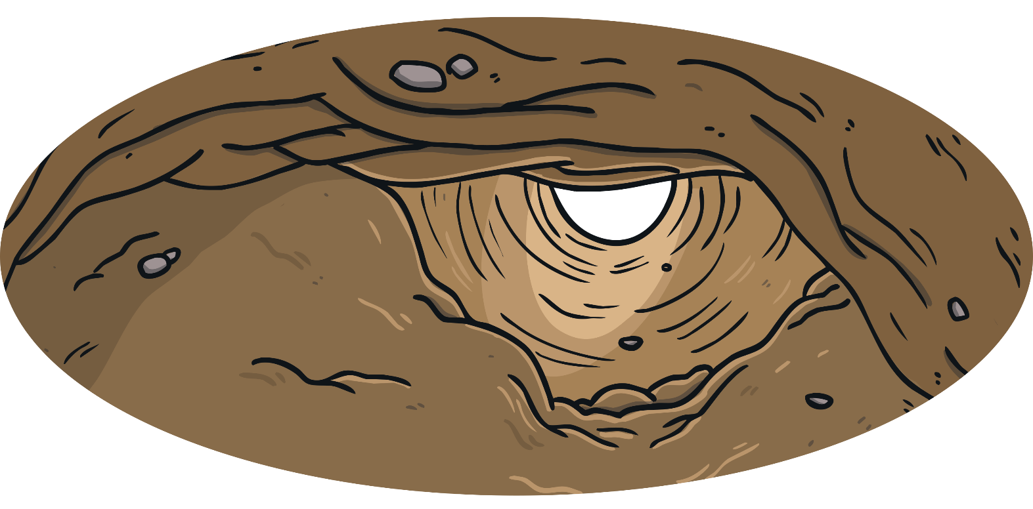
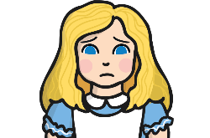
Alice followed the rabbit to the hole.
She peered through the entrance but she could no longer see the rabbit.
She squeezed her head and shoulders into the hole. Then, she wriggled her body a little further…

Slide 5
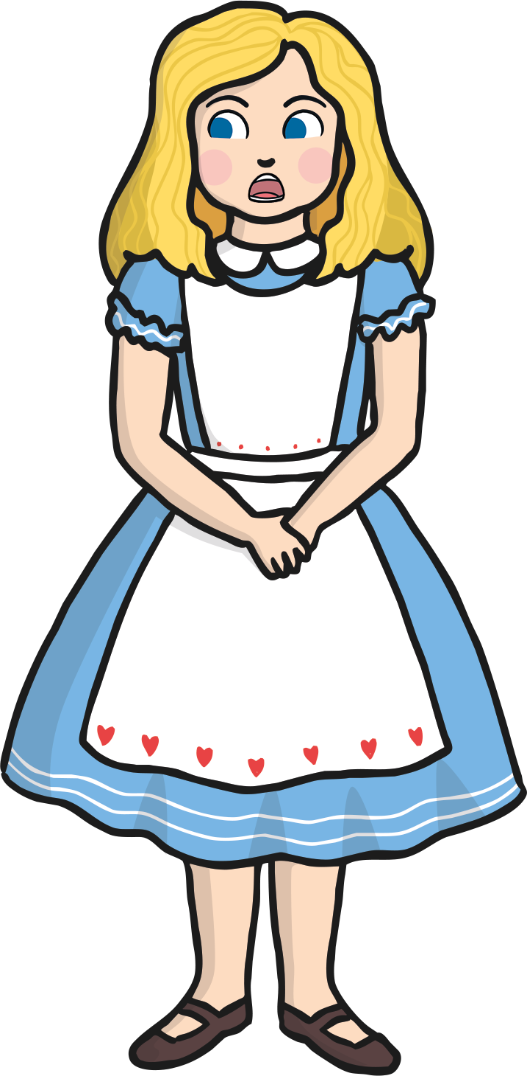


Suddenly, Alice felt herself falling.
For a long time, she tumbled down the rabbit hole.
Finally, she landed with a bump in a long hallway which had a tiny door at the end of it.

Slide 6
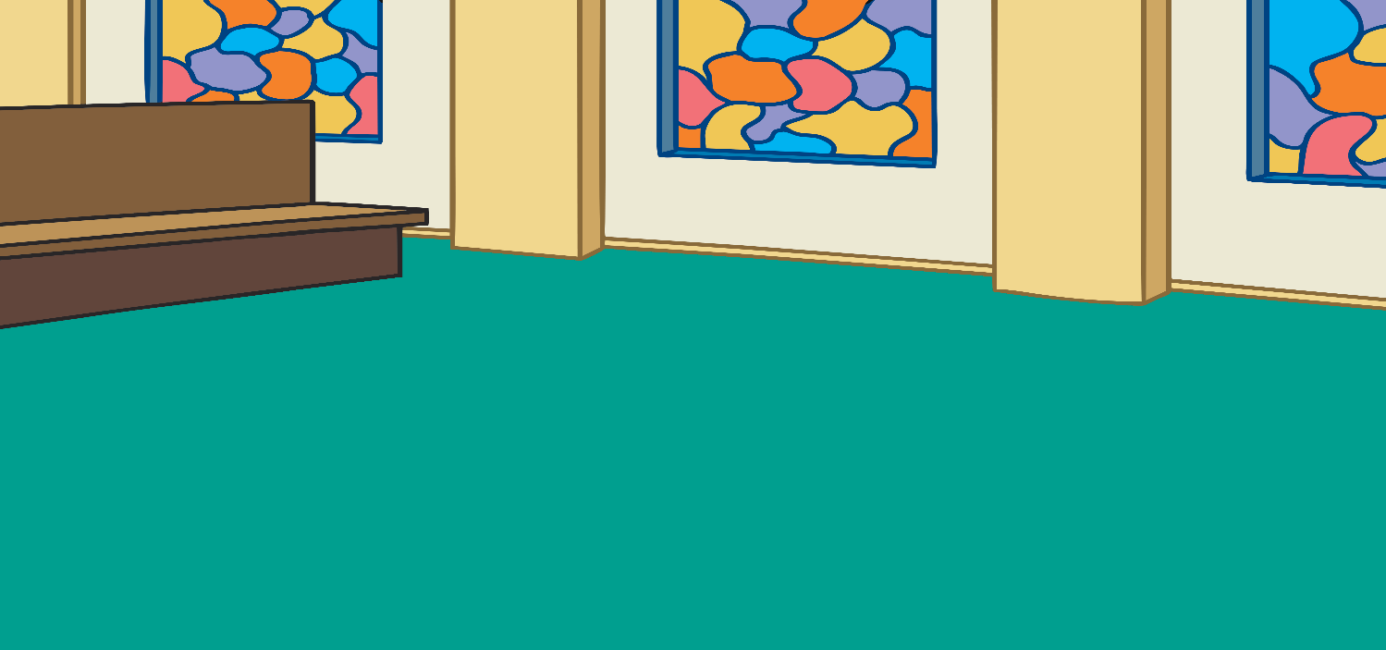
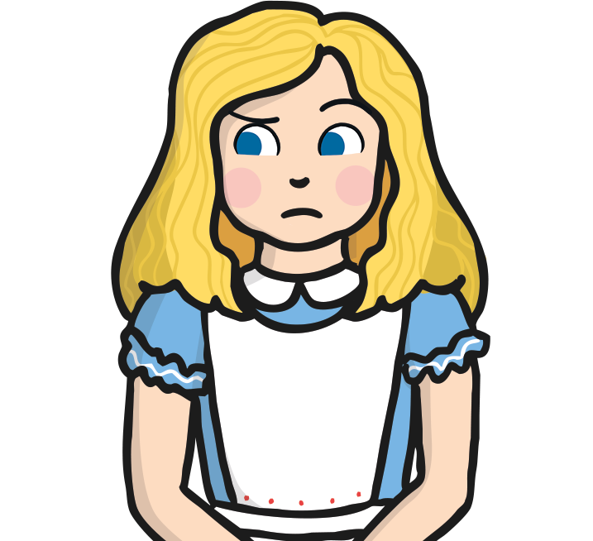
“I'm far too big to fit through such a little door,”
Alice said to herself.
Nearby, on a three-legged table, she found a small bottle. The bottle had a label on it which read ‘drink me’.
Alice quickly drank from the bottle.

Slide 7
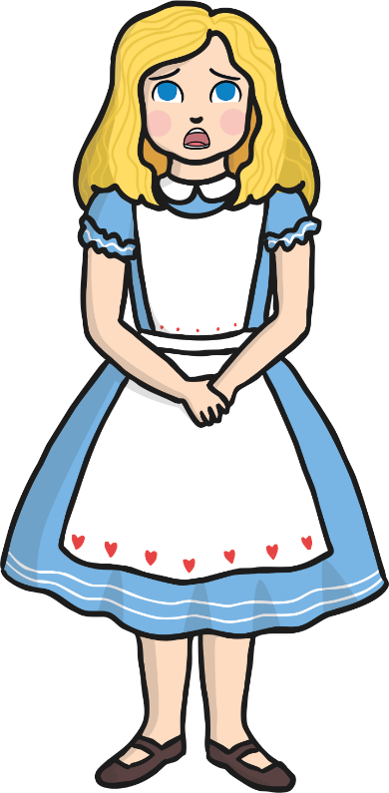
Alice shrank until she was as small as a doll.
She opened the door and quickly ran through it.
“Oh, I'll never get back to the right size,” Alice cried.
She began to look for help.

Slide 8
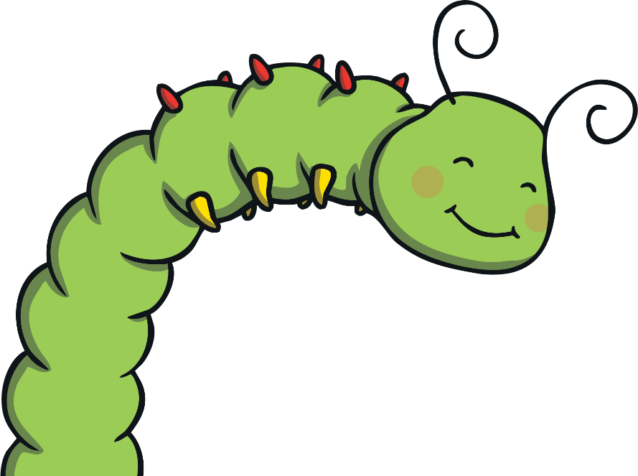
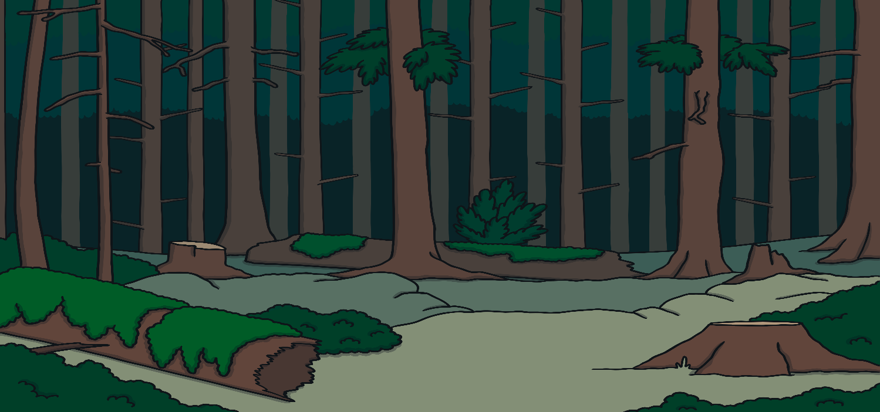



Soon, Alice met a green caterpillar who was sitting on top of a large mushroom.
The caterpillar explained, “Well, I may be able to help if size is your only problem.
One side of this mushroom will make you bigger but the other side will make you smaller.”

Slide 9

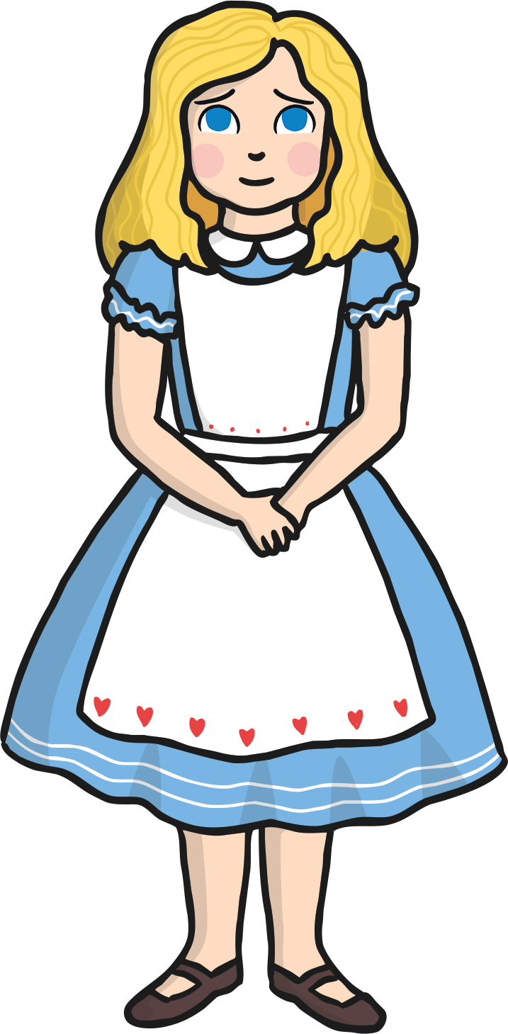
Alice cut a piece from the left side of the mushroom and she took a small bite.
“Thank goodness. I'm growing!” she cried.

Slide 10
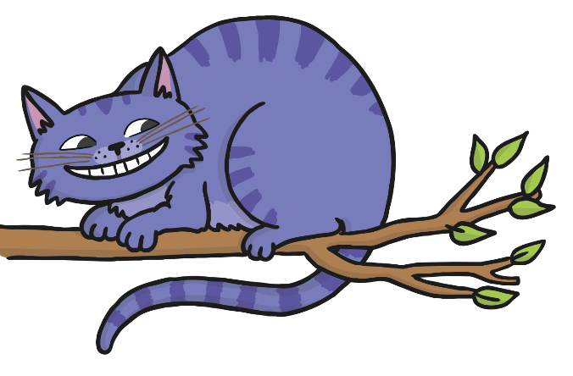

“Which way should I go now?” puzzled Alice.
“That path will lead you to The Mad Hatter’s tea party,” said a cat who was sitting in a tree.

Slide 11

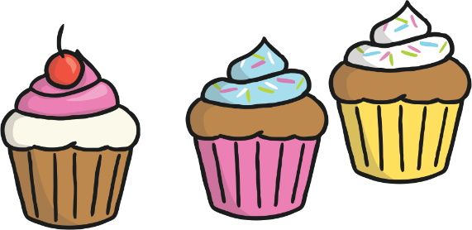
Alice walked down the path. She came across a long table which had been set ready for a tea party.
“How lovely! A tea party!” she cried.

Slide 12
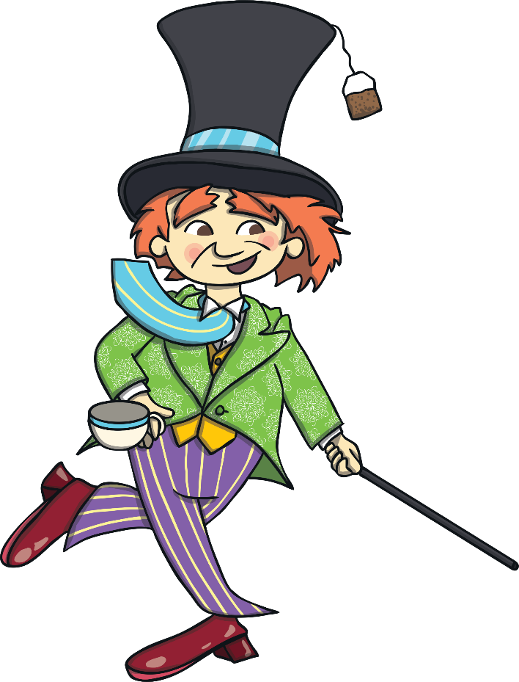
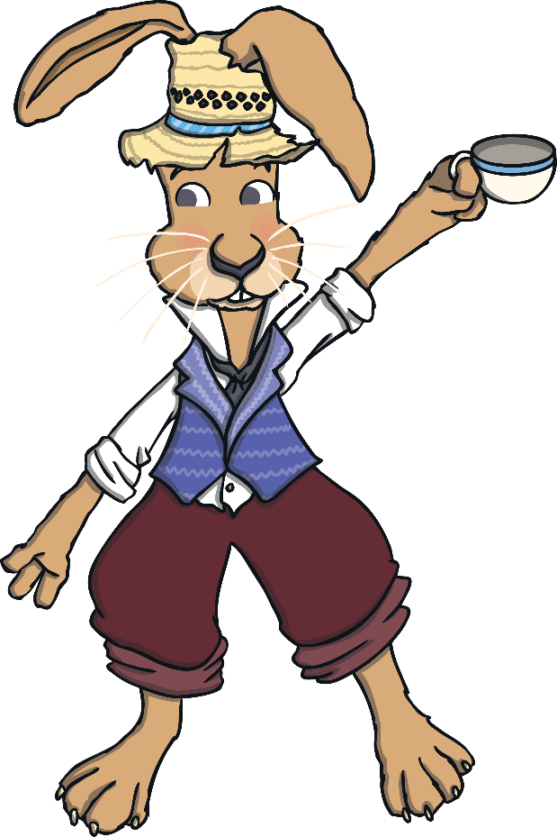
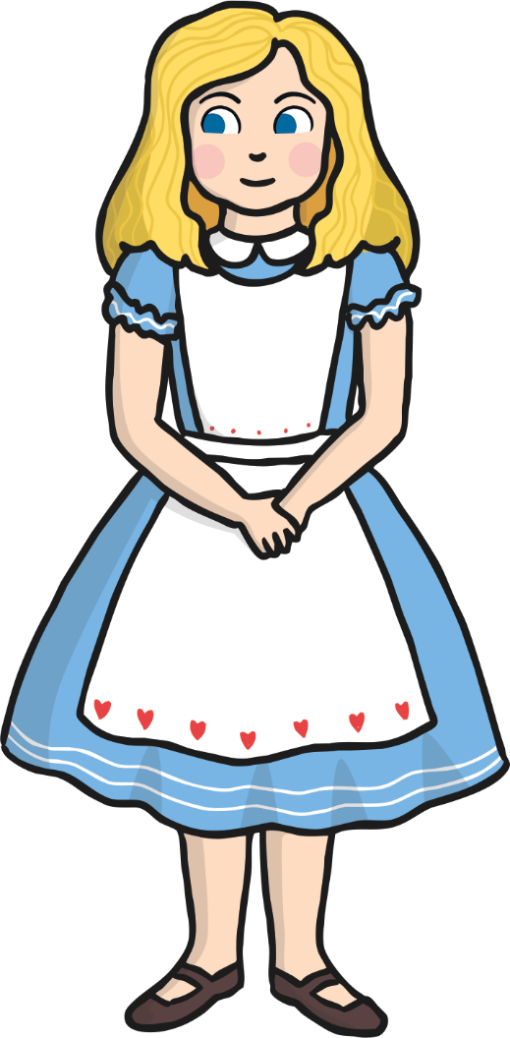
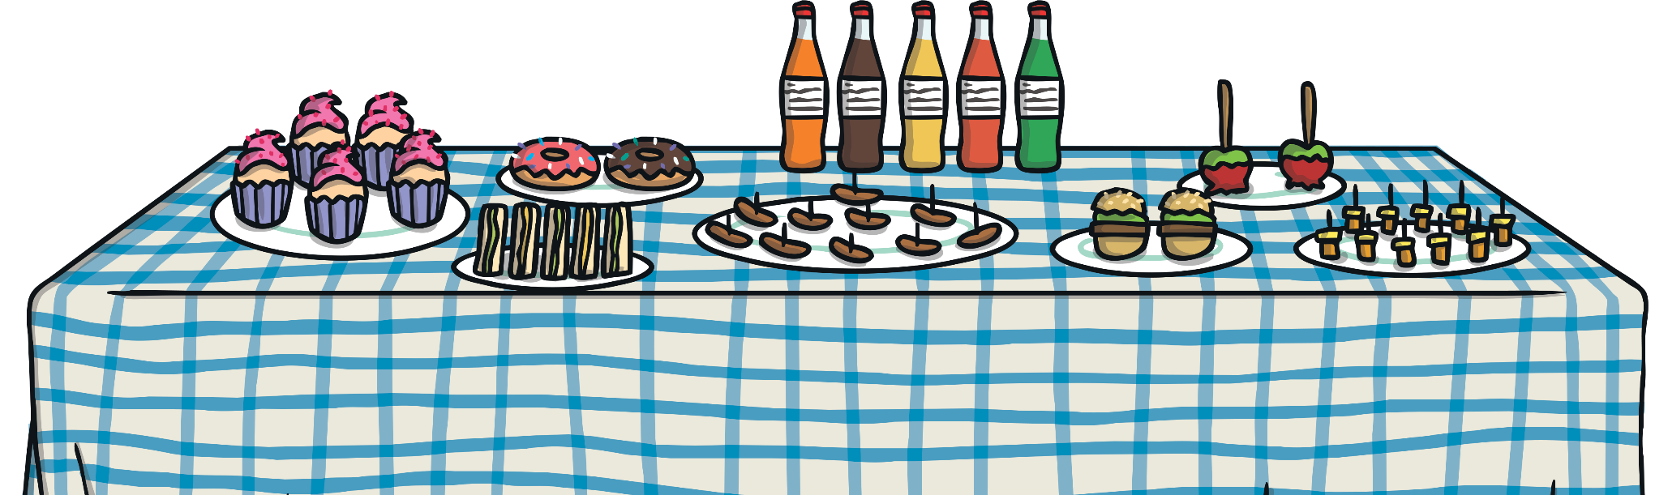
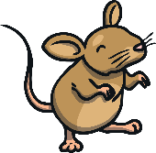
“There’s no room for you!” shouted The Mad Hatter as Alice arrived. Alice ignored him and sat down anyway.
She wanted to have a cup of tea with The March Hare and a sleepy, little mouse.

Slide 13
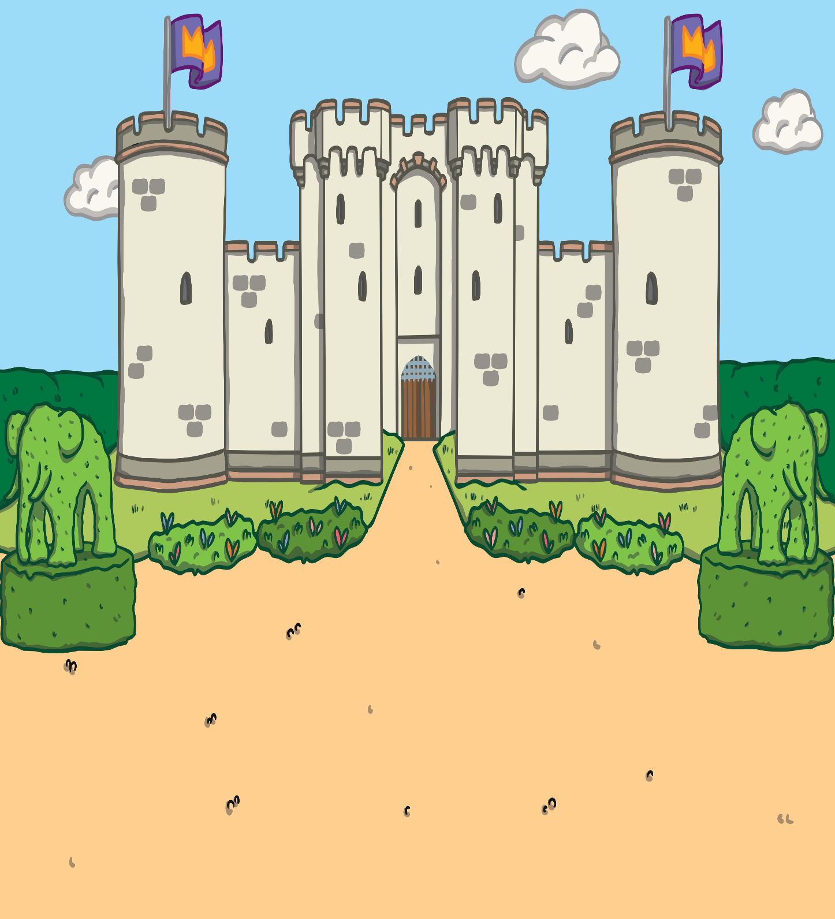
After the tea party, Alice continued walking.
She found herself in the middle of a field where
The Queen of Hearts was playing croquet.

Slide 14

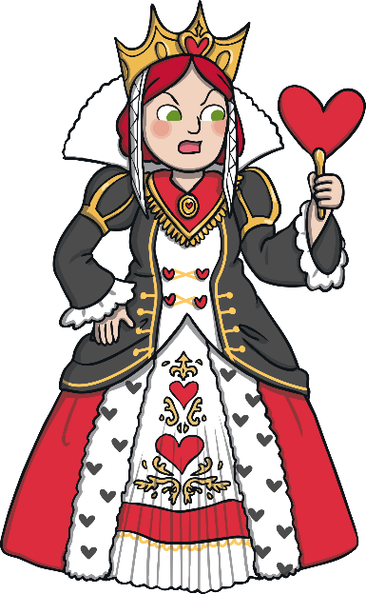

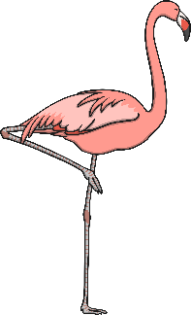

“Have you ever played croquet?”
asked The Queen of Hearts.
“Yes,” Alice answered, “but I've never used
a flamingo or a hedgehog to do so.”

Slide 15


“You will play with me and let me win or I’ll chop
off your head!” ordered The Queen of Hearts.

Slide 16

Alice wasn’t very good at croquet.
“Off with her head!” cried The Queen of Hearts.

Slide 17
Just then, Alice felt someone touch her shoulder.
“Wake up! You’ve been sleeping,” said Alice’s sister.

Slide 18

“I had a strange dream,” said Alice.
Alice told her sister all about her adventure.
Before long, Alice realised that she hadn’t eaten for hours and she ran inside for something to eat.

