Slide 2




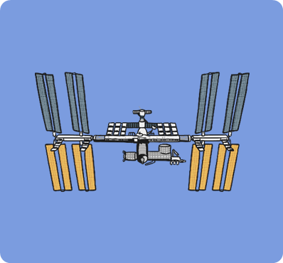

Choose an Image

Slide 3

Home
Start
Subtract
Reveal
Number Sentence
-
=
14
17
-
3
=
14

Slide 4

Home
Start
Subtract
Reveal
Number Sentence
-
=
7
15
-
8
=
7

Slide 5

Home
Start
Subtract
Reveal
Number Sentence
-
=
19
20
-
1
=
19

Slide 6

Home
Start
Subtract
Reveal
Number Sentence
-
=
8
11
-
3
=
8

Slide 7

Home
Start
Subtract
Reveal
Number Sentence
-
=
6
12
-
6
=
6

Slide 8

Home
Start
Subtract
Reveal
Number Sentence
-
=
5
9
-
4
=
5

