Slide 1
Position and Direction co-ordinates
Learning Objective:
To understand compass points
To be able to describe direction using the compass points

Slide 2
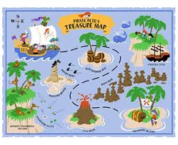
Directions
What are directions?
Directions tell us where something is
Directions help us to find out how we can get somewhere
To follow directions on a map, you need to know where North, East, South and West are. On most maps, North points towards the top of the map
To help us with direction, we use a compass

Slide 3
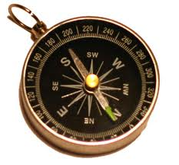
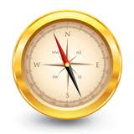

Using a compass
A compass is an important tool for map readers. It tells you which way is north and where to find east, south and west. Together, these are known as the four cardinal points of the compass

Slide 4
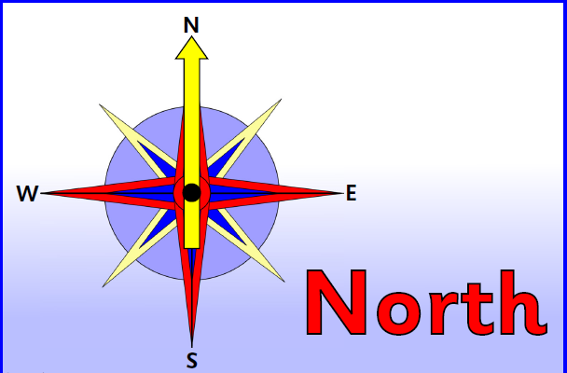
Compass points

Slide 5
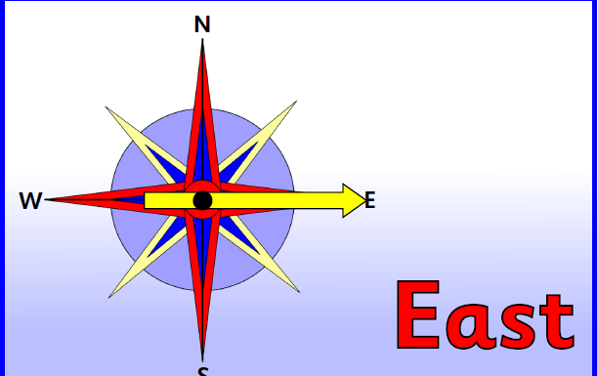
Compass points

Slide 6
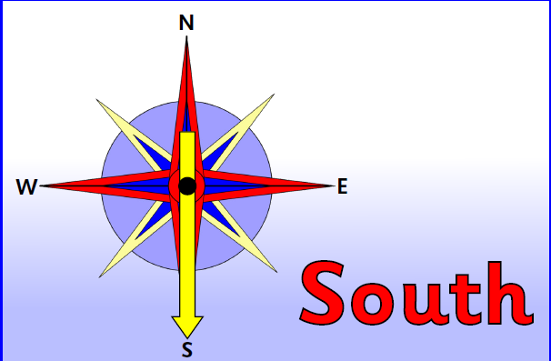
Compass points

Slide 7
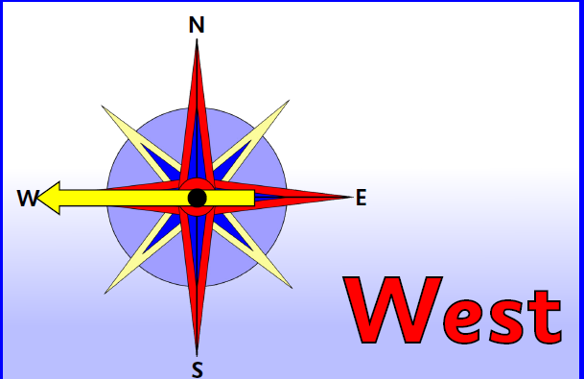
Compass points

Slide 8
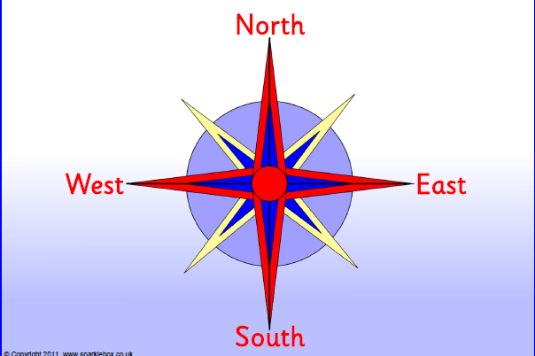
Compass points

Slide 9
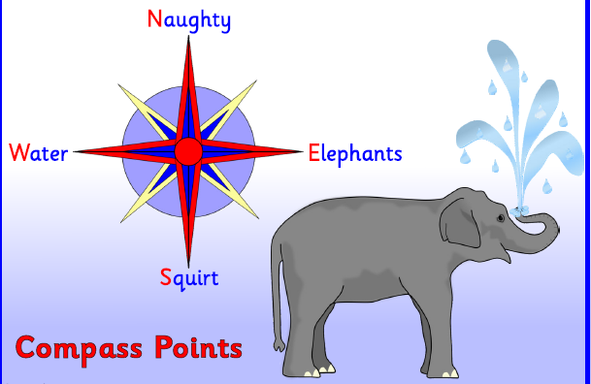
You can remember where the points of a compass are by remembering a rhyme:

Slide 10
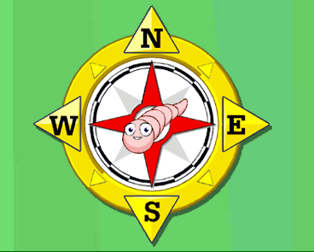
You can remember where the points of a compass are by remembering a rhyme:

Slide 11
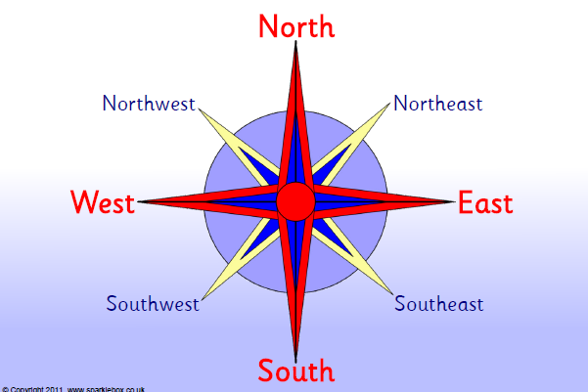
Compass points

Slide 12

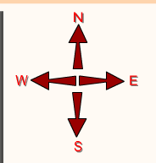
Now lets see if we can label the compass points correctly…
Remember , the four compass directions are:
North
West East
South

Slide 13
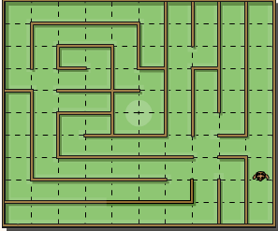
Compass Game

