Slide 1






Guidance for Audio PowerPoints
1. Open the folder and copy all the files.
2. Paste the copied files into a new folder.
3. Open the PowerPoint file, enable editing and enter presentation mode (start the slide show). Go to slide 3 and the backing track will start automatically.
The slides will automatically transition in time with the backing track.
You may wish to delete this slide before beginning the presentation.

Slide 3


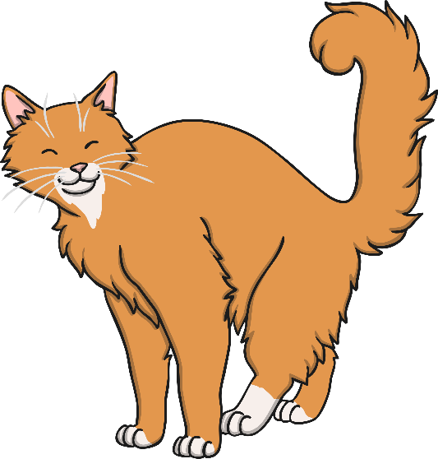
Old MacDonald had a farm, EE-I-EE-I-O,
And on that farm he had a cat, EE-I-EE-I-O,
With a “meow, meow” here and a “meow, meow” there,
Here a “meow,” there a “meow,” everywhere a “meow, meow.”
Old MacDonald had a farm, EE-I-EE-I-O.

Slide 4

Old MacDonald had a farm, EE-I-EE-I-O,
And on that farm he had a cow, EE-I-EE-I-O,
With a “moo, moo” here and a “moo, moo” there,
Here a “moo,” there a “moo,” everywhere a “moo, moo.”
Old MacDonald had a farm, EE-I-EE-I-O.

Slide 5
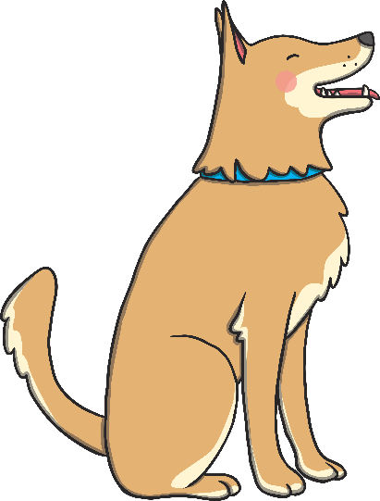
Old MacDonald had a farm, EE-I-EE-I-O,
And on that farm he had a dog, EE-I-EE-I-O,
With a “woof, woof” here and a “woof, woof” there,
Here a “woof,” there a “woof,” everywhere a “woof, woof.”
Old MacDonald had a farm, EE-I-EE-I-O.

Slide 6
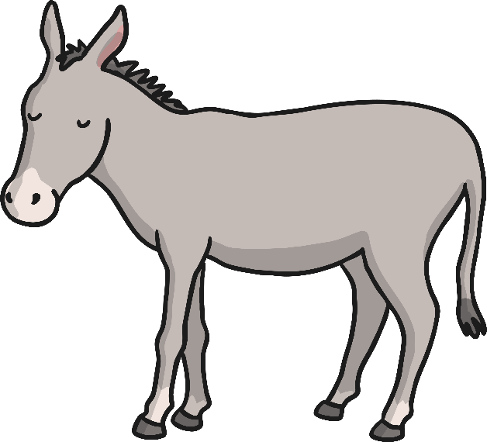
Old MacDonald had a farm, EE-I-EE-I-O,
And on that farm he had a donkey, EE-I-EE-I-O,
With a “hee-haw” here and a “hee-haw” there,
Here a “hee,” there a “haw,” everywhere a “hee-haw.”
Old MacDonald had a farm, EE-I-EE-I-O.

Slide 7
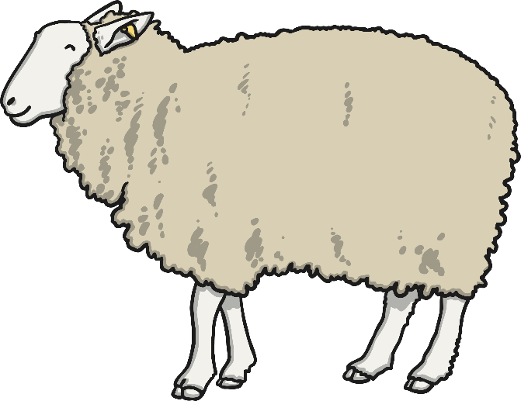
Old MacDonald had a farm, EE-I-EE-I-O,
And on that farm he had a sheep, EE-I-EE-I-O,
With a “baa, baa” here and a “baa, baa” there,
Here a “baa,” there a “baa,” everywhere a “baa, baa.”
Old MacDonald had a farm, EE-I-EE-I-O.

Slide 8
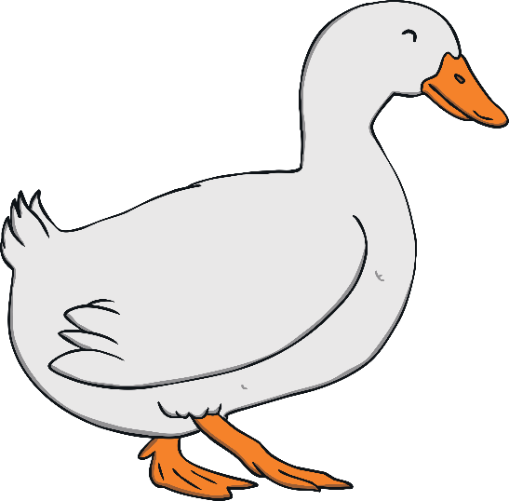
Old MacDonald had a farm, EE-I-EE-I-O,
And on that farm he had a duck, EE-I-EE-I-O,
With a “quack, quack” here and a “quack, quack” there,
Here a “quack,” there a “quack,” everywhere a “quack, quack.”
Old MacDonald had a farm, EE-I-EE-I-O.

Slide 9
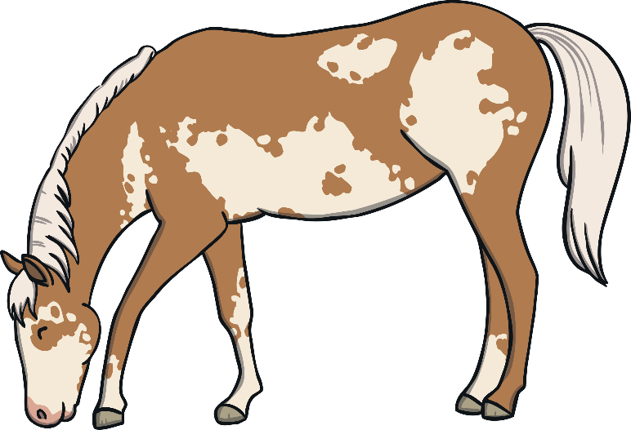
Old MacDonald had a farm, EE-I-EE-I-O,
And on that farm he had a horse, EE-I-EE-I-O,
With a “neigh, neigh” here and a “neigh, neigh” there,
Here a “neigh,” there a “neigh,” everywhere a “neigh, neigh.”
Old MacDonald had a farm, EE-I-EE-I-O.

