Slide 1





Slide 3


Slide 4

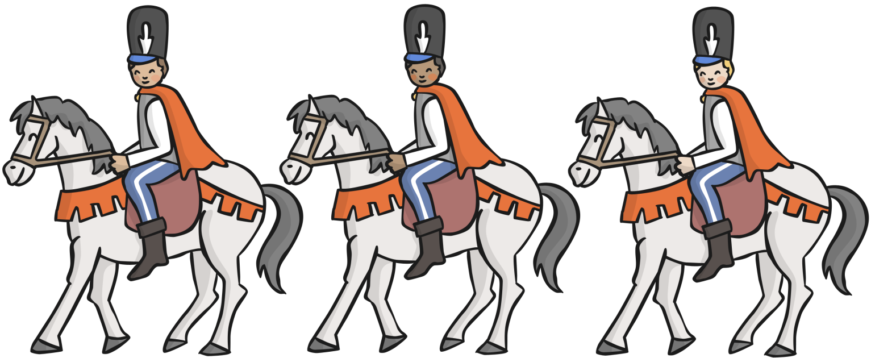

Slide 5


Slide 6
THE END

