Slide 2
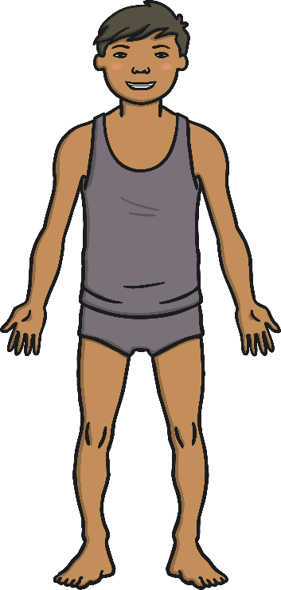
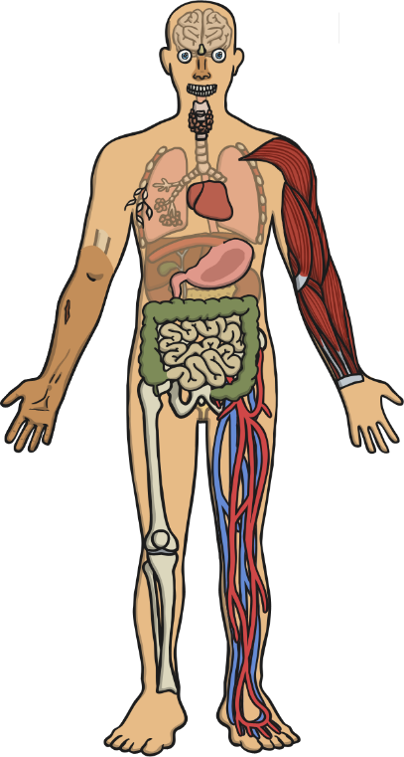
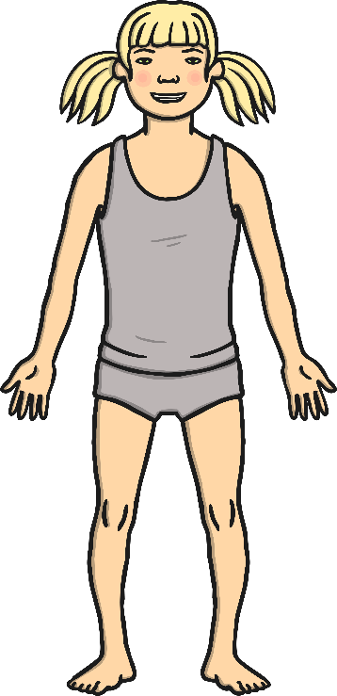
Let’s have a look inside the body…
What’s Inside of Me?
Have you ever wondered what was underneath your skin?
It is your organs. Your heart, brain, lungs and many more!

Slide 3
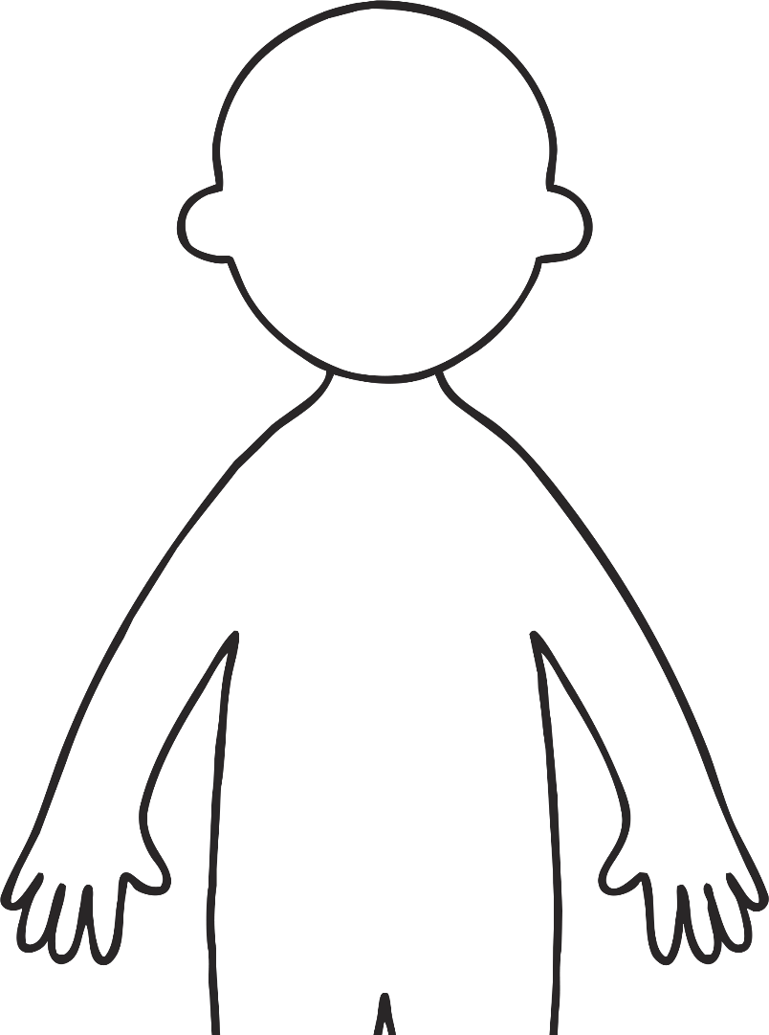
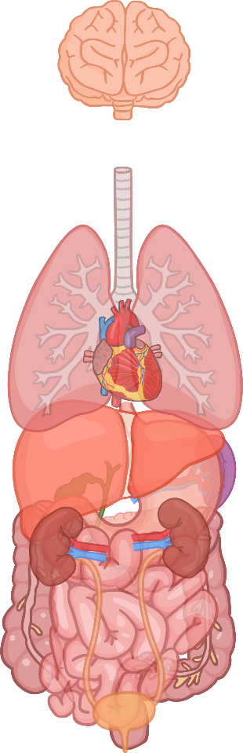
Here are the Main Organs
Do you know what they are called?
brain
lungs
kidneys
trachea
skin
small intestine
heart
large intestine
stomach
liver
bladder

Slide 4
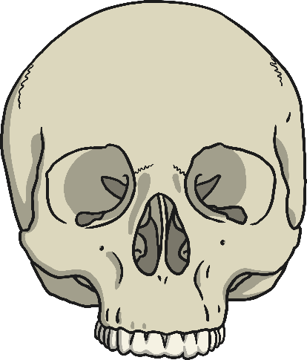
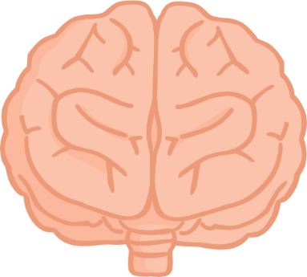
The Brain
The brain is protected by the skull and is surrounded by fluid to cushion it if you fall over.
The brain is about the size of a small cauliflower. It sends messages to the rest of the body using the spinal cord. It is a bit like your body’s own control centre.
The brain needs oxygen from blood to work properly. Around 3500 pints/2000 litres of blood flows through the brain every day!

Slide 5
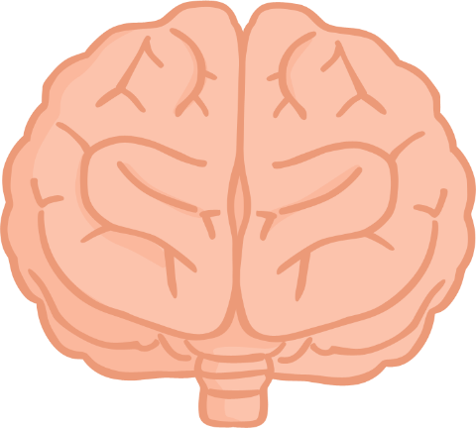
The Brain
The brain is split into two sides called hemispheres.
Different parts of the brain control different functions.
The right side of the brain controls the left side of the body.
The left side controls the right side of the body.
There are areas of the brain that help with all of our senses, our behaviour, our speech, our memory and movements.

Slide 6
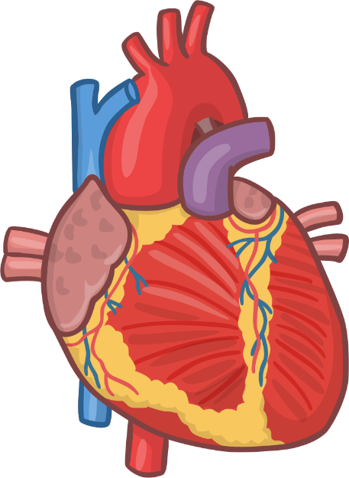
The Heart
The heart is like a pump, but it is a muscle. It is located in the centre of the chest and it is about the size of your fist.
The heart sends blood around the body.
The blood provides the body with the oxygen and nutrients it needs.
The left side of the heart does the exact opposite. It receives blood from the lungs and pumps it out to the body.
The right side of the heart receives blood from the body and pumps it to the lungs.

Slide 7
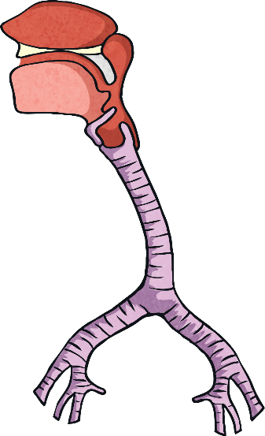
The Trachea
The trachea, also known as the windpipe, is a hollow tube that connects the nose and mouth to the lungs.
It begins at the lower part of the larynx (the voice box) and continues down to the lungs.
The trachea allows air to flow in from our nose and mouth, down to our lungs.
If the trachea becomes blocked, breathing is restricted which can be very serious.

Slide 8

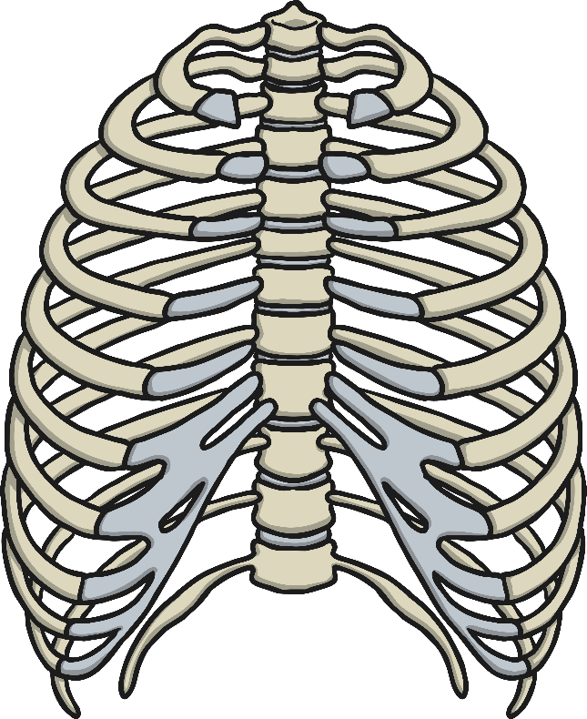
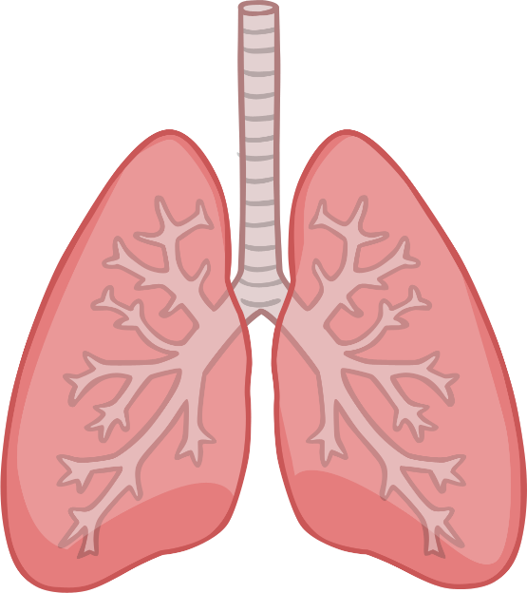
The Lungs
The ribcage protects the lungs.
The lungs take up most of the space in the chest.
The left lung is smaller than the right lung so that there is enough space for the heart.
The lungs allow you to take in fresh air and get rid of stale air.
Your body needs oxygen to stay alive. When you breathe in, oxygen enters the lungs. The oxygen goes into the bloodstream through your lungs and is carried to the parts of the body that need it.

Slide 9
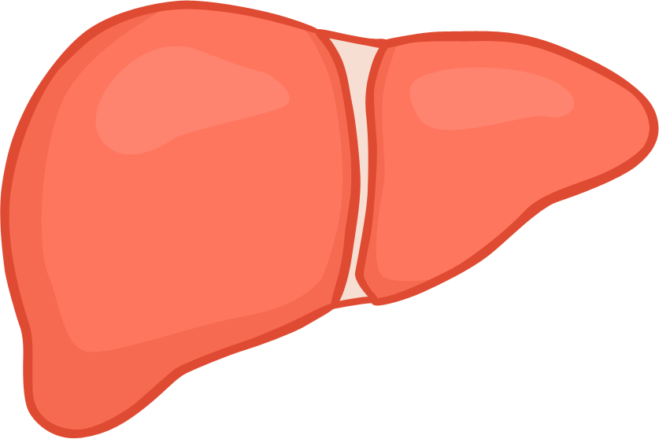
The Liver
The liver is the largest organ inside the body.
The liver gets rid of toxins and helps the body store energy.
When the body is fully grown the liver will weigh 1.5 kilograms, but by the time it is 60 years old it will have shrunk to 0.8 kilograms!

Slide 10
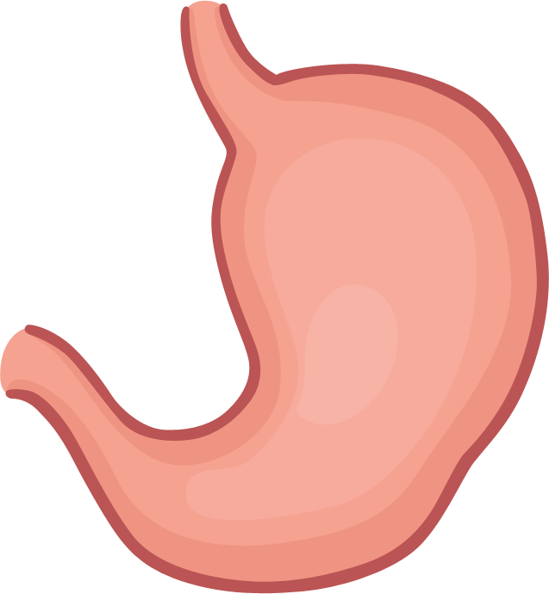
The Stomach
When we eat food the body sends it to the stomach and it stays there for 2 ½ to 3 hours.
The stomach muscles squash the food until it is a creamy pulp.
The stomach produces juices to break down food and kills germs you may have swallowed.

Slide 11
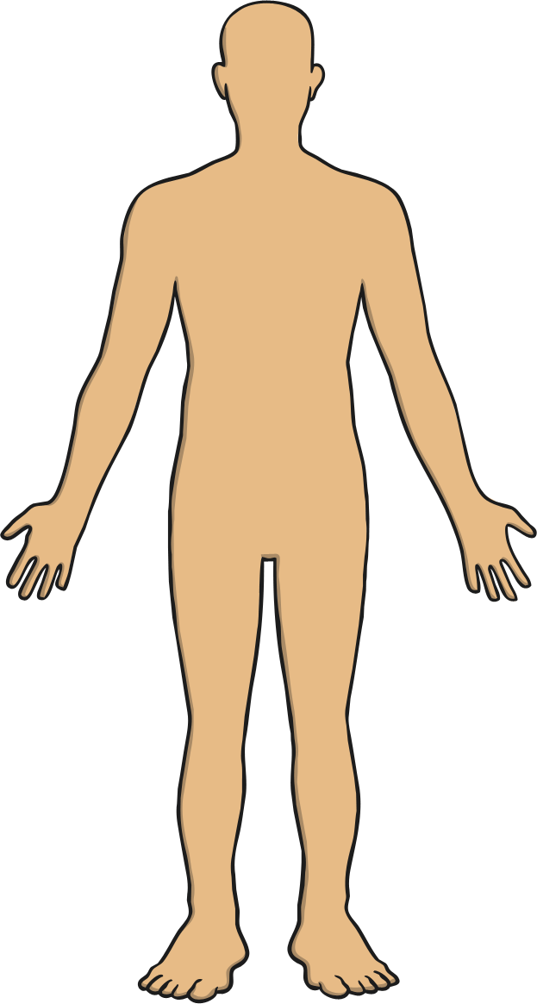
The Skin
The skin is tough and strong, just right for covering your body and protecting it.
The skin helps to keep our body at just the right temperature.
The skin is the body’s largest organ!
The skin allows us to have the sense of touch.
The skin is very important. It covers and protects everything inside the body.
Skin is always renewing itself. Though you cannot see it happening, every minute of the day we lose about 30,000 to 40,000 dead skin cells off the surface of our skin.

Slide 12
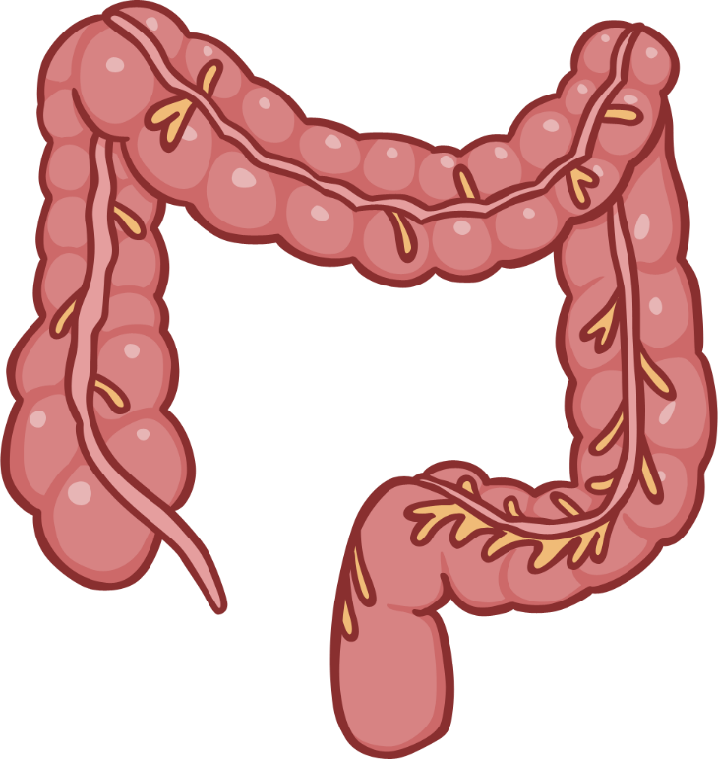
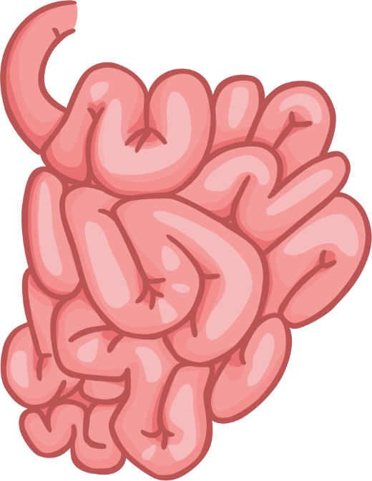
The Intestines
The intestines are in two parts:
the large intestine
and the small intestine.
The small intestine is a narrow coiled tube that is about 6 or 7 metres long. When food leaves the stomach it comes here so that nutrients can be absorbed back into the body.
Water and food that cannot be digested pass into the large intestine and come out of your body as waste.

Slide 13
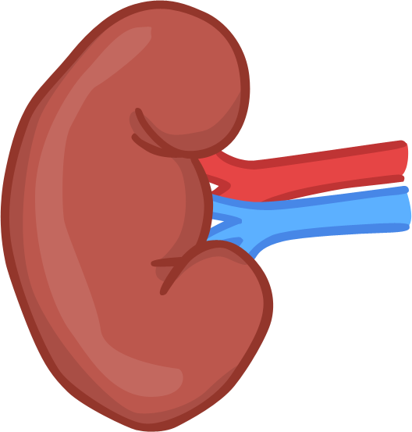
The Kidneys
One of the main jobs of the kidneys is to filter out the waste in the blood. Most of the waste is just stuff your body doesn’t need because it already has enough. The waste is combined with water to make urine. This travels to the bladder.
The kidney is just as important as the heart. The body needs at least one kidney to survive.
If you have ever seen a kidney bean, then you have a pretty good idea of what a kidney looks like!
Kidneys come in pairs. Each kidney is 13cm long and about 8cm wide. About the size of a computer mouse.

Slide 14
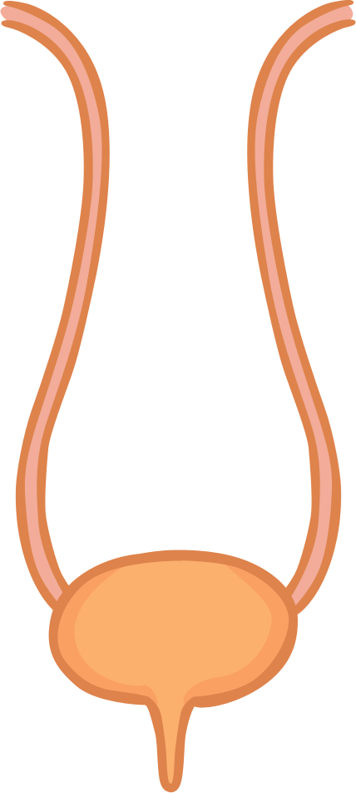
The Bladder
The bladder is a bag that collect the urine that leaves the kidneys. When the bladder is full it sends a message to the brain and you go to the toilet.
Drinking plenty of water and avoiding rich foods will help keeps the bladder and kidneys in good condition.

