Slide 1
Term 3 Week 4
Carry out operations such as multiplication and division.
Find fractions of amounts; half, quarters, thirds, fifths, tenths
To know not all objects can be shaded or cut to find fractions

Slide 2
Fractions
‪Hit the Button - Quick fire maths practice
Notes:
Practise your times tables – Great Fun ☺
Focus on 2, 3, 4, 5 and 10

Slide 3
Multiplication questions ☺
5 x 3 = 4 x 10 =
3 x 2 = 8 x 5 =
7 x 10 = 3 x 4 =
10 x 7 = 4 x 3 =
Notes:
Lesson 1
Starter

Slide 4
What is a fraction?
A fraction is made up of 3 parts:
Numerator
Dividing line
Denominator
3
4
Notes:
Recep what a fraction is

Slide 5
What is a fraction?
A fraction is made up of 3 parts:
Numerator
3
The numerator is how many parts you have of the ‘whole’.
4

Slide 6
What is a fraction?
A fraction is made up of 3 parts:
Dividing line
3
4
A fraction tells you how many parts you have out of how many in the ‘whole’. The whole is divided into equal parts.

Slide 7
What is a fraction?
A fraction is made up of 3 parts:
Denominator
3
The denominator are how many EQUAL parts in the ‘whole’.
3

Slide 8
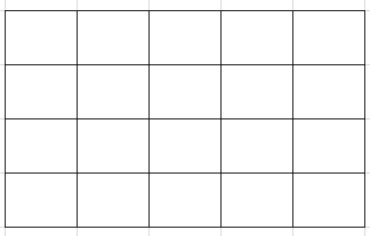
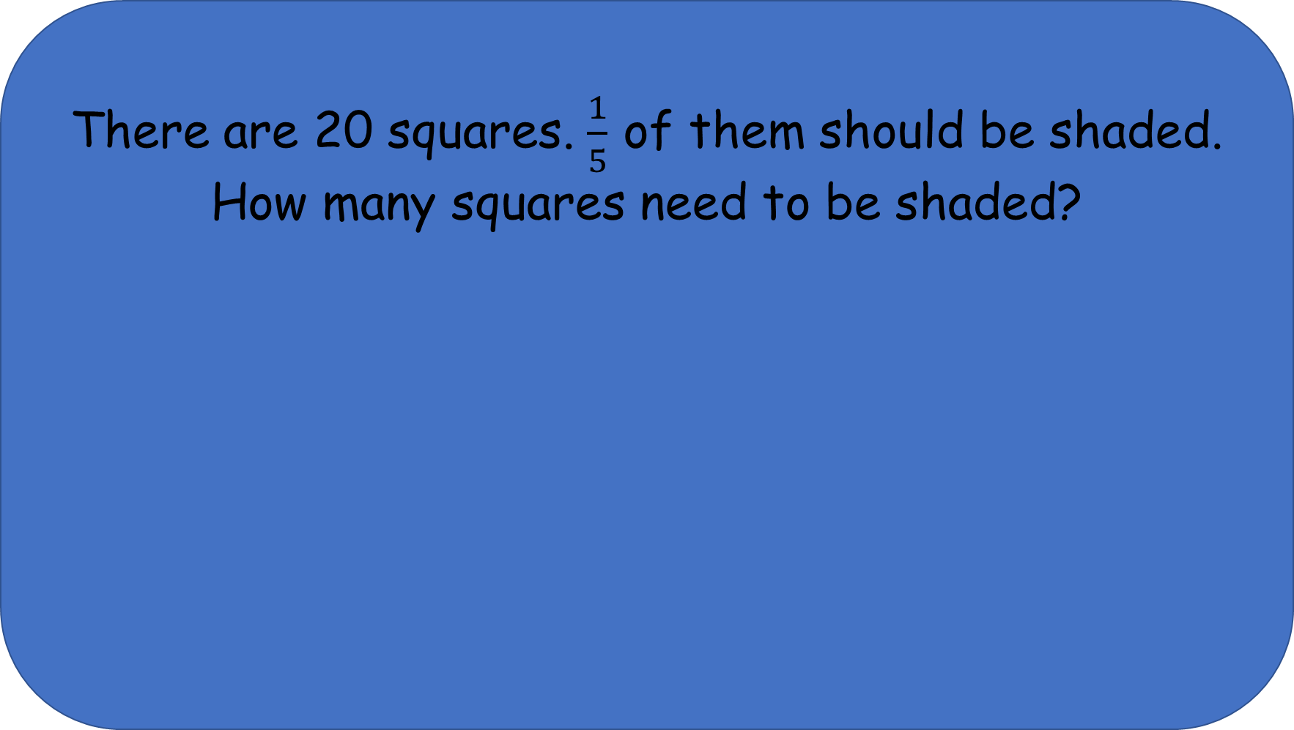
There are 20 squares. $\frac{1}{5}$ of them should be shaded.
How many squares need to be shaded?
Notes:
Using times knowledge to help solve problems.

Slide 9
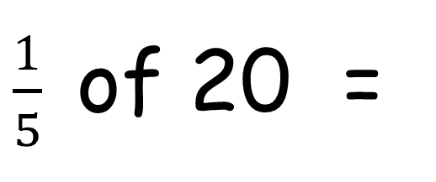
$\frac{1}{5}$ of 20 =
4
How many times does 5 go into 20?
Count in 5s
4 jumps so 5 goes in 4 times.
Multiply the numerator by the answer.
1 x 4 = 4
0
5
10
15
20
Notes:
Using times knowledge to help solve problems.
Model shading 4 parts. They can be in a row or they can be anywhere in the shape.

Slide 10
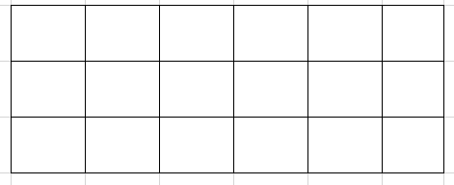
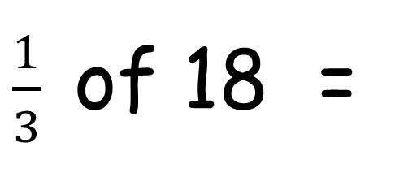
$\frac{1}{3}$ of 18 =
6
How many times does 3 go into 18?
Count in 3s
6 jumps so it goes in 6 times.
Multiply the numerator by the answer.
1 x 6 = 6
Notes:
Using times knowledge to help solve problems.
Model shading 6 parts. They can be in a row or they can be anywhere in the shape.

Slide 11
Have a go at the questions on the worksheet.

Slide 12
What are you more confident in today?
Notes:
Whole class – gather ideas to check understanding of tasks set

Slide 13
Fractions
‪Hit the Button - Quick fire maths practice
Notes:
Lesson 2
Practise your times tables – Great Fun ☺
Focus on 2, 3, 5 and 10

Slide 14
Multiplication questions ☺
5 x 10 = 4 x 15 =
3 x 5 = 8 x 3 =
7 x 2 = 6 x 5 =
10 x 4 = 4 x 8 =
Notes:
Lesson 2
Starter

Slide 15
What is a fraction?
A fraction is made up of 3 parts:
Numerator
Dividing line
Denominator
3
4
Notes:
Reminder slide

Slide 16
You can find fractions of amounts as well as shapes.
It is important to remember that all parts MUST be equal.
If I need to find ½ of a number, I can use my 2 times table.
If I need to find ¼ of a number, I can use my 4 times table.
Notes:
Discuss the denominator being how many parts we are sharing the amount into.

Slide 17
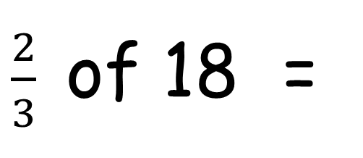
6 jumps so it goes in 6 times.
Multiply the numerator by the answer.
2 x 6 = 12
$\frac{2}{3}$ of 18 =
12
How many times does 3 go into 18?
Count in 3s
Notes:
Using times knowledge to help solve problems.
Model shading 6 parts. They can be in a row or they can be anywhere in the shape.

Slide 18
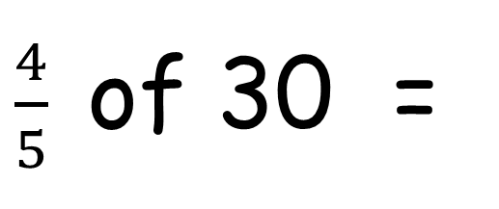
6 jumps so it goes in 6 times.
Multiply the numerator by the answer.
4 x 6 = 24
$\frac{4}{5}$ of 30 =
12
How many times does 5 go into 30?
Count in 5s
Don’t forget you can swap the numbers around to make it easier for you to use your times table knowledge.
4 x 6 is the same as 6 x 4
Notes:
Using times knowledge to help solve problems.
Reminder – multiplication can be swapped around and still be the same answer.

Slide 19
Have a go at the questions on the worksheet.

Slide 20
What are you more confident in today?
Notes:
Whole class – gather ideas to check understanding of tasks set

