Slide 1


Science
Animals Including Humans
Year One
Science | Year 2 | Animals Including Humans | Growing and Changing | Lesson 2

Slide 2
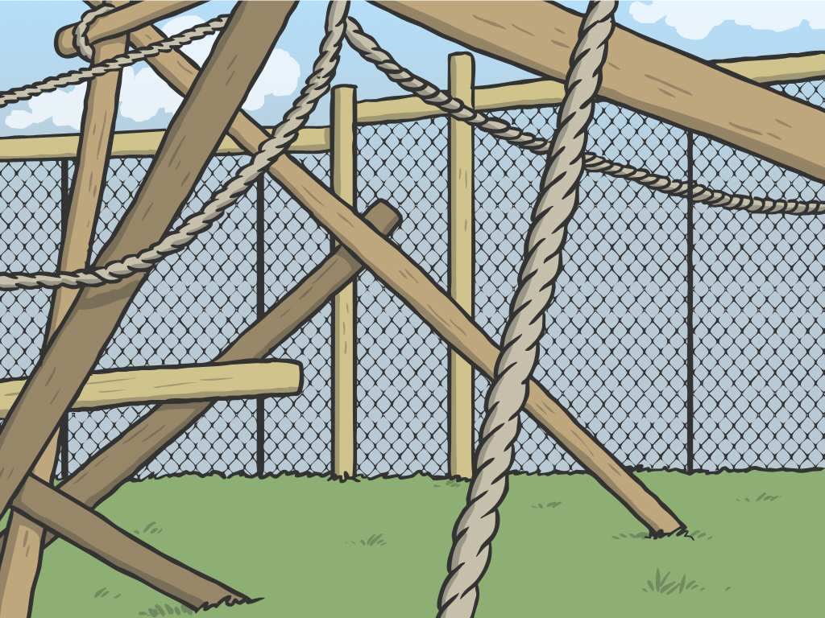


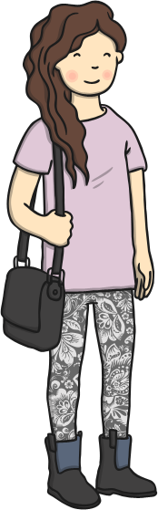
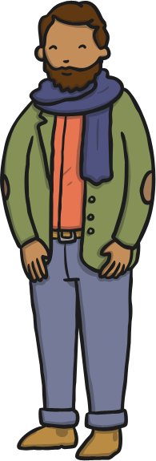
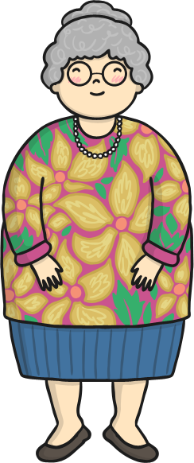
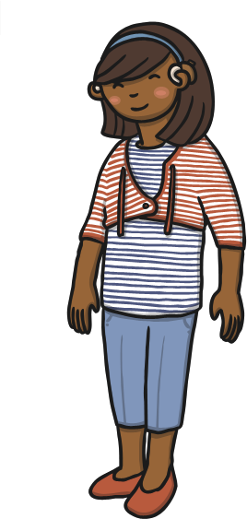
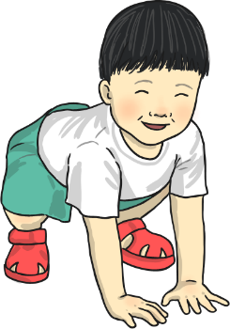
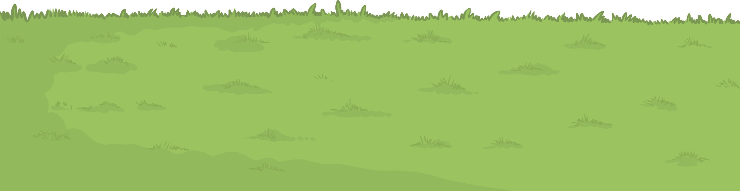

Growing and Changing

Slide 3
Aim
I can describe how humans change as they grow.
I can set up a test to find out if children are faster when they are older.
Success Criteria
I can name the different stages in the human timeline.
I can describe what humans are like during the different stages of their lives.
I can set up a test.
I can collect and interpret results.

Slide 4


Growing Up
Human beings are growing and changing all the time.
You are different now to how you were a year ago, and a year from now, you will be different again!
Can you think of a way that you have changed as you have got older?

Slide 5
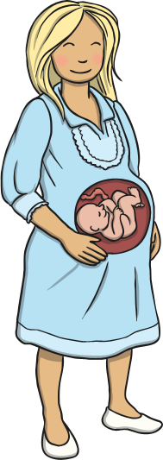
Growing Up
Life for humans, starts when they grow inside their mother’s womb.
What happens next? What are the stages of life that human beings go through?

Slide 6
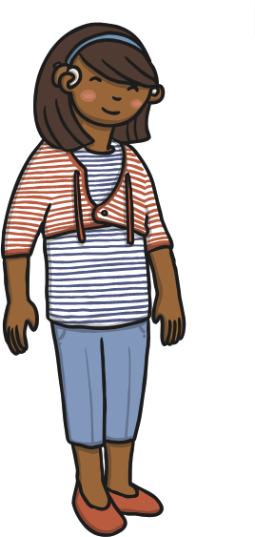

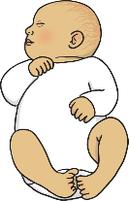
Life Stages
Life for humans, starts when they grow inside their mother’s womb.
Baby
Toddler
Child
Teenager
Adult
Elderly

Slide 7
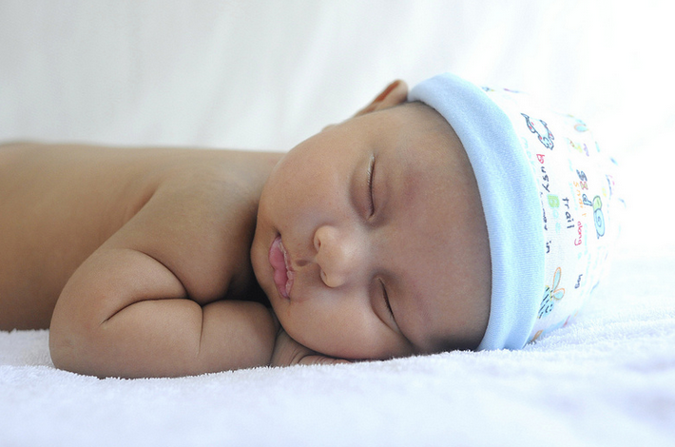
Life Stages
Babies
All babies are born completely helpless. They need a grown-up to take care of them all the time and give them everything they need.
What do grown-ups need to do to take care of a baby?
Answer
To feed the baby with milk.
Keep the baby clean and healthy by changing its nappy and bathing it.
Make sure the baby is warm and comfortable.
Play with the baby.
Give the baby lots of love.
Photo courtesy of hockhow siewpeng (@flickr.com) - granted under creative commons licence – attribution

Slide 8
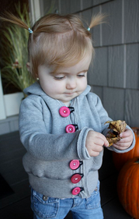
Life Stages
Toddler
Between the ages of 1 and 3, humans start to develop lots of new skills. Toddlers grow and develop muscles to help them move around. They learn to walk and talk. At first, they only know a few words and they will be wobbly on their feet.
Toddlers like to investigate everything, and are always playing and learning. They start to try to do things for themselves, like feeding and dressing themselves. They might not be very good at it at first! Toddlers need lots of looking after, because they haven’t yet learnt to keep themselves safe.
How do grown-ups take care of toddlers?
Answer
Toddlers still need lots of love and attention.
Grown-ups need to play with them, dress them and feed them.
Toddlers need to be kept away from things that can hurt them, like stairs and fires.
Photo courtesy of ressicajachael (@flickr.com) - granted under creative commons licence – attribution

Slide 9
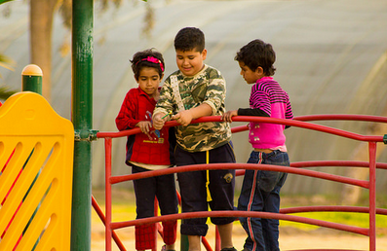
Life Stages
Child
This is your stage of life! Children are aged 3-12.
During these years you learn lots of new skills - such as reading and writing, counting, kicking a ball, swimming and riding a bike.
Your parents no longer need to be with you all the time, but still need to make sure that you are safe and happy.
What changes are happening to you at the moment?
Answer
Wobbly tooth.
New shoes because feet have grown.
Starting to go to play at your friends’ houses with mum or dad being there.
Going to bed later.
Photo courtesy of rassoulali (@flickr.com) - granted under creative commons licence – attribution

Slide 10
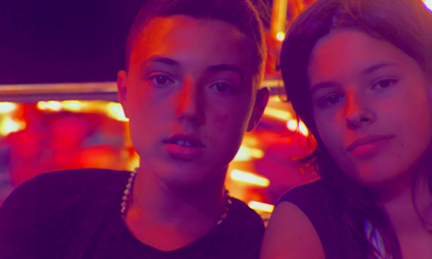
Life Stages
Teenager
Teenagers are aged between 13 and 19.
Teenagers are getting ready to become adults. They want to try things on their own.
Teenagers eat a lot because they grow and change a lot. They can get spots and their hair changes.
They can sometimes be a bit grumpy! This is because new hormones are growing and changing in their body.
How can you tell someone is a teenager?
Answer
Teenagers are taller and stronger than children.
Teenagers want to try things on their own.
Their bodies are changing and becoming more grown up.
Photo courtesy of rassoulali (@flickr.com) - granted under creative commons licence – attribution

Slide 11
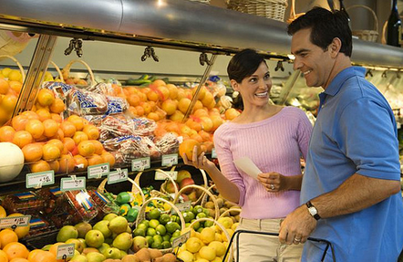
Life Stages
Adult
Once you are fully grown, you are an adult.
Adults must exercise and make sure they eat healthily to keep their bodies working well. Adults can have babies of their own.
Who are the adults in your family? How are they different to you?
Answer
Adults are bigger and stronger than children.
Adults are able to take care of themselves.
They can make families of their own.
Photo courtesy of passiveincomedream (@flickr.com) - granted under creative commons licence – attribution

Slide 12
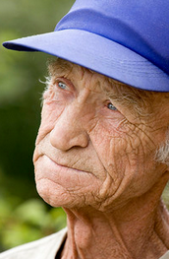
Life Stages
Elderly
As adults go through their lives, they get older.
You are classed as elderly after the age of 65, but many adults of this age don’t yet feel old!
Elderly people begin to slow down as their body ages, because their joints and muscles can ache. Their eyes might not work so well and they often need glasses.
Older people have softer skin with wrinkles, and often have grey or white hair.
How are elderly people different from young adults?
Answer
They might have softer skin or wrinkles.
They might have grey or white hair.
They might move more slowly, or need help with getting around.
Photo courtesy of ~deliza~ (@flickr.com) - granted under creative commons licence – attribution

Slide 13

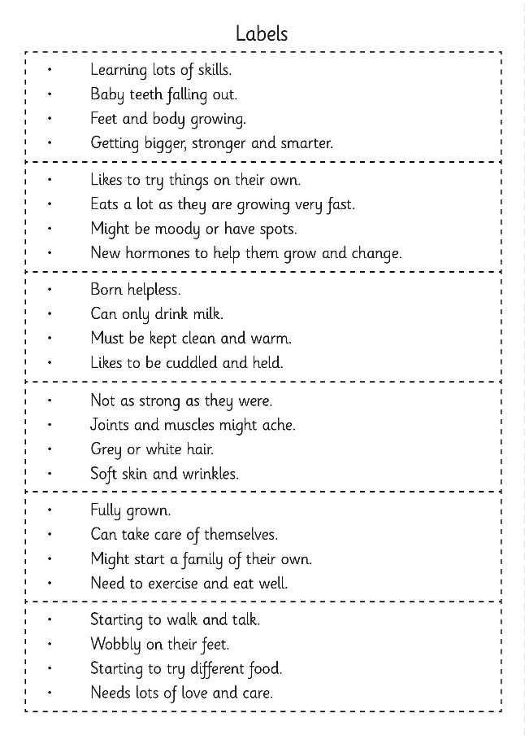
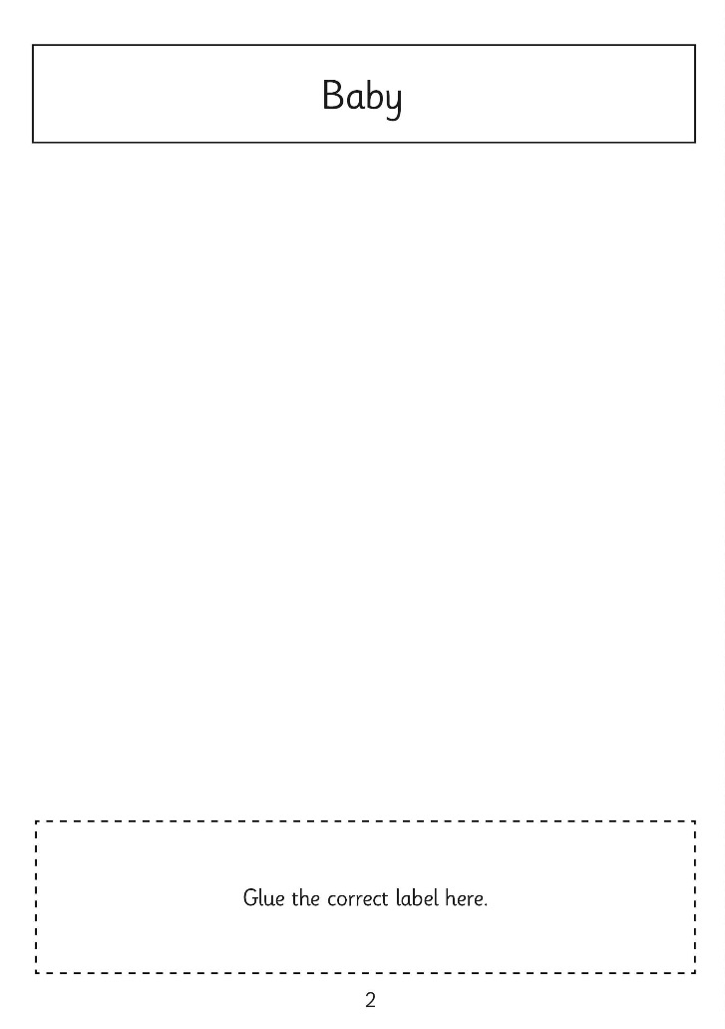
Growing and Changing
Mini Book
For each page in your mini book, draw a picture of
a person at that
life stage.
Read the labels and choose which one matches that life stage.
Stick it on the page of your mini book.

Slide 14

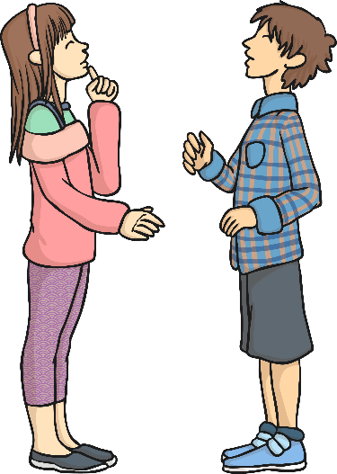
Growth Enquiry - Ideas
How could we investigate the answer to this question?
How would we know if we have done it?
Can we collect any information to help us find out?
Do children get faster as
they grow older?

Slide 15
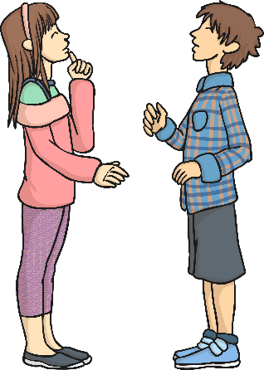
Growth Enquiry - Ideas
In your group, think of a simple activity that you would like to use in your test.
Here are some ideas:
Doing 10 star jumps
Eating a banana
Completing a simple puzzle
Running the length of the hall
Drinking a glass of water
Writing the numbers 1-10
Or you can think of your own!
Do children get
faster as they
grow older?

Slide 16
Growth Enquiry - Ideas
You are going to time 5 younger children and 5 older children, completing this task.
We are going to compare the time it took for each set of children to complete the activity.
Do children get faster as
they grow older?
This is called a comparative test.

Slide 17
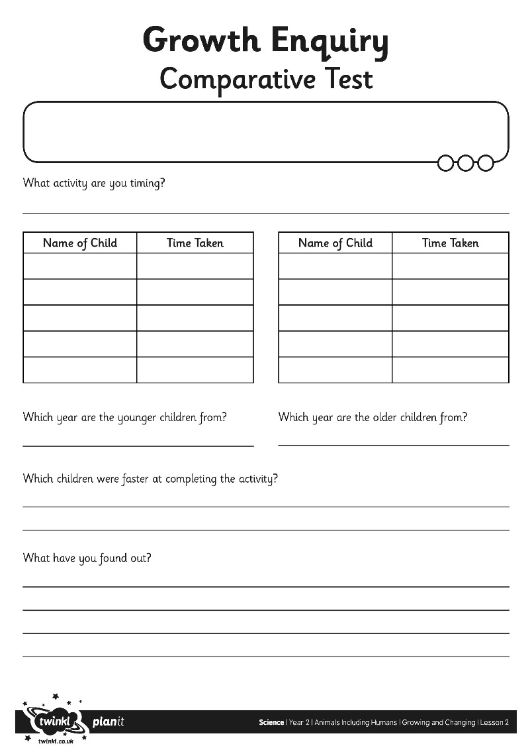
Growth Enquiry
Comparative Test

Slide 18
Growth Enquiry - Ideas
Look carefully at the results of your test.
Which children completed the activity in the shortest time?
Do children get
faster as they
grow older?
What did you find out?
Were the results what you expected?
Do we have enough information to answer the question?
What other information could we collect?

Slide 19

Aim
I can describe how humans change as they grow.
I can set up a test to find out if children are faster when they are older.
Success Criteria
I can name the different stages in the human timeline.
I can describe what humans are like during the different stages of their lives.
I can set up a test.
I can collect and interpret results.

Slide 20
Aim

