Slide 1
Aerial Views
What is it ?

Slide 2
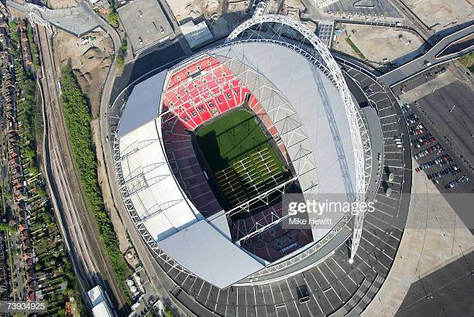

Slide 3


Slide 4
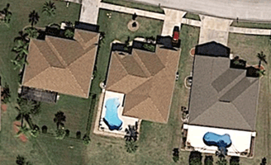

Slide 5


Slide 6
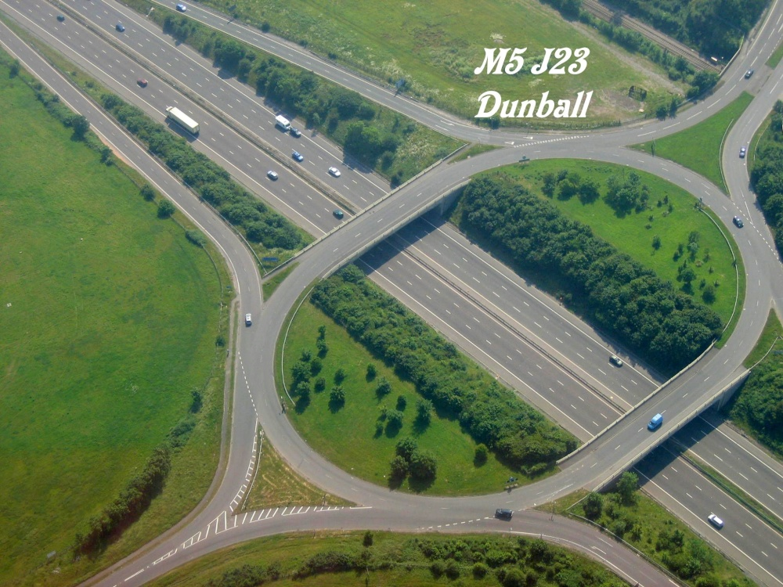

Slide 7
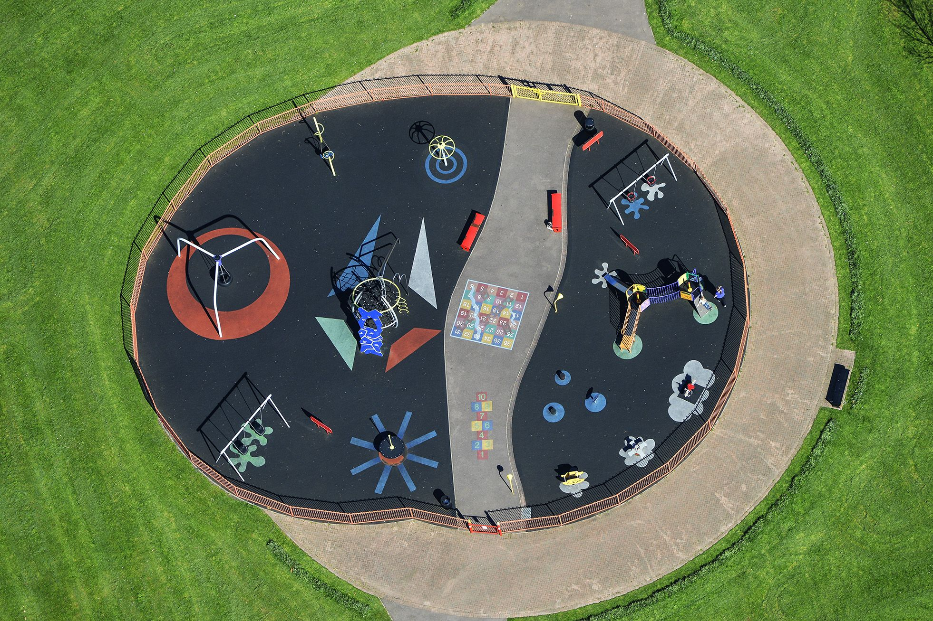

Slide 8


Slide 9
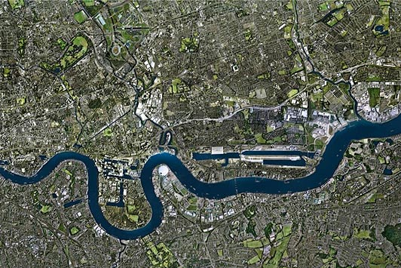

Slide 10



