Slide 2
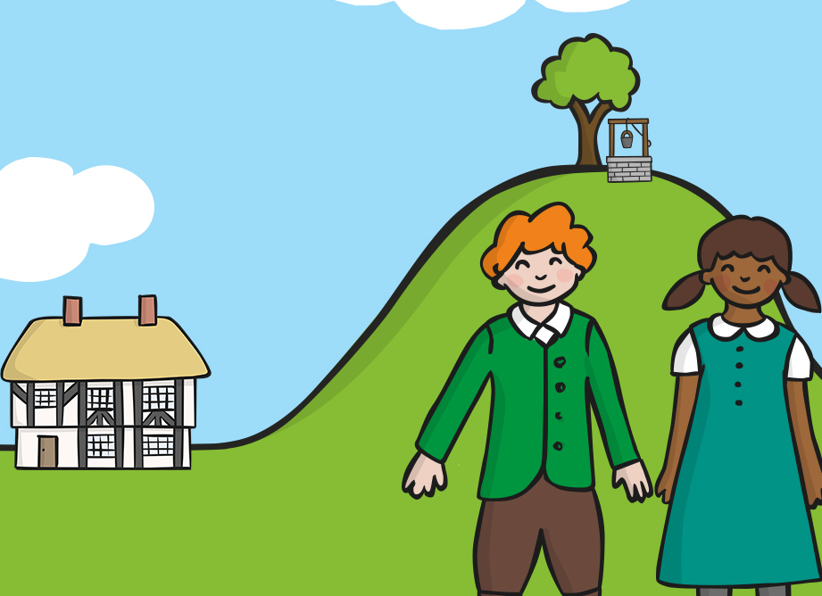
Jack and Jill went up a hill to fetch a pail of water.

Slide 3
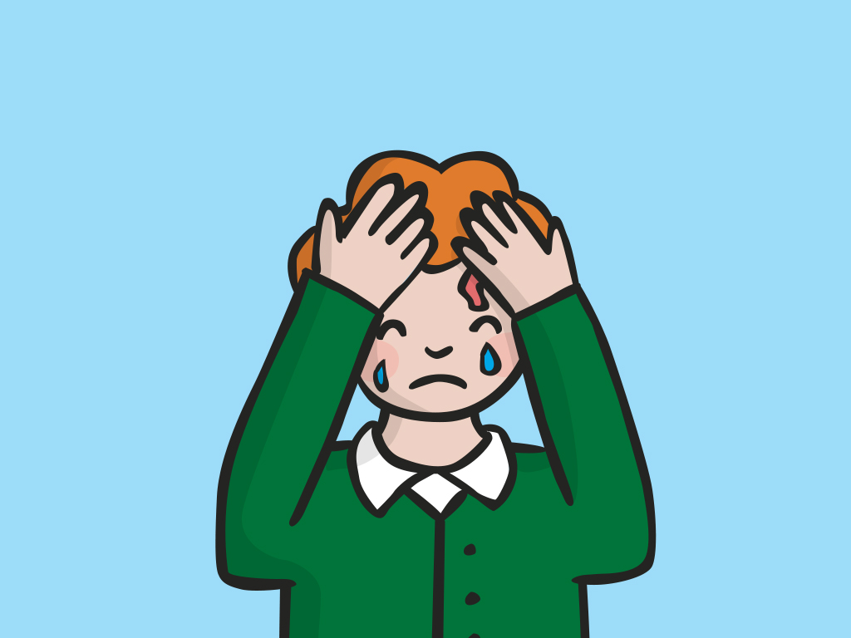
Jack fell down and broke his crown.

Slide 4
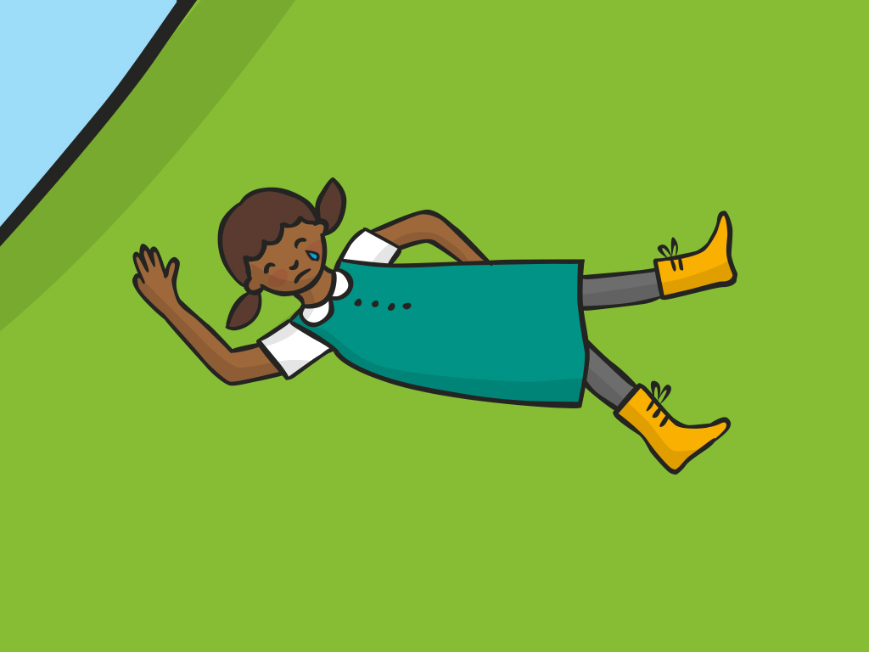
And Jill came tumbling after.

Slide 5
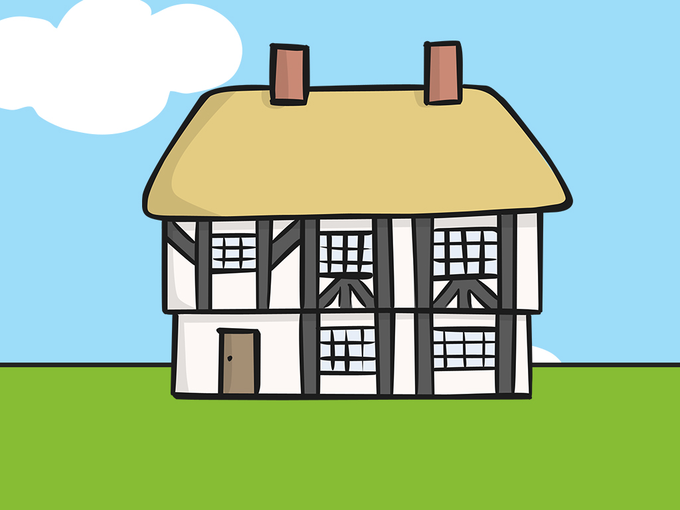
Up Jack got, and home did trot, as fast as he could caper.

Slide 6

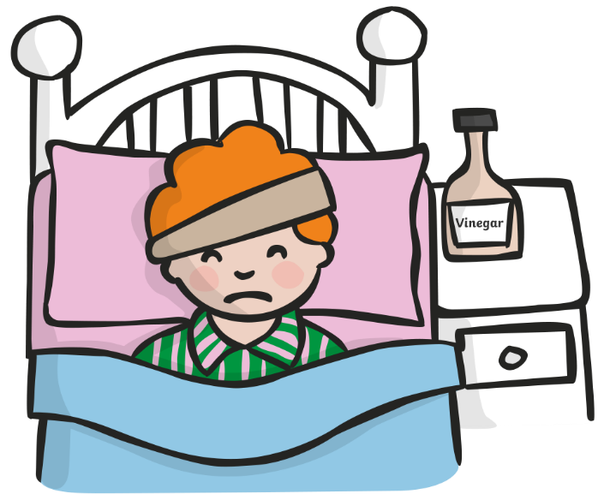
He went to bed and bound his head,
with vinegar and brown paper.

Slide 7
LO – To sequence the nursery rhyme of Jack and Jill.

