Slide 2
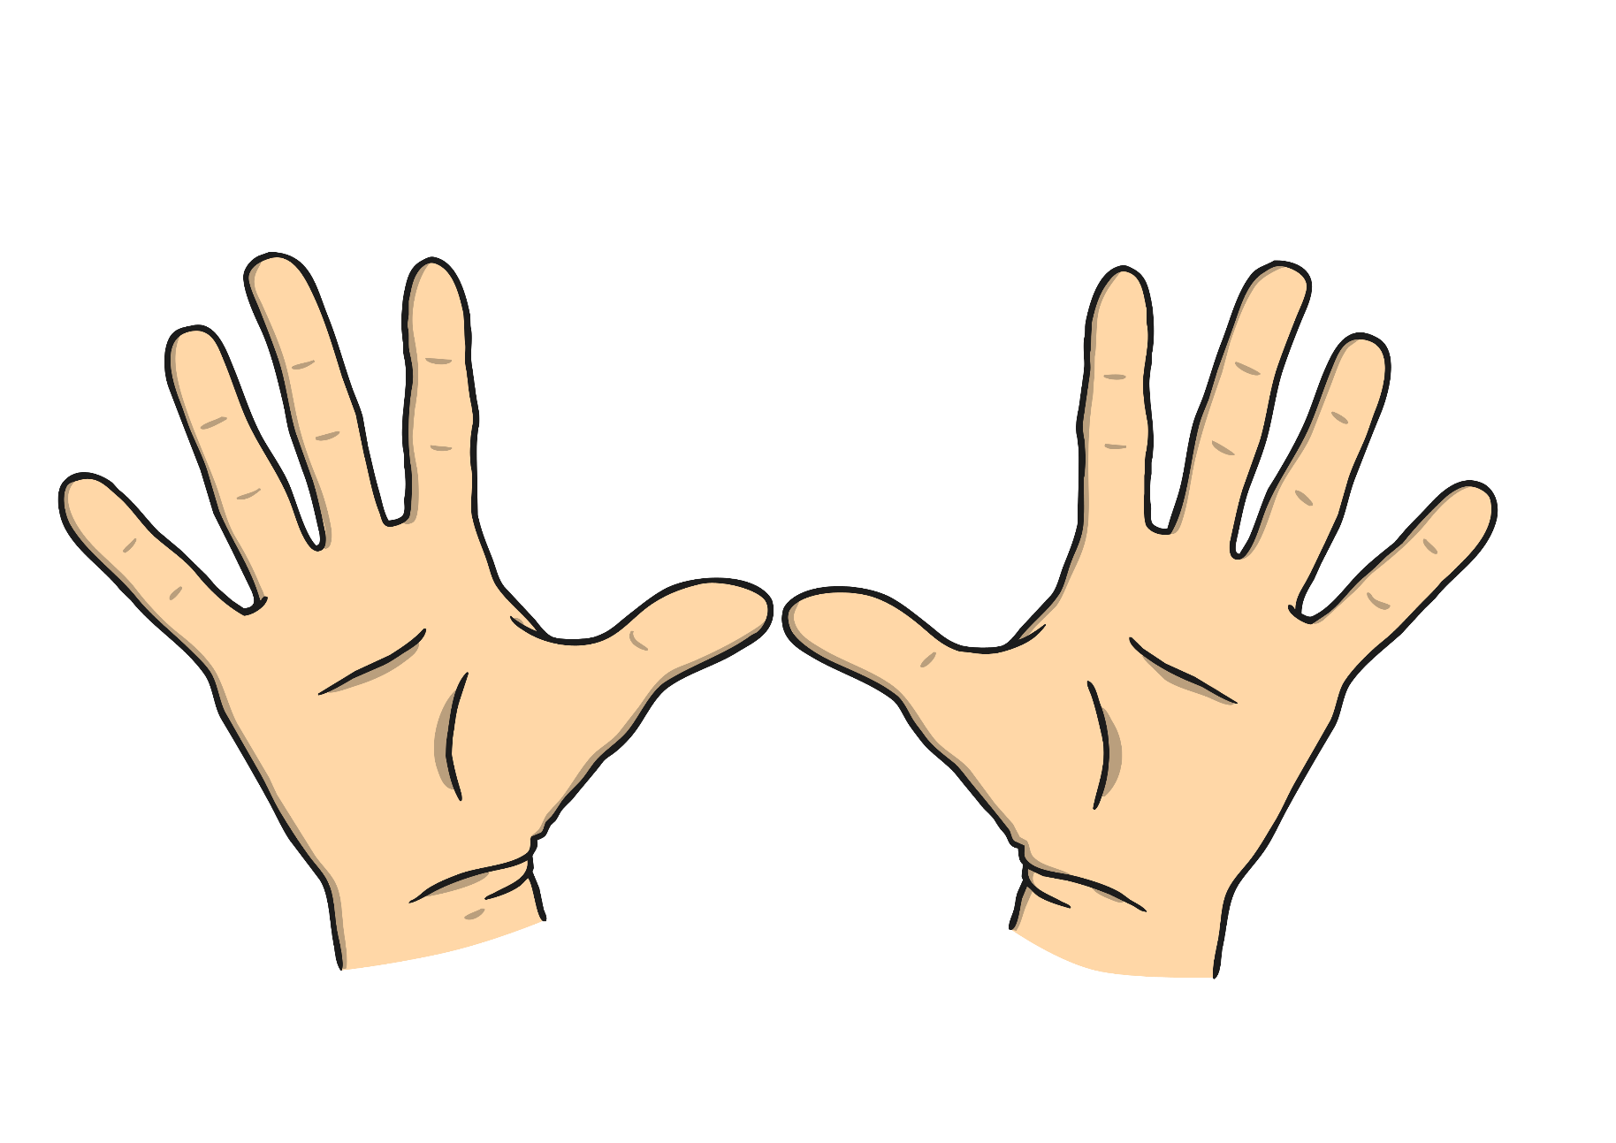
What noises can you make with your fingers or hands?

Slide 3



Can you…?
Clap! Snap! Click! Tap

Slide 4
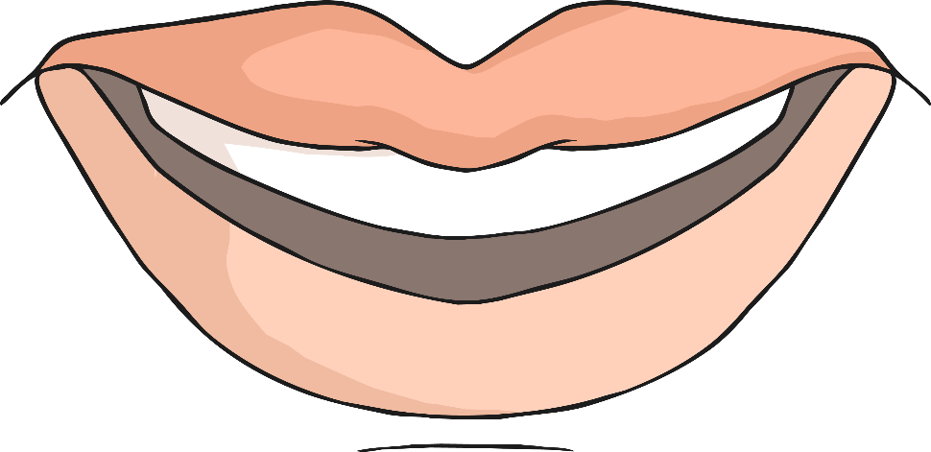
What noises can you make with your mouth?

Slide 5
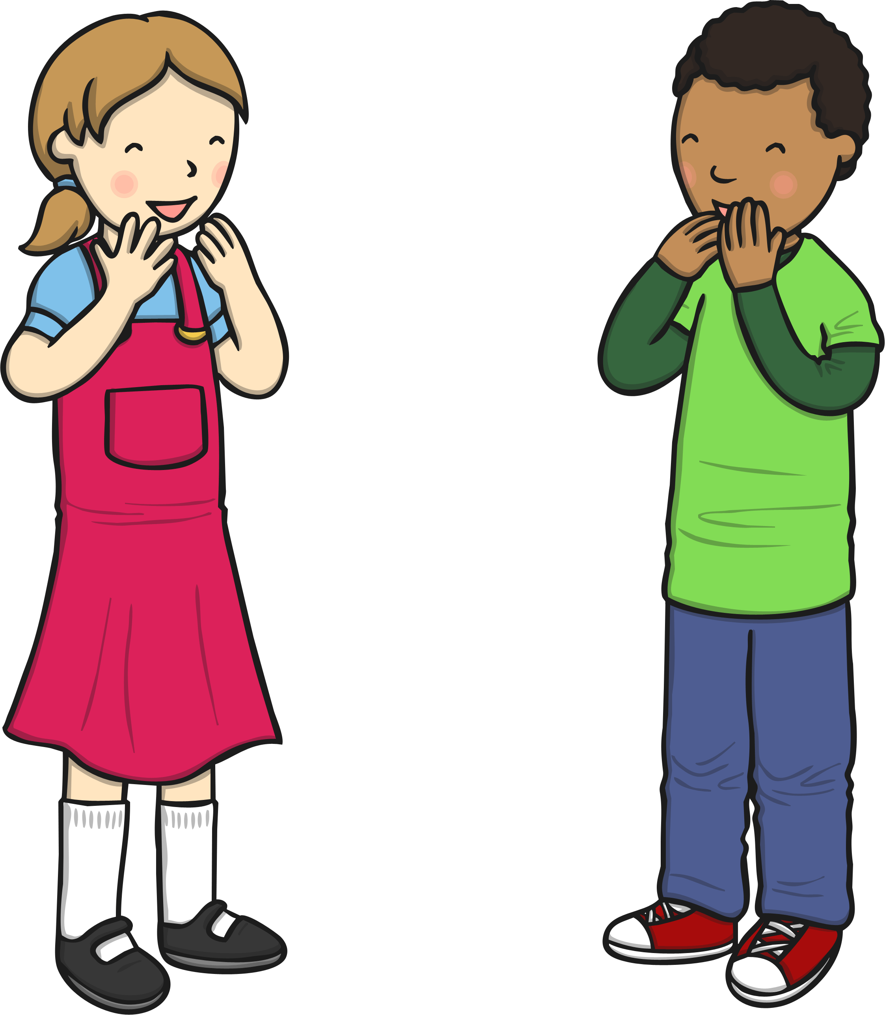
Can you…?
Pop! Shhhhhhh! Hum

Slide 6
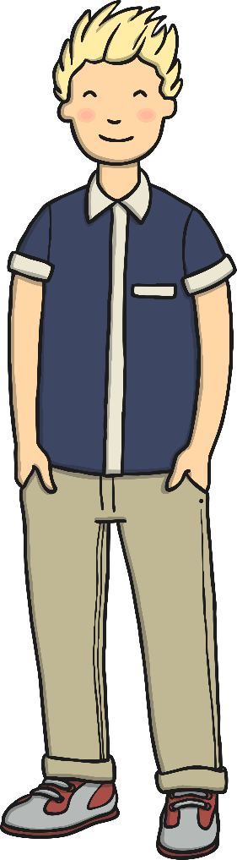
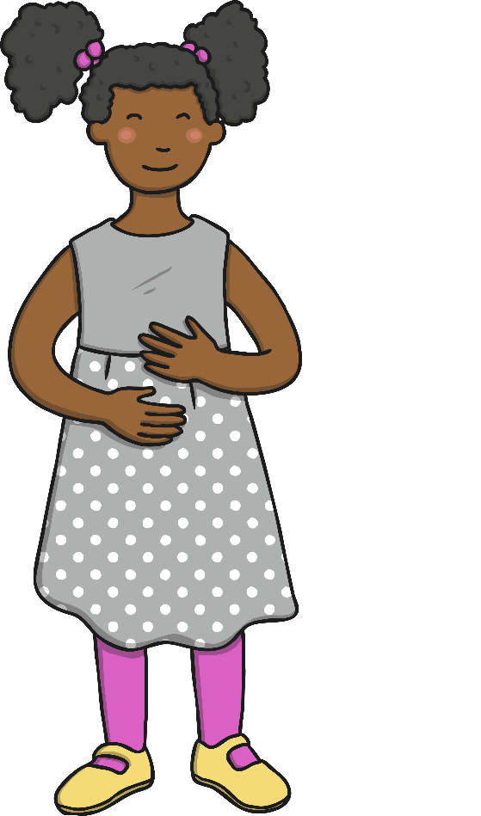


What sounds can you make with your feet?

Slide 7
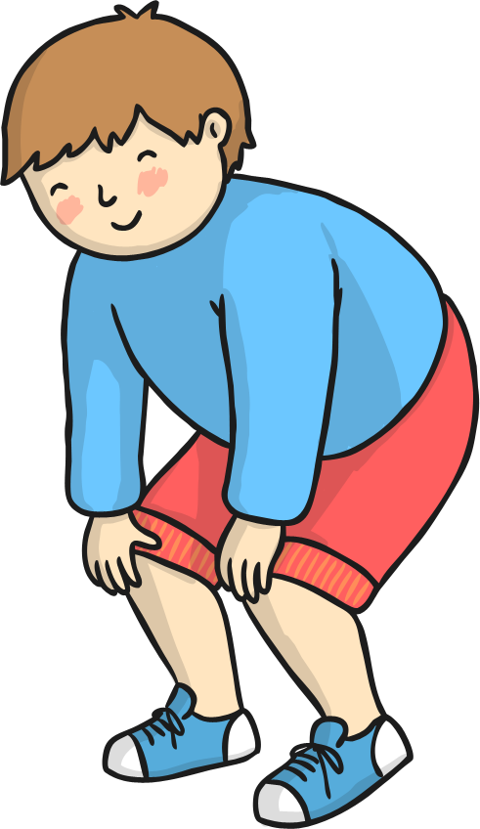
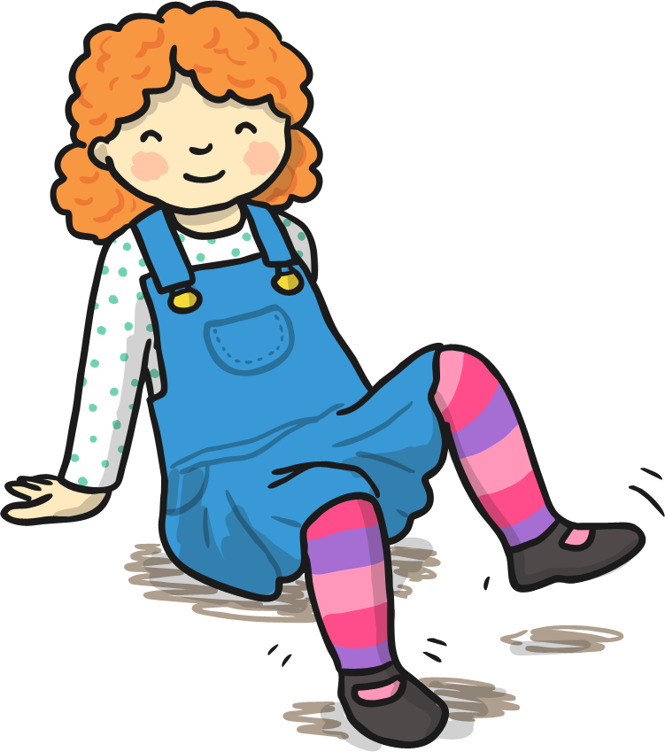
Can you…?
Stomp! Stamp! Tap!

Slide 8
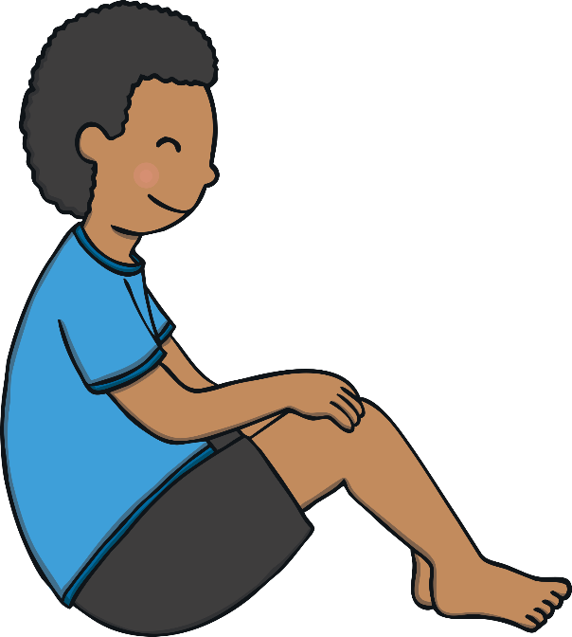
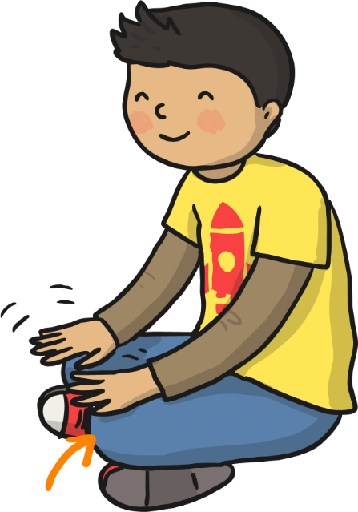
Can you think of any other sounds you can make with different parts of your body?

