Slide 1



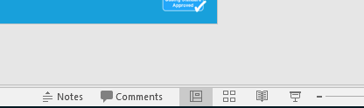


Guidance for Video/Audio in PowerPoints
1. Open the folder and copy all the files.
2. Paste the copied files into a new folder.
3. Open the PowerPoint file, enable editing and enter presentation mode (start the slide show).
Please note the embedded audio may not be compatible with early versions of PowerPoint.
You may wish to delete this slide before beginning the presentation.

Slide 3

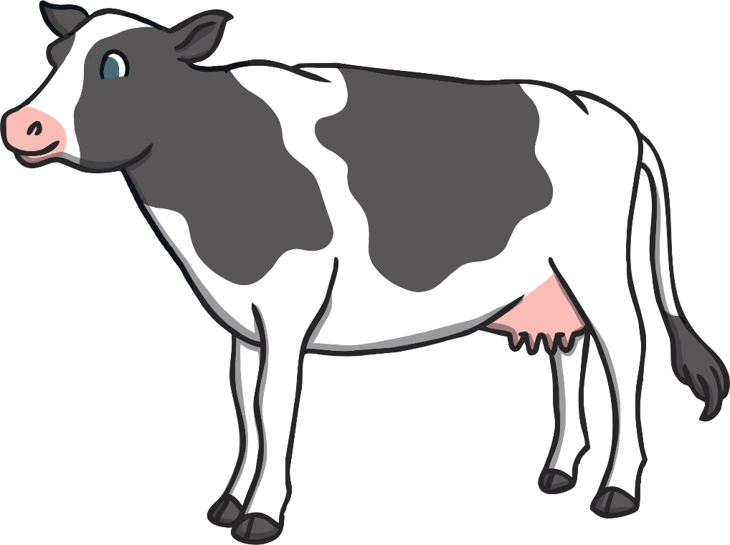


What’s That Sound?
Can you choose the correct animal that makes this sound…?
Click the letter above the picture to make your choice.
A
B
C

Slide 4
Well Done!
It’s a cow.
Can you make the sound?
A
B
C

Slide 5



What’s That Sound?
Can you choose the correct animal that makes this sound…?
A
B
C

Slide 6
Well Done!
It’s a snake.
Can you make the sound?
A
B
C

Slide 7
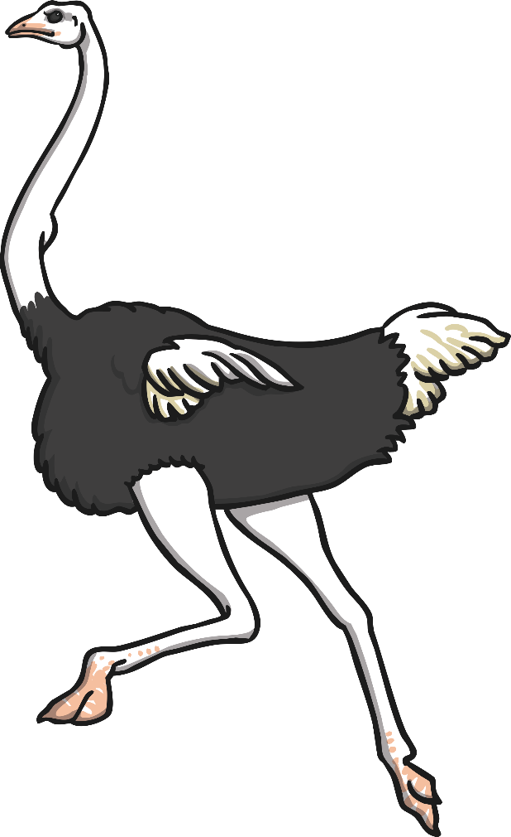


What’s That Sound?
Can you choose the correct animal that makes this sound…?
A
B
C

Slide 8
Well Done!
It’s an owl.
Can you make the sound?
A
B
C

Slide 9
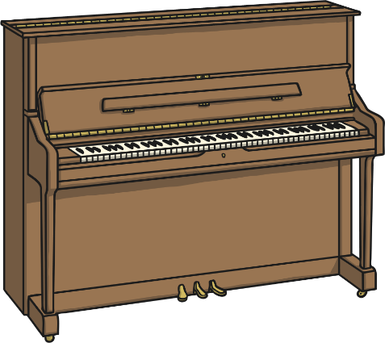


What’s That Sound?
Can you choose the correct instrument that makes this sound…?
A
B
C

Slide 10
Well Done!
It’s a drum.
Can you make the sound?
A
B
C

Slide 11
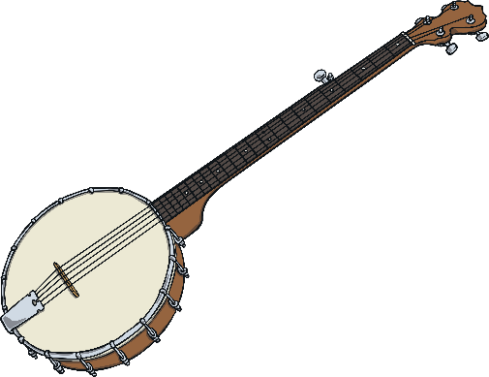


What’s That Sound?
Can you choose the correct instrument that makes this sound…?
A
B
C

Slide 12
Well Done!
It’s a saxophone.
Can you make the sound?
A
B
C

Slide 13


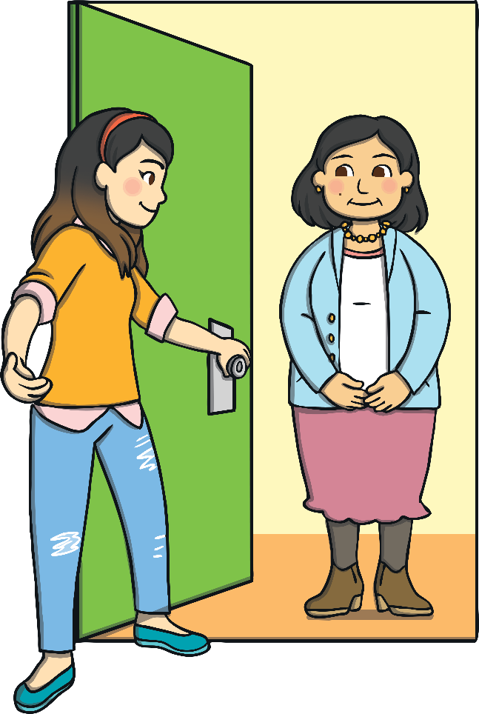
What’s That Sound?
Can you choose the correct option that makes this sound…?
A
B
C

Slide 14
Well Done!
It’s a doorbell.
Can you make the sound?
A
B
C

Slide 15


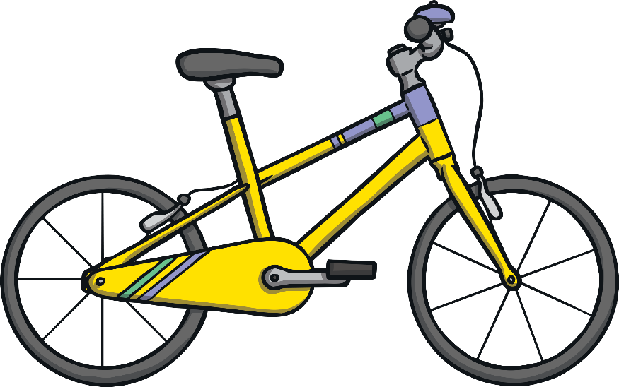
What’s That Sound?
Can you choose the correct vehicle that makes this sound…?
A
B
C

Slide 16
Well Done!
It’s a car.
Can you make the sound?
A
B
C

