Slide 2

What Am I? What Am I Made From?
Can you follow the clues to work out what object is being described and what it is made from? The objects are all things that can be recycled!
Click on the recycling symbol to reveal each clue!

Slide 3

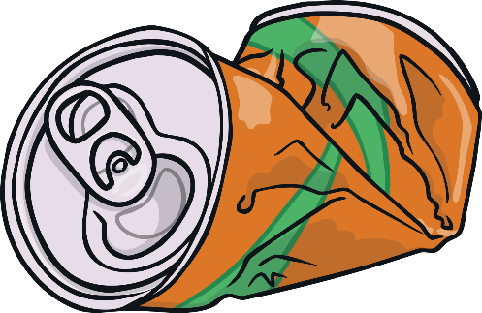
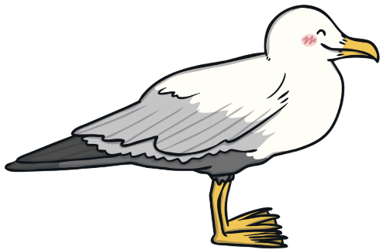

What Am I? What Am I Made From?
I am smooth and shiny.
?
I am usually brightly coloured.
You can crush me easily.
You can drink from me.
I am a fizzy drinks can!
I am made from metal.
Click on me to reveal the answer.
Next

Slide 4
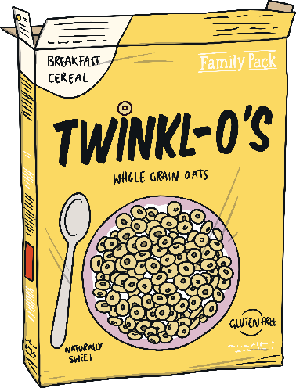
What Am I? What Am I Made From?
I am made from trees.
?
I am stronger than paper.
I contain food.
You might eat this food for breakfast.
I am a cereal box!
I am made from cardboard.
Click on me to reveal the answer.
Next

Slide 5

What Am I? What Am I Made From?
You can see through me.
?
I am hard and smooth.
I break easily.
I sometimes contain food, like jam.
I am a jar!
I am made from glass.
Click on me to reveal the answer.
Next

Slide 6

What Am I? What Am I Made From?
You can play games on me.
?
I have a screen.
I can fit in your pocket.
You can call your friends on me.
I am a mobile phone!
I am made from lots of different materials
(such as glass and metal).
Click on me to reveal the answer.
Next

Slide 7
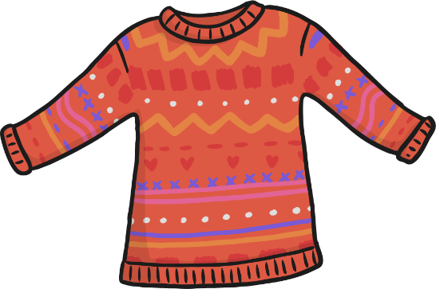
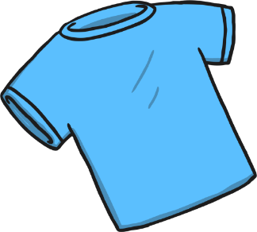

What Am I? What Am I Made From?
I am soft.
?
I help to keep you warm.
I come in different colours and sizes.
You wear me.
I am clothing!
I am made from different fabrics
(such as wool and cotton).
Click on me to reveal the answer.

