Slide 2
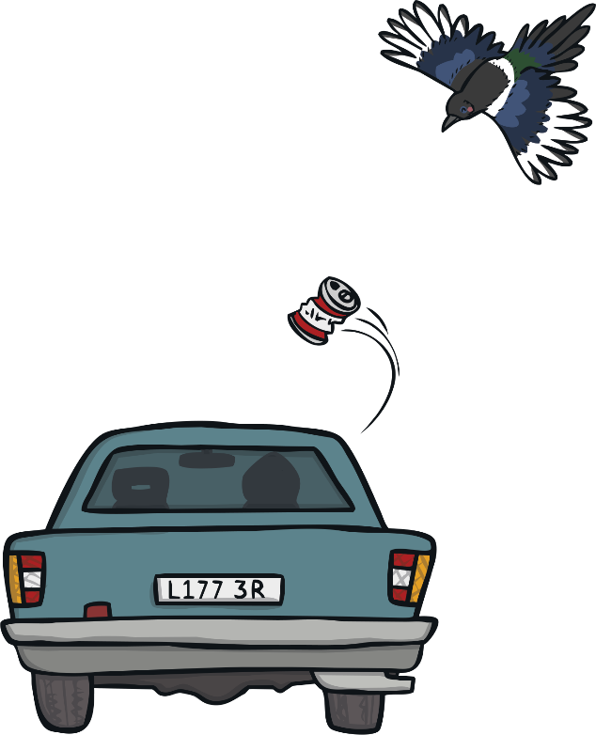
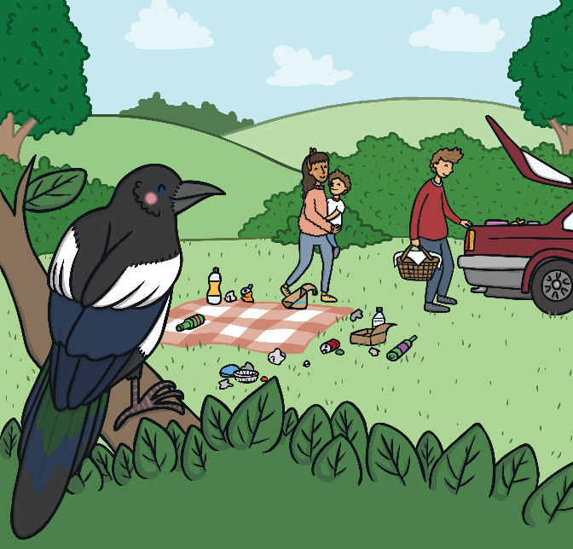
What Is Litter?
Litter is rubbish that has not been put in a bin.
Litter might have been dropped by accident or left by someone who didn’t think carefully about putting it in the bin.

Slide 3

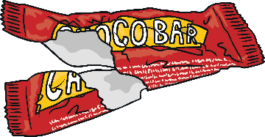
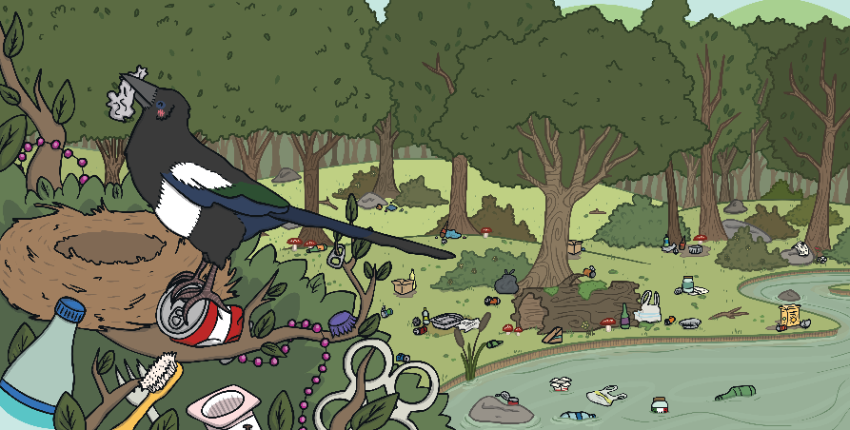
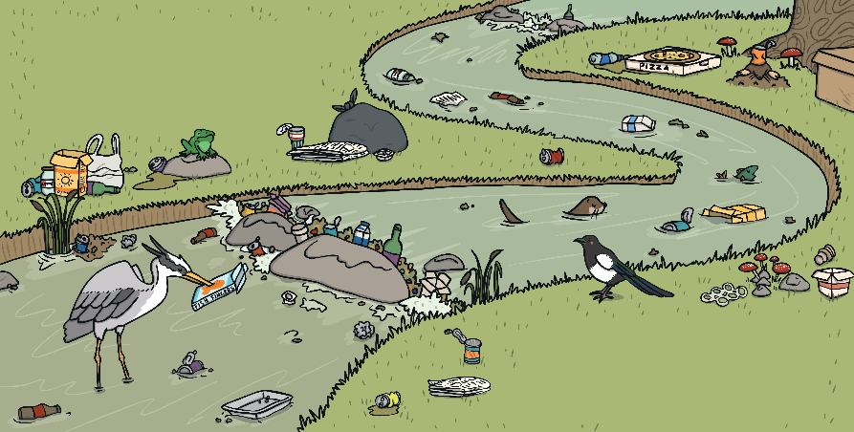
Why Is Litter Bad?
Litter is bad for our world.
It doesn’t look very nice and it can be very harmful to humans, animals and the environment.

Slide 4
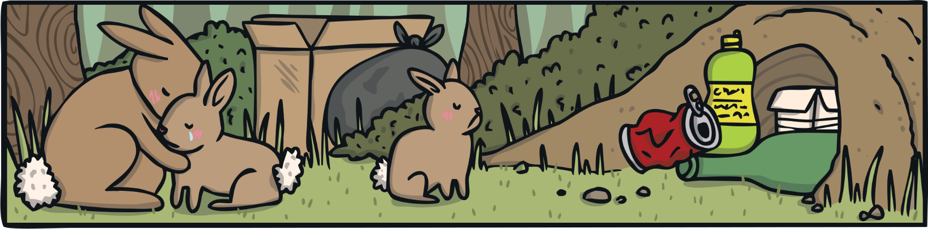


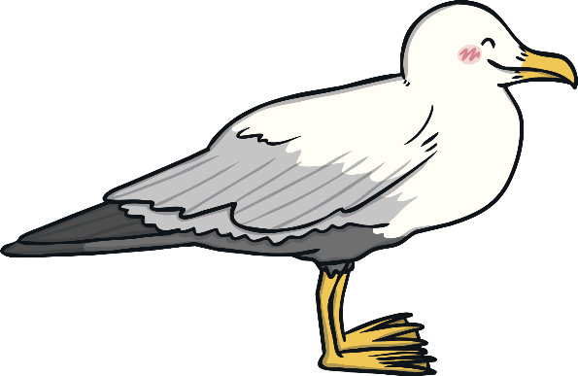
How Is Litter Affecting the Rabbits?
The litter has blocked the rabbits’ burrow. They have nowhere to live!
Click on me to find out.

Slide 5
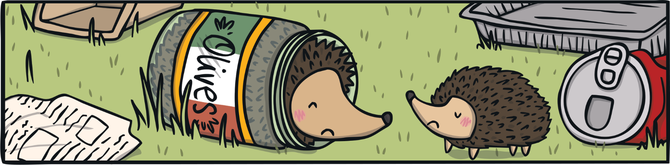
How Is Litter Affecting the Hedgehogs?
The hedgehog has got stuck in the glass jar. He won’t be able to move and find food!
Click on me to find out.

Slide 6
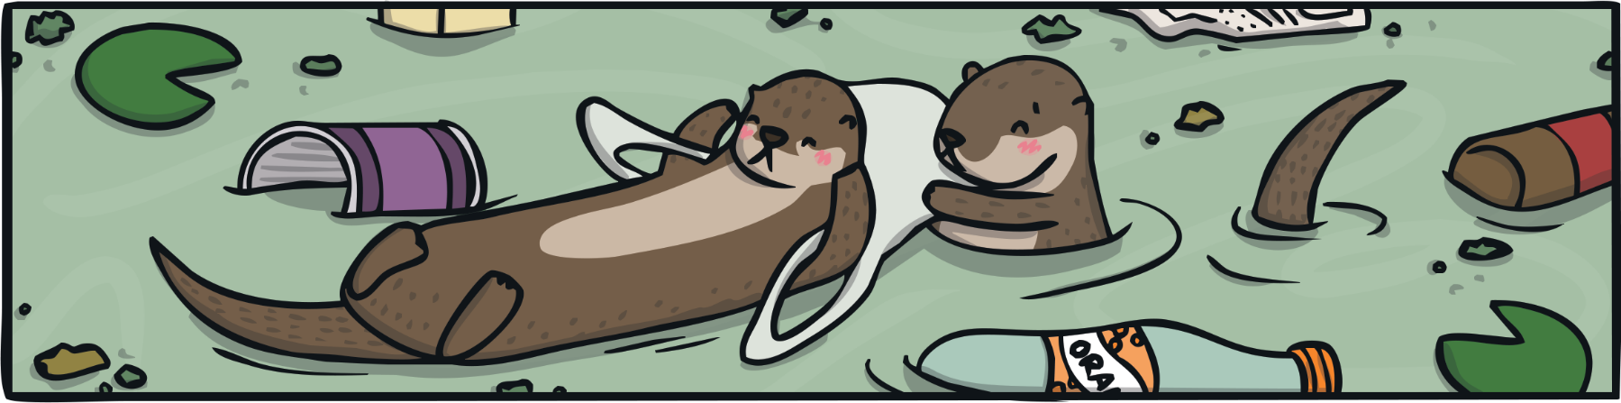
How Is Litter Affecting the Otters?
The otter is caught in the plastic bag. The litter is also blocking up the river.
Click on me to find out.

Slide 7
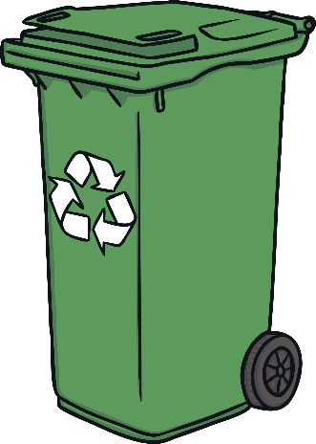
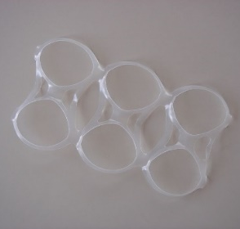
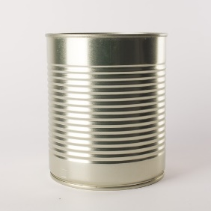
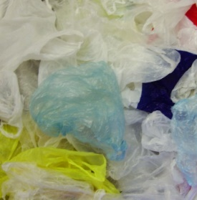
How Can You Help?
Make sure you recycle as much rubbish as you can.
If rubbish cannot be recycled, make sure you put it carefully into a rubbish bin.
Try to follow these steps to stop animals getting hurt from different types of rubbish:
Cut up rubbish like balloons and plastic drinks holders before throwing them away.
Crush cans and tins before recycling them.
Tie up the handles of plastic bags before recycling them.

Slide 8
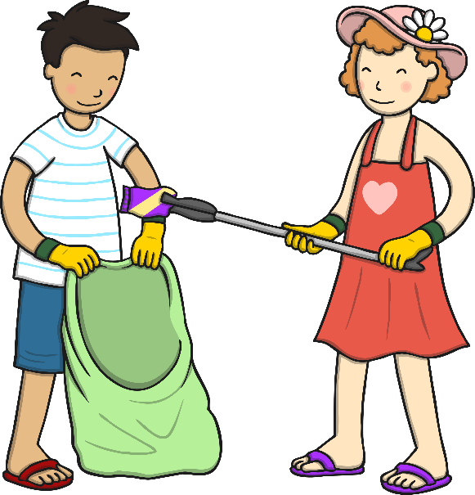
How Can You Help?
You could also help to make other people aware of the dangers of dropping litter.
Make posters to put up in your school.
Talk to people at home about how important it is to recycle and throw rubbish away carefully.
You could even start a litter-picking club to keep your school environment free from litter.

Slide 9


