Slide 1
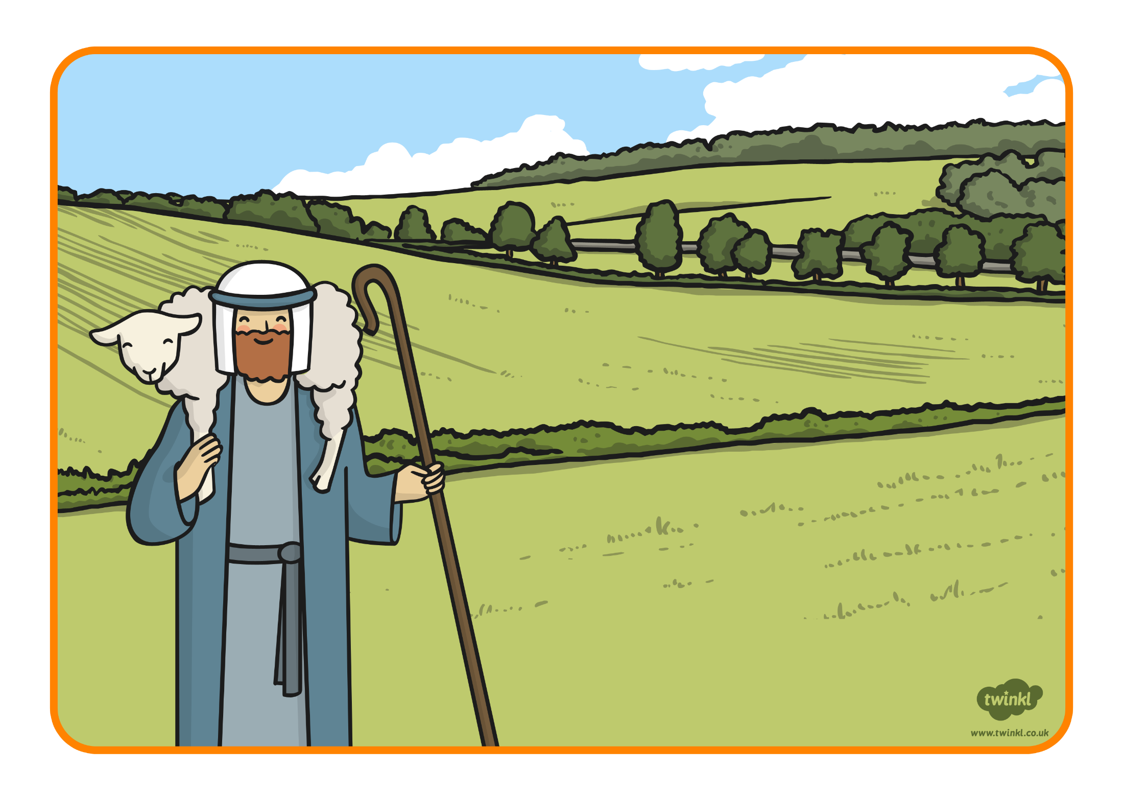
The Lost Sheep

Slide 2
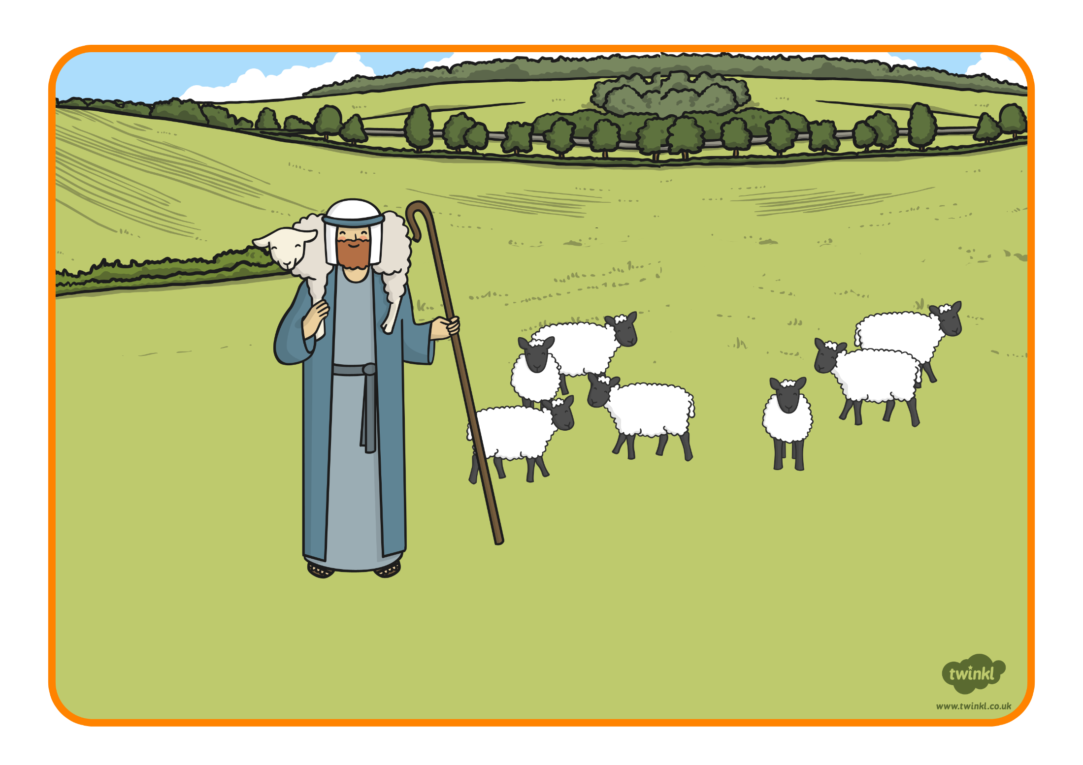
A shepherd had 100 sheep.
He cared for them very much.

Slide 3
He watched over them in case any animals
came to attack.

Slide 4
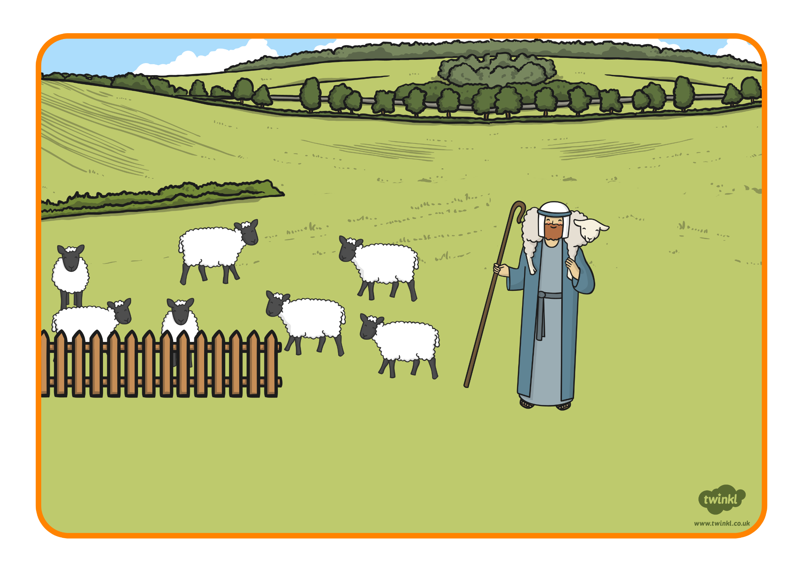
Every evening he took them back to the sheep fold and counted to make sure they were all there.

Slide 5
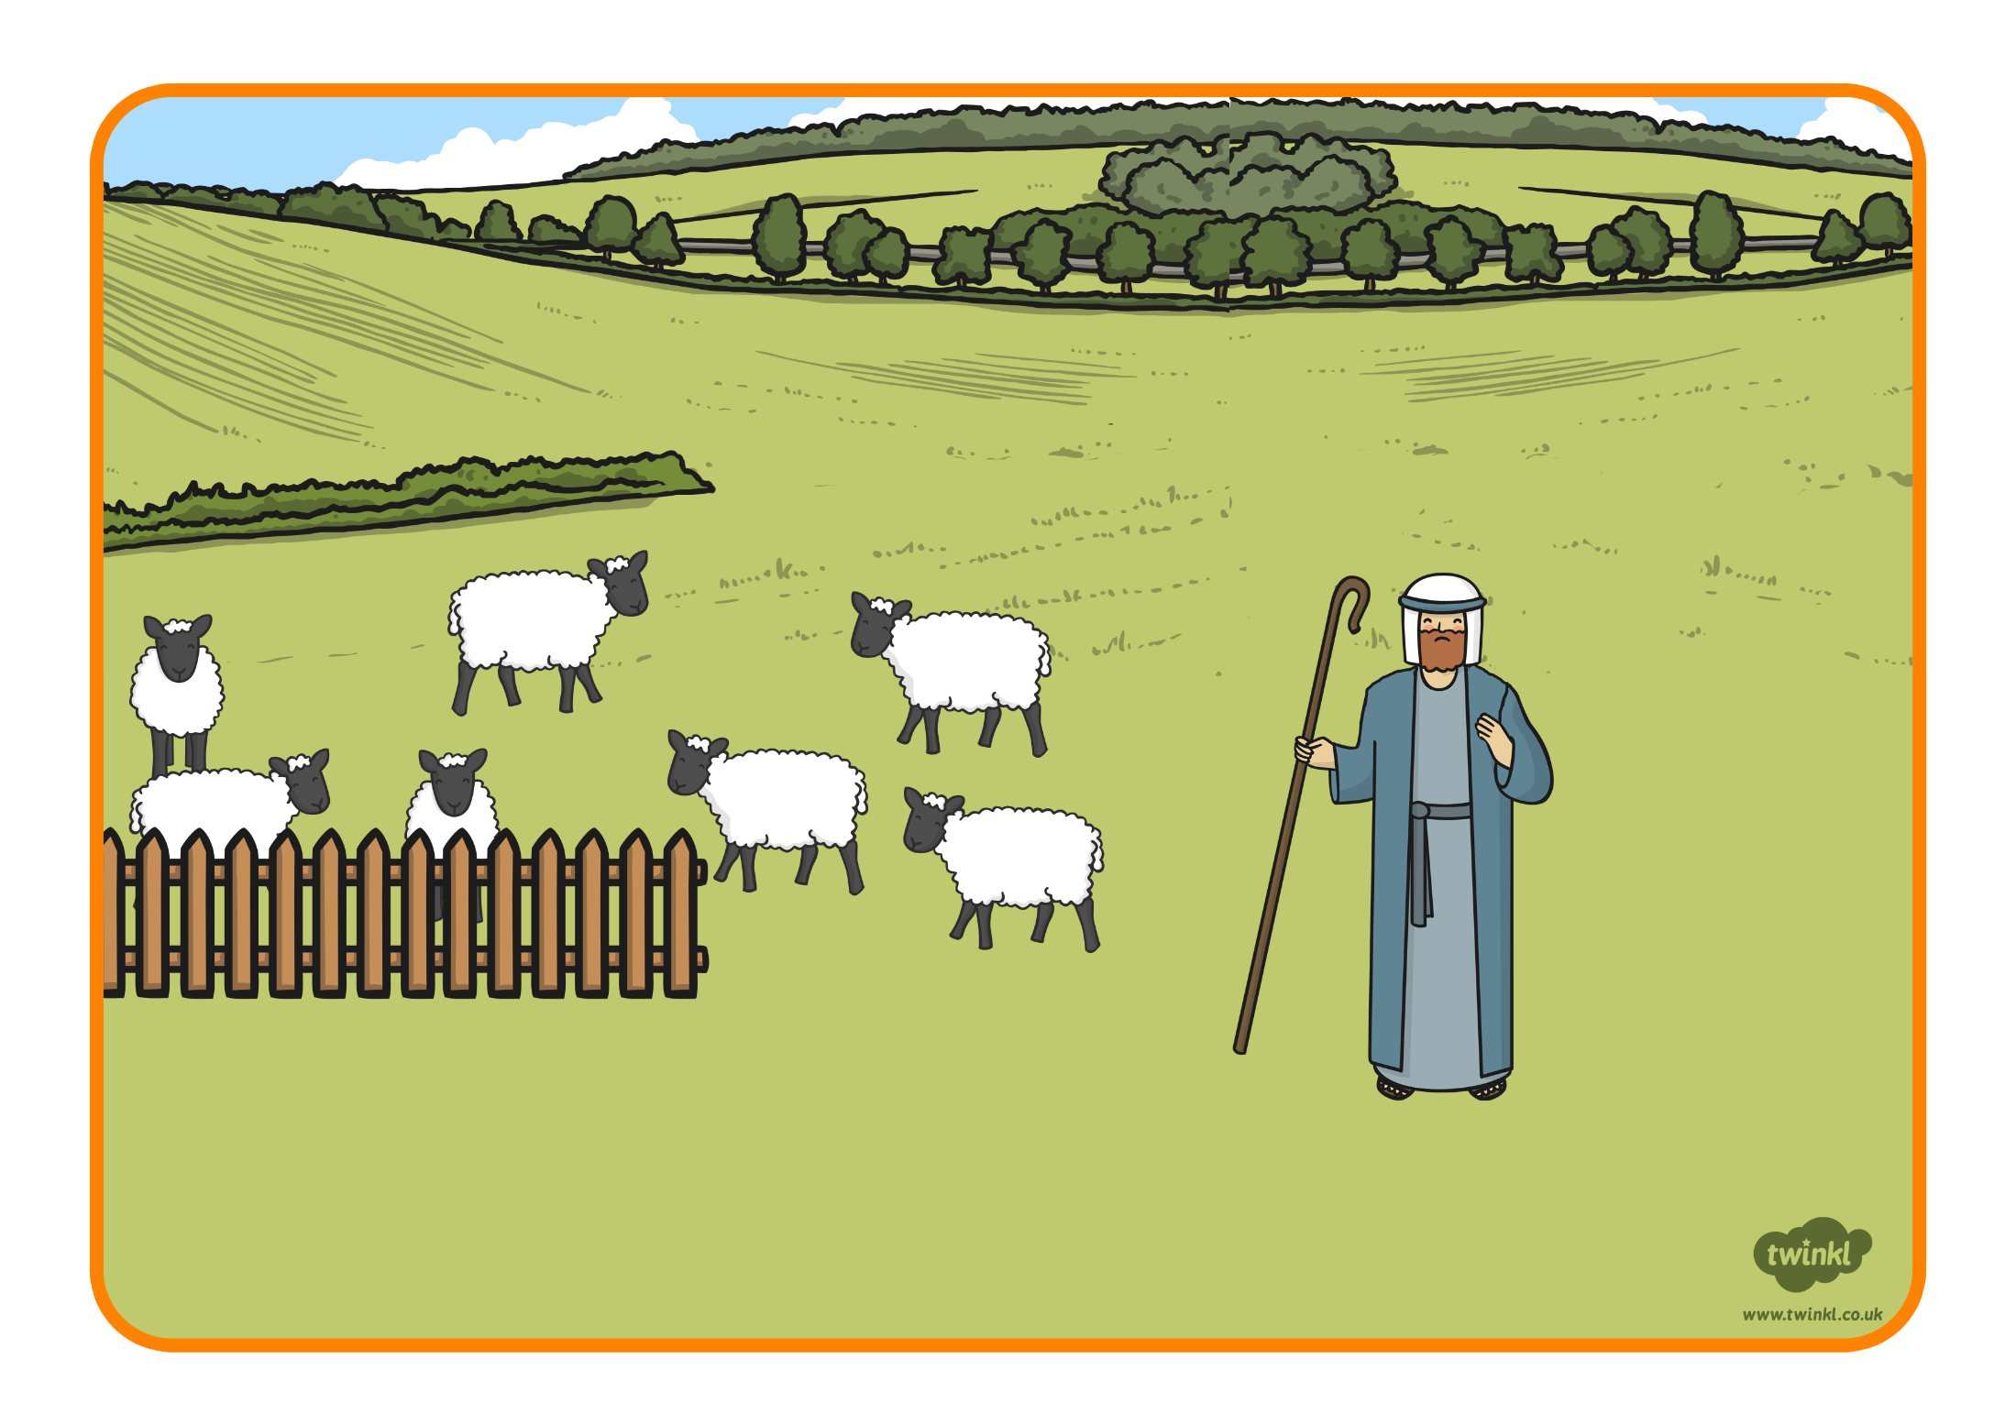
One evening, the shepherd only counted 99 sheep.

Slide 6
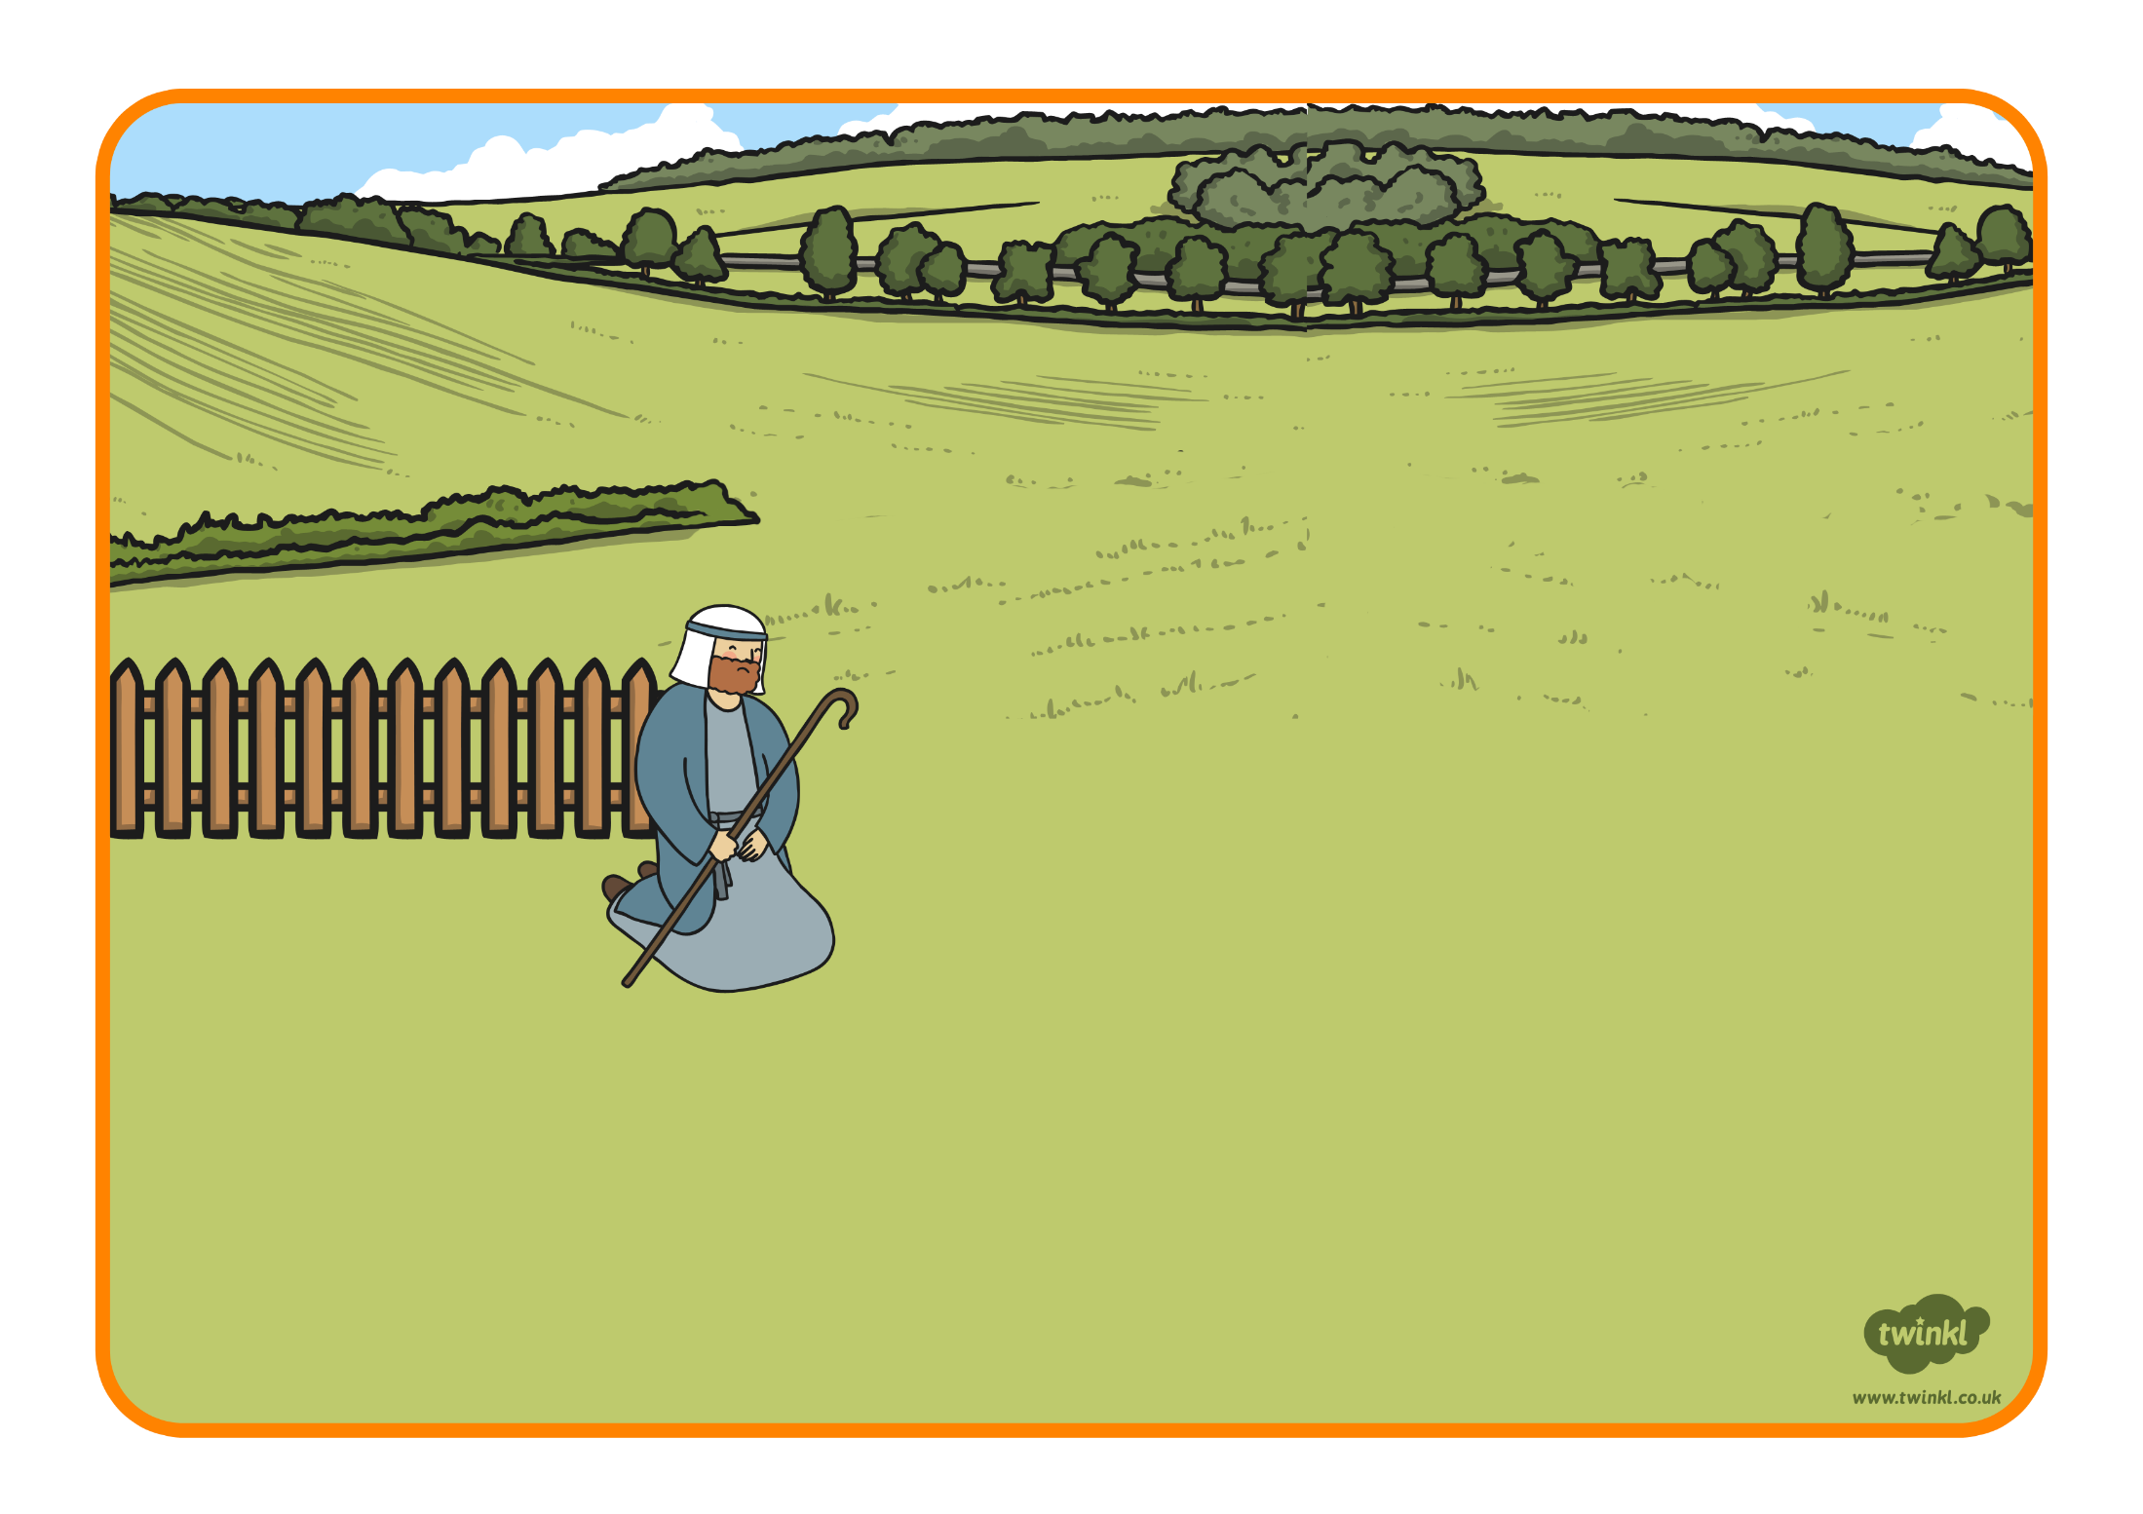
The shepherd was very worried and went out to look for his lost sheep.

Slide 7
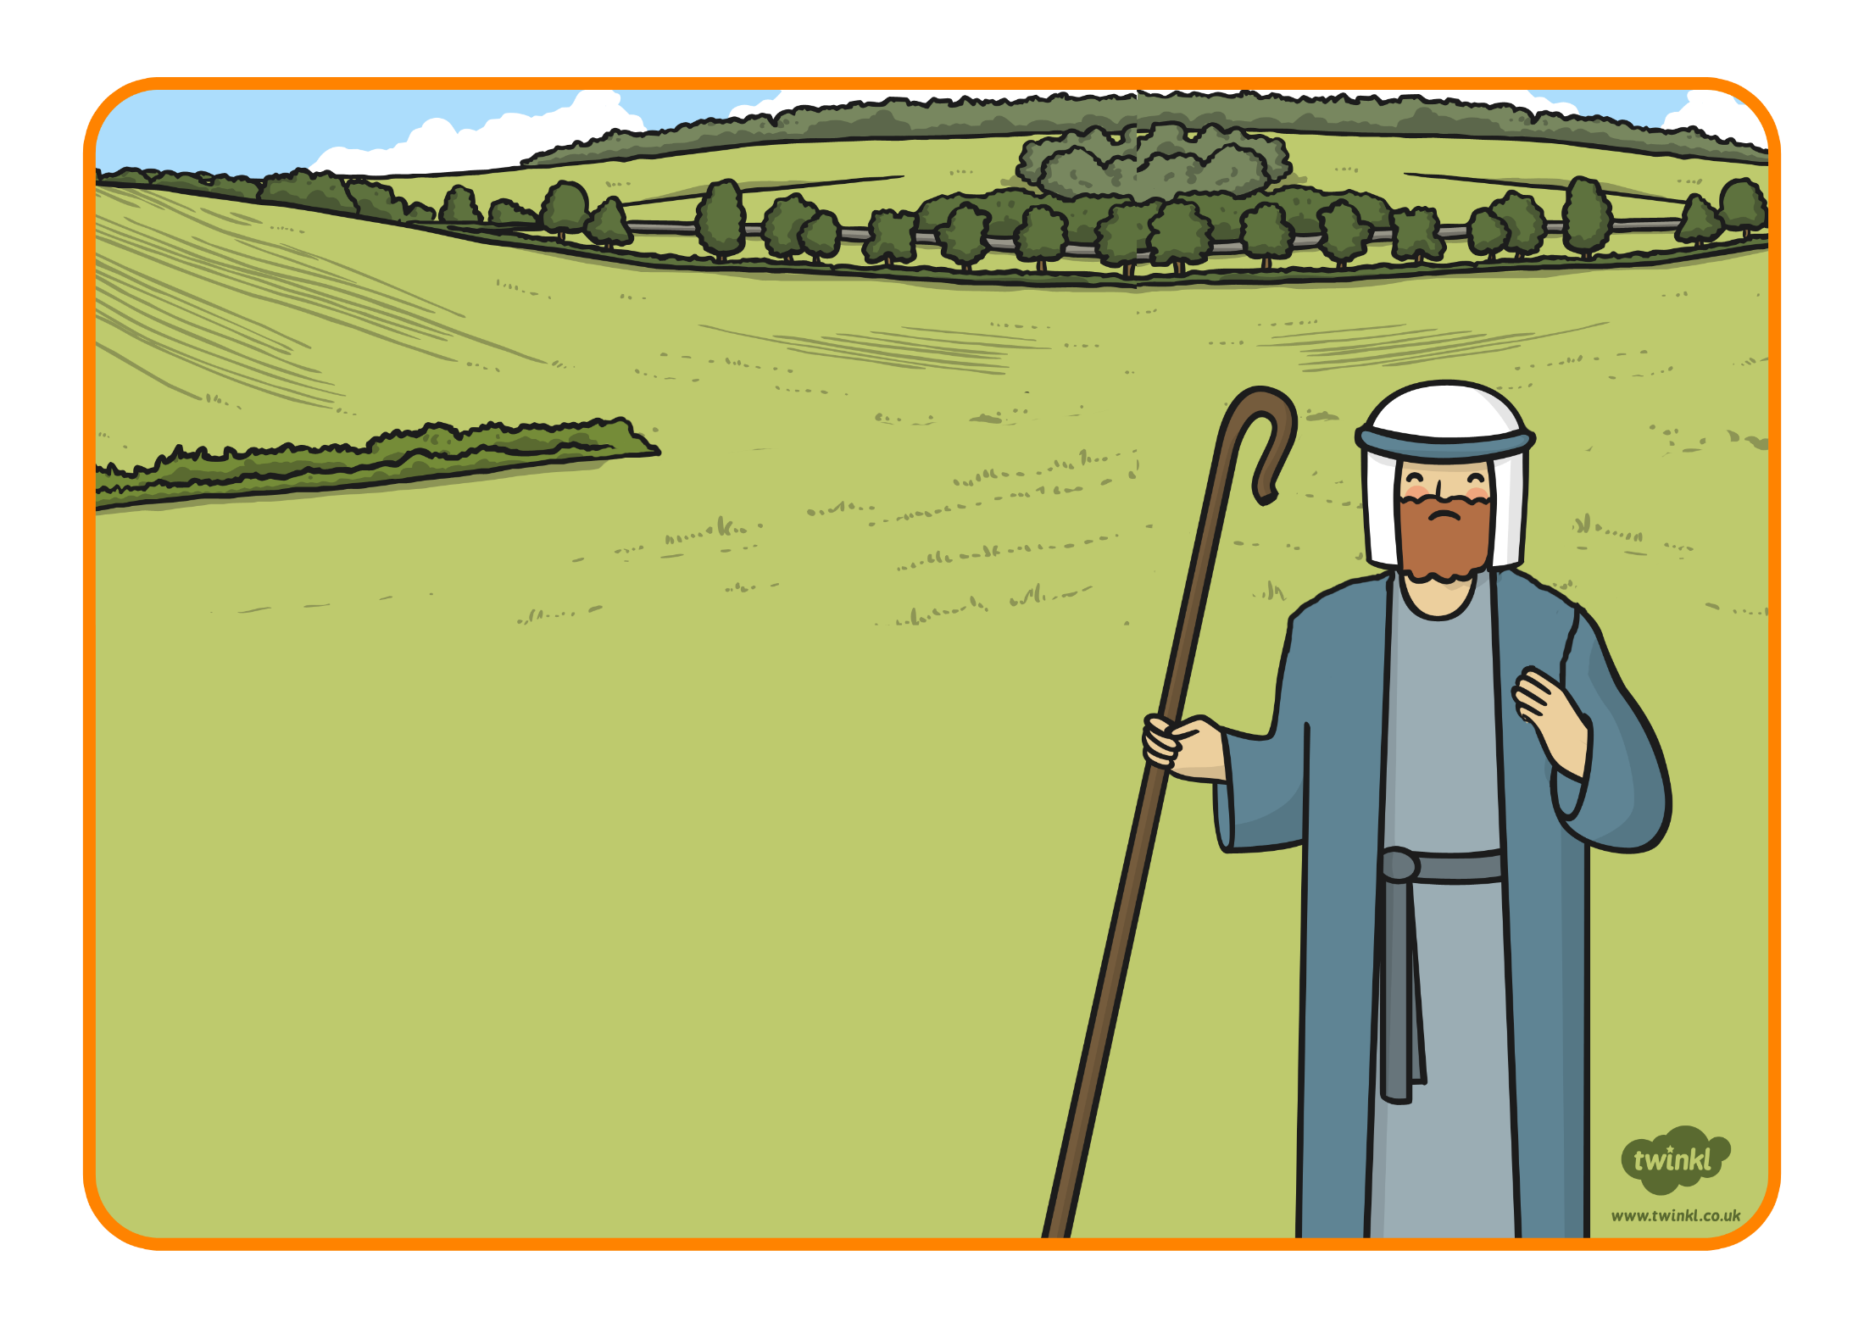
He searched and searched.
Where was his sheep?

Slide 8
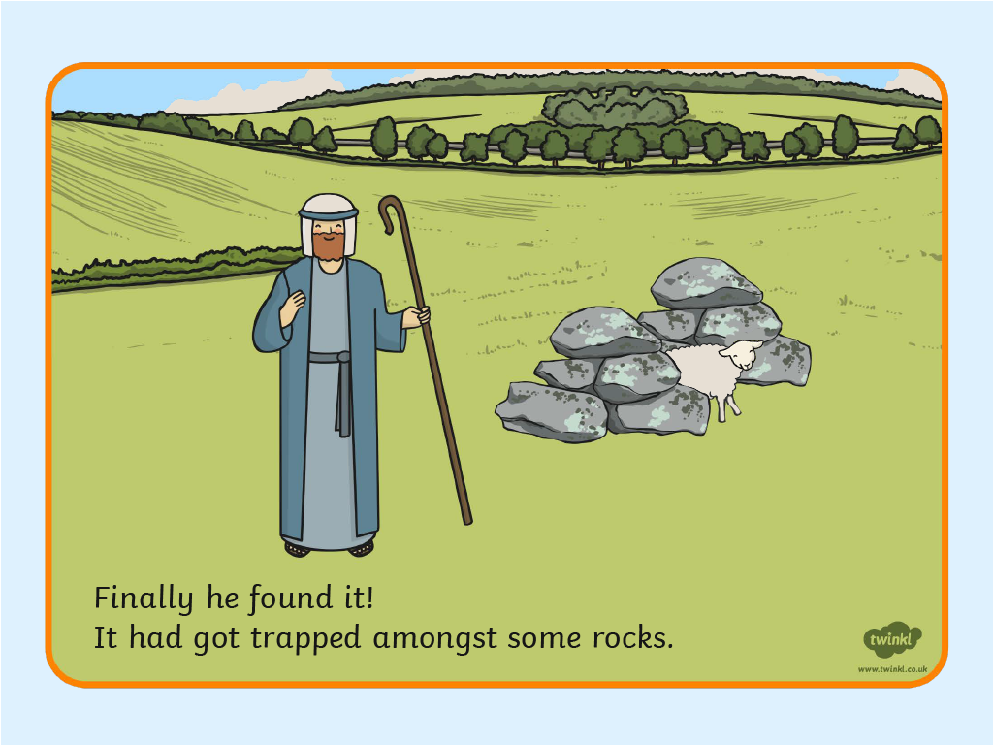
,

Slide 9
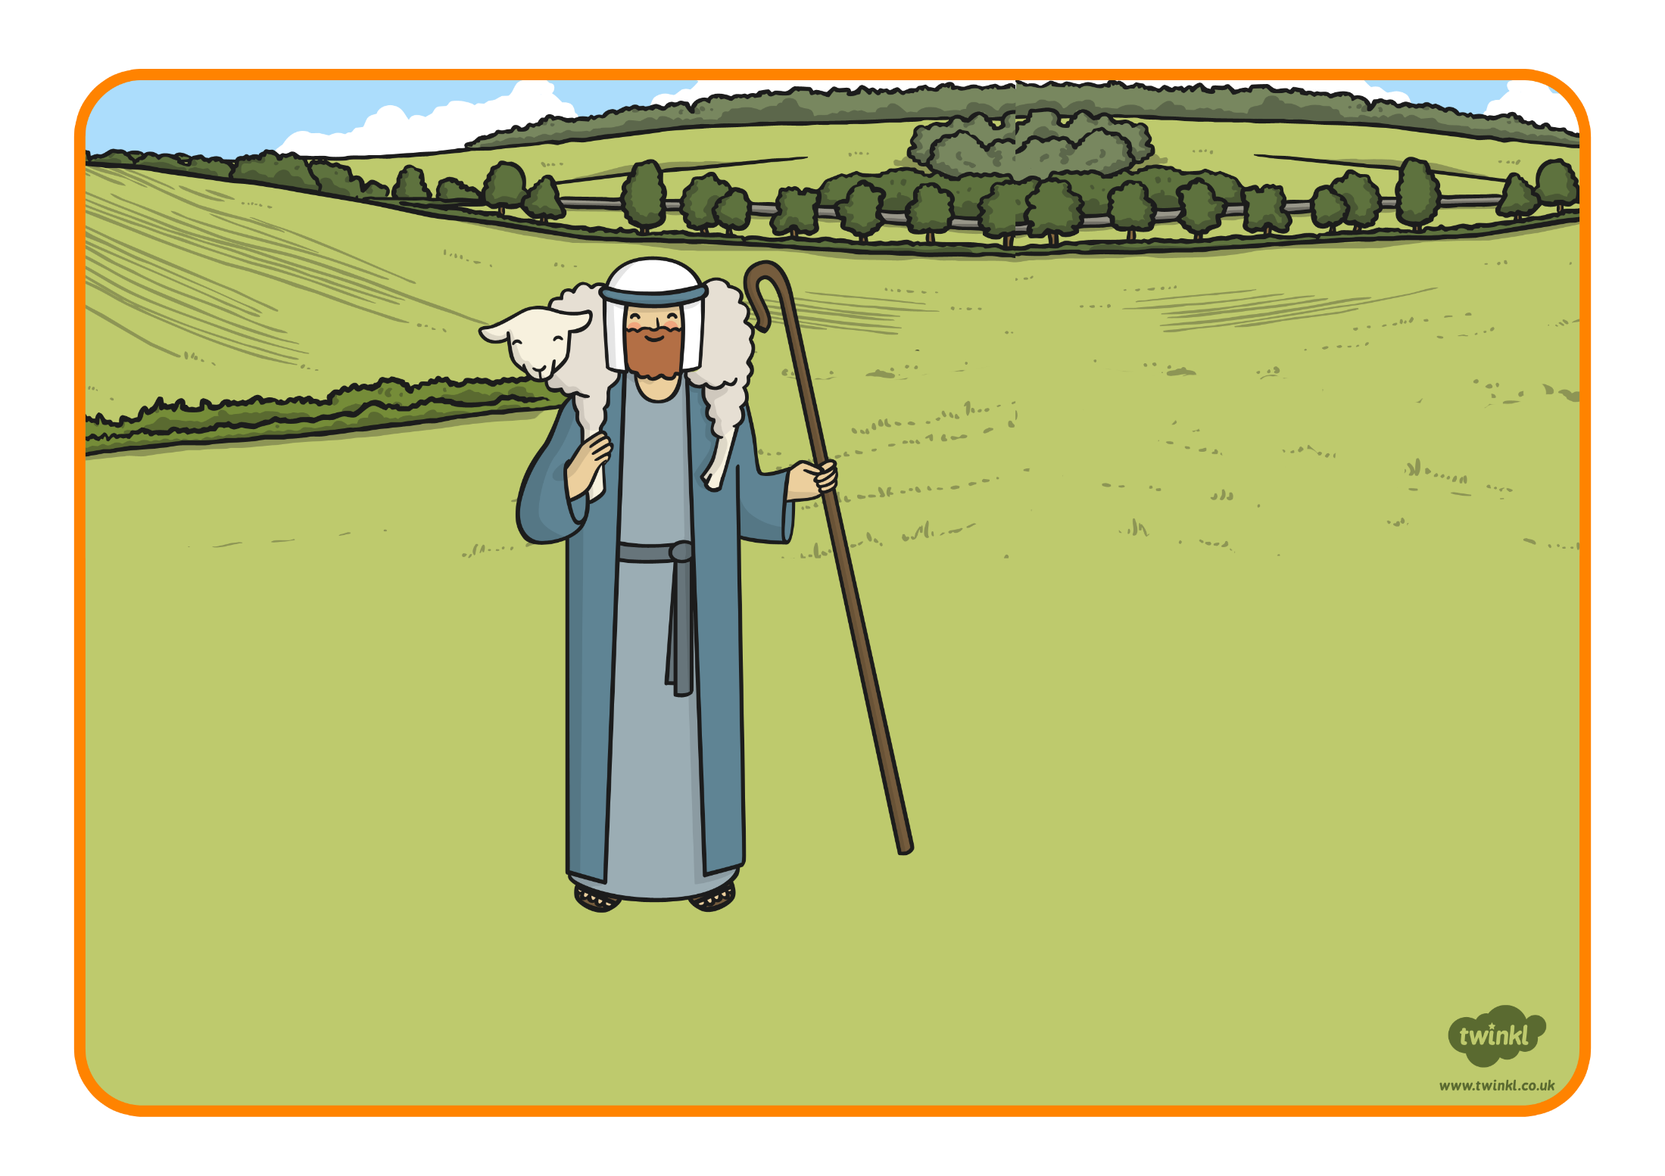
The shepherd carried his sheep home and made
sure it was safe.

Slide 10
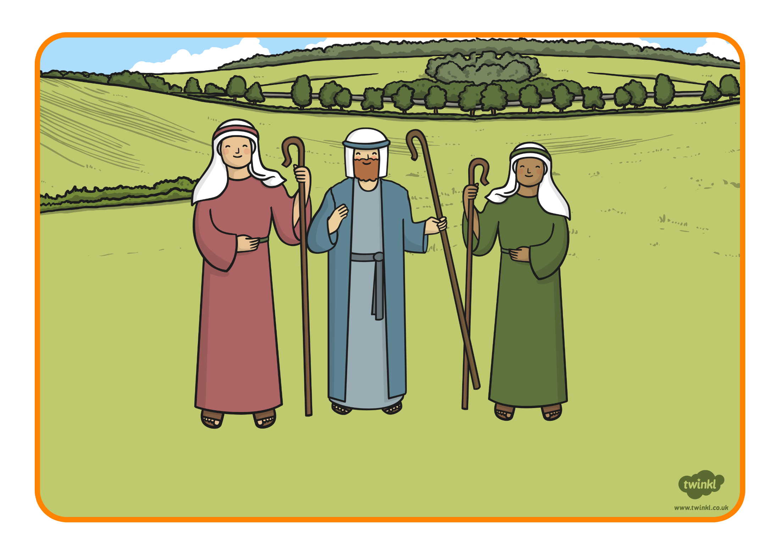
The shepherd was so happy, he threw a party to celebrate!

