Slide 2
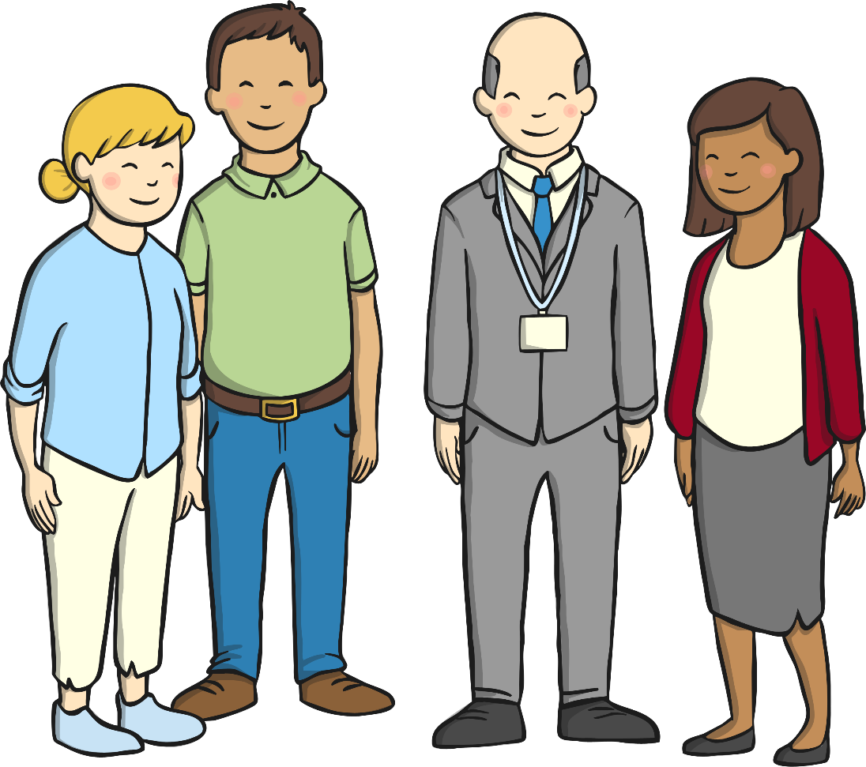
Aim
To understand who the different people at school are.
To understand some of their roles and responsibilities.

Slide 3
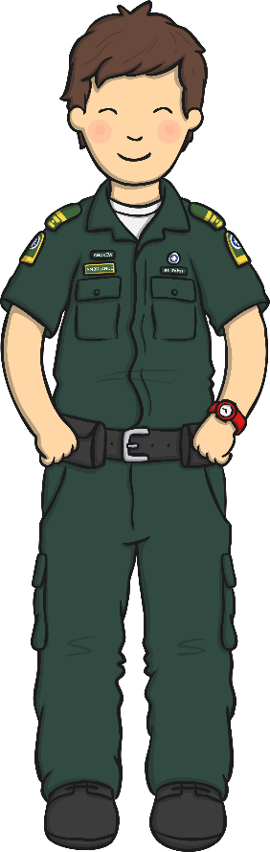
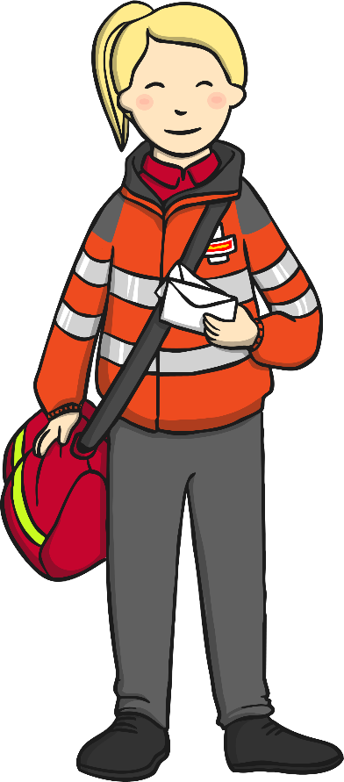
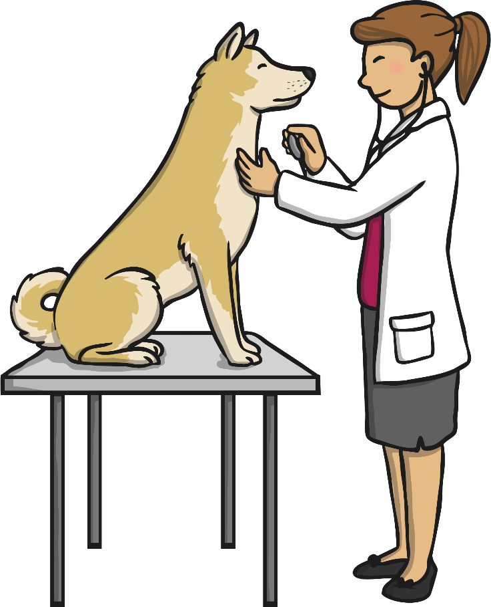
People Who Help Us
Can you name some of the people who help us in our lives?
What are their jobs?

Slide 4

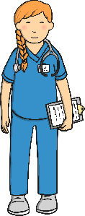





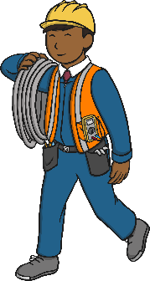
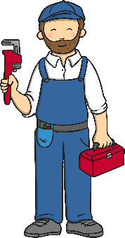



People Who Help Us
There are many people who help us in our lives…
doctors
nurses
paramedics
firefighters
police officers
vets
postal workers
builders
electricians
plumbers
bus drivers
teachers
…and lots of other important people who help us at school!

Slide 5
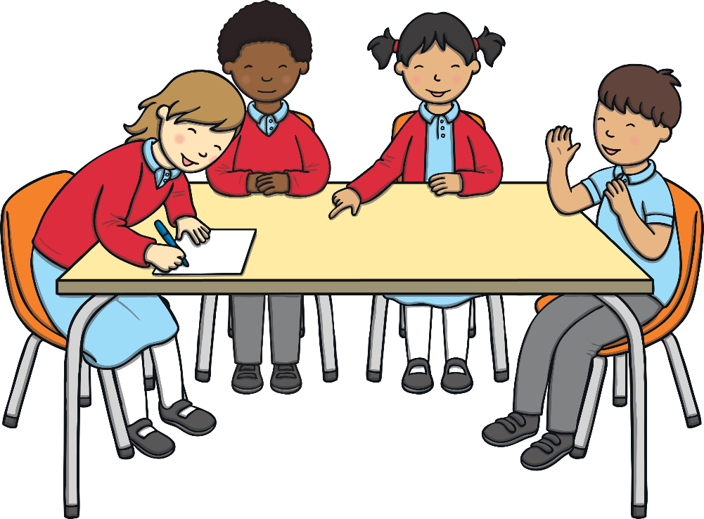
People at School
There are lots more important people who help us at school.
Can you think of someone?
Do you know what their job is?

Slide 6
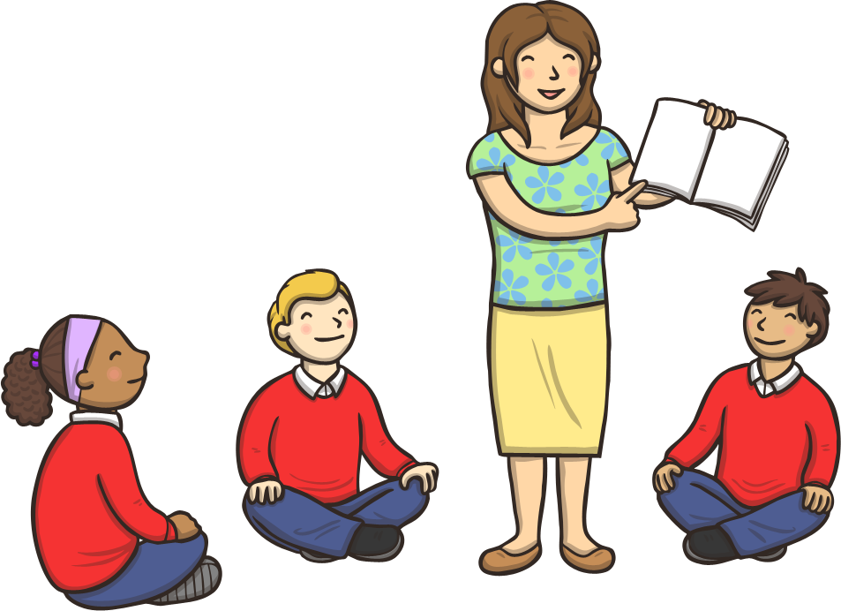
Teachers
Teachers teach you, they help you learn and they look after you at school.
They plan lessons, prepare resources, create displays, look after the classroom, mark and assess children’s work and manage behaviour. They meet with parents and carers, other people from school and outside school, make sure you’re progressing and go to staff meetings and training. They also plan trips, events, invite visitors
in and help other adults in school.
Which teachers have you had?
What have you liked learning about with them?

Slide 7
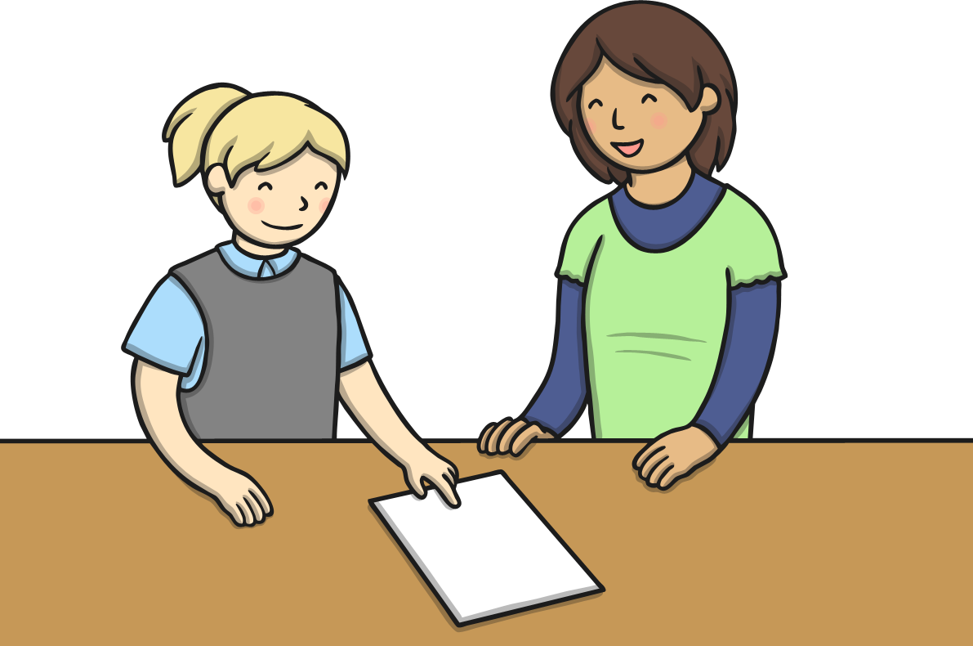
Teaching Assistants
Some teaching assistants help in the classroom and some help children outside the classroom.
Teaching assistants help children with their learning, help teachers with their lessons, get lots of things ready, tidy and help children to remember good behaviour. They sometimes teach groups of children, help create displays and do lots more!
Who is a teaching assistant in your school?
What have they helped you with?

Slide 8
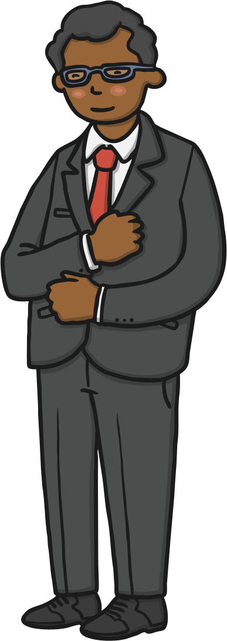
Leaders
Headteachers are in charge of the school. You may also have deputy headteachers, assistant headteachers or heads of school. They do lots of important jobs to help you, the school, the people who work there and parents and carers.
You may visit the headteacher or someone else if you have done something special, to get an award or if something has gone wrong.
Who are your school leaders?
When do you see them?

Slide 9
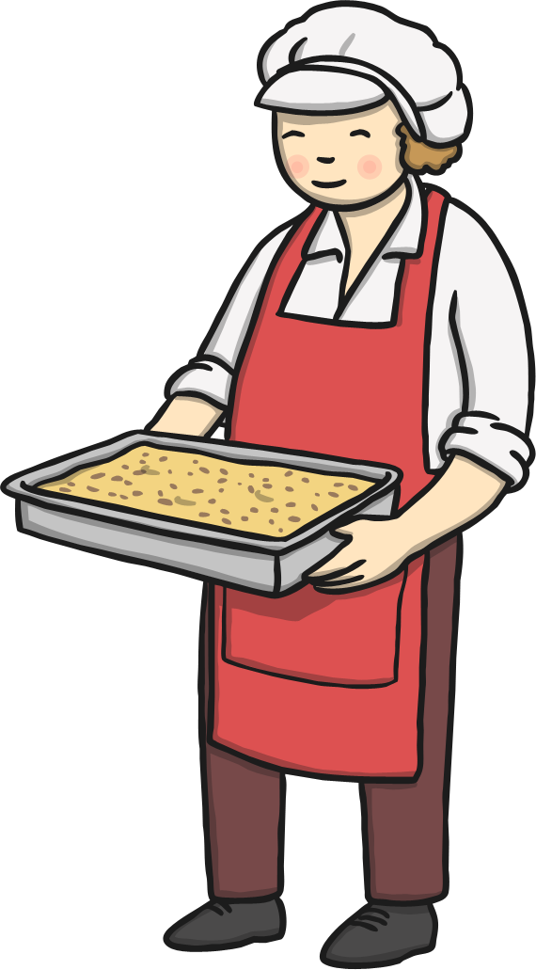
School Cooks
School cooks make the food you have at lunchtime if you have school meals. They get the food ready while you are learning, look after the school kitchen and many serve the food to you too.
Who is your school cook?
What is your favourite school meal?

Slide 10

Lunchtime Assistants and First Aiders
Lunchtime assistants help you at lunchtime. They get the hall ready, put the chairs and tables out, give you school meals, help with any problems at lunchtime inside and out in the playground, clean and tidy up. There are also first aiders who help you when you are hurt or poorly.
Who are your lunchtime and playground assistants?
What do you like to do after
you finish your lunch?

Slide 11

Office People
There are people who work at the school to help everything run smoothly. Sometimes there are receptionists, business managers and administrators. Some people help greet people, take in the school registers, answer the phones, show people around the school and sort out lots of other jobs.
Who works in your
school office?
What do they help you with every day?

Slide 12
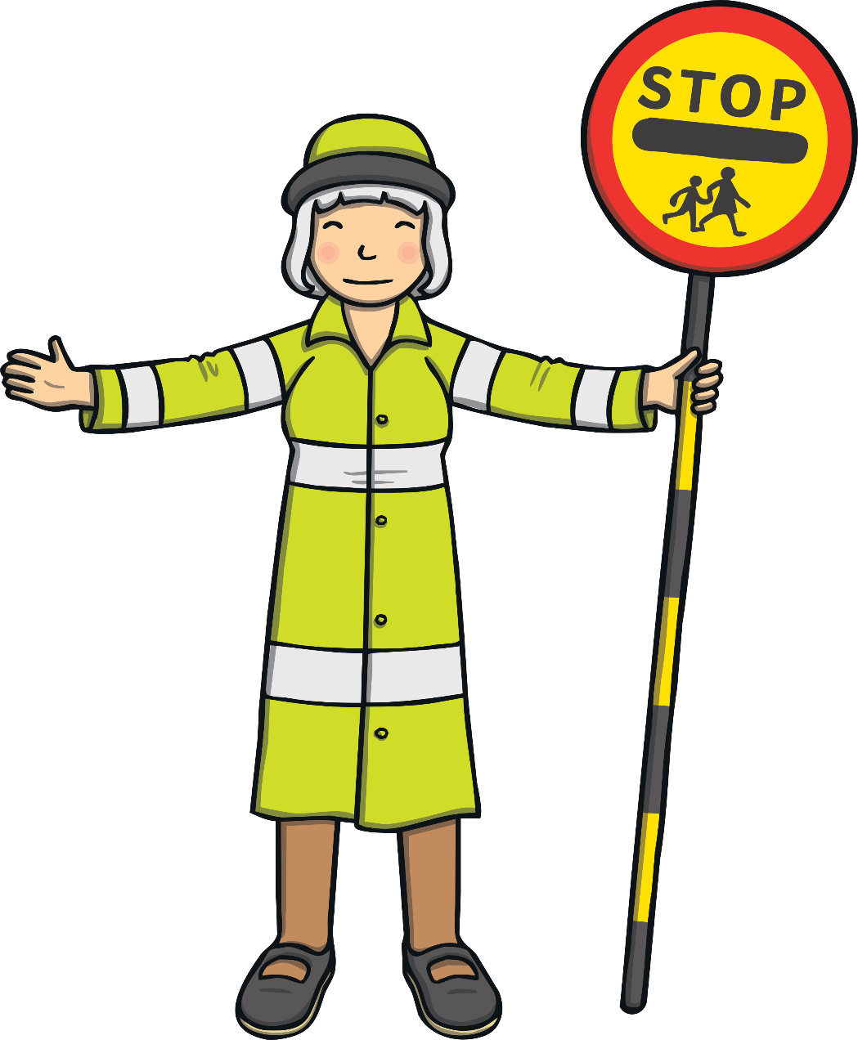
Lollipop People
If your school is near a road, there may be a school lollipop person who helps you cross the road before and after school. They help keep you safe from the cars and other traffic.
Does your school have a
lollipop person?
Who are they?
Have they helped you cross
the road?

Slide 13
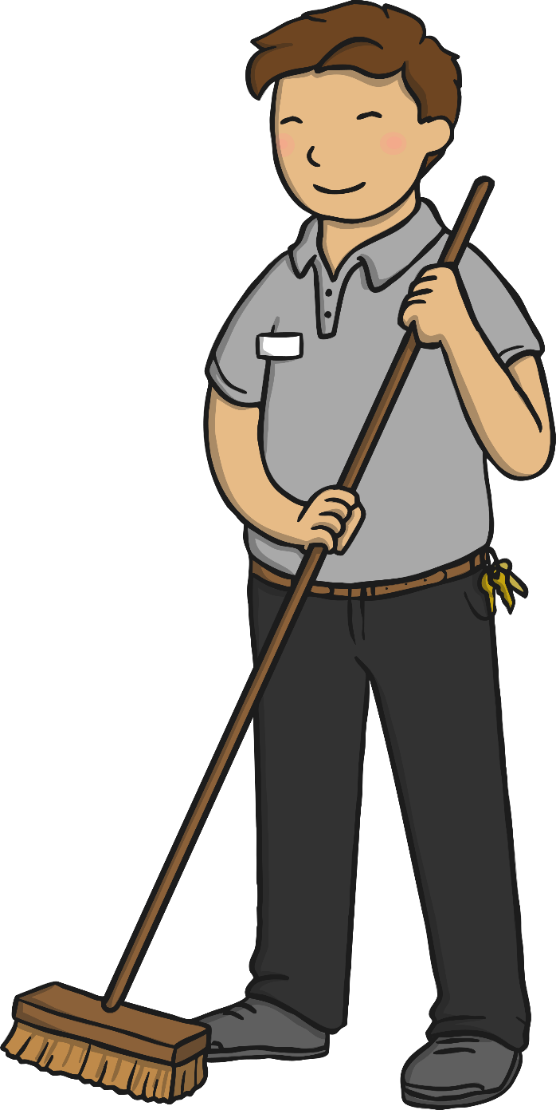
Building Supervisors
Building supervisors do lots of jobs around the school. Building supervisors put display boards up, fix broken furniture and other things, paint the walls and doors, look after the playground and lots of other important jobs. If your school has a school field, they might look after that too.
Does your school have a
building supervisor?
Who are they?
Have they helped you make, fix or look after?

Slide 14
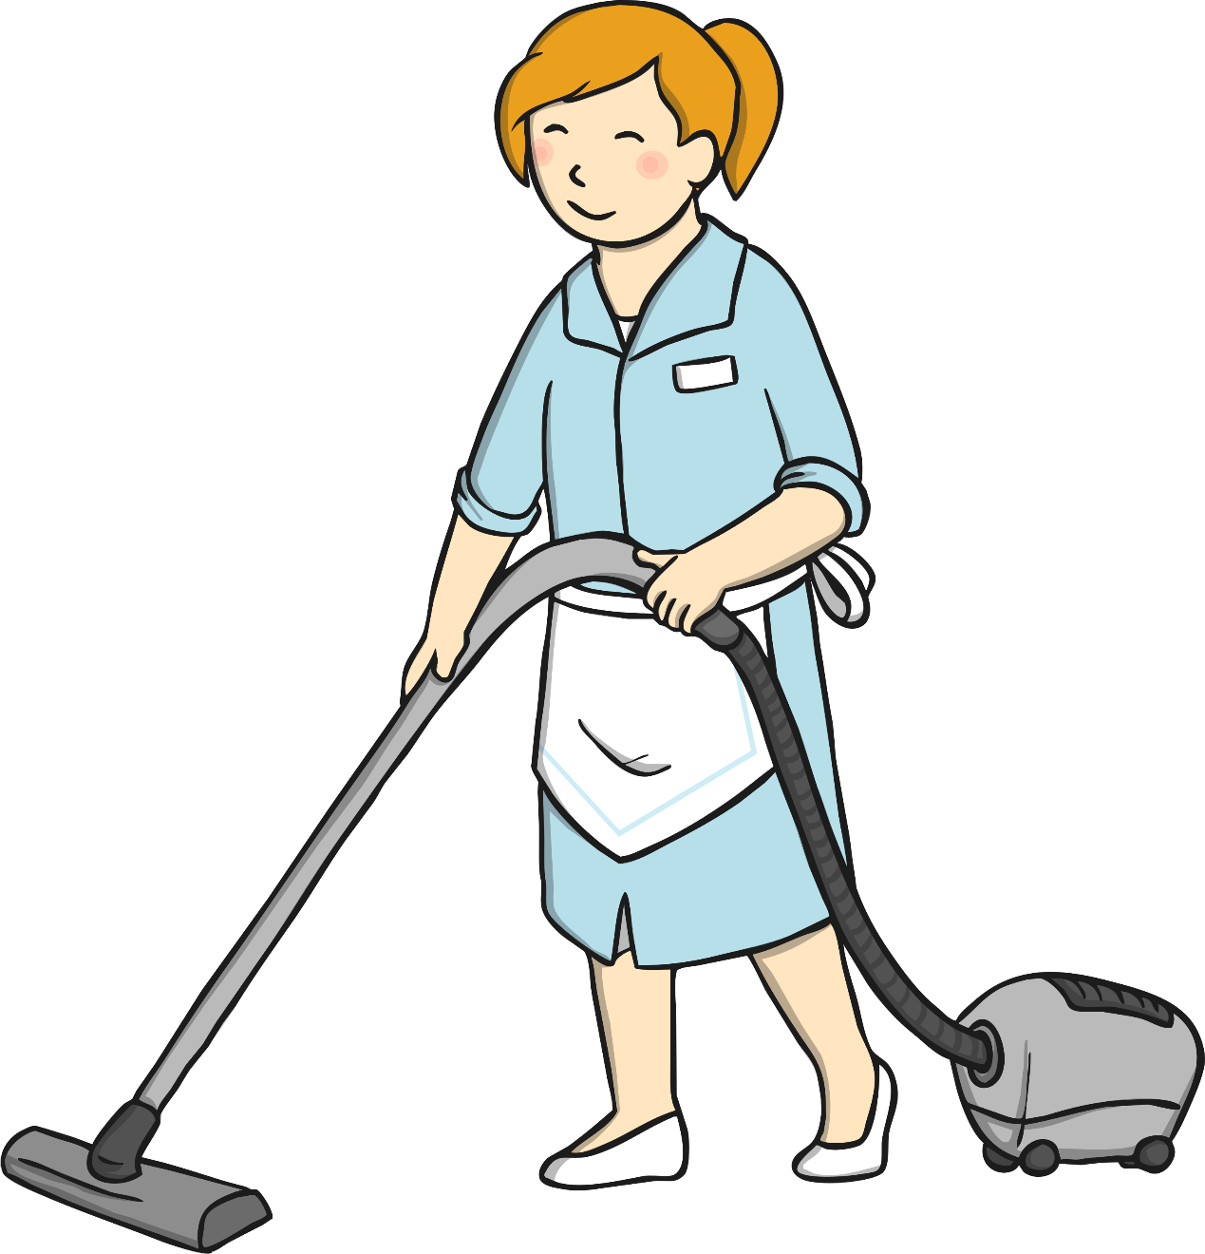
Cleaners
School cleaners help keep your school clean, tidy and ready for you. They vacuum (hoover), sweep and wash the floors, wipe the tables, clean the windows and walls, clean the sinks, toilets, rooms and hall.
Who are your school cleaners?
Have you ever said thank you
for cleaning up a big mess in your classroom?

Slide 15
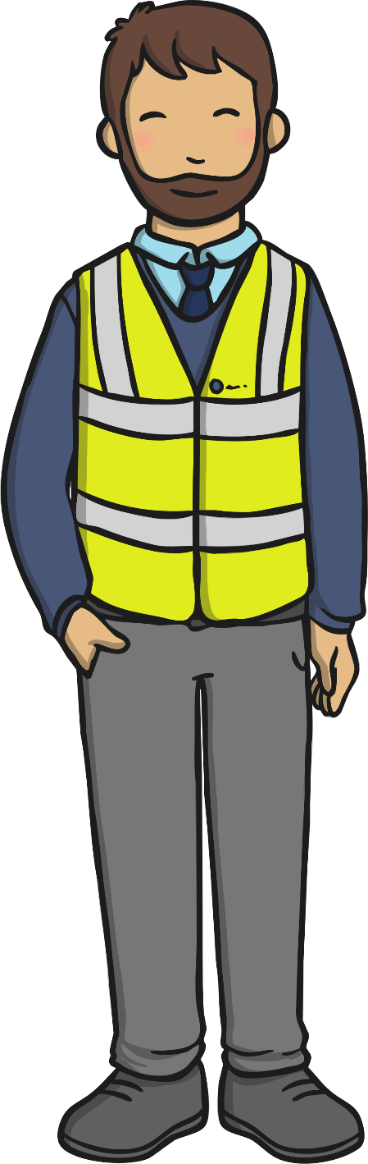
Bus Drivers
Some schools have bus drivers and minibus drivers who help take you to school, home and on trips.
Does your school have a bus or minibus driver?
Who are they?
Where have they helped you
get to?

Slide 16

Thank You!
How many adults are there in your school?
Can you think of even more people at your school that help you?
Who would you like to say a big ‘thank you’ to?
How many people at your school have helped you?

