Slide 1
Term 3 Week 3
Smash up numbers
Label fractions with key vocabulary
Show halves and quarters
Show given fractions on shapes
Find fractions of amounts

Slide 2
Smash Up Numbers ☺
Roll your dice twice to make a two-digit number.
How many ways can you smash it up?
Notes:
Lesson 1
Starter

Slide 3
Fractions
‪Fractions: Intro‬ (colorado.edu)
‪Fractions: Game‬ (colorado.edu)
Notes:
Try the Fractions games on this website – Great Fun ☺

Slide 4
What is a fraction?
A fraction is made up of 3 parts:
Numerator
Dividing line
Denominator
3
4

Slide 5
What is a fraction?
A fraction is made up of 3 parts:
Numerator
3
The numerator is how many parts you have of the ‘whole’.
4

Slide 6
What is a fraction?
A fraction is made up of 3 parts:
Dividing line
3
4
A fraction tells you how many parts you have out of how many in the ‘whole’. The whole is divided into equal parts.

Slide 7
What is a fraction?
A fraction is made up of 3 parts:
Denominator
3
The denominator are how many EQUAL parts in the ‘whole’.
3

Slide 8
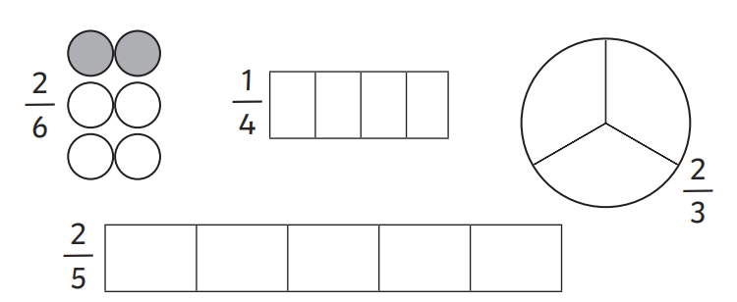
Here are some shapes which have been split into equal parts. How many parts need to be shaded?
The first one has been done for us.
Notes:
Colour the number parts the same as the numerator.
Discuss the parts all being equal so it doesn’t matter which are shaded – they don’t have to be next to each other it will still be correct.

Slide 9
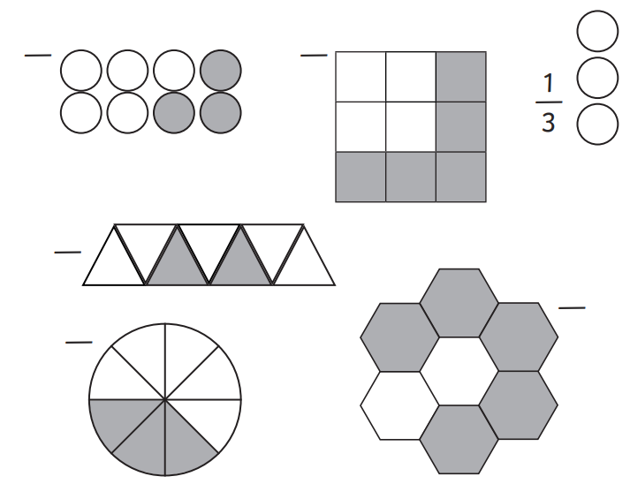
Can you write the fractions for these?
Notes:
Count the equal parts for the denominator.
Count the shaded parts for the numerator

Slide 10
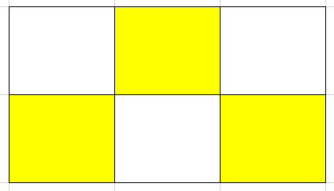
What went wrong?
Alfie was asked to shade
Is he right?
4
6

Slide 11
What are you more confident in today?
Notes:
Whole class – gather ideas to check understanding of tasks set

Slide 12
Smash Up Numbers ☺
Roll your dice twice to make a two-digit number.
How many ways can you smash it up?
Notes:
Lesson 2
Starter

Slide 13
Fractions
‪Fractions: Intro‬ (colorado.edu)
‪Fractions: Game‬ (colorado.edu)
Notes:
Try the Fractions games on this website – Great Fun ☺

Slide 14
What is a fraction?
A fraction is made up of 3 parts:
Numerator
Dividing line
Denominator
3
4
Notes:
Reminder slide

Slide 15
You can find fractions of amounts as well as shapes.
It is important to remember that all parts MUST be equal.
If I need to find ½ of a number, I need to split it into 2 equal parts.
If I need to find ¼ of a number, I need to split it into 4 equal parts.
Notes:
Discuss the denominator being how many parts we are sharing the amount into.

Slide 16
Let’s find ½ of 10.
Get 10 counters.
We need to share them into 2 equal groups.
5
5
Notes:
Sharing into 2 groups

Slide 17
Can you find ½ of 16?
You can draw 2 circles and share 16 into them by drawing smaller circles in them.
Notes:
Use counters or drawings but always do one at a time to embed equality

Slide 18
Can you find ¼ of 12?
You can draw 4 circles and share 12 into them by drawing smaller circles in them.
Notes:
Use counters or drawings but always do one at a time to embed equality

Slide 19
What are you more confident in today?
Notes:
Whole class – gather ideas to check understanding of tasks set

