Slide 1
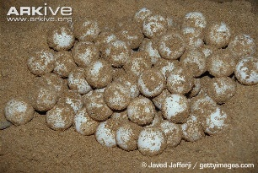
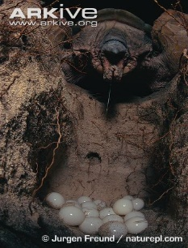
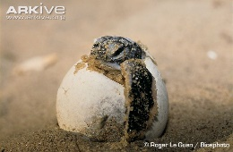
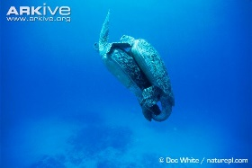
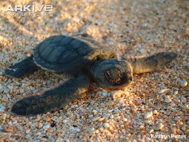
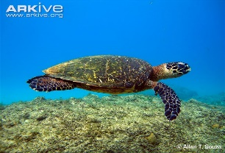
Turtle Life Cycle

Slide 2
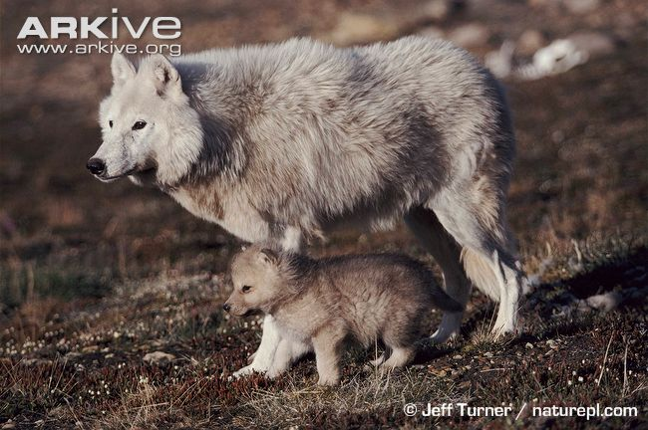
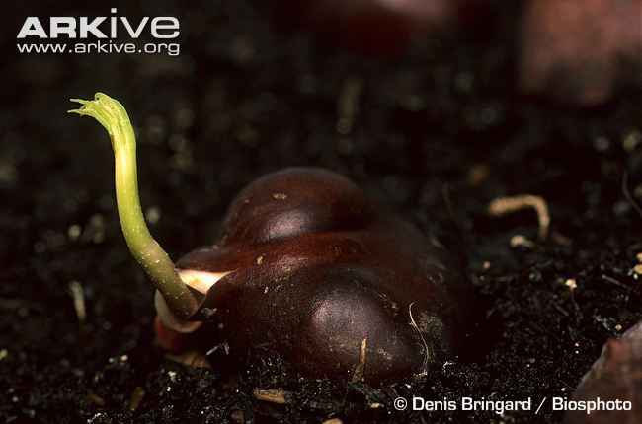
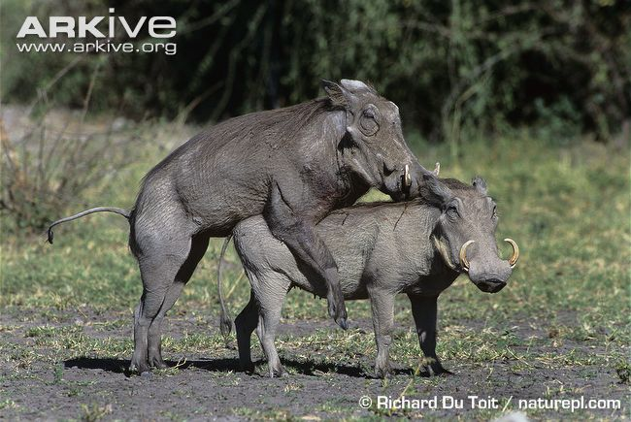
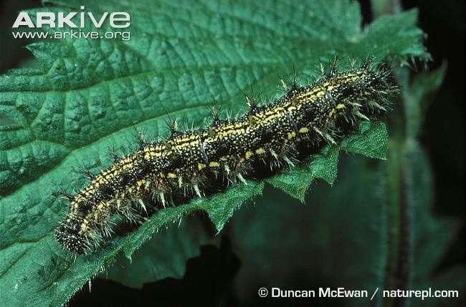
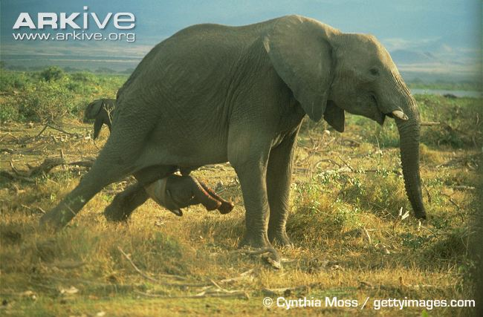
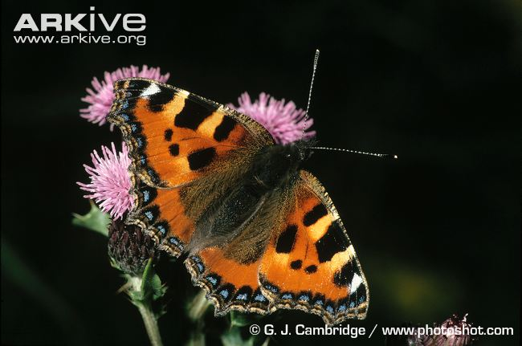
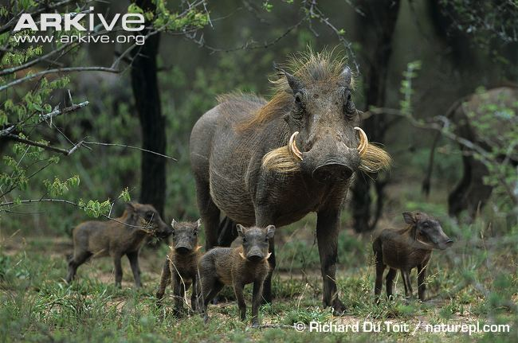
What is a life cycle?
The different stages an animal or plant goes through during its life.
What stages might this include?
  - Birth or germination
  - Development
  - Reproduction
Notes:
Explain that a life cycle is made up of the different stages an animal or plant goes through during its life.
Ask the students if they can name any stages that a life cycle might include (use the first answer as a prompt if they cannot come up with any answers).
Explain that one of the earliest stages in a life cycle is birth or germination. In animals it is called birth, whereas in plants it is called germination. Define the term ‘germination’:
Germination is when a seed from a plant begins to sprout and grow (such as in the picture of a horse chestnut).
Explain that development can mean different things, depending on the species or species group in question. For some animals it just means growing, whereas others go through a process known as metamorphosis. This is where the animals change physical form as they mature. A great example of metamorphosis can be seen in butterflies, which change from a caterpillar to a butterfly (which have completely different physical forms) during their life cycle.
This can be compared with animals that just grow, where adults are basically larger versions of the young.
Recap or explain the definition of reproduction: the process of producing young (which are also known as ‘offspring’).
A life cycle is complete when a new one begins (i.e. when the animal or plant reproduces and ‘replaces’ itself).

Slide 3
Species groups
There are many different species on the planet, and they belong to different groups.
Can you name some groups of species?
INVERTEBRATES
MAMMALS
AMPHIBIANS
PLANTS
FISH
FUNGI
BIRDS
REPTILES
Notes:
Explain that there is a huge variety of species on Earth, and these species can be classified into groups.
Ask the students if they can name any species groups – start them off with mammals and see how many they can name.
Once the students have named as many as they can, reveal the answers!
Note: Invertebrates include insects, spiders, centipedes, molluscs, etc.
Explain here that different species within a particular species group (e.g. foxes, deer and humans within mammals) often show similarities in their life cycles. Both similarities and differences can be seen between species groups (e.g. birds and reptiles both lay eggs, but while birds usually look after their young, reptiles often do not. Some reptiles are also able to give birth to live young).

Slide 4
Species groups
These are the groups we will be looking at today in more detail:
MAMMALS
AMPHIBIANS
PLANTS
REPTILES
Notes:
Say that you are now going to talk in more detail about the similarities and differences between the life cycles of these particular species groups.

Slide 5
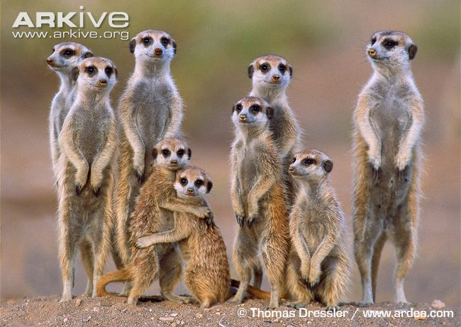
Mammals
Most mammals have very similar life cycles, with the individuals going through similar stages of development:
  Female gives birth to young
  Young looks like a miniature version of the adult
  Female provides milk for the young to grow and develop
  Adults take care of the young
  Reproduce through sexual
  reproduction, involving sperm
  and eggs
Notes:
Most mammals have very similar life cycles, with most individuals going through similar stages of development.
Talk the class through the main similarities between mammals:
In mammals, the female gives birth, usually to live young (not eggs).
Young mammals usually look like miniature versions of the adults (i.e. development in mammals involves growth rather than metamorphosis, as shown by this meerkat picture, where the young look just like the adults).
Females produce milk (from mammary glands), which the young require early on in their development in order to grow.
Mammals often give parental care (i.e. they look after their young by protecting them and/or providing food for them). Note that there are different types of parental care: in gibbons, for instance, both the male and female look after the young, whereas in other species, such as cheetahs or whales, the female looks after the young alone. In other species, many individuals within a group take part in looking after the young, as is the case with meerkats.
Explain or recap that both a male and female are required for sexual reproduction, with the male providing the sperm and the female providing the egg. After mating, the female becomes pregnant and gives birth to young, completing the life cycle.
Note: There are some exceptions to the rule! For example, monotremes are mammals that lay eggs instead of producing live young (the duck-billed platypus is an example of a monotreme).
For older or more advanced groups, have a discussion about the difference between ‘placental mammals’ and ‘marsupials’:
Marsupials are much like other mammals (placental mammals), but the big difference is that marsupials give birth to young which are not quite fully developed. These young get transferred to a pouch where they develop and grow further. Ask the students to name a few marsupials (koalas, kangaroos, wombats, etc.).

Slide 6
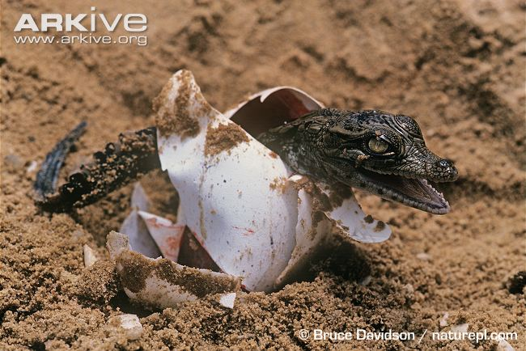
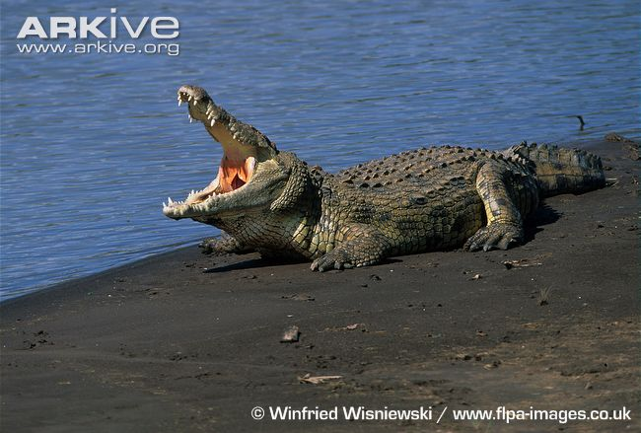
Reptiles
What do you think might be different about the life cycle of reptiles, when compared with the life cycle of mammals? What might be the same?
Most reptiles lay eggs
Young looks like a miniature version of the adult
Generally, no parental care is given – the eggs/young are left to look
after themselves
Most reptiles reproduce
through internal sexual
reproduction, involving
sperm and eggs
Notes:
Ask students to think about what similarities there might be between the life cycles of mammals and reptiles – prompt them with questions such as ‘do reptiles give birth to live young?’ or ‘do reptiles give parental care?’
In reptiles, the female normally lays eggs (Note: some reptiles, including some snake species such as adders, give birth to live young!).
Young reptiles usually look like miniature versions of the adults (i.e. development in reptiles involves growth rather than metamorphosis, as shown by the pictures of the Nile crocodile where the young crocodile looks just like the adult).
Reptiles do not usually give parental care (for instance, sea turtles lay their eggs on land and return to the sea immediately afterwards, and so are not present when the eggs hatch. The young make their own way to the sea, and no food is provided for them). However, in some crocodile species, the female may guard the nest and her young.
Reptiles usually reproduce via sexual reproduction, with the male providing the sperm and the female providing the egg. After mating, the female becomes pregnant and lays eggs, completing the life cycle. However, some female reptiles can reproduce without mating with a male – this is known as parthenogenesis, and is a form of asexual reproduction.

Slide 7
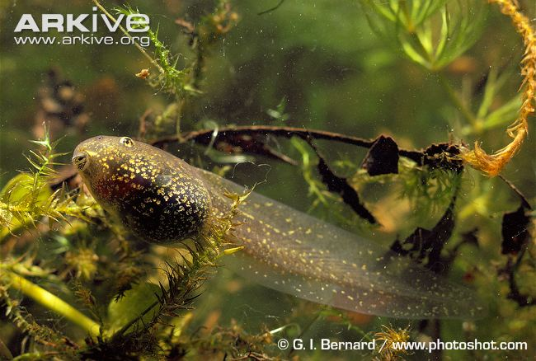
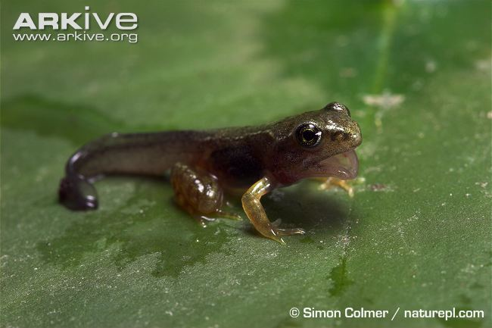
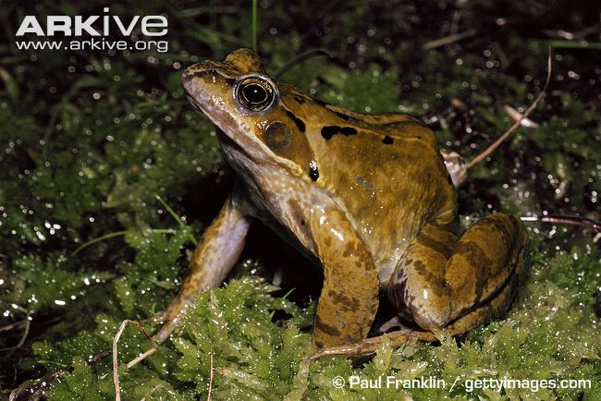
Amphibians
What do you know about the life cycle of amphibians?
Most amphibians lay eggs
After hatching, amphibians usually go through a very different physical form (tadpole) before looking like an adult
Tadpoles and young frogs are not usually given any parental care
Most amphibians reproduce through external sexual reproduction, involving sperm and eggs
Notes:
Ask students what they know about the life cycle of amphibians. If necessary, prompt them with questions – for instance, ask students if amphibians lay eggs or give birth to live young, etc. Students should aim to cover all or some of the following before the answers are revealed:
Do they lay eggs or give birth to live young?
Do young look like miniature versions of the adults, or do they look different?
Are young amphibians given parental care?
Do amphibians reproduce sexually or asexually? Note: for more advanced students, mention that, whereas in mammals sexual reproduction is internal, sexual reproduction in amphibians is external (e.g. the eggs are fertilised outside the body).
- Amphibians lay eggs (although the eggs look very different to the eggs of other groups, such as reptiles and birds).
- A major difference between amphibians and mammals/reptiles is that during the amphibian life cycle, an individual goes through several different physical forms (larval stages - the tadpole stage in frogs) as it matures. Have a look at the pictures which show the various stages the common frog goes through as it matures. Note how different the tadpole looks when compared with the adult frog. These forms are so different that they even live in different habitats. The tadpole lives underwater and uses gills to breathe, whereas the adult frog lives both on land and in water, and breathes through its skin.
- Amphibians generally do not provide parental care for the eggs or young. However, there are some exceptions to the rule! Check out gastric brooding frogs!
- Although amphibians reproduce sexually (as in mammals and most reptiles) and therefore require a male and a female, this occurs externally, with the female releasing eggs and the male fertilising them.

Slide 8

Plants
Plant life cycles are very different to the other life cycles we have looked at so far. But how?
Let’s take a look at flowering plants…
Pollen is transferred from the stamen (male part) of one flower to the carpel (female part) of another flower – pollination
This pollen then joins with the ovules to become seeds – fertilisation
Seeds are then scattered – this can be
through wind dispersal, or by animals
Seeds then grow into plants
Notes:
The life cycle of a plant is very different to the life cycle of an animal. Explain that you are going to look at the life cycle of a flowering plant. Ask students to name the four main parts of the plant: roots, stem, leaves, flowers – ask the students which of these are involved in reproduction.
The plant life cycle begins with a seed which germinates (Recap definition from earlier: Germination is when a seed from a plant begins to sprout and grow). After germination the seed will continue to grow and develop into a plant. Obviously no parental care is given!
Reproduction is very different in plants. Each plant has both male and female reproductive parts. Pollen is transferred from the stamen (the male part of the plant) to the carpel (female part of the plant) of a DIFFERENT flower. This is known as pollination. The pollen is transferred by a pollinator such as a bee or a butterfly.
The pollen then travels down the style (the hollow tube leading to the ovary) to the ovaries where the pollen fertilises the ovules. This produces a seed.
Seeds are then scattered, this can be done by animals, wind dispersal, water, etc. These seeds then germinate and the life cycle begins again.

Slide 9
Summary
 | Eggs, live young or seeds | Miniature version of adult | Parental Care
Mammals
Reptiles
Amphibians
Flowering plants
Live young
Yes
Yes
Eggs
Yes
No
Eggs
No
No
Seeds
Yes
No
Notes:
Ask the students to help fill in the table with the correct answers.
Note: In nature there are nearly always exceptions! Explain to the students that the answer required/given is for the majority of species in each group.

Slide 10
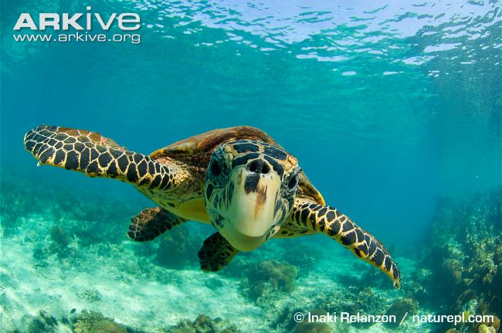
Sea turtle life cycle
Which group do sea turtles belong to?
REPTILES
What does this tell us about their life cycle?
Sexual reproduction
No parental care
Lay eggs
Young are miniature versions of adults
Notes:
The rest of the presentation is now going to focus on the life cycle of sea turtles, and in particular the life cycle of the green turtle. Ask the students which species group they think sea turtles belong to. If they do not know, tell them that sea turtles are reptiles. Ask the students what this might tell us about a green turtle’s life cycle.
Their answers should include that:
they lay eggs
they reproduce sexually
no parental care is given
the young are miniature versions of the adults
They might also add that the young grow to become adults as opposed to going through metamorphosis.

Slide 11
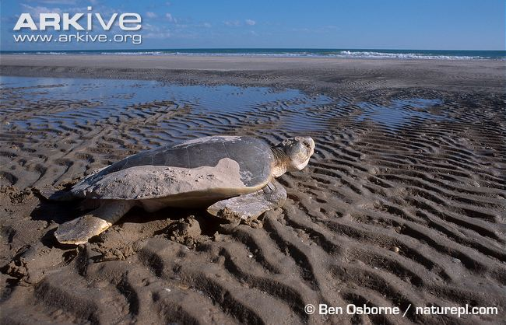
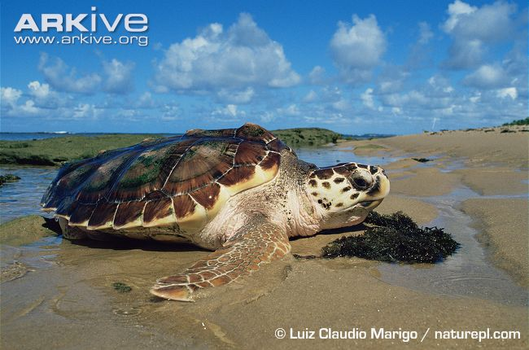
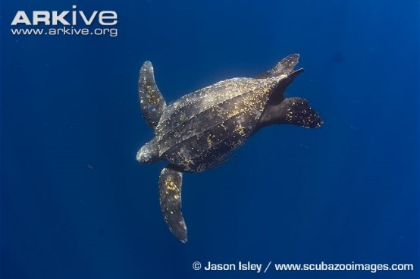
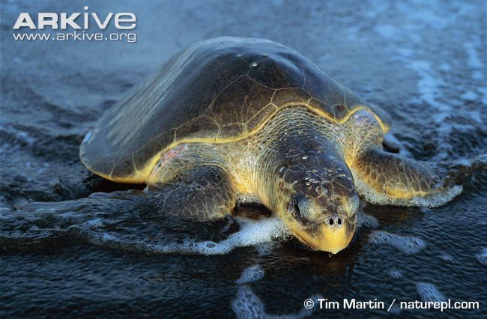
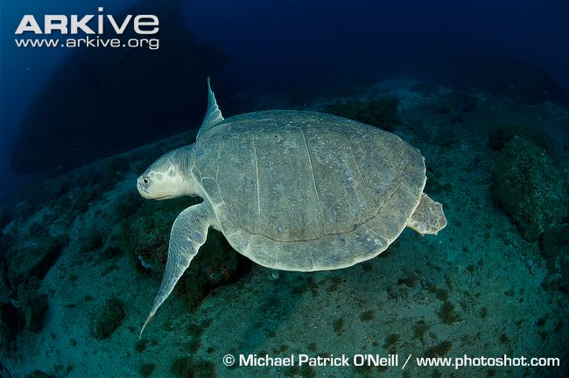
Sea turtles
There are seven different species of sea turtle
Can you name any?
Flatback turtle
Loggerhead turtle
Leatherback turtle
Hawksbill turtle
Olive ridley turtle
Kemp’s ridley turtle
Notes:
Ask the students if they can name any of the seven sea turtle species:
Hawksbill turtle
Leatherback turtle
Loggerhead turtle
Flatback turtle
Olive ridley turtle
Kemp’s ridley turtle
Green turtle

Slide 12
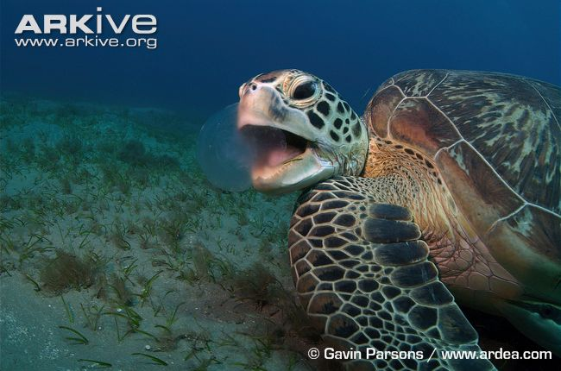
…and the GREEN TURTLE!
Notes:
And finally the green turtle! This is the species that will be focused on for the remainder of the presentation.

Slide 13
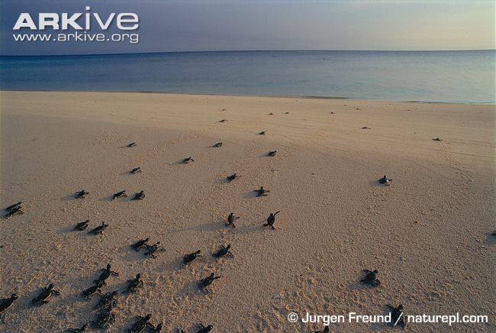
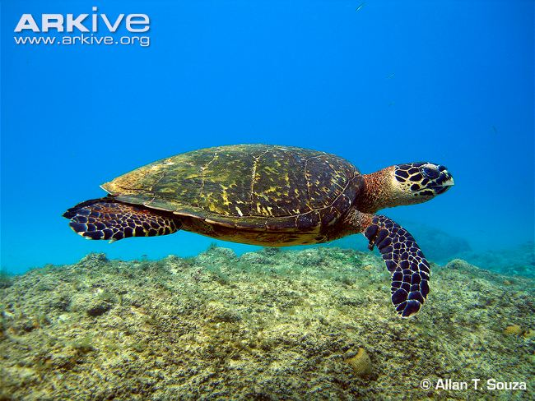
Green turtle
Why are they called green turtles?
→Because their fat is green in colour!
Female green turtles can lay between 100 and 150 eggs per clutch, and usually lay several clutches per breeding season.
Some populations of green turtle migrate thousands of kilometres to feed and breed. Part of the Brazilian population migrates 2,250 kilometres to breed near Ascension Island in the South Atlantic!
Green turtles can live a very long time! Scientists are not sure exactly how long, but it is thought that it could be up to 100 years or more!
Notes:
Introduce the green turtle by asking if the students know why green turtles are called green turtles.
The students may guess that it is because of the colour of the shell, but the shell is actually more brown. Green turtles get their name from their fat which is green in colour!
Female green turtles can lay between 100 and 150 eggs per clutch, and can lay several clutches per breeding season.
Clutch – A group of eggs laid at the same time (i.e. are in the same nest).
Some populations of green turtle migrate thousands of kilometres to feed and breed. Part of the Brazilian population migrates 2,250 kilometres to breed near Ascension Island in the South Atlantic!
NB: Migration is the movement of an animal from one place to another. Species migrate for different reasons. It may be to do with seasons, with species migrating to escape cold, harsh winters. Some species, such as the green turtle, migrate from feeding grounds to breeding grounds.
Green turtles can live a very long time! Scientists are not sure exactly how long, but it is thought that green turtles can live to be up to 100 years old or more!

Slide 14
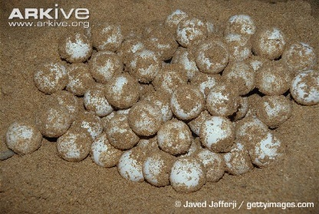





Green turtle life cycle
Notes:
Explain that this diagram represents the key stages in the life cycle of a green turtle.
Each stage will now be looked at in more detail.

Slide 15
Starts off as an egg
Green turtle life cycle
Notes:
Like most other reptiles, green turtles begin life as eggs.

Slide 16
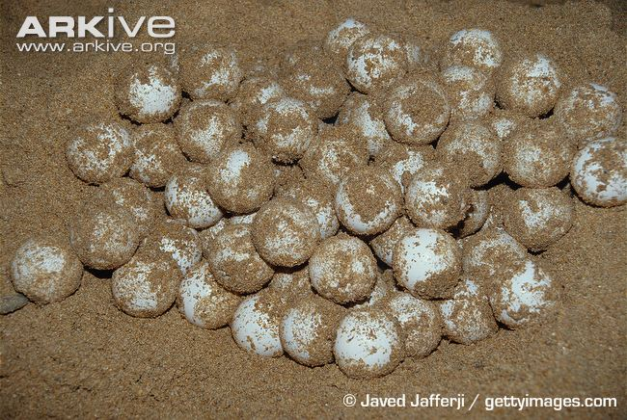
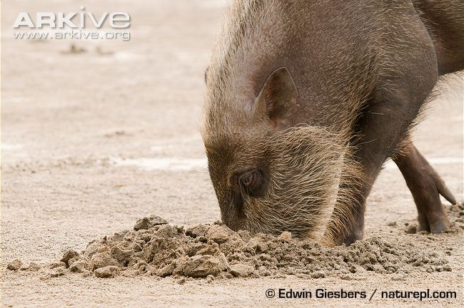
Green turtle life cycle
Egg Stage
Eggs are incubated in the nest for 45
to 70 days
The temperature affects the sex of the young:
- Lower temperatures produce males
- Higher temperatures produce females
- Middle temperatures produce males and females
Threats
Eggs being taken by humans for food
Feral/wild pigs and domestic dogs digging up the nest
The nest getting flooded
Notes:
Green turtles start off as an egg. Green turtle eggs are incubated for 45 to 70 days. Ask the students if they know what incubation means?
Incubation: This is the process by which eggs are kept warm (within a certain temperature range) for a period of time in order to develop. Eggs are incubated at different temperatures and for different periods of time, depending on the species.
The temperature at which green turtle eggs (and eggs of other sea turtle species) are incubated is very important, as it determines what sex the hatchlings will be.
Note: The science behind this is rather complicated, and even top scientists aren’t quite sure of exact temperature figures! Here, introduce the basic idea that, in green sea turtles, warmer incubation conditions generally produce females, and cooler conditions produce males, with a mix in the middle. In other species, it is far more complicated!
In green turtles, a nest temperature of 29°C produces a mix of males and females. At higher temperatures, there will mostly be females (at a certain temperature they will all be female), and at cooler temperatures the nest will contain mostly males (when a certain temperature is reached, the nest will all be male).
For more advanced students, the following concept can be introduced: Explain that, within a nest, the temperature can vary throughout. The eggs in the centre of the nest incubate at a higher temperature than those on the edges of the nest, and so are more likely to produce female hatchlings. The eggs found in the outer parts of the nest will be incubated at a lower temperature than those in the centre, and so are more likely to produce male hatchlings.
Now introduce the various threats that turtle eggs and nests face:
- Turtle eggs are a delicacy in some countries, and so nests are often dug up by humans and the eggs are stolen.
- Wild pigs and domestic dogs also dig up turtle nests. This negatively affects the eggs: some of the eggs are eaten, and those remaining often do not hatch because either they are physically damaged or the temperature conditions are no longer suitable for proper development of the young turtle.
- A further danger to turtle nests is flooding. If a nest is below the high tide line, the sea may flood the nest and prevent the hatchling developing within the egg from breathing, as well as affecting the temperature within the nest.

Slide 17

Starts off as an egg
Hatchling emerges from egg
Green turtle life cycle
Hatchling makes its way to the sea
Notes:
After 45 to 70 days of incubation, the eggs hatch. Hatchlings (baby turtles) use a special ‘egg tooth’ to break out of the egg shell. Usually, all eggs within a nest hatch at the same time, and the hatchlings then make their way through the sand together, and emerge from the nest. It can take them several days to reach the surface! When they come out of the nest, it looks a little bit like a turtle volcano erupting, and is known as a ‘boil’!

Slide 18
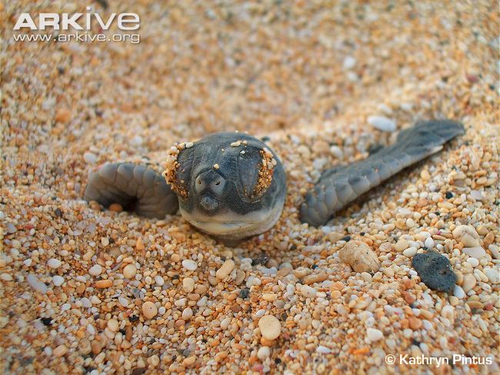
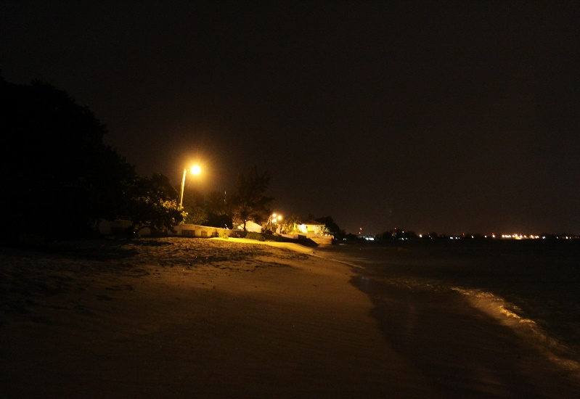
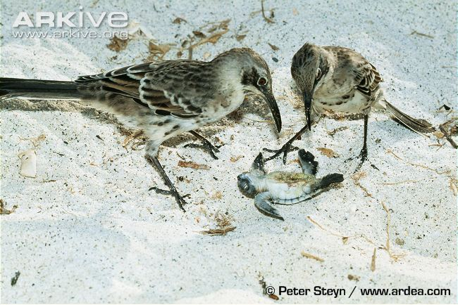
Green turtle life cycle
Hatchling stage
Hatchlings look like miniature adults
Hatchlings get no parental care
Hatchlings head towards the lighter horizon, which will be over the sea
Threats
Predators – gulls and crabs on the beach, and fish and sharks once the hatchlings reach the sea
Artificial lighting – hatchlings head towards that instead of the sea
Notes:
Like most other reptiles, hatchling green turtles look like miniature versions of the adults.
Similar to many other reptile species, green turtle hatchlings do not receive parental care. The female completes her duties and returns to the sea once she has laid the eggs, and so does not provide food or protection for the young once they’ve hatched.
Ask students if they know what time of day sea turtles usually emerge from the nest, and why this is.
Green turtles usually emerge from the nest at night time – it is thought that they are able to tell when it is night as the temperature is generally cooler. By emerging at night, green sea turtle hatchlings are less likely to be eaten, as there are fewer predators around (for instance, there probably won’t be any birds around). After emerging, the hatchlings make a quick dash to the sea. Ask students how the turtles know which way to go.
The light over the sea (towards the horizon) is brighter than the natural light over the land, and so the hatchlings head towards the brighter horizon.
Even at night, hatchlings are at risk from predators, including crabs on land, and fish in the sea. Sometimes hatchlings emerge during the day, and are then also at risk of being eaten by birds. Lizards are also known to eat turtle hatchlings – for instance, on Barrow Island in Australia, the perentie, Australia’s largest lizard, often feeds on turtle eggs and hatchlings.
Artificial light such as light from hotels or streetlamps, and even light from torches, can be a problem for hatchlings. As this light is often brighter than the light over the sea, hatchlings will mistakenly head towards the artificial light, taking them further away from the sea. Some may then never reach the sea, and others may eventually find their way, but will be more tired and weak by the time they get there, decreasing their chances of survival. Spending longer than necessary on the beach also increases the risk of predation.
Video of hatchlings heading towards the sea: http://www.arkive.org/green-turtle/chelonia-mydas/video-09i.html
Note: Although most hatchlings emerge at night, in this particular example the hatchlings have emerged a little earlier, at sunset.

Slide 19

Starts off as an egg
Hatchling emerges from egg
Green turtle life cycle
Hatchling makes its way to the sea
Hatchling grows into a juvenile and then into an adult
Notes:
The intermediate stage of a green turtle (between hatchling and fully grown adult) is known as the juvenile stage.
As juveniles, the turtles need to find food in order to grow into an adult.

Slide 20
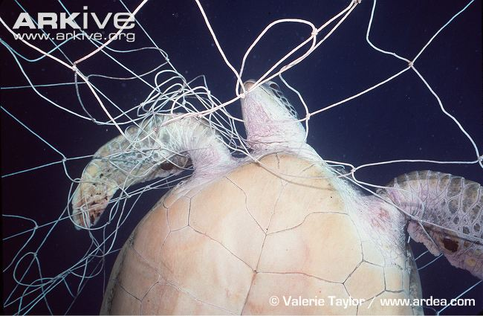
Green turtle life cycle
Juvenile stage
Where do juveniles go?
Nobody really knows! Scientists have yet to figure out exactly where they go between the hatchling and juvenile stages – it’s a mystery!
End up in feeding areas – exact location not known
Threats
Eating plastic bags – the turtles think the bags are jellyfish
Fishing nets and lines
Notes:
The juvenile stage is the stage in between being a hatchling and an adult. The development from a hatchling to an adult turtle (which includes the intermediate ‘juvenile’ stage), is one of biology’s exciting mysteries! Little is known about what happens to green turtle hatchlings once they have reached the sea, but it is thought that they head out to deeper waters to find food. While green turtles are a bit of an enigma, loggerhead turtle hatchlings are known to seek out large floating patches of seaweed in open waters, on which they can feed to become bigger, and which provide them with protection from predators. It is possible that green turtles do something similar, with hatchlings hanging around seaweed patches and growing into juveniles. At this stage, green turtles are known to be omnivores.
Ask the students if they can define the term omnivore.
An omnivore is an animal which eats plants and meat (other animals).
Once it has gorged itself on a diet of seaweed and jellyfish and has reached a certain size, the juvenile turtle will then return to shallower coastal waters, where it feeds mostly on sea grass.
Threats:
For a turtle, it is very hard to tell the difference between a jellyfish and a plastic bag. Plastic bags can block a turtle’s digestive system, as they are not able to be digested. As more and more bags are eaten, this can eventually lead to starvation and eventually death, because the plastic bags take up room needed for real food, and are obviously not providing any nutrients.
Juvenile turtles are large enough to become trapped in fishing nets or get hooked on fishing lines. If they become entangled in the nets, the turtles may not be able to swim to the surface to breathe, and will drown.

Slide 21
Starts off as an egg
Hatchling emerges from egg
Green turtle life cycle
Hatchling makes its way to the sea
When the turtles reach sexual maturity they mate and reproduce
Hatchling grows into a juvenile and then into an adult
Notes:
As they feed on sea grass in the coastal waters, the juveniles eventually grow into mature adults.
Once green turtles reach sexual maturity, they return to their breeding grounds to mate.

Slide 22
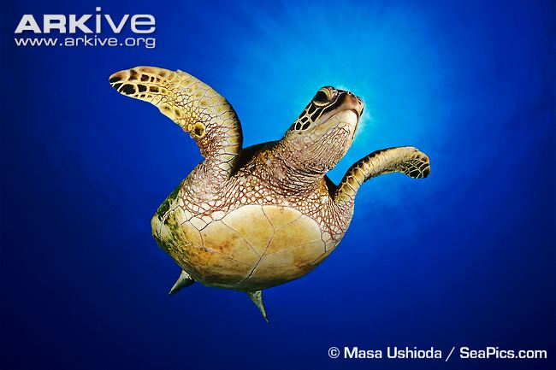
Green turtle life cycle
Adult stage
Reach sexual maturity between 26 and 40 years old
Migrate from feeding grounds to breeding grounds
Breeding ground is the beach where they hatched
Males and females mate just offshore
Males return to feeding grounds
Threats
Getting caught in fishing lines and drowning
Sharks
Notes:
Adult green turtles reach sexual maturity between the ages of 26 and 40 years old. Sexual maturity is the stage at which a turtle can reproduce and have its own young. When the adult turtles reach this stage, they will migrate from the feeding grounds back to the beach where they hatched. Recap definition of migrate if necessary.
This migration is a tremendous feat, with some green turtles migrating 2,250 kilometres to get to their breeding ground!
Note: To help students appreciate how far this is, perhaps include some comparative examples relevant to the students (for example, 2,250 km is the length of the entire River Murray in Australia).
What makes this journey even more impressive is that the turtles are able to find their way back to the beach on which they hatched, despite only having been there once before!
When the turtles get to this beach, the males and females mate in the sea just offshore. After mating, the males return to the feeding grounds, while the females remain behind to lay their eggs.
Threats:
Like the juveniles, adult turtles can get trapped in fishing nets or hooked on fishing lines. If they become entangled in the nets, the turtles may not be able to swim to the surface to breathe, and will drown.
Video of a green turtle caught in a fishing net: http://www.arkive.org/green-turtle/chelonia-mydas/video-14.html – young children may find this distressing
Adult green turtles do not have many predators but they are still at risk of being eaten by sharks.
http://www.arkive.org/green-turtle/chelonia-mydas/video-14.html

Slide 23
Starts off as an egg
Female turtles crawl onto the beach to lay their own eggs
Hatchling emerges from egg
Green turtle life cycle
Hatchling travels to the sea
When the turtles reach sexual maturity they mate and reproduce
Hatchling grows into a juvenile and then into an adult
Notes:
After a female has mated it will crawl up onto the beach to dig a nest and lay its own eggs.

Slide 24
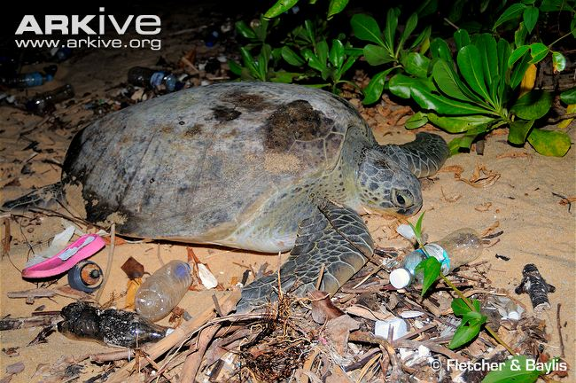
Green turtle life cycle
Egg laying
Female crawls onto the beach at night to lay eggs
Female uses its back flippers to dig a nest
Lays eggs in nest
Female may come up onto the beach up to nine times per nesting season to lay eggs
Once several clutches of eggs have been laid, female returns to feeding grounds
Threats
Beach pollution
Noise and lights
Notes:
Green turtles are adapted for a life at sea, and so struggle to move around on land. This makes the process of digging a nest and laying eggs very difficult for the female. Female turtles come up onto the beach at night to lay their eggs. This is to reduce the chances of drying out, as the temperatures are cooler at night and the hot sun is not beaming down on them.
Female green turtles are very choosy about the location of their nest. Once a good location has been found, a female will dig its nest.
Note: The nest-digging process involves several steps. First, the female uses its front flippers to dig a shallow ‘body cavity’. The female then moves into this, and uses its back flippers, one at a time, to dig a hole in the sand. This nest hole can be up to a metre deep. Once the female is satisfied with the size of its nest, it will begin to lay eggs.
Each female turtle normally lays between 100 and 150 eggs per nest. Each egg is roughly the size of a ping pong ball. After the female has finished laying her eggs, she will cover the nest back up with sand to try and disguise it. This is the only protection that the adult provides for its eggs.
Video of female green turtle laying eggs: http://www.arkive.org/green-turtle/chelonia-mydas/video-09c.html
A female may repeat this whole process up to nine times during a nesting season, resulting in up to nine different nests. Once the nesting season is over, the female migrates back to its feeding grounds. Every two to five years, a female green turtle will return to the same beach to breed and lay more eggs.
Threats:
If a beach is polluted with lots of rubbish, the female will be unable to find a suitable area to dig her nest and lay her eggs.
Bright lights or loud noises will scare female turtles when they come up onto the beach to lay their eggs. This will result in the turtles turning around and heading back to the sea without laying their eggs. This is known as a ‘false crawl’.

Slide 25
Starts off as an egg
Female turtles crawl onto the beach to lay their own eggs
Hatchling emerges from egg
Green turtle life cycle
Hatchling travels to the sea
When the turtles reach sexual maturity they mate and reproduce
Hatchling grows into a juvenile and then into an adult
Notes:
Recap the life cycle by asking students to name each stage.

Slide 26
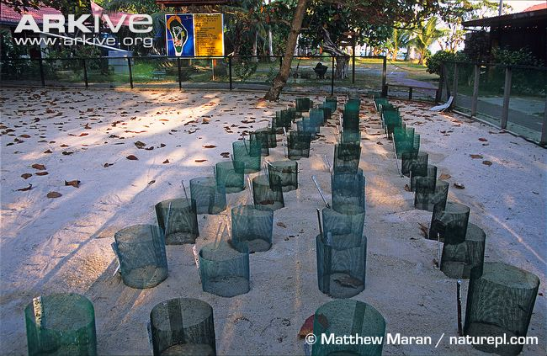
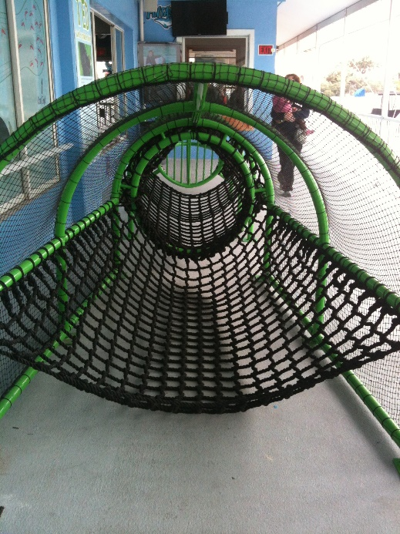
Helping the turtles!
It is not all doom and gloom!
What is being done to help green
turtles complete their life cycle?
Hatcheries
A green turtle hatchery
Beach patrols
Turtle Excluder Devices (known as ‘TEDs’)
TEDs are special ‘trap doors’ in fishing nets that enable turtles and other large marine animals such as sharks to escape safely.
Target fish and shrimps go through a grid at the neck of the main net and into a catch net on the other side, but larger animals such as turtles can’t fit through the barriers, and so escape by swimming out through a special opening in the main net.
Notes:
At this point, the students will have learned that turtles face a lot of threats and problems when trying to complete their life cycle! Most of these problems are caused by humans. However, it is not all bad news! Some people and organisations are trying to help the turtles.
Here are a few examples of things that are being done to help turtles:
Sometimes the eggs need a helping hand. In areas where eggs are likely to be destroyed by animals and the eggs eaten, or perhaps destroyed by wave action on the beach, turtle eggs can be carefully moved to hatcheries where the eggs are protected.
It is not just animals which pose a risk – humans also sometimes take turtle eggs or even the adult turtles themselves as they lay their eggs. Beach patrols, where conservation volunteers walk up and down the beach monitoring nests, provide protection for the nests and discourage people from taking the eggs or disturbing/poaching the adults.
Turtle Excluder Devices, also known as TEDs, are special escape routes fitted into fishing nets which enable turtles to escape while leaving the fish in the net for the fishermen. This prevents the turtles from getting trapped in the nets and drowning.

Slide 27

Helping the turtles!
What can you do?
  - Try to reduce the amount of plastic products you use (e.g. water bottles and plastic bags)
- Try to reuse any plastic items you have
- Recycle your rubbish where possible
REDUCE…REUSE…RECYCLE!!
Notes:
Ask the students if they have any ideas about what they can do to help sea turtles. If they are stuck, prompt them by asking if they know what the ‘three Rs’ are.
Remind the students of the risk plastic poses to turtles (if the turtles eat plastic, it will block their digestive system). Explain that there are three things that the students can do to lower the amount of plastic rubbish in the environment.
Firstly, reduce the amount of plastic they use. For example use reusable drinks bottles instead of always buying new plastic bottles. Use linen bags for shopping instead of plastic bags.
Secondly, reuse plastic items. For example, plastic bags can be reused rather than binning them after a single use.
Thirdly, always recycle where possible.

Slide 28


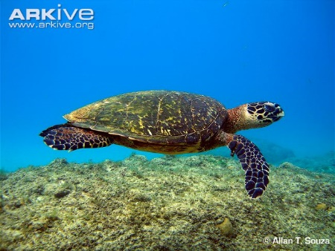
Summary
Start off as eggs
Hatchlings hatch and head into the sea
Do not really know where juveniles go – lost years!
Migrate to feeding grounds
Reach sexual maturity
Migrate back to the area where they hatched, and mate offshore
Males return to feeding grounds
Females go onto beach to lay their own eggs
Turtles face a lot of threats during their life cycle, which is why only 1 in 1,000 survive to adulthood!!!
Notes:
Before the students start the activity, quickly summarise the life cycle of the green turtle:
As in most reptiles, the life cycle of the green turtle begins with an egg. The temperature at which the egg incubates will determine the sex of the turtle.
The eggs then hatch and the hatchlings head towards the sea by moving towards the brighter horizon.
Hatchlings grow into juveniles and then into adults. It is not really known where they go during this period.
Once the turtles reach sexual maturity (between 26 and 40 years old), they will migrate to breed in the area where they hatched.
After mating offshore, the males return to the feeding grounds.
Females go onto the beach at night to lay their eggs, before retuning to their feeding grounds.
Green turtles face threats throughout their whole life cycle. This is why so few green turtles will complete their life cycle, with only about 1 in a 1,000 reaching adulthood!

Slide 29
Activity
Turtle Life Cycle Game
You are going to complete a turtle’s life cycle!
Starting as an egg, you have to journey through the different stages of a turtle’s life cycle, finishing when you lay your own eggs
Along the way you will encounter some of the real threats that green turtles face, and see how hard it is for a turtle to survive to produce its own young!
Split into groups of four, collect one board game set per group, and begin… GOOD LUCK!!
Notes:
The students will now complete the activity. The activity is a board game in which the students will complete a green turtle’s life cycle from egg to reproduction.
Explain the rules and the aim of the game to the students (see the Rules and Key)
Split the students into groups of four and ensure that each group has a board game set (board game, two dice, one counter for each player, copy of the rules and key, green turtle factsheet, question cards, and TED cards)

Slide 30
Recap…
Stage | Threats
Egg
Humans
Dogs and Pigs
Flooding
Hatchling
Artificial light
Predators
Plastic bags
Fishing lines
Juvenile
Adult
Fishing lines
Hunting/poaching
Mating
Female – lays eggs
Male – returns to feeding grounds
Polluted beaches
Hunting/poaching
Noise and light
Notes:
After the students have completed the activity, recap what they have learned from the presentation and from the activity about the different stages of the green turtle’s life cycle.
Ask the students to name the five main stages in a green turtle’s life cycle. Then ask the students to name the various threats green turtles face at each stage.

