Slide 2
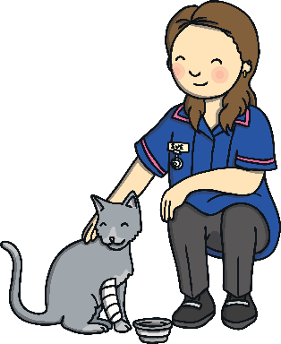

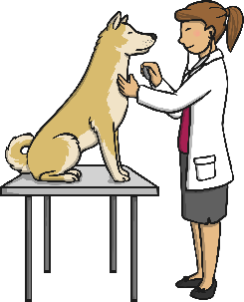

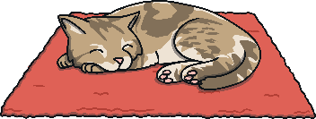
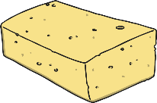
What Is a Pet?
A pet is an animal or creature which we are responsible for looking after.
That means we need to:
feed it
keep it healthy
make sure it is safe
give it somewhere suitable to live
clean their living area

Slide 3
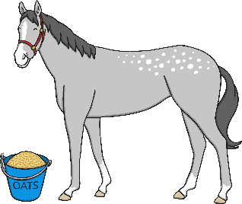
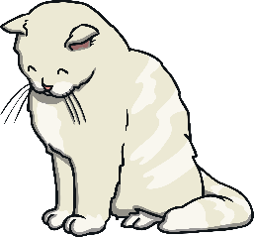
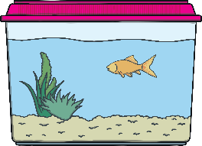

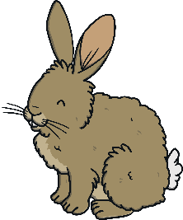
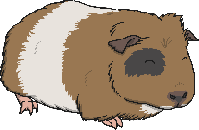
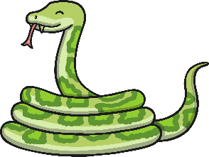
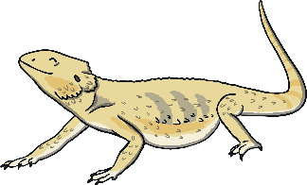
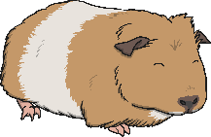
Types of Pet
There are many different types of pet. Do you have any of these pets?
horse
cat
dog
fish
bearded dragon
rabbit
guinea pigs
corn snake

Slide 4




Looking after Pets
Different pets have different needs.
Before you have a pet, you need to know how to look after it properly.
What information do you need to find out?
Lets find out some information together.

Slide 5
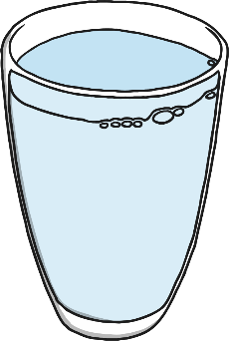


Cats
Many cats like to be able to go in and out when they choose to. Some cats are indoor cats, which means they never go outside.
They need food in the morning and at teatime. Fresh water needs to be available every day.
They should only eat food especially made for cats. They should not be given too many treats because if they get too fat they can become very poorly.

Slide 6
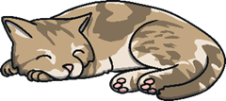
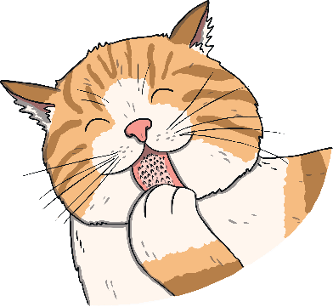
Cats
Cats like different places to sleep, such as chairs, window ledges and the end of a bed. Sometimes they like to lie on your lap.
Some cats like to be picked up but some cats don’t. They are scared of water so they should never be put in the bath or a paddling pool.
Cats often like to play. They need to practise their chasing skills. They also need to be able to scratch as this strengthens their backs and claws. They purr when they are happy, but beware if they flick their tails!
Did you know…?

Slide 7
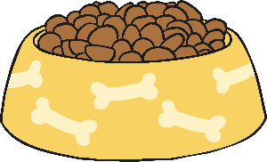
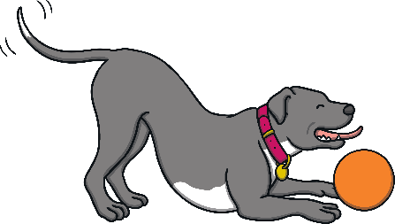
Dogs
All dogs need a daily walk. Some need long walks twice a day, others need only short ones.
They need food in the morning and at teatime. Fresh water needs to be available all the time.
They should really only eat food made just for dogs. They should not have too many treats because if they get fat they can become very poorly and they won’t be able to exercise.
Dogs are often very playful and like to have balls or sticks thrown for them to fetch. They are often friendly and like company. They should not be left on their own for too long or else they might get into mischief!

Slide 8
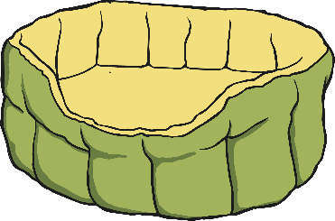
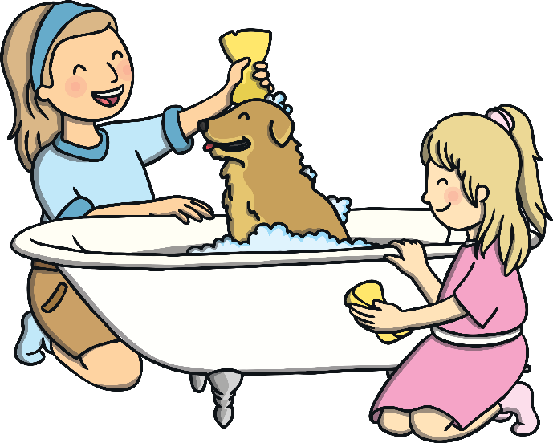
Dogs
Dogs need their own place to sleep. It is a good idea to give them their own dog mat or bed, in a space where they can feel comfortable.
Did you know…?
Dogs come in all different shapes and sizes so they have different needs. Some need a lot of grooming to stop their fur getting tangled up.

Slide 9



Rabbits
Some rabbits live indoors and some live outdoors.
Rabbits need food and water to be available all day. They eat special pellets and raw green vegetables.
Rabbits like to have company so it is a good idea to have two rabbits, as long as they get along!

Slide 10
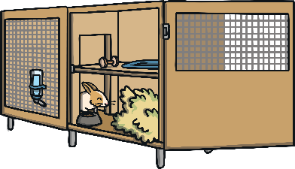
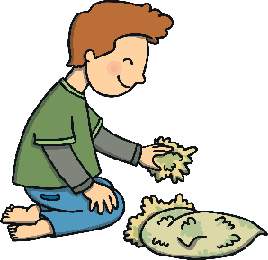
Rabbits
Rabbits need a dry place to live with enough space to be able to exercise. If they do not have enough space, they can become very miserable. If they are playing outside, make sure they are safe, can’t escape and have places to hide. Their hutches need cleaning out regularly.
Rabbits need clean, fresh hay or straw to sleep on and a separate area to go to the toilet.
Rabbits need to be picked up and stroked very carefully.
Their teeth carry on growing so they need to be able to chew straw and hay to keep their teeth the right length.
Did you know…?

Slide 11
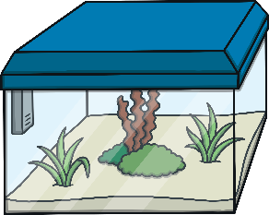

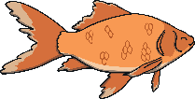

Fish
Different types of fish have very different needs.
Aquarium fish need to live in large tanks. The water needs to be filtered and the right temperature so that the fish stay healthy.
Some fish do not get along with each other and can fight. If you have some fish you need to watch them carefully and notice if there are any injuries.
Fish need special food. Some fish need the food to sink to the bottom and others need the food to float on the top of the water.
Did you know…?
Fish need plants in their tank. They use them to hide in and for shelter.

Slide 12
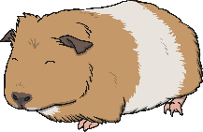
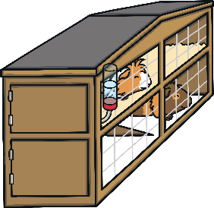

Guinea Pigs
Guinea pigs originally come from the grasslands of South America.
Guinea pigs like to have company so it is a good idea to have two or more. Sometimes, guinea pigs can bully each other so make sure they get along well.
Guinea pigs live in hutches. They are active animals who need space to exercise. They can run in the garden as long as they are kept safe. They also like to explore.
Guinea pigs need to eat a lot of grass and hay. They cannot store vitamin C so they have to eat a lot of it. It is found in many vegetables.
Did you know…?
Guinea pigs ‘talk’ to each other using a lot of different sounds.

Slide 13
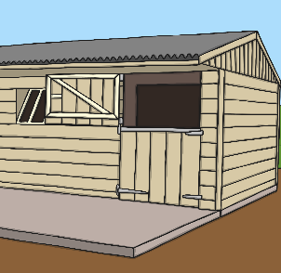
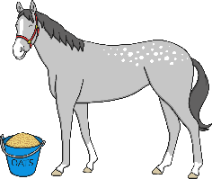
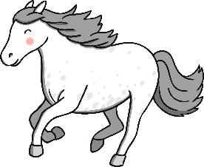
Horses
Horses need a lot of care and attention.
Horses need to live in a stable. The stable should be covered with dust-free straw on the ground and cleaned out regularly. Horses also need to be able to go out into a paddock for daily exercise.
Horses need to have fresh water and special feed available all day. They need to be able to graze on grass as often as possible too.
Horses like to be given rewards and to hear nice words. They should not be shouted at or punished. They can get bored and unhappy so make sure you spend time with them.
Did you know…?
Horses should not be given too many apples as they can make them poorly.

Slide 14
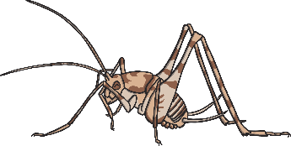
Bearded Dragon
Bearded dragons are reptiles and originally come from the scrublands of Australia, where it is hot and dry.
Bearded dragons live in a vivarium which is a large glass tank with special lighting and controlled temperatures. There needs to be a warm place and a slightly cooler place for the dragon to lie in. The vivarium must be cleaned regularly.
Bearded dragons eat live insects like crickets and locusts. The also like green plants. They should not eat spinach.
Bearded dragons shed their skin as they grow bigger.

Slide 15


Bearded Dragon
Bearded dragons can be picked up and taken out of the vivarium for about 15 minutes. You must never grab or surprise a bearded dragon as they can bite when they are frightened.
Did you know…?
The folds of skin around the neck of the bearded dragon balloon out and turn black when they feel in danger.

Slide 16
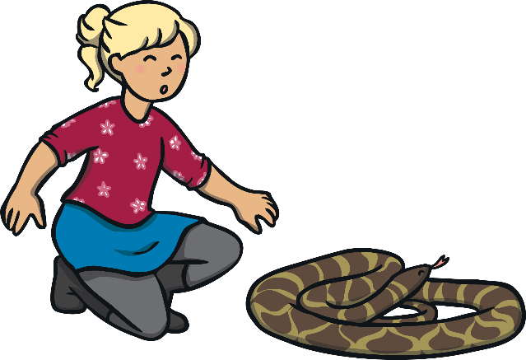
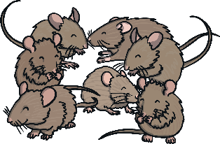
Corn Snake
Corn snakes are reptiles and have this name because they have often been found around corn barns beside fields.
Corn snakes live in a large, glass vivarium. The vivarium needs to be long enough for the snake to stretch out in. It needs to have a ‘basking zone’, which is the warmest part, for the snake to lie and get some heat.
Corn snakes eat mice. They like to eat in the dark so the feeding tub needs to be covered. Feeding time has to be done in a very careful way.

Slide 17
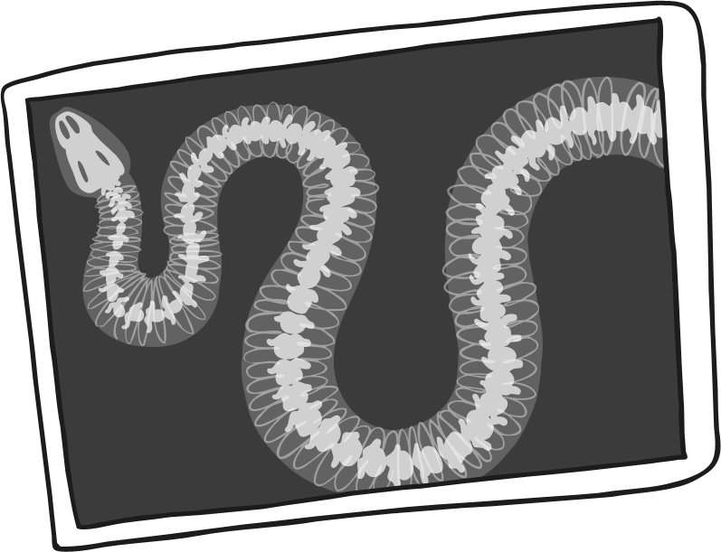
Corn Snake
Corn snakes shed their skin as they grow. They will rub on the sides of the vivarium to help the old skin come away. You must never pull the skin off though as this can damage the new skin underneath.
Did you know…?
Corn snakes can be handled but always very carefully and they are to go back in the vivarium again after a few minutes.

Slide 18

Caring for Animals
Animals need a lot of care. Once we have a pet to look after, we are responsible for it being healthy and happy.
Remember to:
Always wash your hands when you have handled a pet. They have germs on their bodies which can make people very poorly.
Always use special cleaning products when you clean out an animal’s habitat.
If your pet starts behaving in a different way or stops eating or drinking, take your pet to the vet as soon as you can.
Enjoy looking after your pet!

