Slide 1
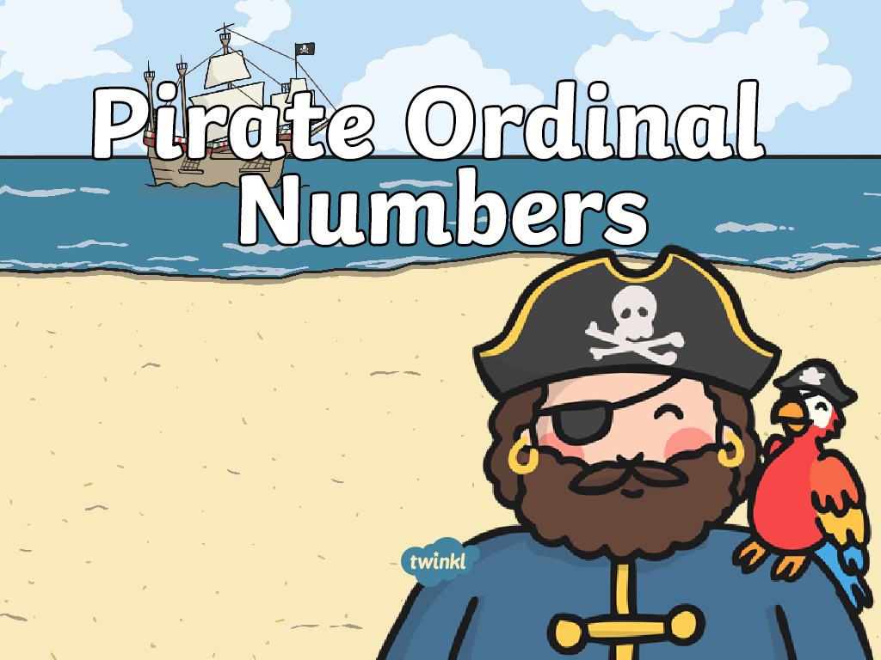

Slide 2






Who Is Fifth?
1
2
3
4
5

Slide 3
Who Is Second?
1
2
3
4

Slide 4
Who Is Third?
1
2
3

Slide 5
Circle the First Pirate
1
2
3
4

Slide 6


Circle the Fourth Pirate
1
2
3
4
5
6

