Slide 2
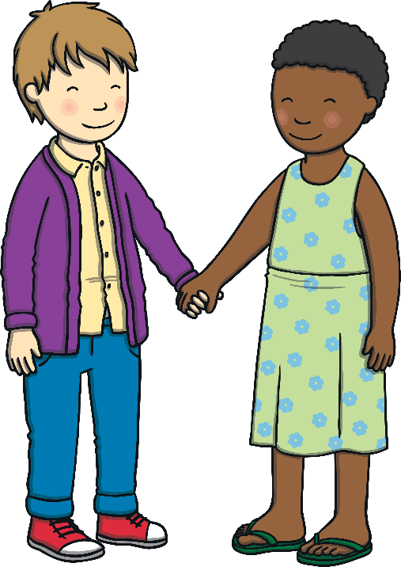
What things make us different?
Eye colour
Skin colour
Hair colour
Height
Type of family
Body shape

Slide 3
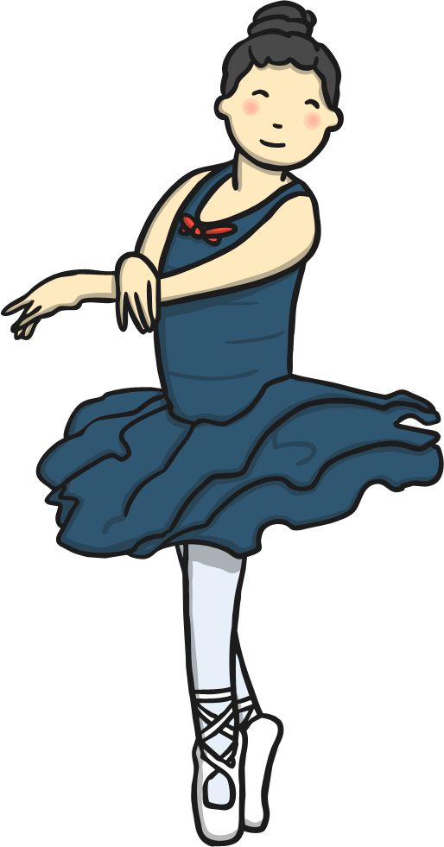
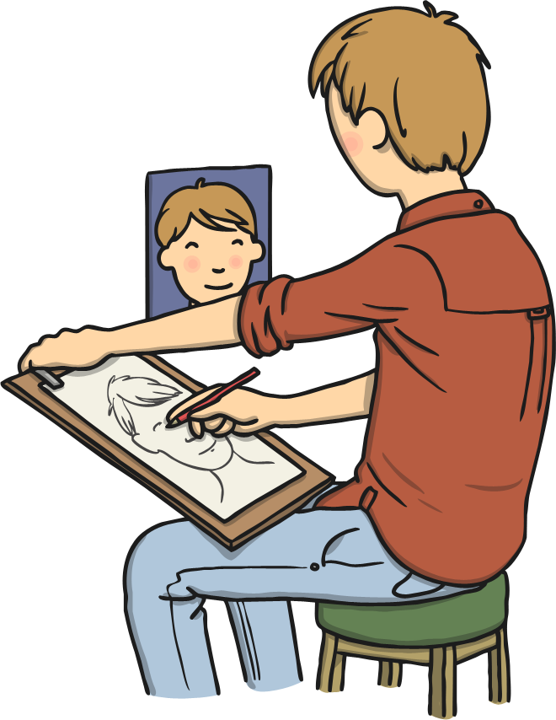
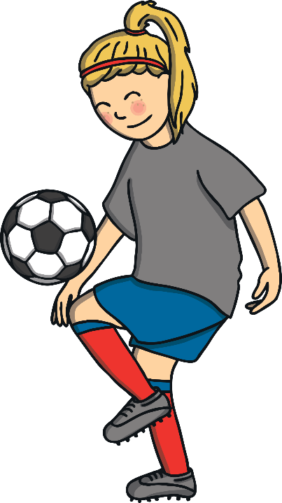
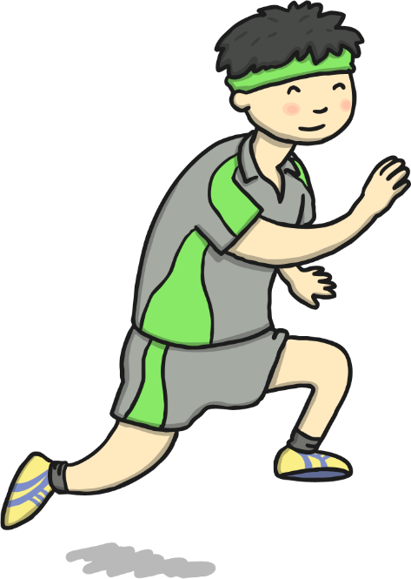
What things make us special?
What do you have that no one else has?
What can you do that no one else can do?

Slide 4
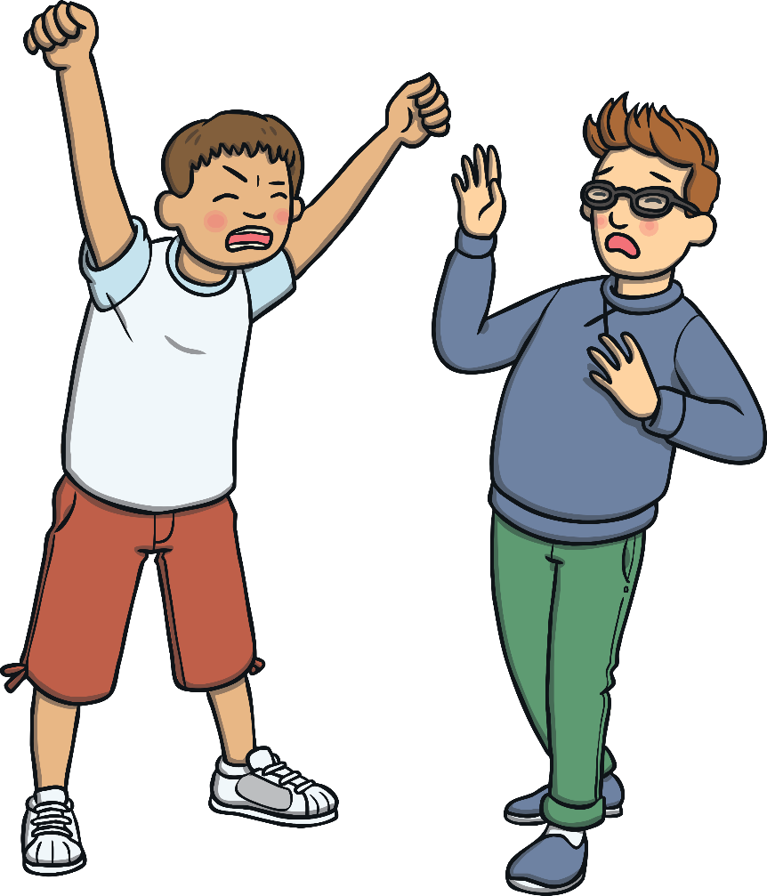
What makes people bully?
Feeling bad about themselves
Jealous of talents
Jealous of friendships
Feeling they are not very good at something

Slide 5
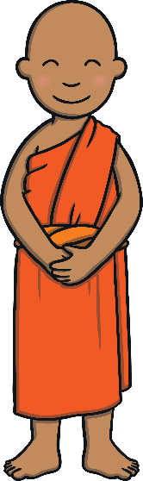
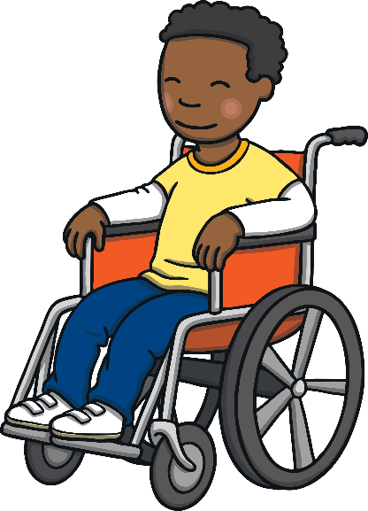
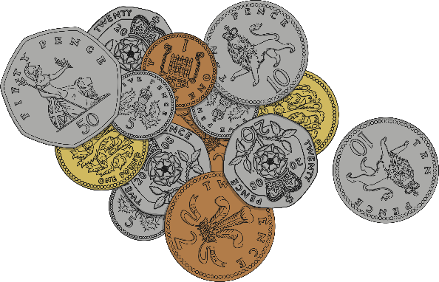
What might people bully about?
Race
Money
Disability
What else might people bully about?

Slide 6

We all have the right to play and be happy!
What else do we have the right to be?
What responsibilities come with these rights?

Slide 7
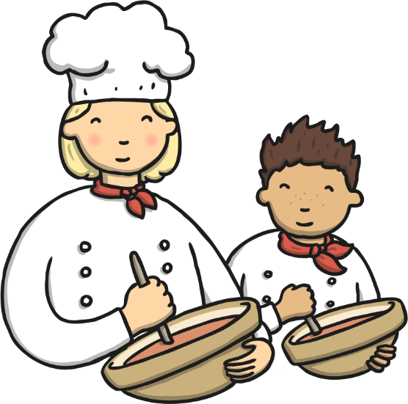
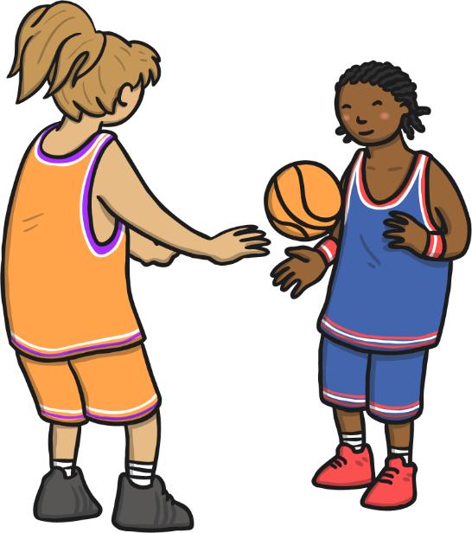
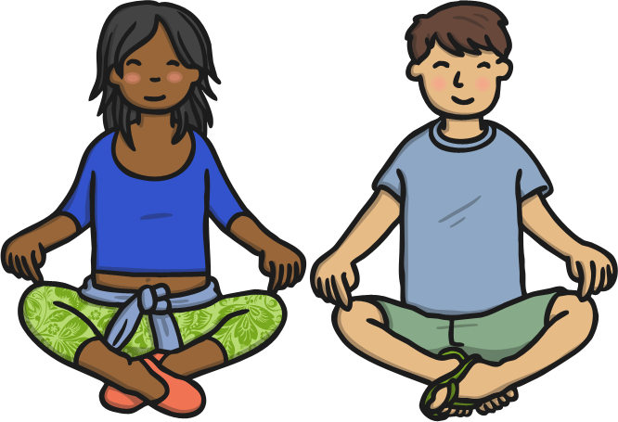
How could we use other people’s talents?

