Slide 2
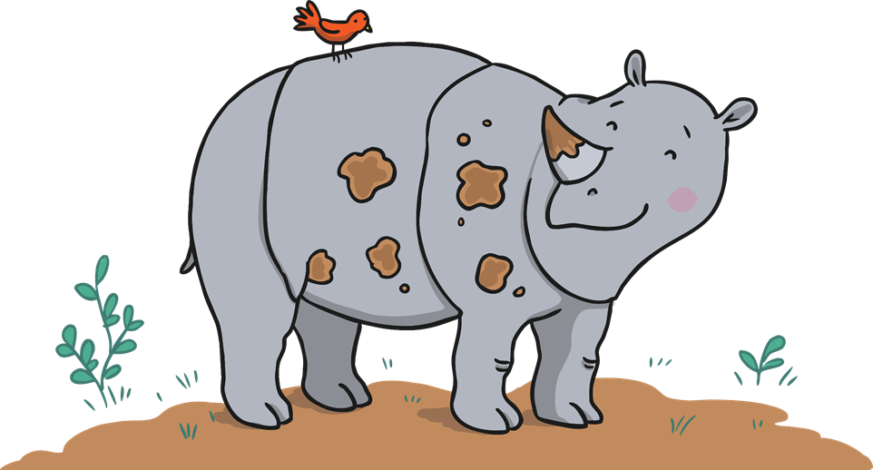
Jungle Riddles
Can you follow the clues to work out which animal Ronald is describing?
Click on Ronald the Rhino to start!

Slide 3

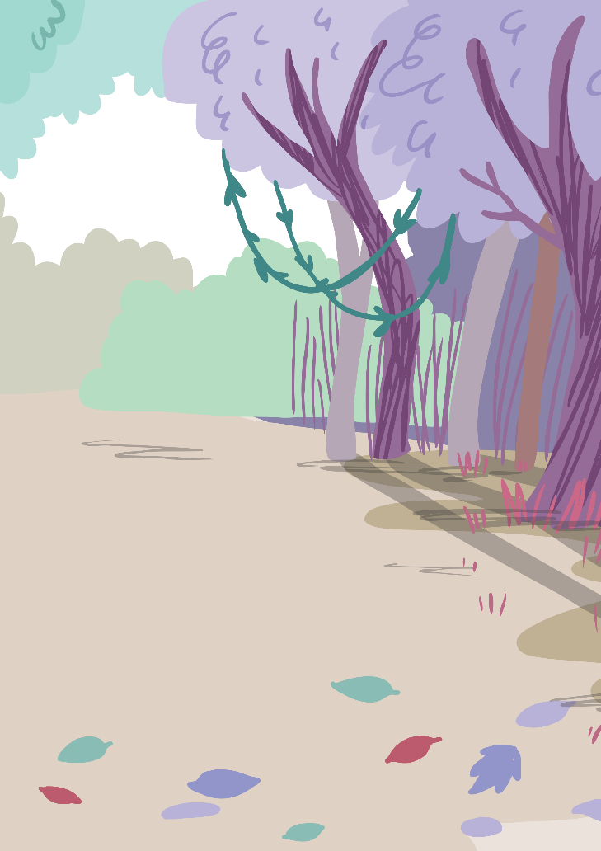


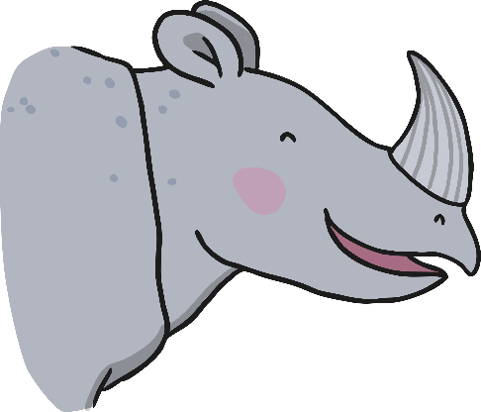



What Am I?
Click on the leaves for clues.
I have big ears and no fingers or toes.
I have tusks on my face and a trunk for my nose.
Click on me to reveal the answer.
I am an elephant!
Previous
Next

Slide 4
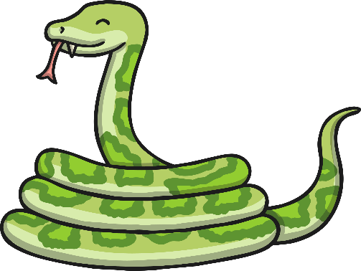
What Am I?
Click on the leaves for clues.
A long, patterned body, high in a tree.
My eyes and large jaws help me hunt for my tea.
Click on me to reveal the answer.
I am a snake!
Previous
Next

Slide 5
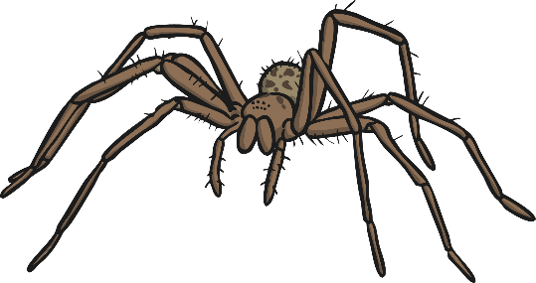
What Am I?
Click on the leaves for clues.
I make webs with my body and have 8 hairy legs.
I eat bugs and have babies that hatch from small eggs.
Click on me to reveal the answer.
I am a spider!
Previous
Next

Slide 6
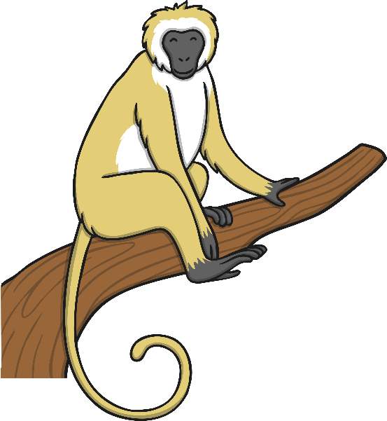
What Am I?
Click on the leaves for clues.
My tail is curly, I’m cheeky and hairy.
I swing through the trees and I’m not very scary!
Click on me to reveal the answer.
I am a monkey!
Previous
Next

Slide 7
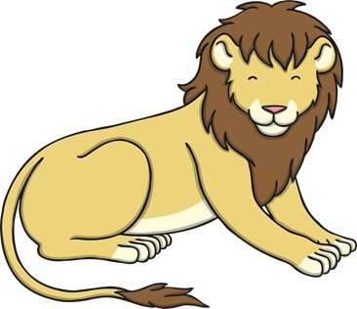
What Am I?
Click on the leaves for clues.
My beautiful mane reaches right round my head.
I’m the king of the jungle and I want to be fed!
Click on me to reveal the answer.
I am a lion!
Previous
Next

Slide 8
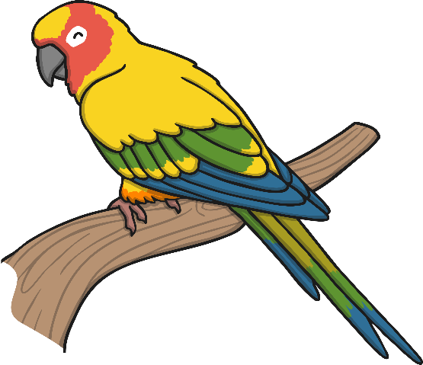
What Am I?
Click on the leaves for clues.
A beak helps me to talk and I have colourful feathers.
I love to fly high, no matter the weather.
Click on me to reveal the answer.
I am a parrot!
Previous
Next

Slide 9
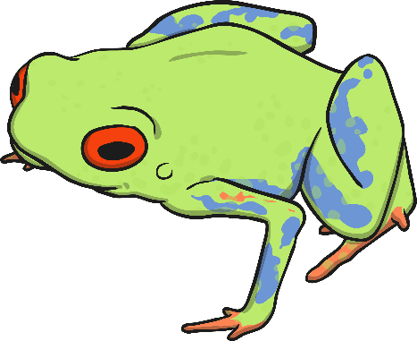
What Am I?
Click on the leaves for clues.
I have bright, poisonous skin and tiny webbed feet.
My babies are tadpoles and I eat flies for a treat!
Click on me to reveal the answer.
I am a tree frog!
Previous
Next

Slide 10

What Am I?
Click on the leaves for clues.
I lurk in the water, with skin green and rough.
Sharp, pointy teeth and jaws that are tough.
Click on me to reveal the answer.
I am a crocodile!
Previous
End

