Slide 1


Maths
Number and Place Value
Year One
Maths | Number and Place Value | Identify One More and One Less | Lesson 1 of 3: Finding One More Than Numbers to 20

Slide 2
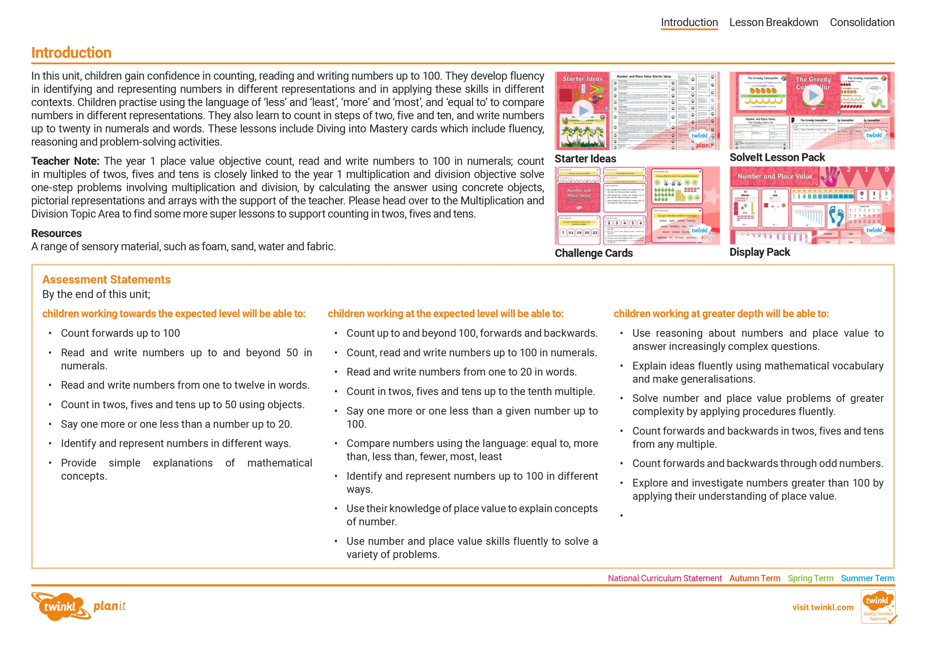
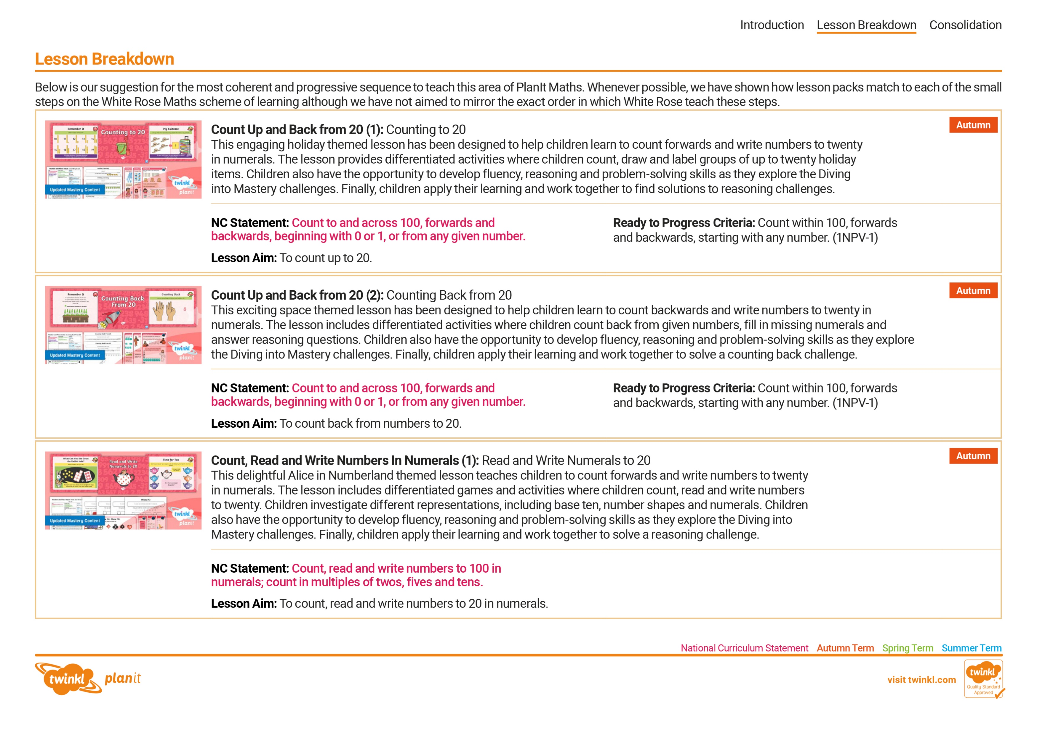
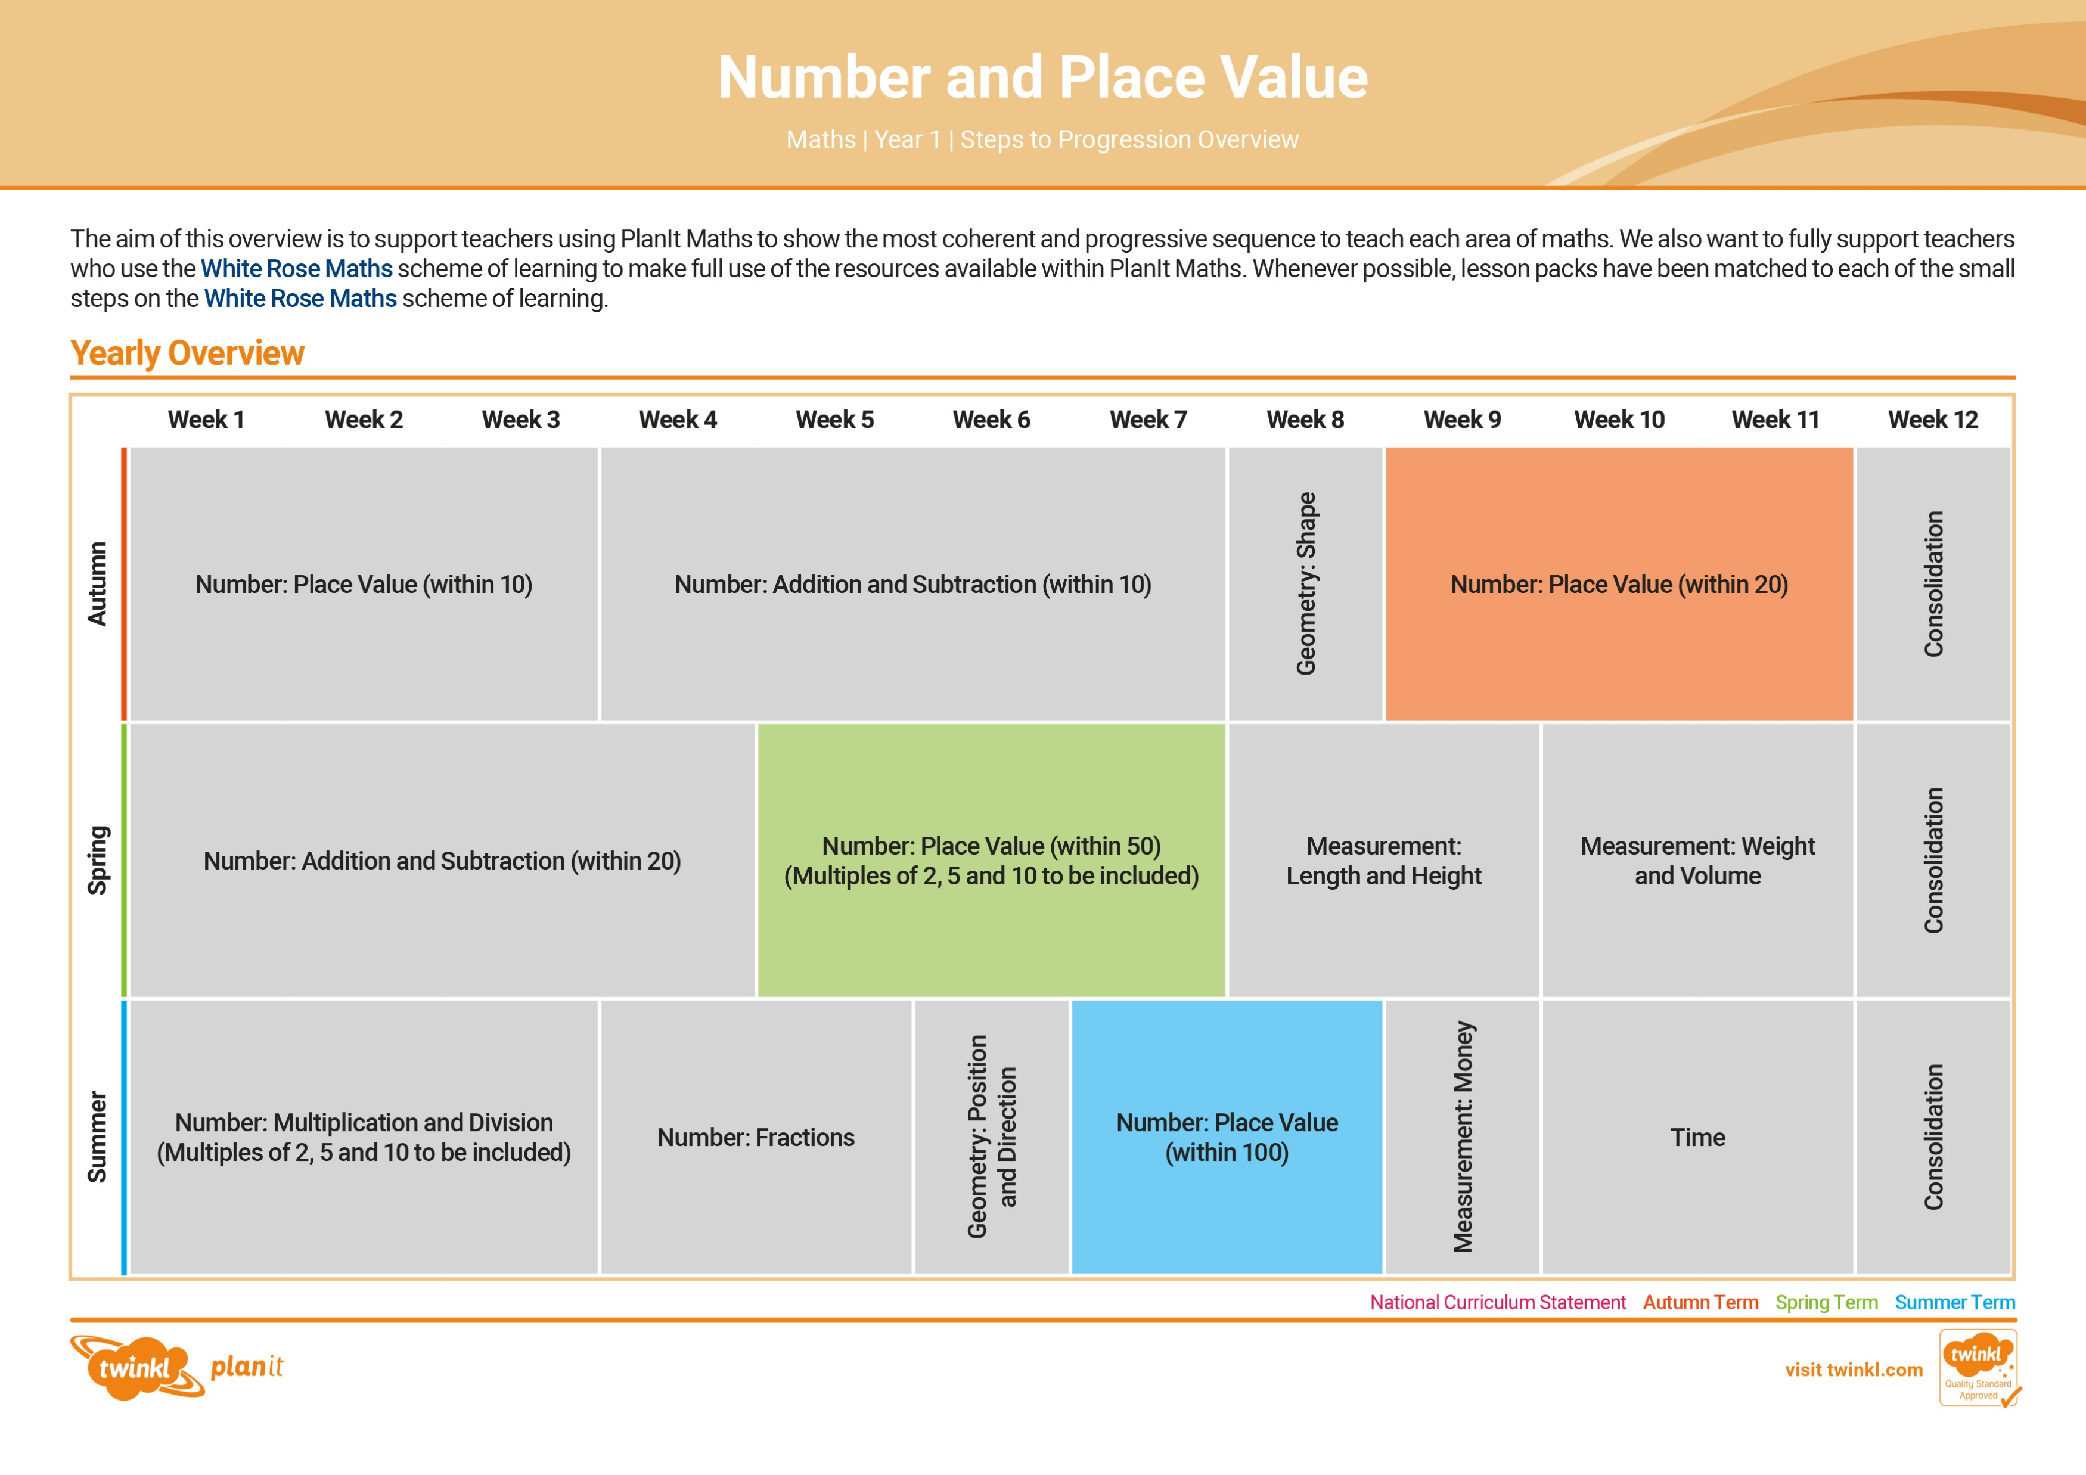

Need a coherently planned sequence of lessons to complement this resource?
See our Number and Place Value Steps to Progression document.
Twinkl PlanIt is our award-winning scheme of work with
over 4000 resources.

Slide 4
Aim
To find one more than a given number to 20.
Success Criteria
I can find one more than a given numeral to 20.
I can find one more than a group of up to 20 objects.
I can find one more than a representation of a number up to 20.

Slide 5







Remember It
Work with a partner to write the numerals and draw
matching pictures on a whiteboard.
11
=
13
=
15
=
12
=
Can you match more numbers up to 20?

Slide 6
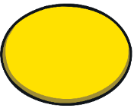

Can You Make One More?
Can you find one more than your partner?
Place the cards face down in a pile.
Take turns to turn one over and count out that number of objects.
Can your partner count out a group of objects that is one more?
5

Slide 7

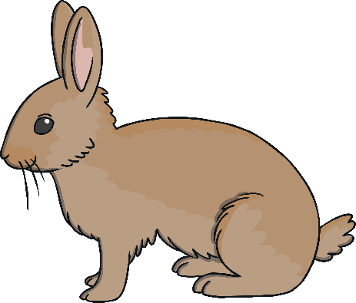

Bunny Hops
How can we find one more on a number line?
0
1
2
3
4
5
6
7
8
9
10
11
12
13
14
15
16
17
18
19
20
We can find one more by hopping forward on the number line.

Slide 8
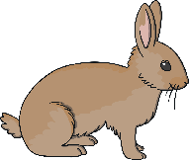

Bunny Hops
What is one more than 5?
0
1
2
3
4
5
6
7
8
9
10
11
12
13
14
15
16
17
18
19
20
One more than 5 is 6.

Slide 9

Bunny Hops
What is one more than 11?
0
1
2
3
4
5
6
7
8
9
10
11
12
13
14
15
16
17
18
19
20
One more than 11 is
12
.

Slide 10
Bunny Hops
What is one more than 17?
0
1
2
3
4
5
6
7
8
9
10
11
12
13
14
15
16
17
18
19
20
One more than
17
is
18
.

Slide 11
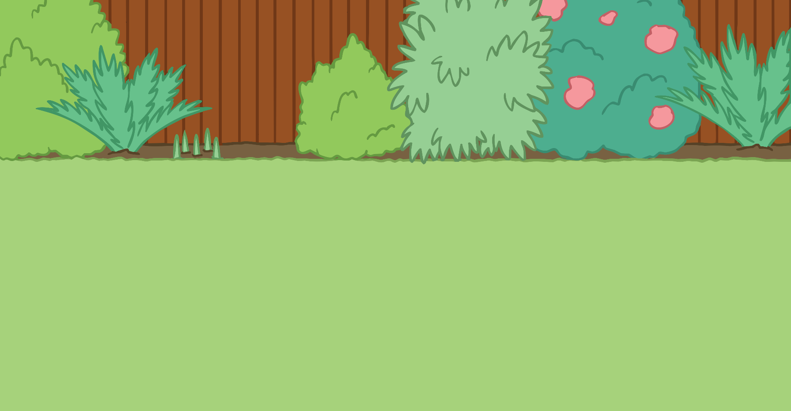


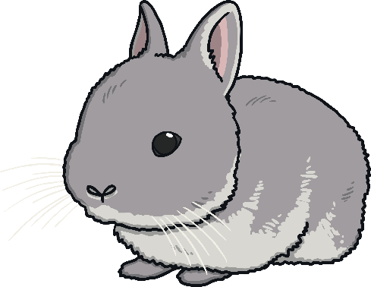

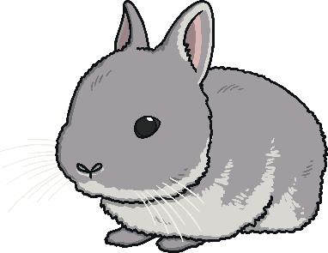

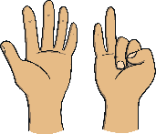
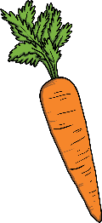

Feeding Time
Which bunny shows one more than the number on the carrot?
Correct!
4
0
1
2
3
4
5
6
8
One more than
4 is 5.

Slide 12






Feeding Time
Which bunny shows one more than the number on the carrot?
Correct!
10
11
12
13
14
15
16
13
One more than
13 is 14.
9
How did you work out the answer?
Is there another way?

Slide 13



Feeding Time
Which bunny shows one more than the number on the carrot?
Correct!
16
14
15
16
17
18
19
One more than
16 is 17.

Slide 14
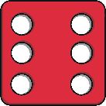
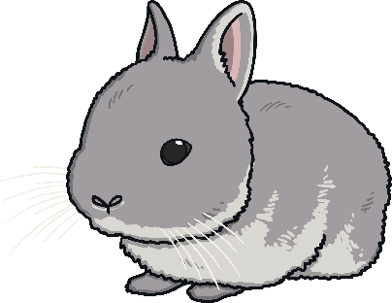
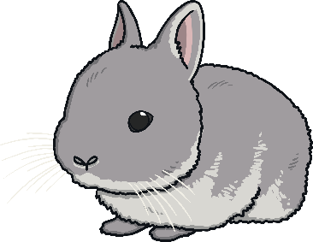

Feeding Time
Which bunny shows one more than the number on the carrot?
Correct!
4
5
6
7
8
One more than
6 is 7.
9
Were there any rabbits you knew couldn’t be right before you checked? Can you explain why?

Slide 15





Feeding Time
Which bunny shows one more than the number on the carrot?
Correct!
8
9
10
11
12
13
13
One more than
9 is 10.
2
3
4
5

Slide 16
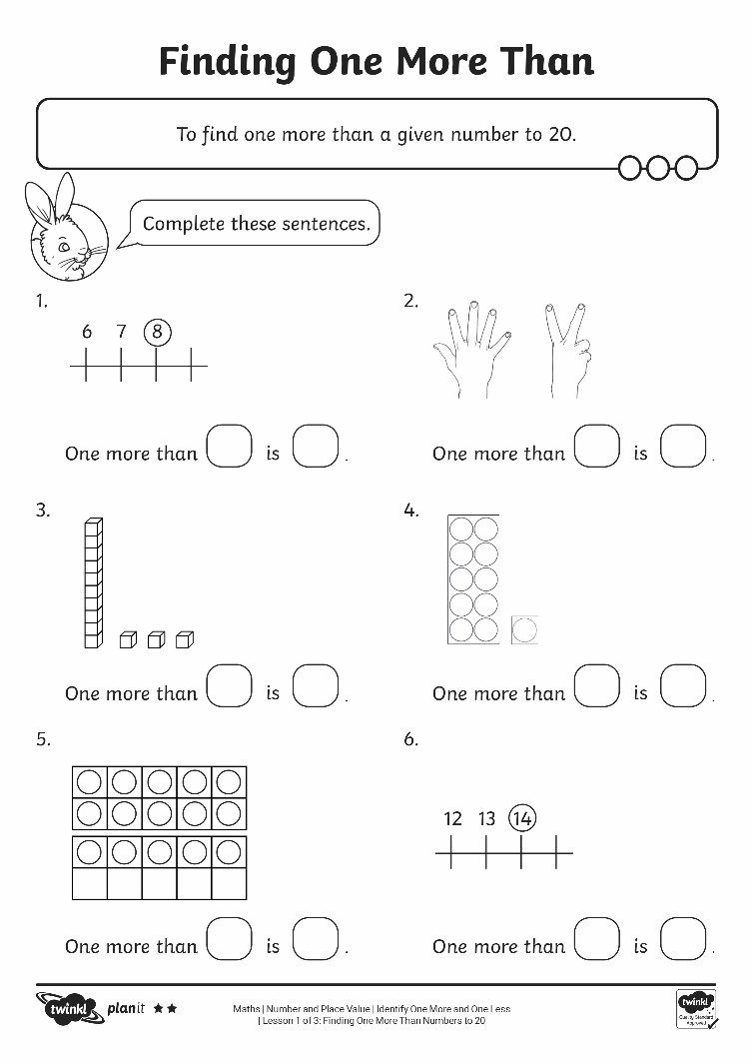
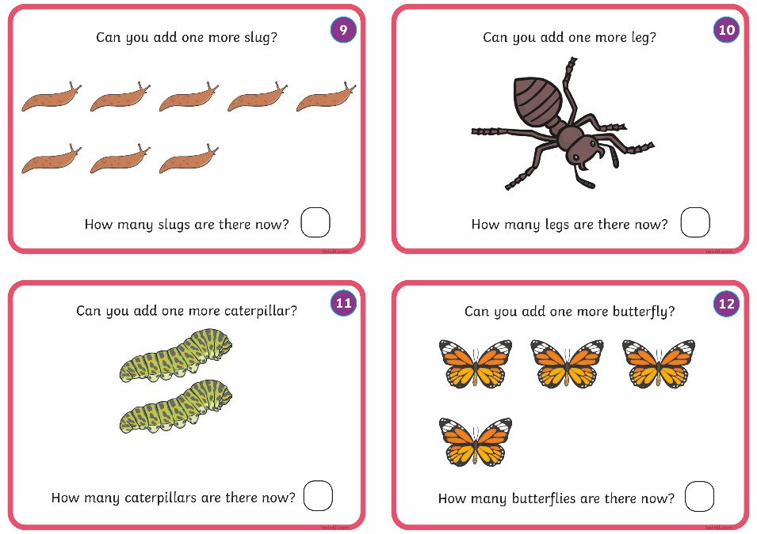
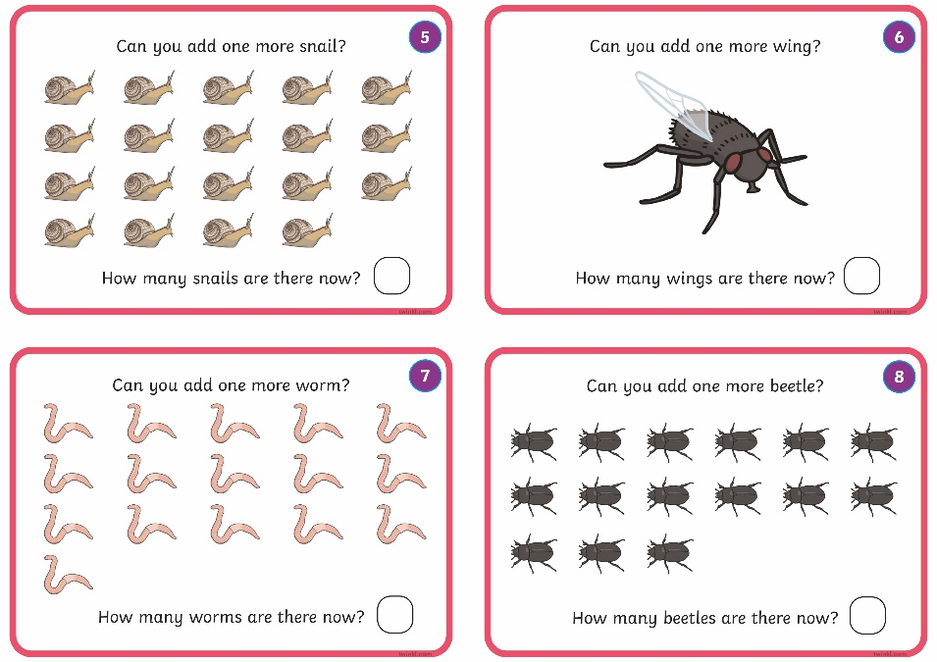
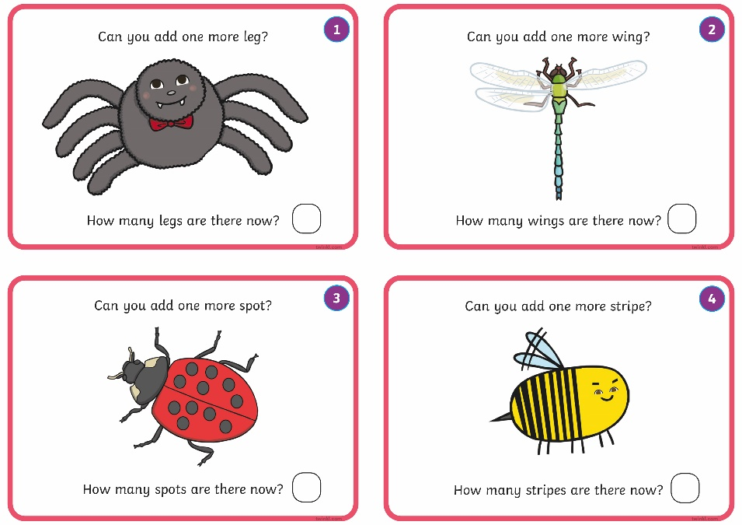
Finding One More

Slide 17
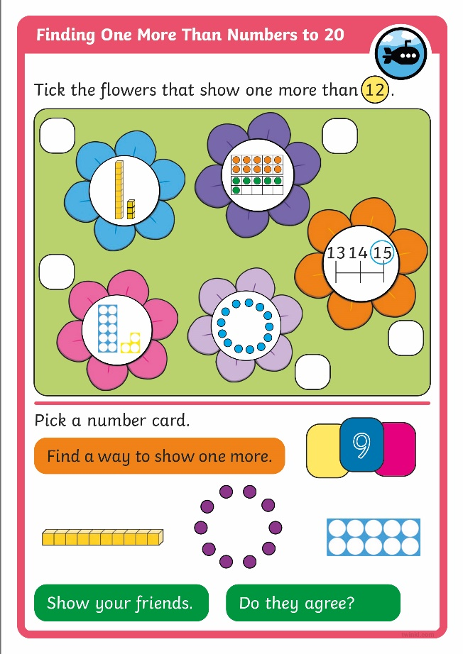
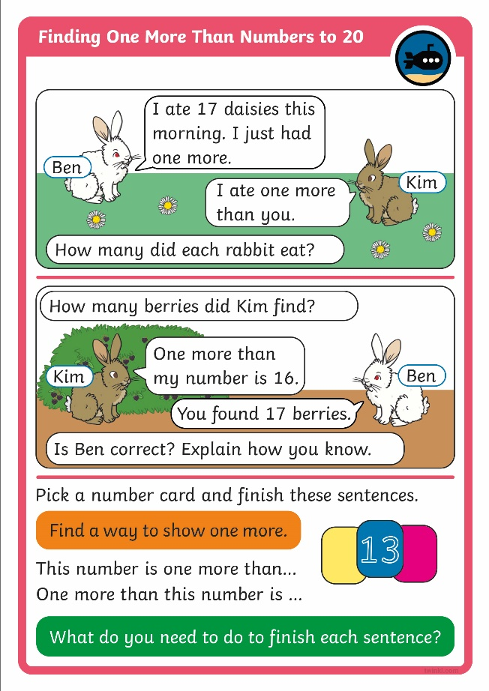

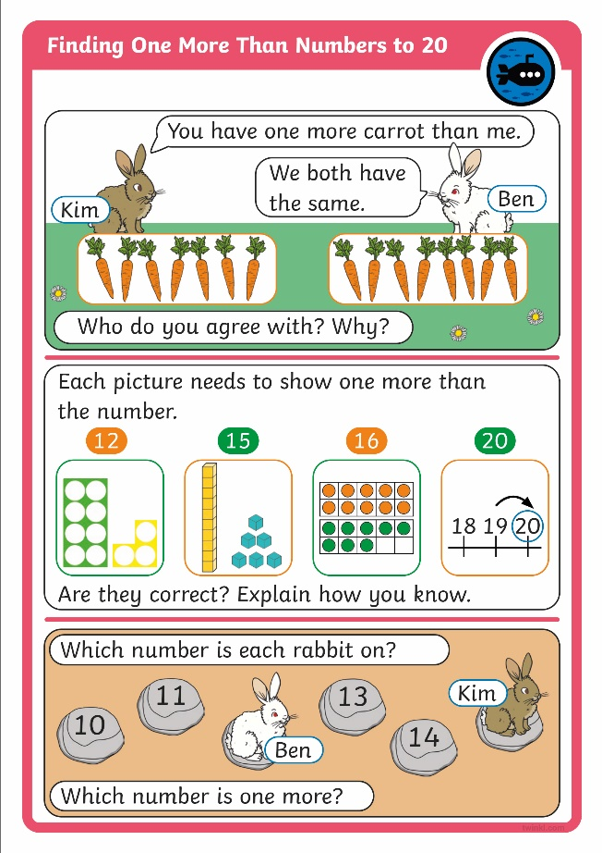
Diving into Mastery
Dive in by completing your own activity!

Slide 18
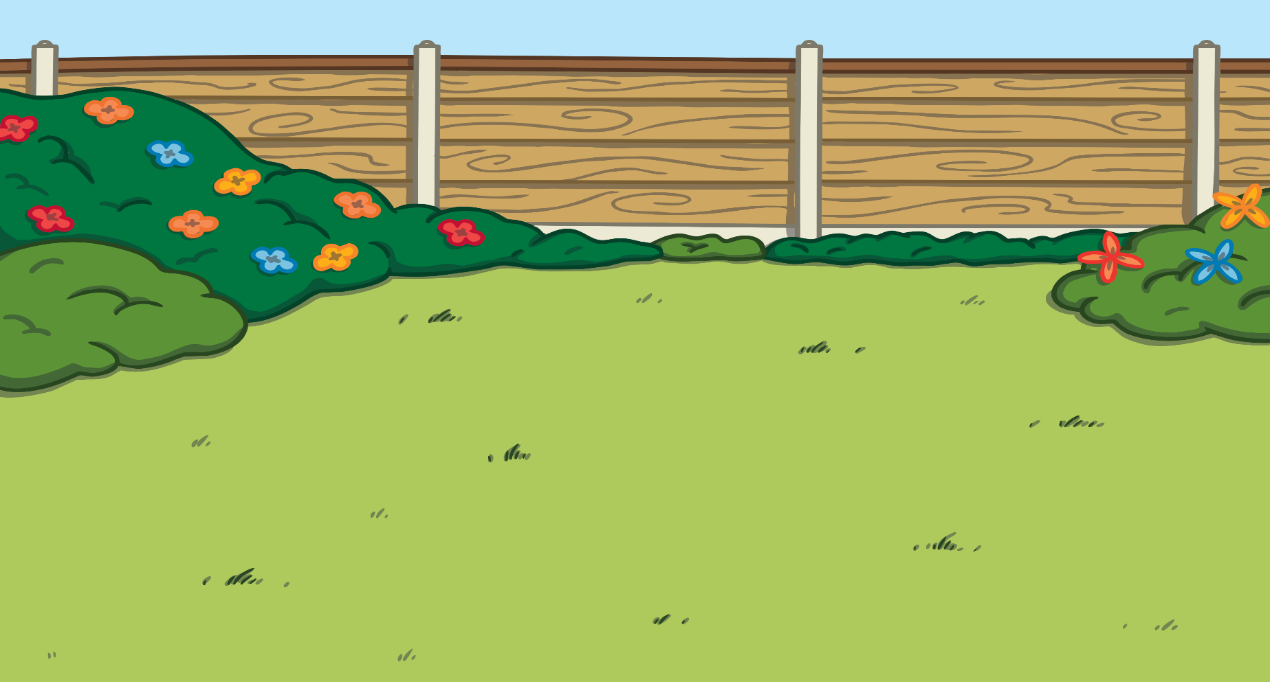

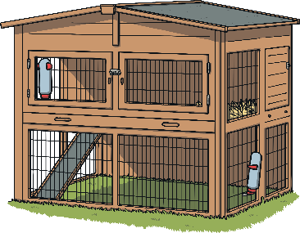
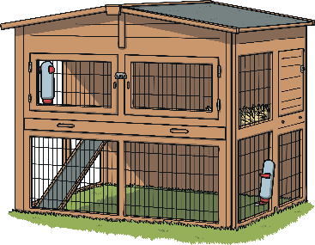


Hop Home
Help me find my home.
My hutch has the number that is one more than this.
17
15
16
14
What’s the first thing you need find out?
What will you do next?

Slide 19

Hop Home
Help me find my home.
My hutch has the number that is one more than this.
19
17
18
16
What can you do to find the answer?
Is there another way?

Slide 20
Hop Home
Help me find my home.
My hutch has the number that is one more than this.
20
18
19
17
What is your favourite way to find one more?
Can you explain why?

Slide 21
Aim
To find one more than a given number to 20.
Success Criteria
I can find one more than a given numeral to 20.
I can find one more than a group of up to 20 objects.
I can find one more than a representation of a number up to 20.

