Slide 1




Slide 2

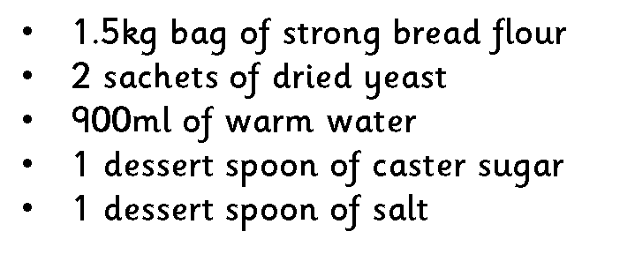




Slide 3



Slide 4




Slide 5


Slide 6


Slide 7
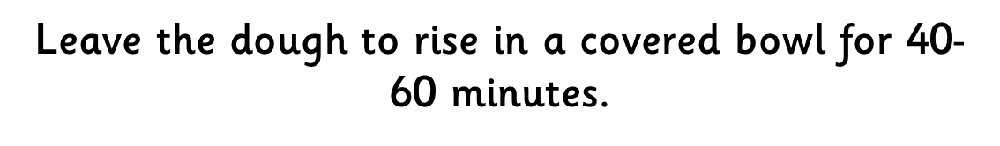


Slide 8
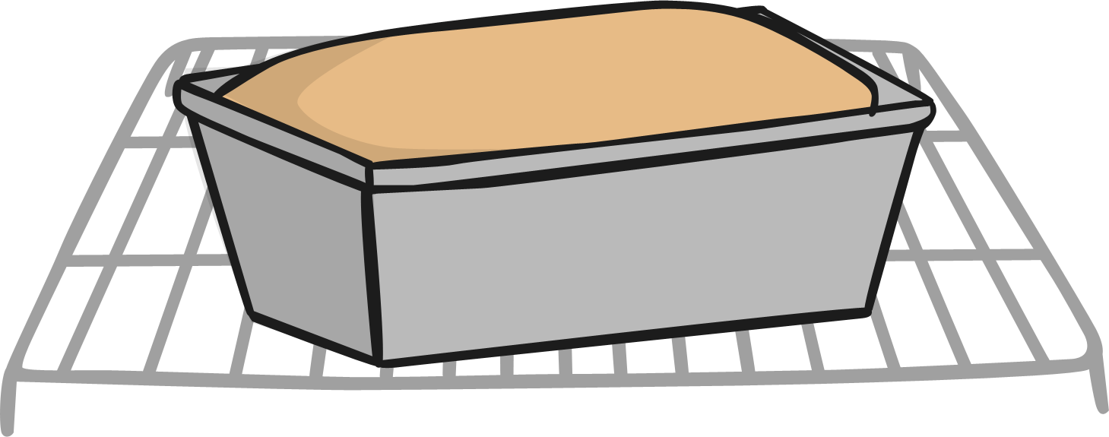

Slide 9


Slide 10
THE END

