Slide 1


RE
Nature and God
Year One
RE | Year 2 | Nature and God | Creation Story 1 (Christianity) | Lesson 1

Slide 2
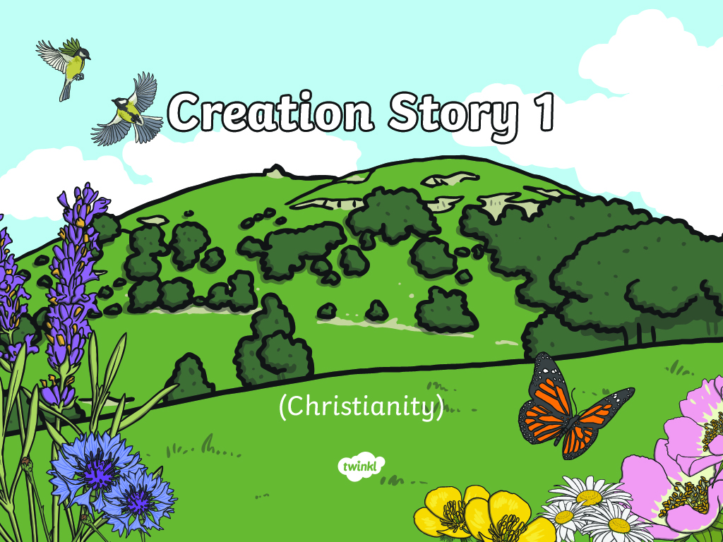

Slide 3
Aim
I can recall the Christian Creation Story.
Success Criteria
I can tell you three things which God created.
I can tell you what God did on the seventh day.

Slide 4

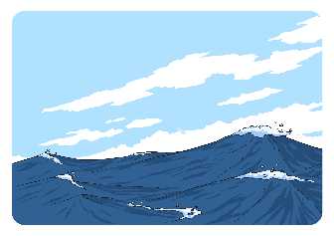
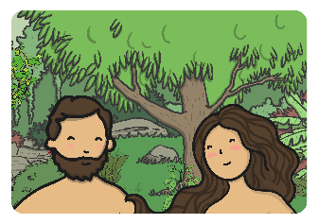


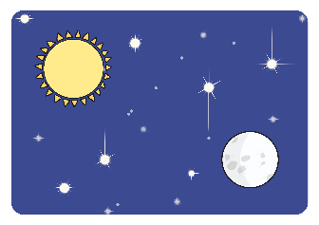
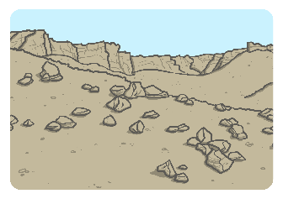

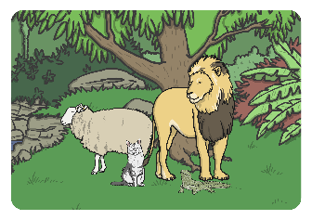
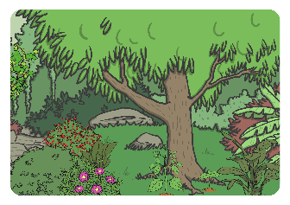
Creation Gallery
Look at the pictures and talk about:
what you can see;
what you think the Creation story is going to be about;
the sequence of the story, which pictures do you think might come first and last?

Slide 5
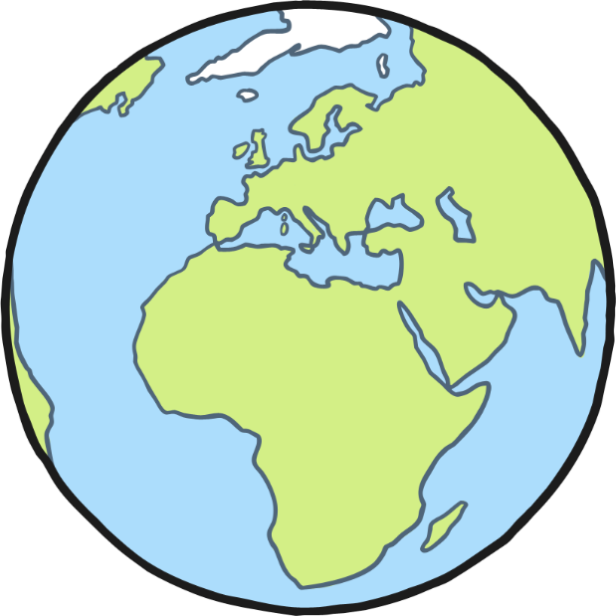
What is the Creation Story?
The Creation story is how Christians believe the world was created by God.
There are lots of stories from other religions, as well as scientific theories which also explain how the world was created.

Slide 6

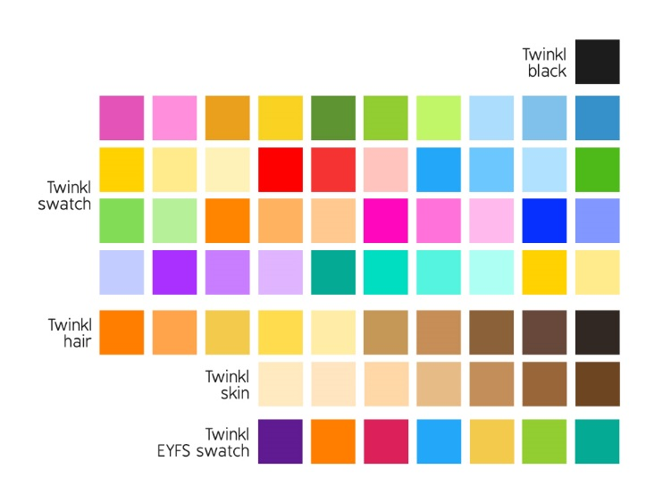
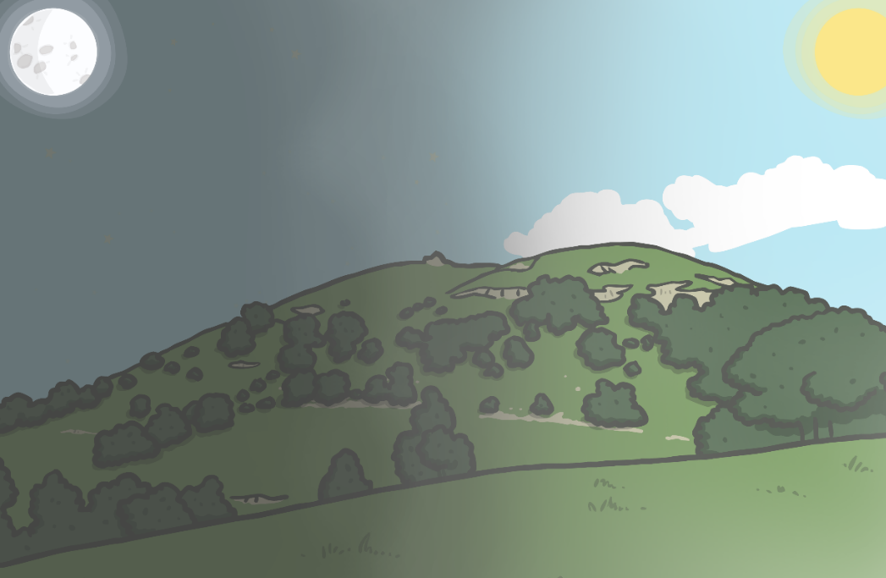
The Creation Story
On the first day…
God separated light from darkness. He called the light “day” and the darkness “night”.

Slide 7

The Creation Story
On the second day…
God made the earth and sky.

Slide 8
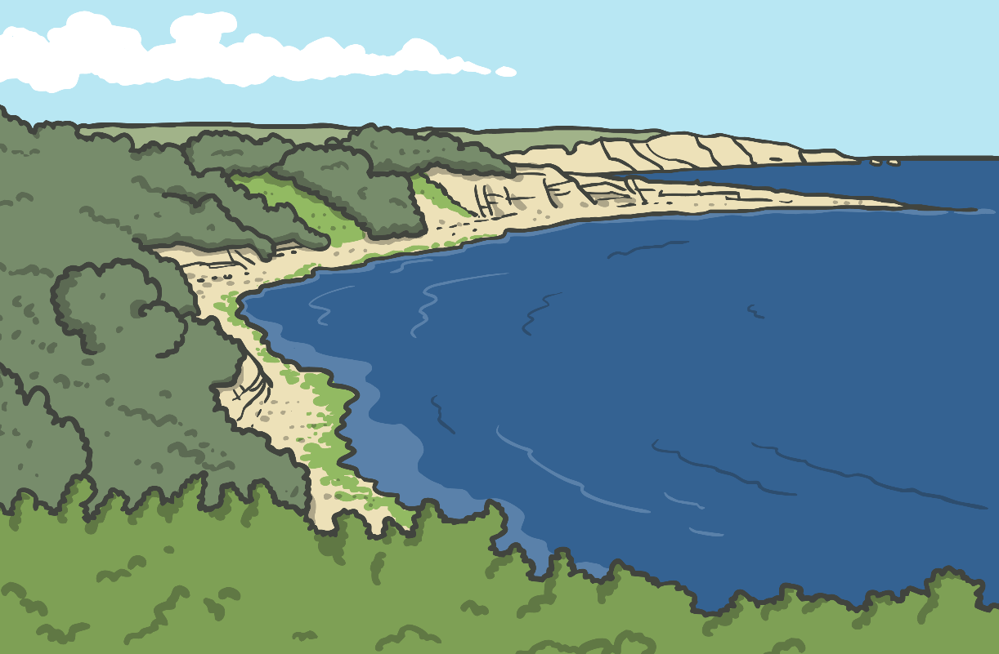
The Creation Story
On the third day…
God created the land and the seas. He also created plants and trees.

Slide 9
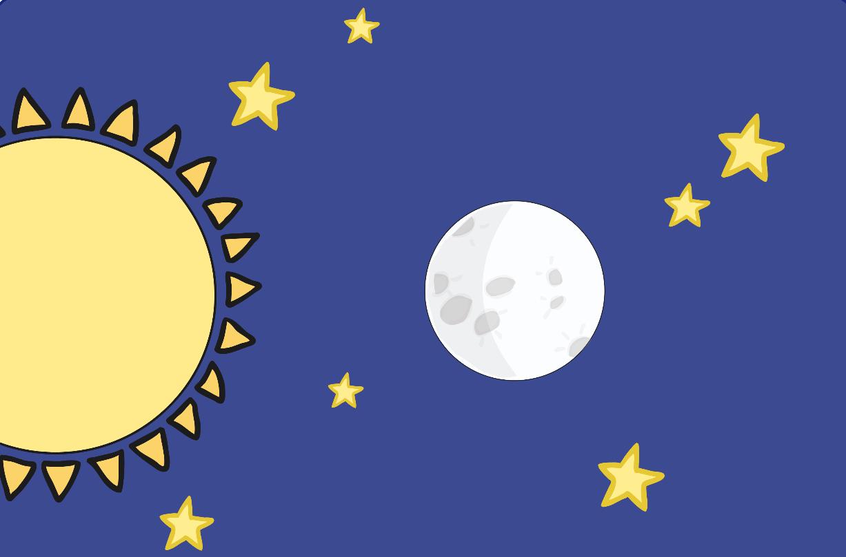
The Creation Story
On the fourth day…
God created the sun, the moon and the stars.

Slide 10
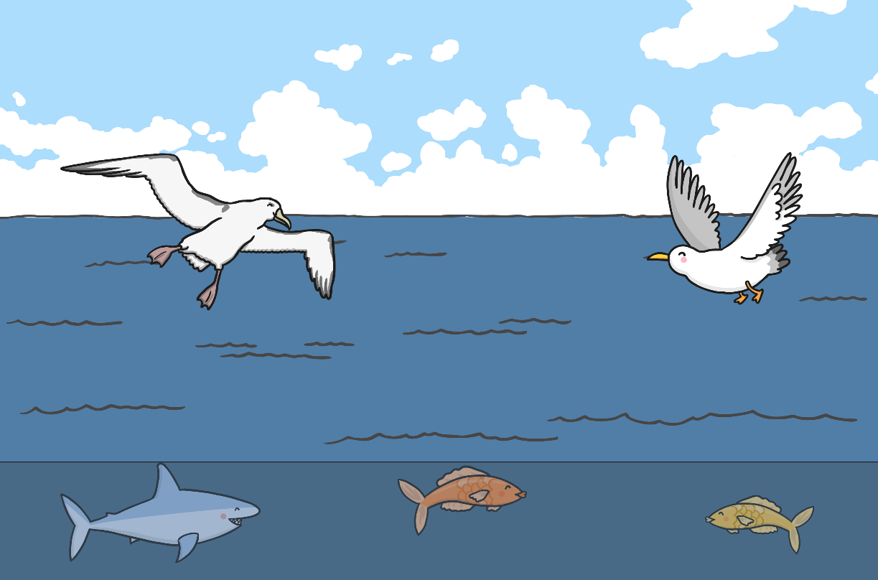
The Creation Story
On the fifth day…
God created birds and sea creatures.

Slide 11
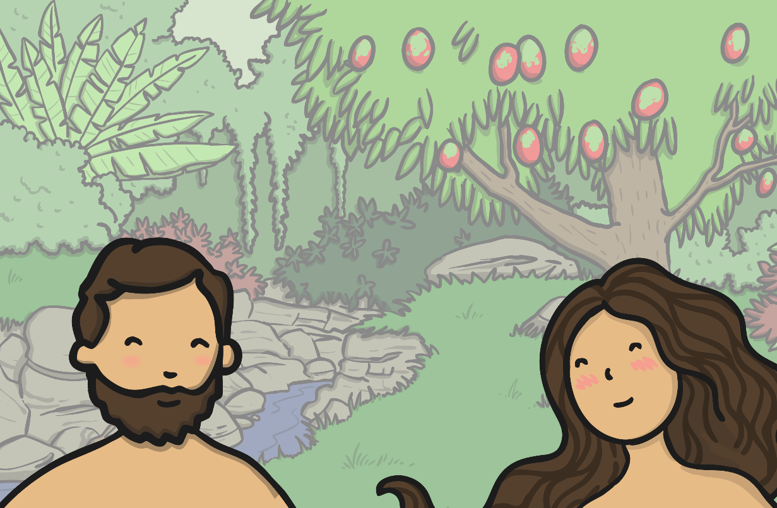
The Creation Story
On the sixth day…
God created animals to fill the earth. God also created humans to enjoy and care for all that He had made.

Slide 12
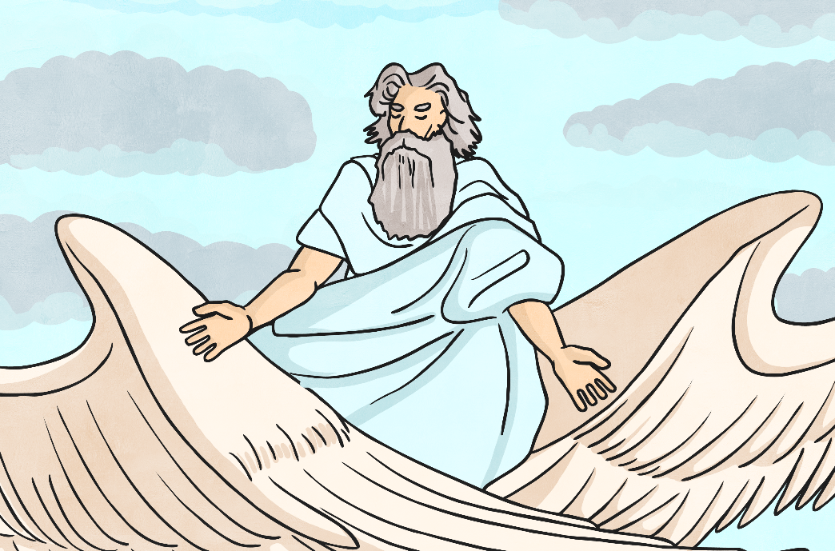
The Creation Story
On the seventh day…
God rested.
God was happy with all He had made.

Slide 13

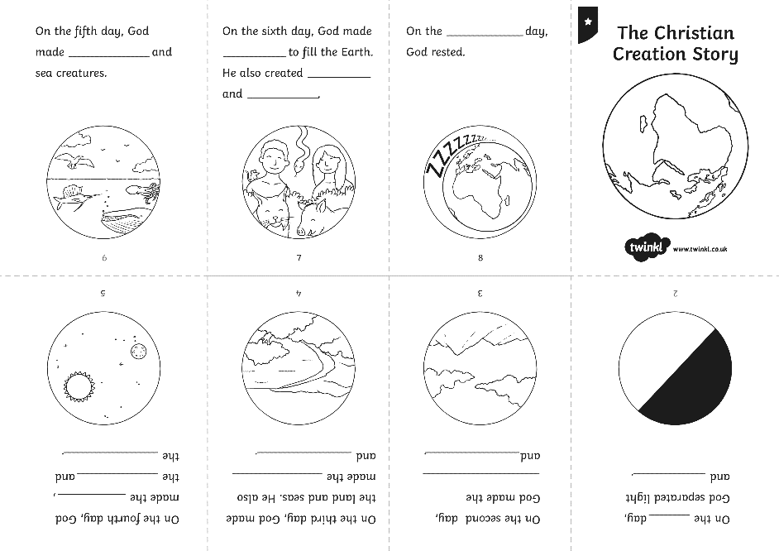
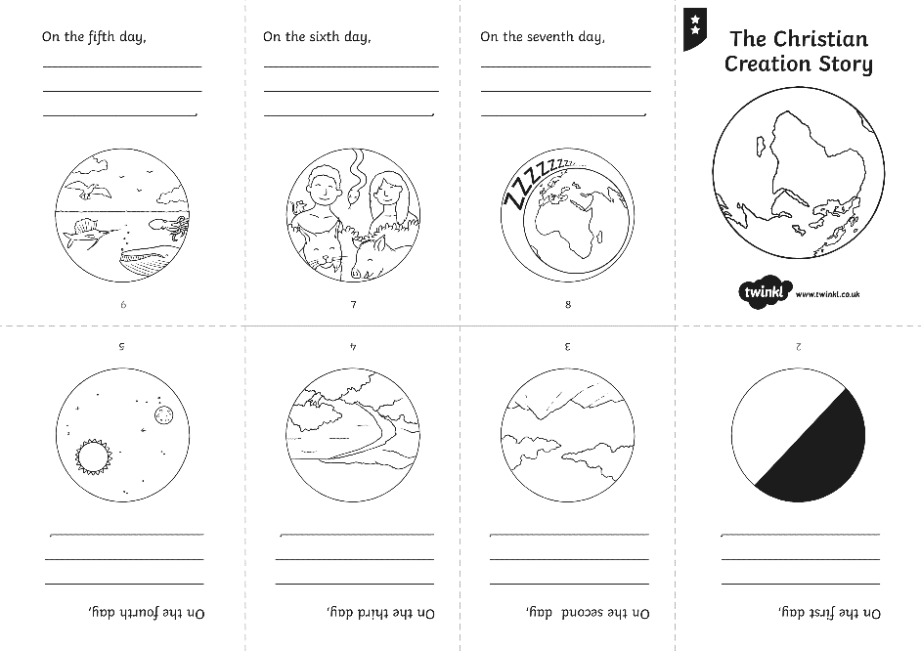
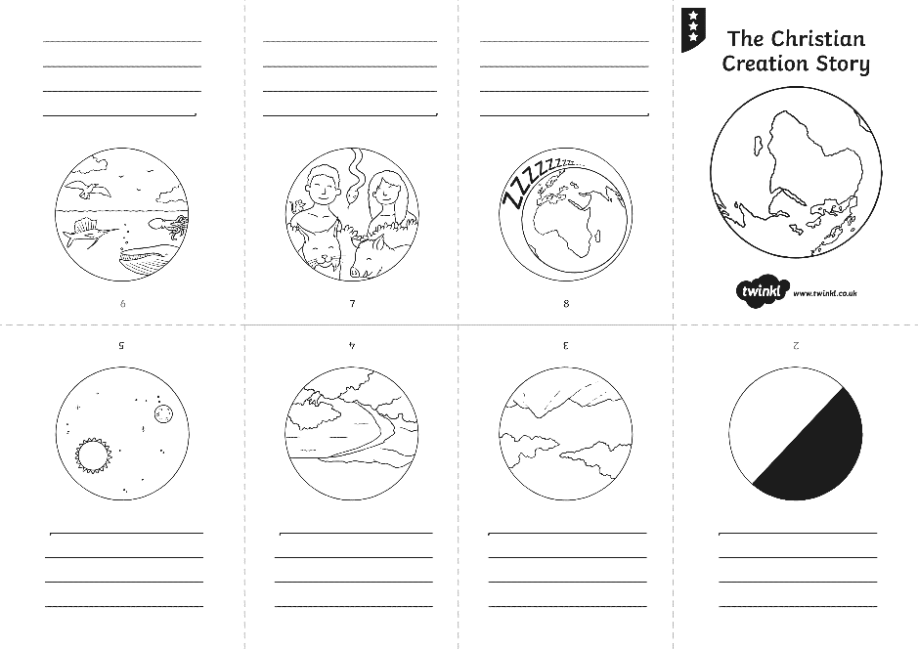
Creation Story Books

Slide 14

Aim
I can recall the Christian Creation Story.
Success Criteria
I can tell you three things which God created.
I can tell you what God did on the seventh day.

Slide 15


