Slide 1

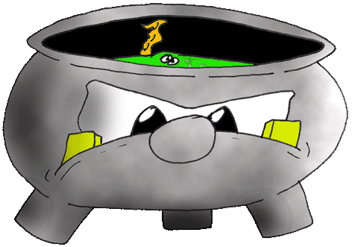

Copyright Pete Wells 2006
Contact: sensorystoriespodcast@gmail.com
More rubbish at https://sensorystoriespodcast.com/

Slide 2
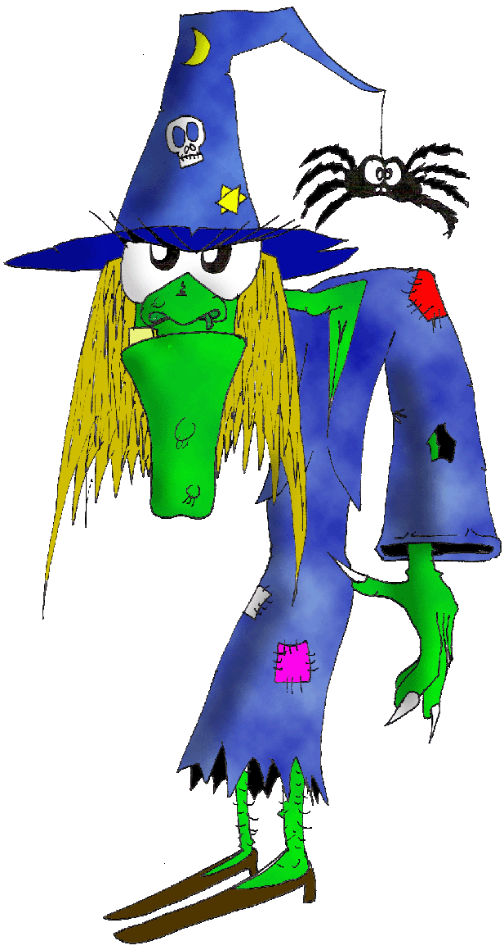
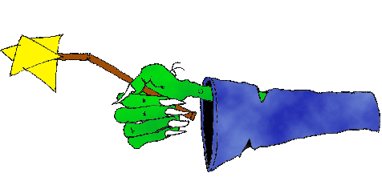
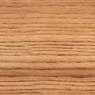

Slide 3




Slide 4







