Slide 1
Term 3 Week 1
Smash up numbers
Add two-digit numbers mentally
Subtract two-digit numbers mentally
Add three-digit numbers using formal written methods
Subtract three-digit numbers using formal written methods
Solve multi-step problems

Slide 2
Smash Up Numbers ☺
0+10
10+10
How many ways can you make 10?
How many ways can you make 20?
1+9
1+19
2+8
2+18
5+5
15+5
You can do this with all numbers.
Notes:
Lesson 1
This will be the starter for the next couple of lessons to build up fluency of partitioning and number facts

Slide 3
25
48
36
74
63
Notes:
Answer on whiteboards

Slide 4
Can you solve this in your head?
56 + 27 = ___
Try this one.
49 + 25 = ___
We can use jottings to help us.
56 + 7 =
63
63 + 20 =
83
Notes:
Encourage chn to write the jottings rather than whole number sentences
Eg. Chn can write the answer to the first part of the calculation under the original calculation. Then the final answer at the end in the normal place.
56 + 27 = 83
63

Slide 5
36 + 21 =
23 + 34 =
52 + 23 =
37 + 12 =
49 + 21 =
75 + 14 =
36 + 42 =
23 + 48 =
52 + 34 =
37 + 66 =
89 + 74 =
75 + 69 =
Notes:
Indep. Workings - choose 4 or 5 to assess understanding.

Slide 6
Can you solve this in your head?
84 – 37 = ___
Try this one.
78 – 25 = ___
We can use jottings to help us.
84 – 7 =
77
77 – 30 =
47
Notes:
Encourage chn to write the jottings rather than whole number sentences
Eg. Chn can write the answer to the first part of the calculation under the original calculation. Then the final answer at the end in the normal place.
84 – 37 = 47
77

Slide 7
74 – 32 =
88 - 34 =
67 - 23 =
59 - 12 =
84 - 21 =
98 - 14 =
81 - 42 =
74 - 48 =
63 - 34 =
128 - 66 =
135 - 74 =
164 - 82 =
Notes:
Indep. Workings - choose 4 or 5 to assess understanding.

Slide 8
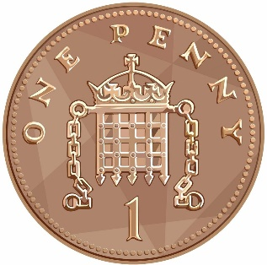
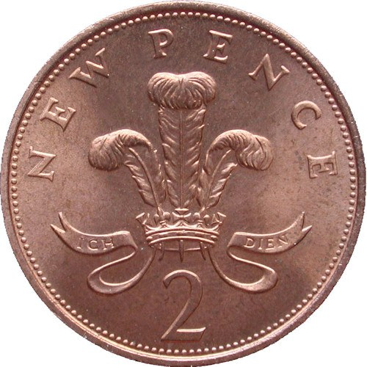
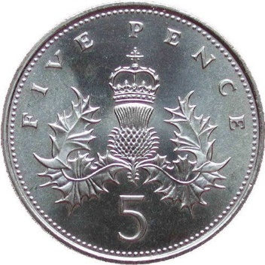
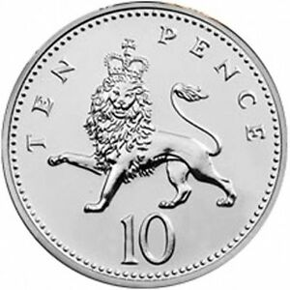
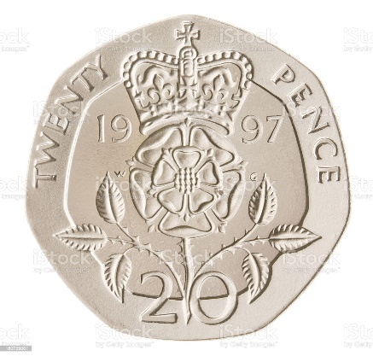
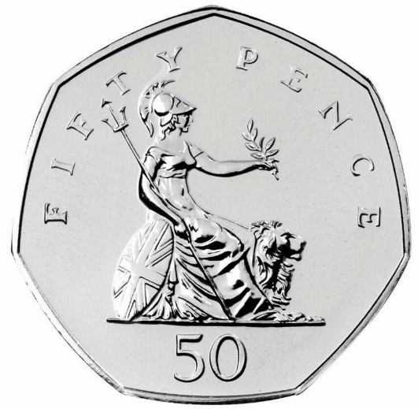
How much have I got?
How much have I got?
Notes:
Recap recognition of coins.
Encourage adding from biggest coin to smallest

Slide 9
How much have I got?
How much have I got?
Notes:
Recap recognition of coins.
Encourage adding from biggest coin to smallest

Slide 10
Pick up 4 coins from the trays and add them up.
Notes:
Chn to pick up four coins and find the total.

Slide 11
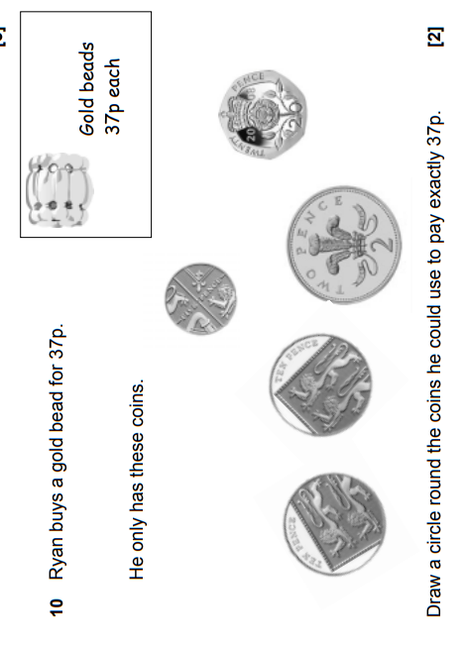
Notes:
Make an amount

Slide 12
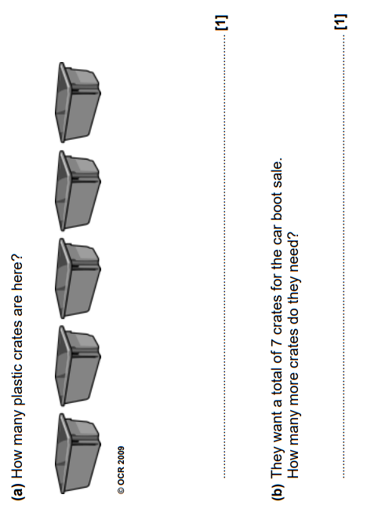
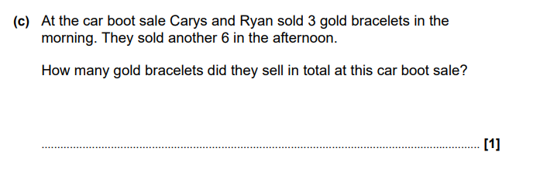
Notes:
Addition / subtraction problems

Slide 13
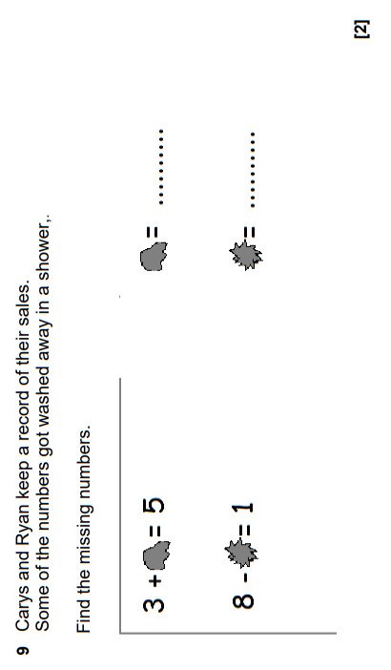
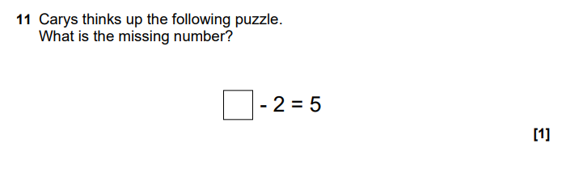
Notes:
Addition / subtraction problems

Slide 14
What are you more confident in today?
Notes:
Whole class – gather ideas to check understanding of tasks set

Slide 15
Smash Up Numbers ☺
Roll your dice twice to make a two-digit number.
How many ways can you smash it up?
Notes:
Lesson 2
Starter

Slide 16
Some calculations need to be worked out with columns
123 + 274 = ___
Try this one.
649 + 225 = ___
148
+274
Notes:
Model the formal written method
Remind chn to carry over into the next column. Either putting the tens/hundreds above or below the digits in the column – whichever is easier for the chn to remember to include it!!

Slide 17
Some calculations need to be worked out with columns
623 - 274 = ___
Try this one.
641 + 265 = ___
623
-274
Notes:
Model the formal written method
Remind chn to exchanging from the column to the left. Reminding the chn you are adding 10/100 to the original amount for you can subtract without having a negative answer

Slide 18
236 + 321 =
423 + 234 =
652 + 323 =
437 + 312 =
649 + 221 =
475 + 314 =
536 + 342 =
623 + 248 =
452 + 334 =
737 + 166 =
489 + 274 =
725 + 169 =
Notes:
Indep. Workings - choose 4 or 5 to assess understanding.

Slide 19
536 - 321 =
765 - 234 =
658 - 323 =
437 - 312 =
649 - 221 =
475 - 314 =
536 - 348 =
713 - 234 =
612 - 323 =
437 - 353 =
649 - 274 =
475 - 387 =
Notes:
Indep. Workings - choose 4 or 5 to assess understanding.

Slide 20
I need to make 50p.
What coins could I use?
Notes:
Can they find more than one way to make the amount?

Slide 21

What coins could you use?
Pick up a Price Tag and show the coins you would use to make the amount.
46p
Notes:
Price tags on tables

Slide 22
Alfie wanted to buy some new shoes which cost £25.
He was given £5 for Christmas and £6 for his birthday.
How much more does he need to buy the shoes?
Notes:
What do we need to do? What operations are involved?
Work out as a class.

Slide 23
There were 500 beads in the jar.
120 were red.
150 were blue.
The rest of the beads were green.
How many beads were green?
Notes:
What do we need to do? What operations are involved?
Work out independently.

Slide 24
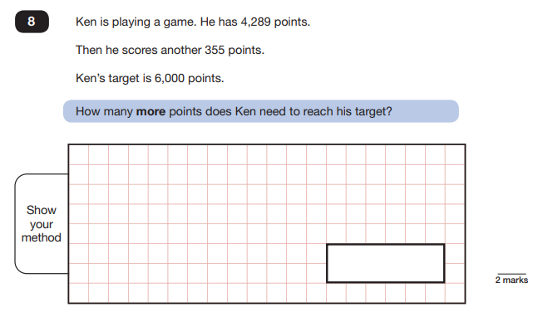
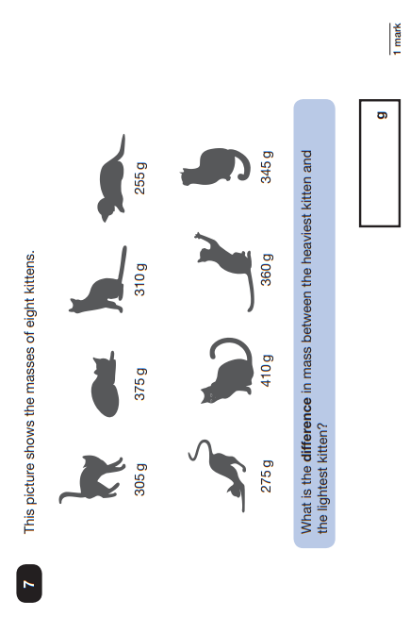
Notes:
Addition/Subtraction problem

Slide 25
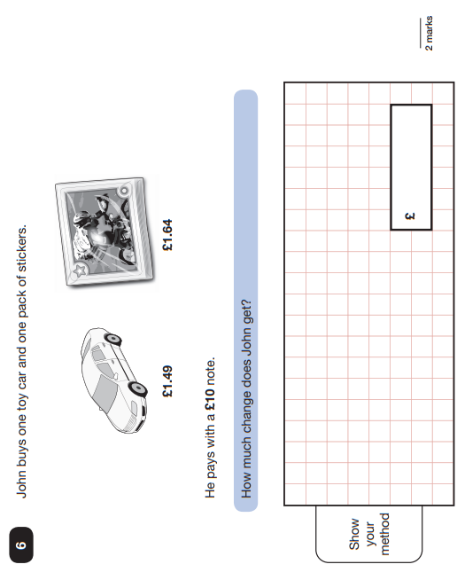
Notes:
Money addition/subtraction
Involves decimals so may need scaffolding

Slide 26
What are you more confident in today?
Notes:
Whole class – gather ideas to check understanding of tasks set

